Slide 1


Cache Coherence for GPU Architectures
SHOBHIT
Under The Guidance of
DR. Manoranjan Satpathy
Image source: www.forces.gc.ca
Notes:
First academic work on cache coherence on GPU architecture
3 main points of this work and talk
Cache coherence is a natural evolution for GPU computing
Existing coherence protocols are not quite fully suited for the unique set of challenges that GPUs pose for cache coherence
Our protocol is designed to address these new and unique challenges, and it does so by using global time, instead of coherence messages

Slide 2
Content:
Cache Coherence
GPU
GPU Architecture
GPU Coherence Challenges
Temporal Coherence
Design Issues and solution
TC-Weak
Interconnect Traffic
Performance
Complexity
Summary

Slide 3
What is Cache Coherence?
Client
Cache
Memory
Resource
Coherency
Client
Cache

Slide 4
What is a GPU?
Workgroups
CPU
Wavefronts
spawn
GPU Core
GPU Core
GPU
▪▪▪
done
CPU
Memory
CPU
spawn
GPU
time
Notes:
GPU hardware is made up of GPU cores connected via an on-chip interconnection network to a shared banked L2 cache. There’s also L1D
CPU spawns tens of thousands of GPU threads. These are divided into groups called WORKGROUPS
Workgroups are scheduled onto the GPU, one per core. Threads within the workgroup are further divided into SIMD execution groups called WAVEFRONTS. These are 32 or 64 threads wide
Important #1: GPU is latency tolerant. It hides long memory latencies by selecting among thousands of threads for execution
Important #2: To do that, GPU memory system is designed to handle 1000s of inflight requests
Current GPUs do not have cache coherence -> threads on different cores can’t communicate with each other. So the GPU programming models require that any communication between threads be limited to within a workgroup only

Slide 5
GPU Architecture
Multiprocessor 1
Multiprocessor 2
Multiprocessor n
......
L1 Cache
L1 Cache
L1 Cache
L2 Cache
Global Memory
Constant Memory

Slide 6
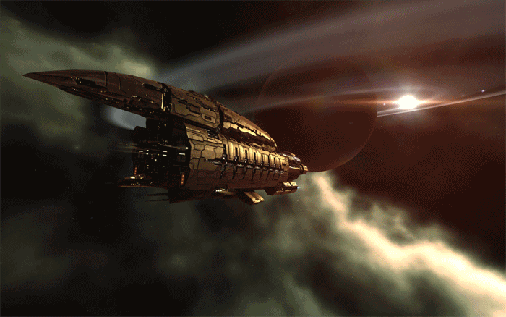
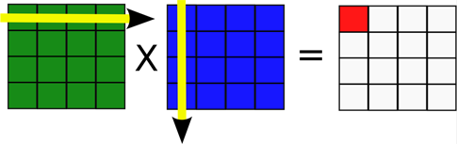
Evolution of GPUs
Graphics pipeline
Compute (OpenCL, CUDA)
e.g. Matrix Multiplication
OpenGL/
DirectX
Vertex
Shader
Pixel
Shader
Notes:
GPUs were originally designed to render polygons for displays
The graphics pipeline is setup so that pixels and vertices can be processed independently and threads don’t need to communicate -> so no need for cache coherence
Then programmers began using this highly parallel hardware for general purpose computation, so manufacturers released extensions to simply GPGPU programming
They used the same abstraction as the graphics pipeline of parallel threads, but added some communication between threads by introducing workgroups
This is great for applications like matrix multiplication, where threads are independent but the added ability to communicate within groups of threads helps with caching

Slide 7
GPU Coherence Challenges
Challenge 1: Coherence traffic
Load C
Load D
Load E
Load F
…
Load G
Load H
Load I
Load J
…
Load K
Load L
Load M
Load N
…
Load O
Load P
Load Q
Load R
…
No coherence
MESI
GPU-VI
Load C
C1
C2
C3
C4
1.5
Recalls
L1D
L1D
L1D
L1D
A
B
A
B
A
B
A
B
Interconnect traffic
rcl A
rcl A
rcl A
1.0
ack
ack
rcl A
ack
ack
gets C
L2/Directory
0.5
A
B
Do not require
coherence
Notes:
First challenge is coherence traffic
We first look at interconnect traffic for existing GPU applications that do not require coherence
When we add MESI, traffic doubles. More details about this in the paper
Then we created write-through GPU-VI. GPU-VI better than MESI, but still adds traffic over no coherence. Turns out it is recall traffic
Cores have cache lines A and B cached and the directory is tracking them
One core wants space in the directory for a new entry, so the directory has to drop one of the entries. This requires recall messages to all the sharers of this entry so they can invalidate their cached copy
If we didn’t send these recalls before dropping the entry, we would have an incoherent system
On a GPU, there are thousands of memory requests bombarding the directory for space – so we have a lot more recalls than we may on a CPU
We evaluated aggressive directory sizes and found it still remains a problem
Key point: independent of the directory size, adding coherence to a GPU introduced a traffic and hence a power power

Slide 8
GPU Coherence Challenges
Challenge 2: Tracking in-flight requests
Significant % of L2
S Shared
Transient States
M Modified
L2 / Directory
MSHR
Notes:
Second challenge is tracking inflight coherence requests
Let’s start with looking at coherence states. Most of us are familiar with the textbook Shared and Modified states
In real coherence implementations, these are not all. We also have transient states between these stable states
The transient states are needed because transitions are not atomic/instant; they require multiple messages bouncing between components. Transient states track those messages
These transient states need to be tracked somewhere. This is typically in Miss Status Holding Register / MSHR entries. Aka Transaction Buffer Entries or TBEs
So how many of these do we need?
In CPUs, you can easily size these for the worst case because there are only tens of requests at a time
On a GPU, we have thousands of requests
We estimate that worst case sizing here would take up a significant portion of the L2 just for MSHRs, upto a third of the L2
With a smaller table we can introduce subtle complexities that easily lead to deadlocks and faulty hardware

Slide 9
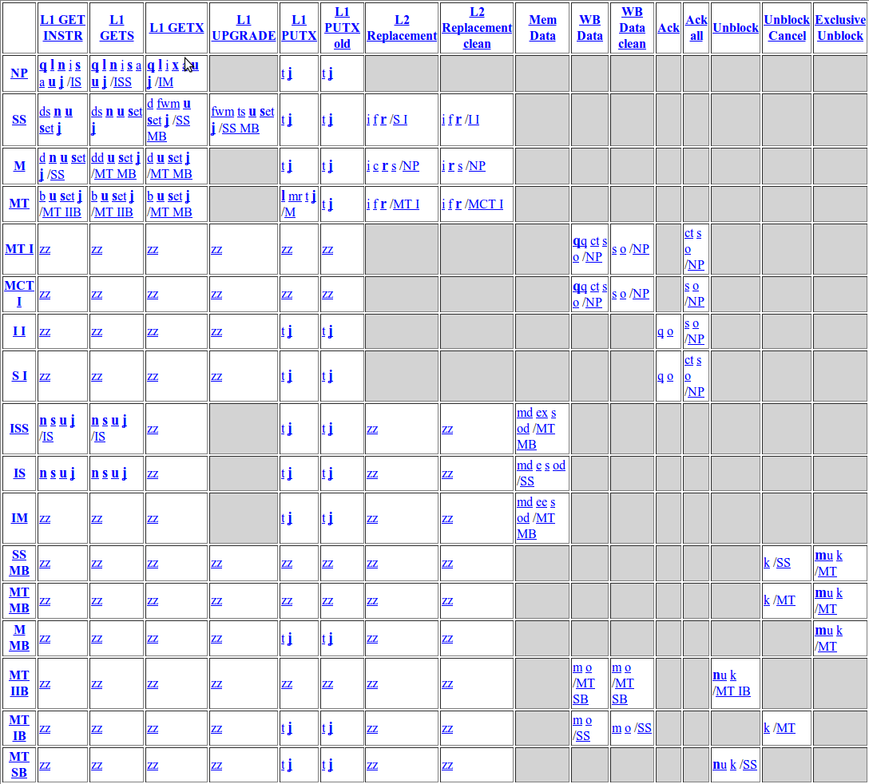
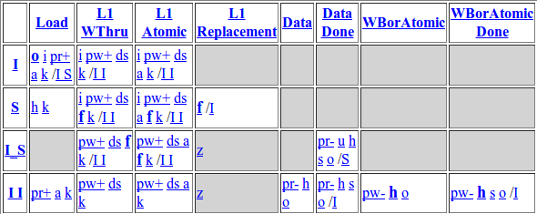
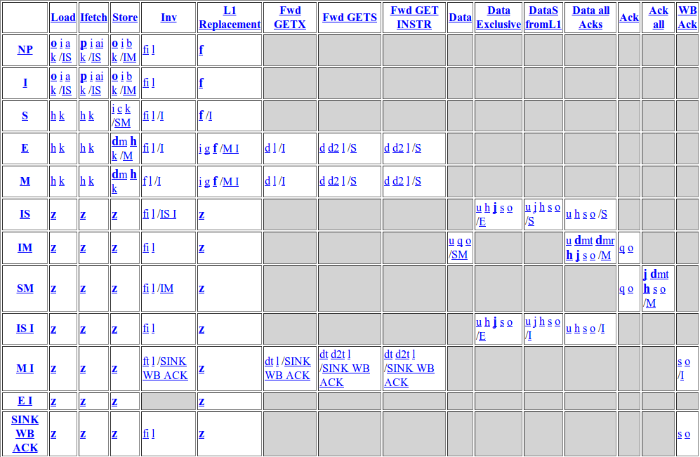
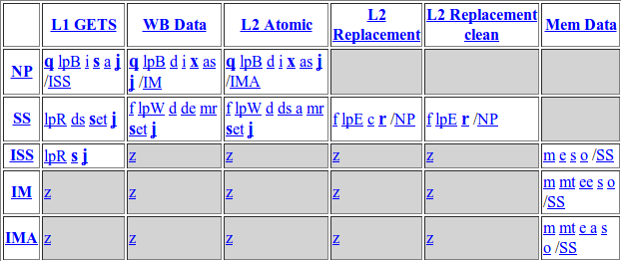
GPU Coherence Challenges
Challenge 3: Complexity
MESI L2 States
Non-coherent L1
MESI L1 States
Events
States
Non-coherent L2
Notes:
The third challenge is implementation complexity
Let’s look at how coherence protocols are specified. Examples here are from GEMS Ruby
I want you to focus on the size of these tables because gives us an idea of how complex the protocol is
For those interested, I’ll give a very quick high level description of the table
Rows corresponds to states, Columns correspond to events. Each box lists the actions that will be taken and the next state when an event occurs for a cache line in the given state
Now let’s look at MESI’s tables.
These tables are significantly more complex because coherence messages introduces potential race conditions, which all needed to be handled
So by asking GPU manufacturers to implement a protocol like MESI we are asking them to significantly increase the complexity of their hardware and spend a lot of effort on verifying the changes

Slide 10
Solution
GPU cache coherence without coherence messages?
YES – using global time
Which coherence technique use timer?
Temporal coherence
Notes:
Turns out they all stem from coherence messages
The traffic overhead was from transferring these messages around
The storage overhead was from tracking them
The complexity overhead was from managing the races between these messages
Next question is, is GPU coherence possible without these messages? YES – using global time

Slide 11
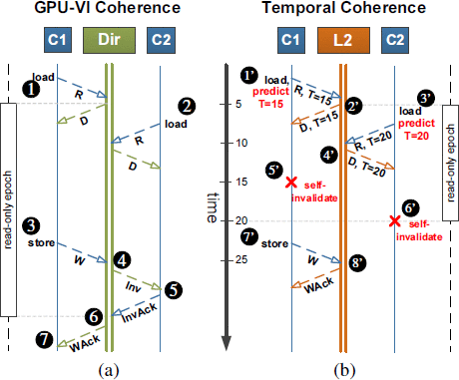
GPU-VI vs Temporal Coherence

Slide 12
Design Issues of Temporal Coherence (TC)
Use a predictor to predict lifetime values
Synchronize counter
Stalling
Solution: TC Weak
Notes:
Two possible questions at this point
First, what lifetimes should the cores request on loads
For this, we use a lifetime predictor. You can see the details of this predictor in our paper
The second question you may have is what if we have a store operation to a line that hasn’t expired in an L1. What should we do?
One possibility is to simply stall the store request at the L2 until the copy in the L1 has expired, and then complete the store

Slide 13
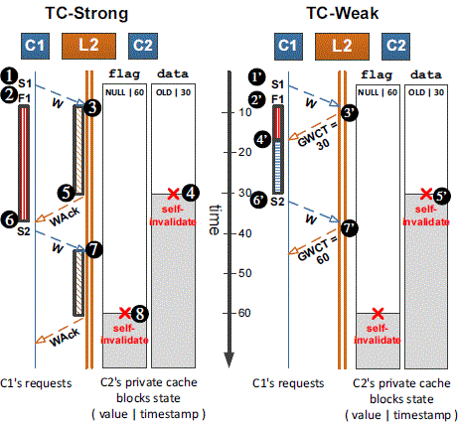

Slide 14
Interconnect Traffic
NO-COH
MESI
GPU-VI
TC-Weak
1.50
1.25
TC Weak Reduces traffic by 53% over MESI and 23% over GPU-VI for intra-workgroup applications
1.00
0.75
Interconnect Traffic
0.50
0.25
0.00
Do not require coherence
Notes:
First let’s take a look at interconnect traffic
I already showed you some of this data before
Again, I’m showing you GPU applications that don’t require coherence, and we are normalized to our baseline GPU without coherence
We saw earlier that other coherence protocols added unnecessary traffic overheads. TC-Weak is able to eliminate this overhead and reduce traffic by 53% over MESI and 23% over GPU-VI
TC-Weak also offers traffic saving over really large and highly associative directories. There are more details in the paper

Slide 15
Performance
NO-L1
MESI
GPU-VI
TC-Weak
2.0
TC-Weak with simple predictor performs 85% better than disabling L1 caches
Performs 28% better than TC with stalling
Larger directory sizes do not improve performance
1.5
Speedup
1.0
0.5
0.0
Require coherence
Notes:
Next let’s look at the performance
This time I’m going to show you the performance for the set of GPU applications that require coherence (highlight inter-workgroup communication)
This means we have to disable the non-coherent L1 caches on our GPU for these applications to work correctly
TC-Weak improves the performance by 85% because it does not have to disable the L1 caches
TC-Weak also performs 28% better than the stalling alternative I discussed earlier
Finally, we observed that larger directory sizes generally do not improve performance
Directory miss latency hurts on a CPU but GPUs are latency tolerant

Slide 16
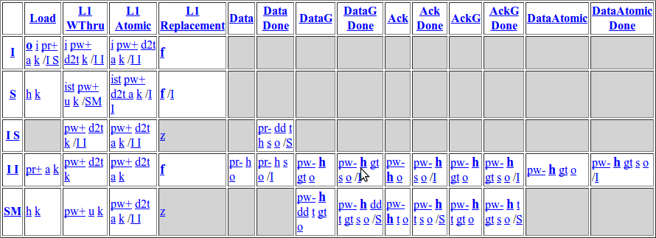
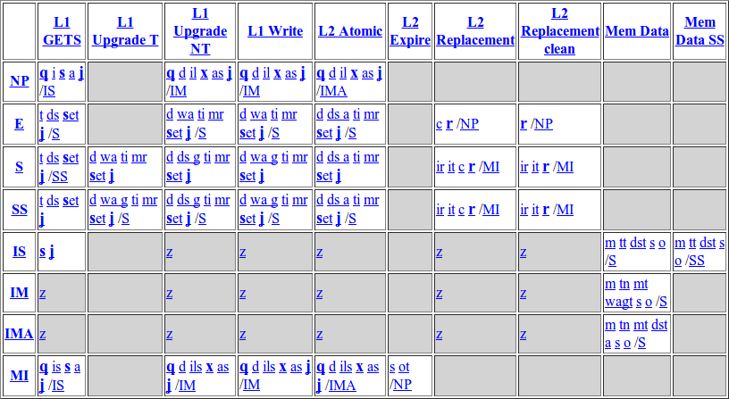
Complexity
MESI L1 States
MESI L2 States
TC-Weak L1
TC-Weak L2
Notes:
Finally, let’s revisit the complexity challenge
I’m again showing the state tables for the non-coherent GPU and MESI protocol
Looking at TC-Weak, it is much closer to no coherence in terms of complexity than it is to MESI
This really reduces the extra overhead on GPU manufacturers for adding coherence to their hardware
In our paper we show the complete state tables for TC-Weak and provide numerical comparisons in the number of states against other protocols

Slide 17
Summary
First work to characterize GPU coherence challenges
Save traffic and energy by using global time
Reduce protocol complexity
85% performance improvement over no coherence
Notes:
This was the first academic study to characterize the challenges posed by coherence on GPUs
We addressed these challenges by proposing a protocol based on time
This helped save energy
And reduce the protocol complexity
In Fermi, for our coherent applications the caches had to be disabled by the user, otherwise the GPU application deadlocks. In Kepler, this is fixed by automatically disabling L1 caching of shared data. In this study we show that enabling this caching can buy you an 85% performance improvement with coherence

Slide 18
References:
I. Singh, A. Shriraman, W. W. L. Fung, M. O'Connor and T. M. Aamodt, "Cache coherence for GPU architectures," 2013 IEEE 19th International Symposium on High Performance Computer Architecture (HPCA), Shenzhen, 2013, pp. 578-590.
X. Ren and M. Lis, "Efficient Sequential Consistency in GPUs via Relativistic Cache Coherence," 2017 IEEE International Symposium on High Performance Computer Architecture (HPCA), Austin, TX, 2017, pp. 625-636.
A. Tabbakh, X. Qian and M. Annavaram, "G-TSC: Timestamp Based Coherence for GPUs," 2018 IEEE International Symposium on High Performance Computer Architecture (HPCA), Vienna, 2018, pp. 403-415
Miss. Shivani, Mr. Rohit Dilip Agarwal for paper review

Slide 19



Slide 20
Thank You

Slide 21
Lifetime Predictor
One prediction value per L2 bank
Events local to L2 bank update prediction value
Store A
Events Prediction
Expired load: ↑
Unexpired store: ↓
Unexpired eviction: ↓
Load A
L2 Bank
T = 20
T = 0
prediction--
Prediction Value
prediction++
30
A
10
A
Notes:
Now let’s take a quick look at our predictor
Our predictor is very simple in that we maintain a single prediction per L2 bank. All accesses that go to this bank use this prediction
We use events local to the L2 bank to update the prediction
The first of these feedback events is a load to an expired block
This indicates to us that the load might have missed at the L1 due to short lifetime so we should increase the prediction
The second even is a store to an unexpired block
This indicates that there may be a delay before this store is made globally visible, so we should decrease the lifetime prediction
The last event is eviction of unexpired blocks
Here we decrease the lifetime to reduce the storage overage of tracking these unexpired but evicted entries
We have more details about the specifics of this predictor in the paper and I encourage you to take a look

