Slide 1
Loan Approval Application

Slide 2
Loan Approval Application
cin
Company name
Date of Registration
Month Name
State
ROC
Company Status
Category
Class
Company Type
Authorized Capital
PaidUp Capital
Acitivity Code
Acitivity Descirption
Registered Office Address
EMAIL
X1 - X5

Slide 3
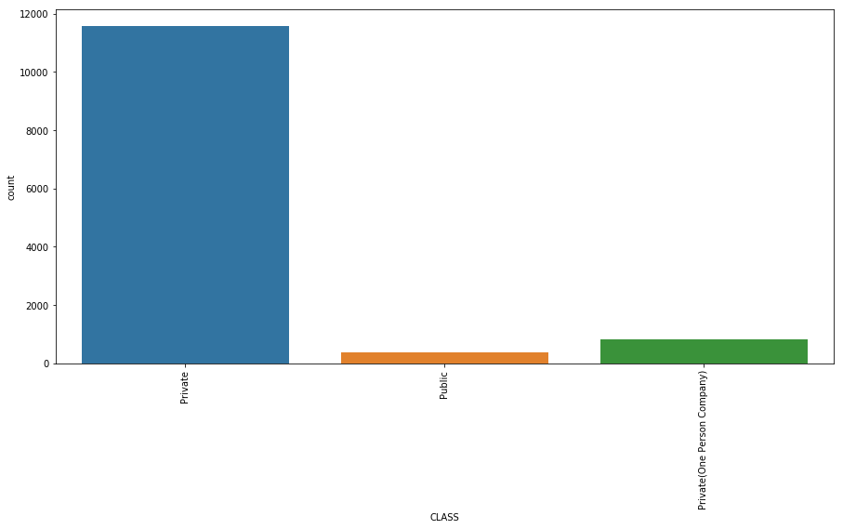
Distribution of CLASS

Slide 4
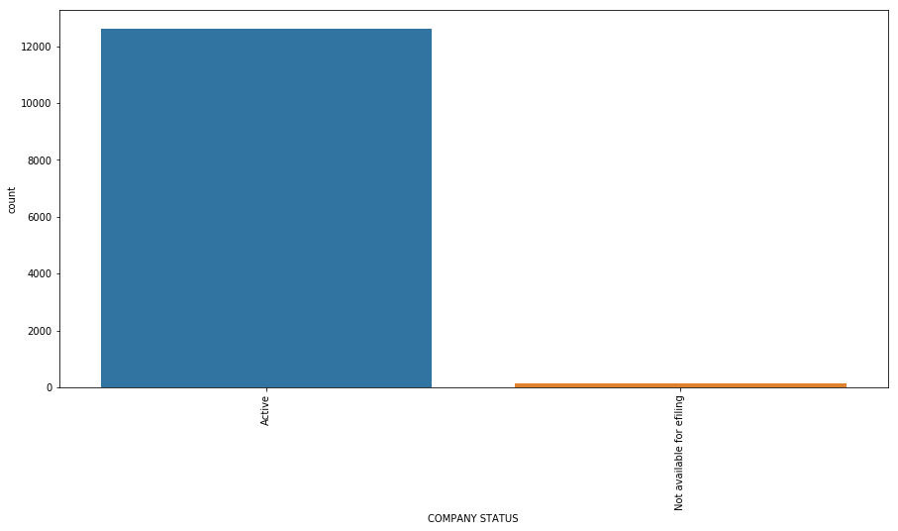
Distribution of STATUS

Slide 5
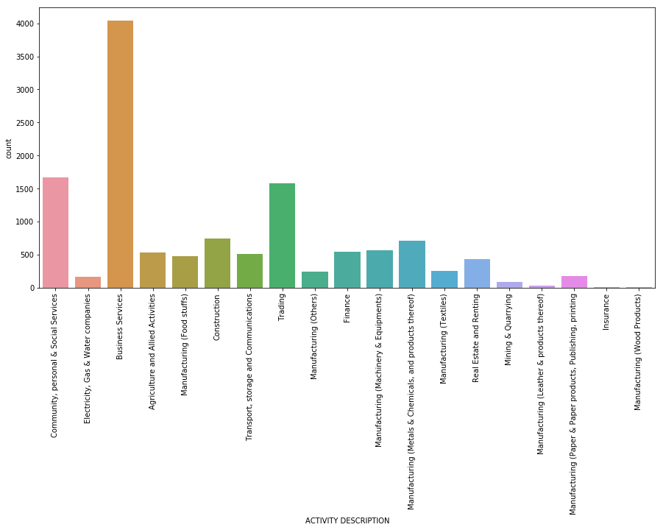
Distribution of ACTIVITY

Slide 6
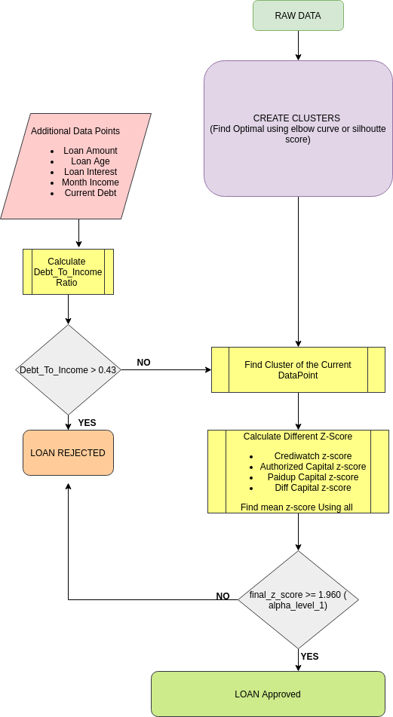

Slide 7

Home Page

Slide 8
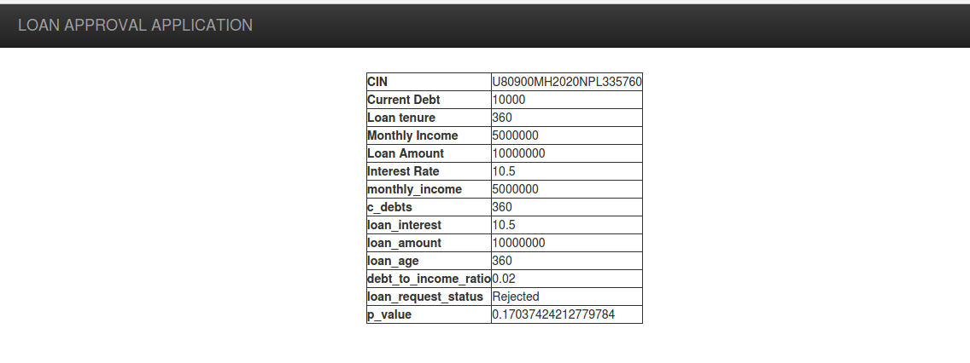
Result Page

