Slide 1
BDSN
Assignment
SUBMITTED BY : SHOBHIT SHARMA
(A21030)

Slide 2
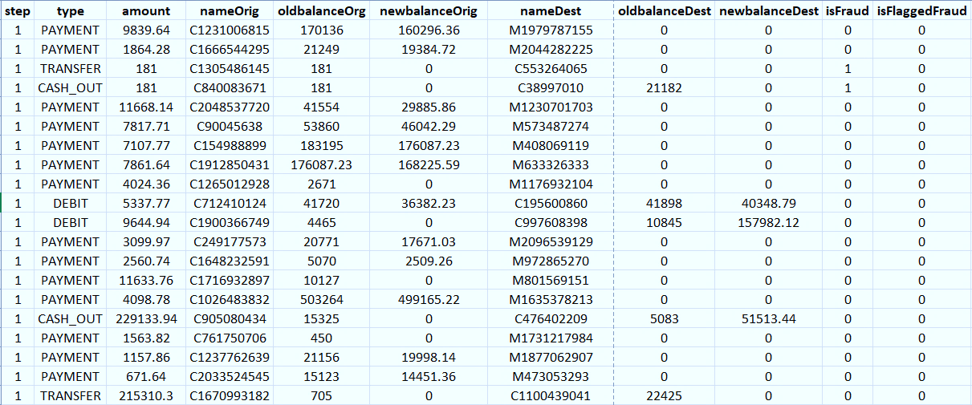
QUICK GLANCE AT THE DATASET

Slide 3
BACKGROUND
There is a lack of publicly available datasets on financial services and specially in the emerging mobile money transactions domain. Financial datasets are important to many researchers in the domain of fraud detection. Part of the problem is the intrinsically private nature of financial transactions, that leads to no publicly available datasets for model exploration and building.
A synthetic dataset were generated using the simulator called PaySim. PaySim uses aggregated data from the private dataset to generate a synthetic dataset that resembles the normal operation of transactions and injects malicious behavior to later evaluate the performance of fraud detection methods.

Slide 4

OBJECTIVE
The goal of this analysis is to develop a generalized model to deal with big and imbalance data prediction that suitable to real-world applications. The big data part was solved by using the PySpark.
Data The data of this project can be downloaded from here.

Slide 5
COLUMN’s EXPLAINATION
step - maps a unit of time in the real world. In this case 1 step is 1 hour of time. Total steps 744 (30 days simulation).
type - CASH-IN, CASH-OUT, DEBIT, PAYMENT and TRANSFER.
amount - amount of the transaction in local currency.
nameOrig - customer who started the transaction
oldbalanceOrg - initial balance before the transaction
newbalanceOrig - new balance after the transaction
nameDest - customer who is the recipient of the transaction
oldbalanceDest - initial balance recipient before the transaction. Note that there is not information for customers that start with M (Merchants).
newbalanceDest - new balance recipient after the transaction. Note that there is not information for customers that start with M (Merchants).
isFraud - This is the transactions made by the fraudulent agents inside the simulation. In this specific dataset the fraudulent behavior of the agents aims to profit by taking control or customers accounts and try to empty the funds by transferring to another account and then cashing out of the system.
isFlaggedFraud - The business model aims to control massive transfers from one account to another and flags illegal attempts. An illegal attempt in this dataset is an attempt to transfer more than 200,000 in a single transaction.

Slide 6
WORKFLOW
We’ll continue this project in GOOGLE COLAB as it is a free Jupyter
.
For better readability I’ve divided the notebook into 5 different sections namely:
  Part 1: Creating the Environment
  Part 2: Data Cleaning
  Part 3: Exploring the dataset
  Part 4: Constructing different machine learning models.
  Part 5: Conclusion

Slide 7
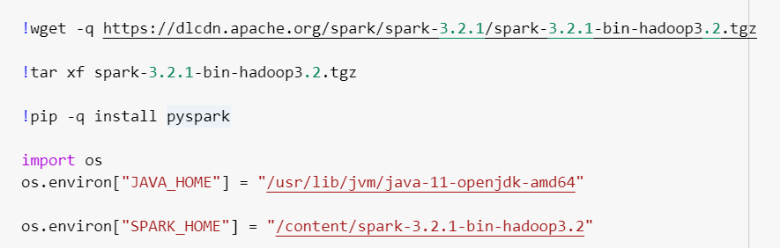
PART 1: CREATING THE ENVIRONMENT
For this project we’ll need to install JAVA and we are using version 11 of Java
For the spark version we’ll be using the latest version of spark that is 3.2.1
Next, we will install PySpark package in COLAB
After these steps we’ll need to assign JAVA and SPARK in the machine environment

Slide 8
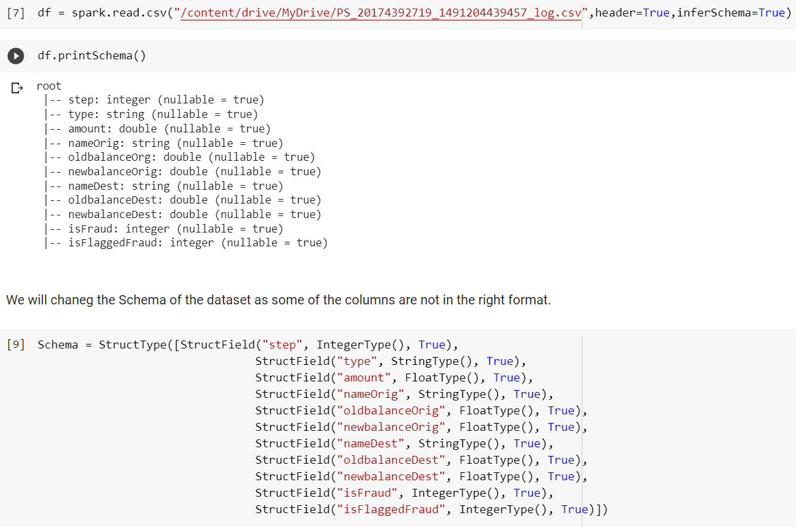
PART 1: CREATING THE ENVIRONMENT…
Here we first check what's the schema of our dataset.
And we found that some of the columns were having wrong datatypes. So, we must change them into appropriate by providing a Schema of our own.

Slide 9
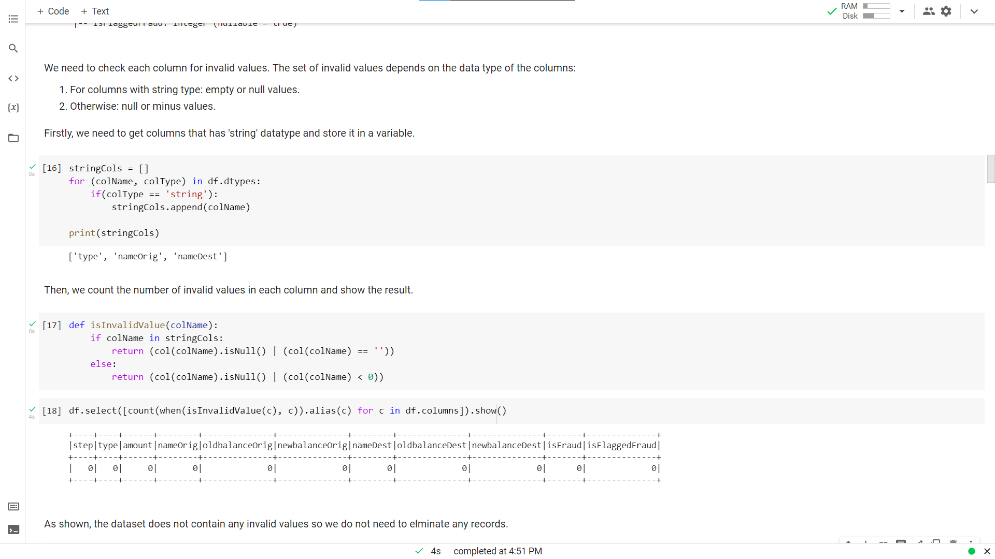
PART 2: DATA CLEANING
At first, we’ll check if the schema of the dataset is correct or not.
Then we’ll check each columns for invalid values:
  For string type: empty or null values
  Other dtype: null or negative values
INSIGHT:
There is no null or wrong values in our dataset

Slide 10
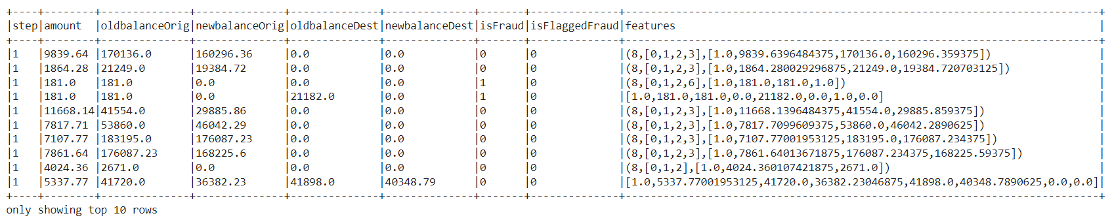
PART 3: EXPLORING THE DATA
First, we need to check the correlation of our features, and for that we need to create a new column with the help of VectorAssembler and then we use Correlation library of PySpark to create the correlation matrix and the output is shown into Pandas format which has better readability as compared to Sparks format.
A new column named “features” is created which has all the information of the given features and is shown below.

Slide 11
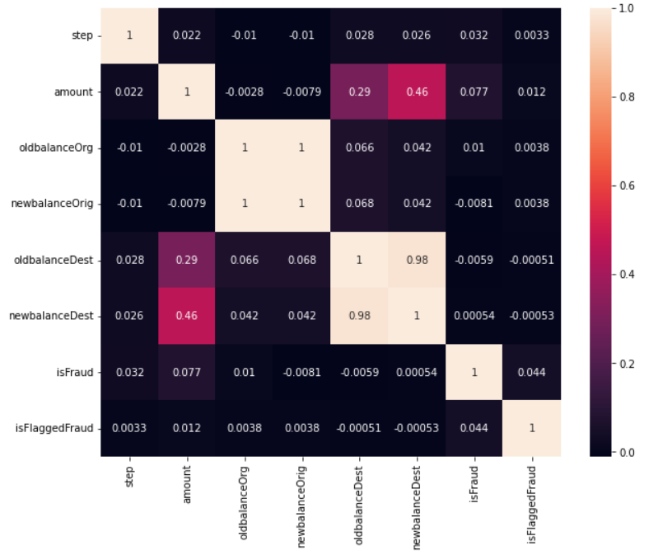
CORRELATION MATRIX
For better readability I’ve used seaborn package of python to create a heatmap of the correlations so that we can easily distinguish between the highest and lowest correlated features by color itself, and as we can see “newbalanceDest” has the highest correlation with “amount” with 0.46 which is not that high in real life situation.

Slide 12
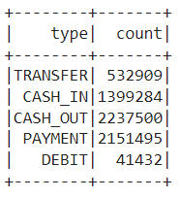
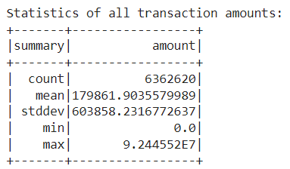
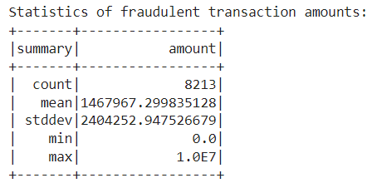
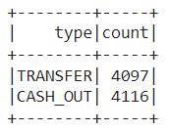
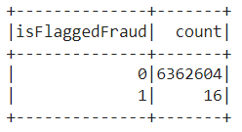
PART 3: EXPLORING THE DATA
Now we will try do find some more statistical inferences from the dataset.
  What’s the frequency of different types of payment methods.
  What’s the statistical summary of transaction amounts.
  What’s the statistical summary of Fraudulent transactions amounts.
  What’s the frequency of different types of payment method for Fraudulent transactions.
  What’s the frequency of different classes of “isFlaggedFraud” column.
1.
2.
3.
4.
5.

Slide 13
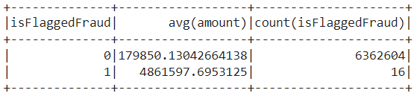
WHAT CLASSIFIES AS “isFlaggedFraud”
In the overview of the dataset, “isFlaggedFraud” is defined as:
  "An illegal attempt in this dataset is an attempt to transfer more than 200,000 in a single transaction.“
But we must check through our dataset whether is this statement correct or not.
INSIGHT : We can clearly see that though there are only 16 cases of frauds, the average amount is very high almost 27 times the average amount of non-fraudulent customers.

Slide 14


SOME OTHER INSIGHTS WE FOUND
We know that fraudulent transactions only take form in 'CASH_OUT' and 'TRANSFER'. Therefore, we can skip checking other type of transactions.
We found that the columns “isFlaggedFraud”, “nameOrig” and “nameDest" do not help in predicting fraudulent transactions. Therefore, we will not use those columns for training our model.

Slide 15
BEFORE CREATING MODEL…
To use the machine learning algorithms provided by MlLib, we have to do a few transformations on our input data:
  Convert the label column (i.e., 'isFraud') to doubleType.
  Convert the categorical attributes into numeric attributes. The only categorical attribute that we will use is 'type'.
  Combine the values of all feature/attribute columns into a feature vector.
  Pass the feature vector through vector indexer to differentiate between categorical and continuous attribute.
  And since our dataset is of a classification problem, we’ll use different types of classification machine learning algorithms.

Slide 16
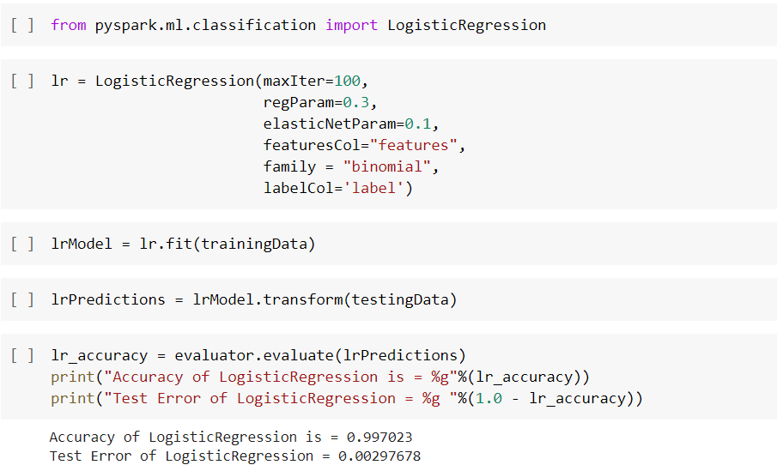
MODELS USED
LOGISTIC REGRESSION
The accuracy of Logistic Regression came out to be 0.997023 which is great, and it means our model was able to correctly predict almost all the test data points.

Slide 17
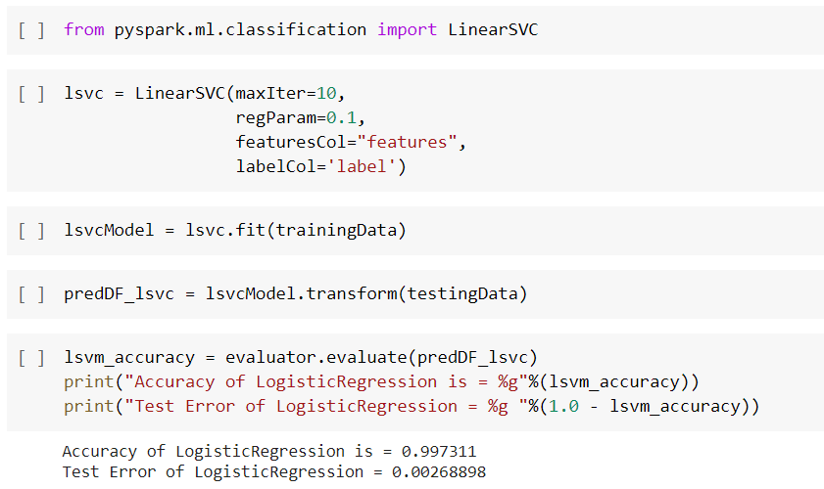
MODELS USED
LINEAR SUPPORT VECTOR CLASSIFIER
The accuracy of LSVC came out to be 0.997311 which is better than our past model of logistic regression.

Slide 18
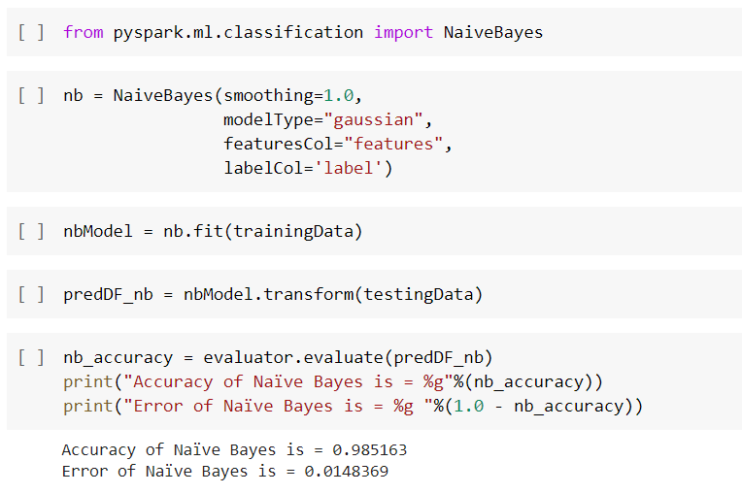
MODELS USED
NAÏVE BAYES CLASSIFIER
The accuracy of NB classifier came out to be 0.9851 which is worse than both of our past models.

Slide 19
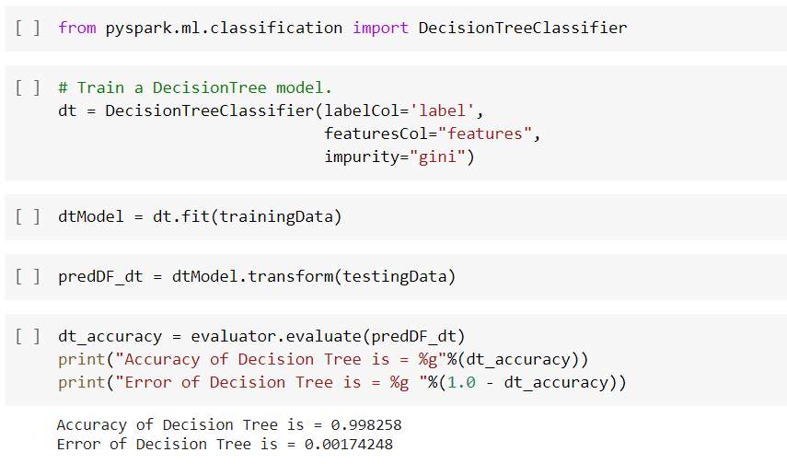
MODELS USED
DECISION TREE CLASSIFIER
The accuracy of DT classifier came out to be 0.998 which is better than all three past models.

Slide 20
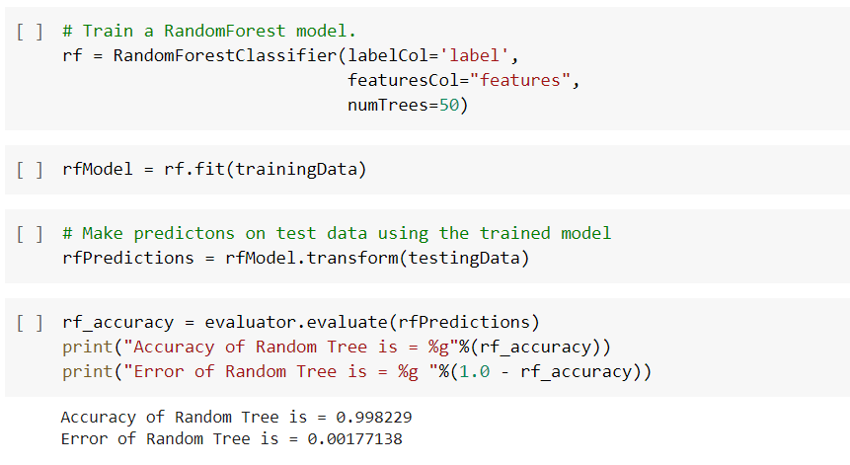
MODELS USED
RANDOM FOREST CLASSIFIER
The accuracy of RF classifier came out to be 0.998 which is almost equal to decision tree classifier which makes sense as it uses multiple decision trees in its processing.

Slide 21
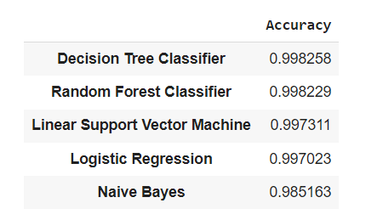
CONCLUSION
Here a new DataFrame has been created just to compare how all 5 of our models are doing, and we can easily observe that DECISION TREE CLASSIFIER gave us the best result.

Slide 22
THANK YOU

