Slide 1
Does Giving an AI a “Map” of Your Code
Actually Help?
ContextAI + ConnectContext, put to the test with a real AI coding agent
A hands-on evaluation across 3 connected projects — 48 real questions, 288 AI runs

Slide 2
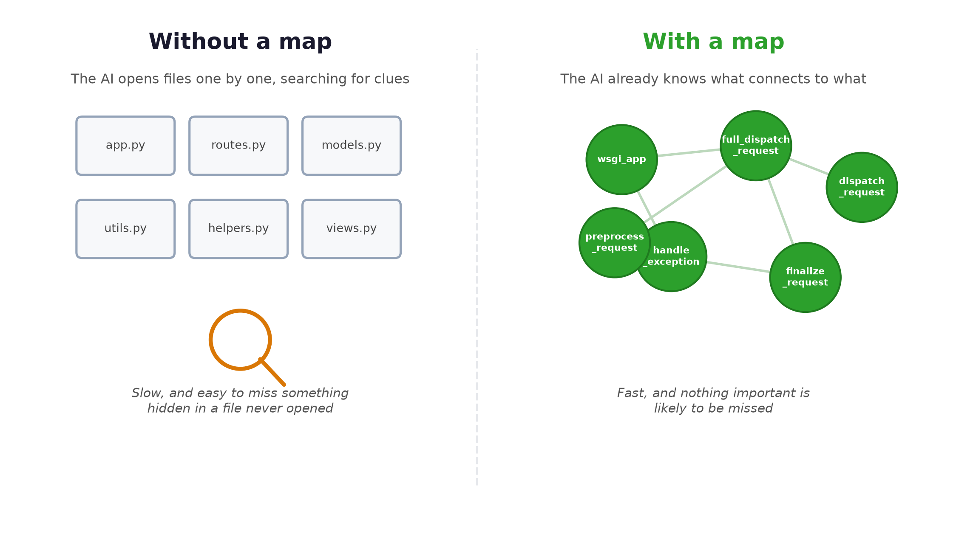
The everyday problem — and the idea
1 · THE IDEA
Why understanding a big codebase is hard, and what if the AI had a map first?
“Does a real AI coding assistant answer code questions better with a pre-built map of the code — compared to using only its normal tools?”

Slide 3
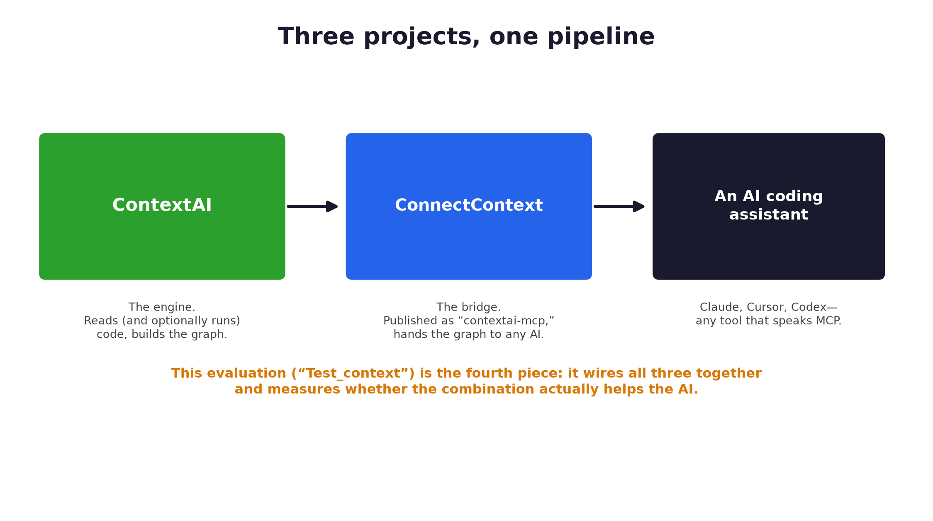
Three connected projects, one pipeline
1 · THE IDEA
This isn't one repo — it's a small stack, and this deck covers all of it

Slide 4
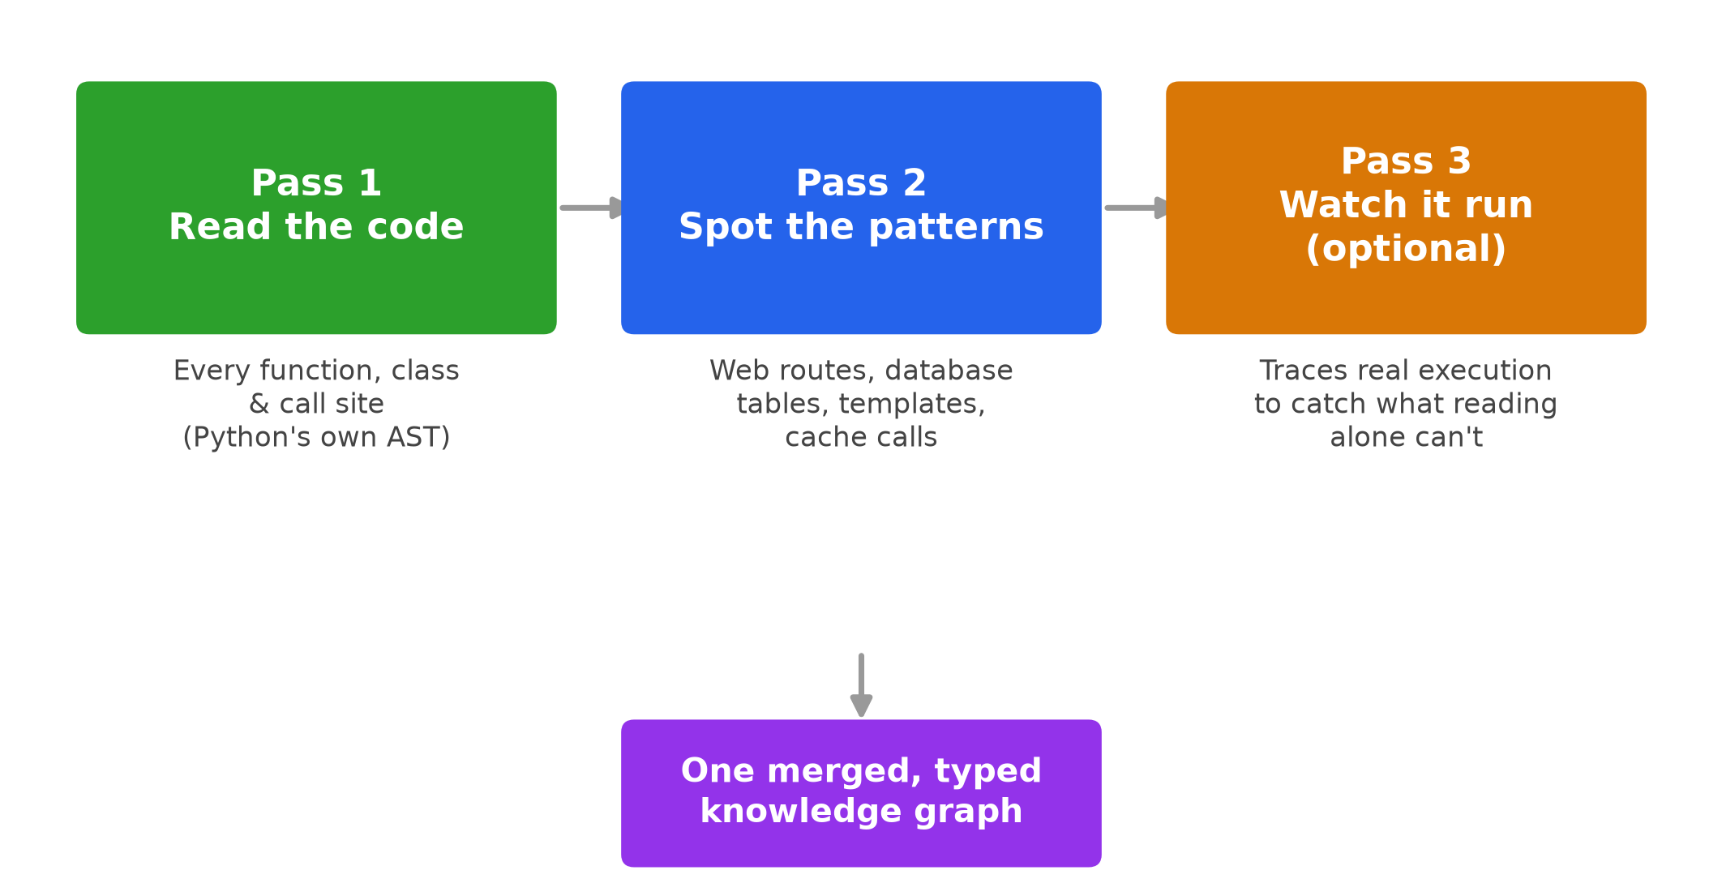
Project 1: ContextAI — the engine
2 · THE THREE PROJECTS
▸ Each function becomes a rich node: code, signature, error handling, complexity, test coverage, git history.
▸ Each connection becomes a typed edge, with how critical and how likely-to-fail it is.
▸ Alpha stage; backed by 150+ automated tests.

Slide 5
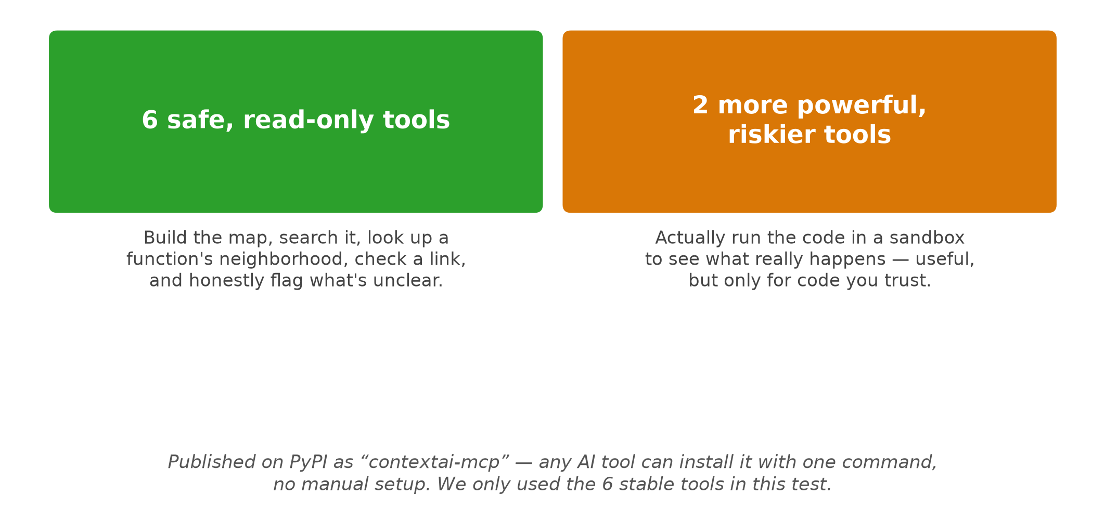
Project 2: ConnectContext — the bridge
2 · THE THREE PROJECTS

Slide 6
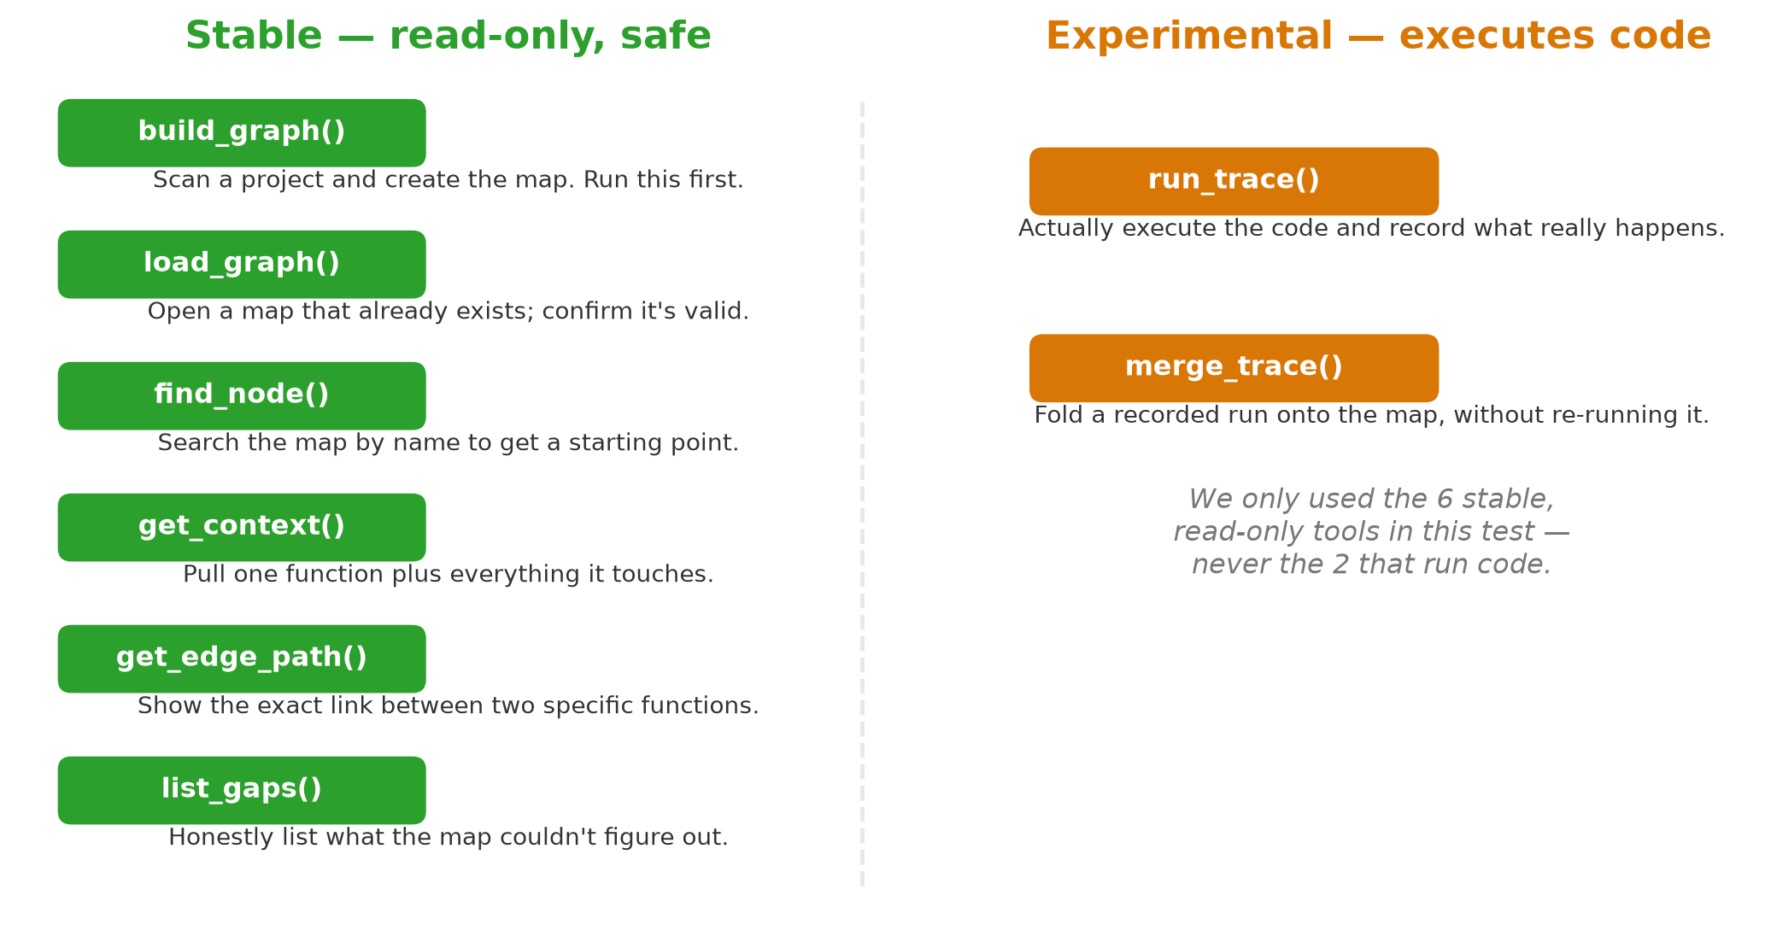
The functions ContextAI actually exposes
2 · THE THREE PROJECTS

Slide 7
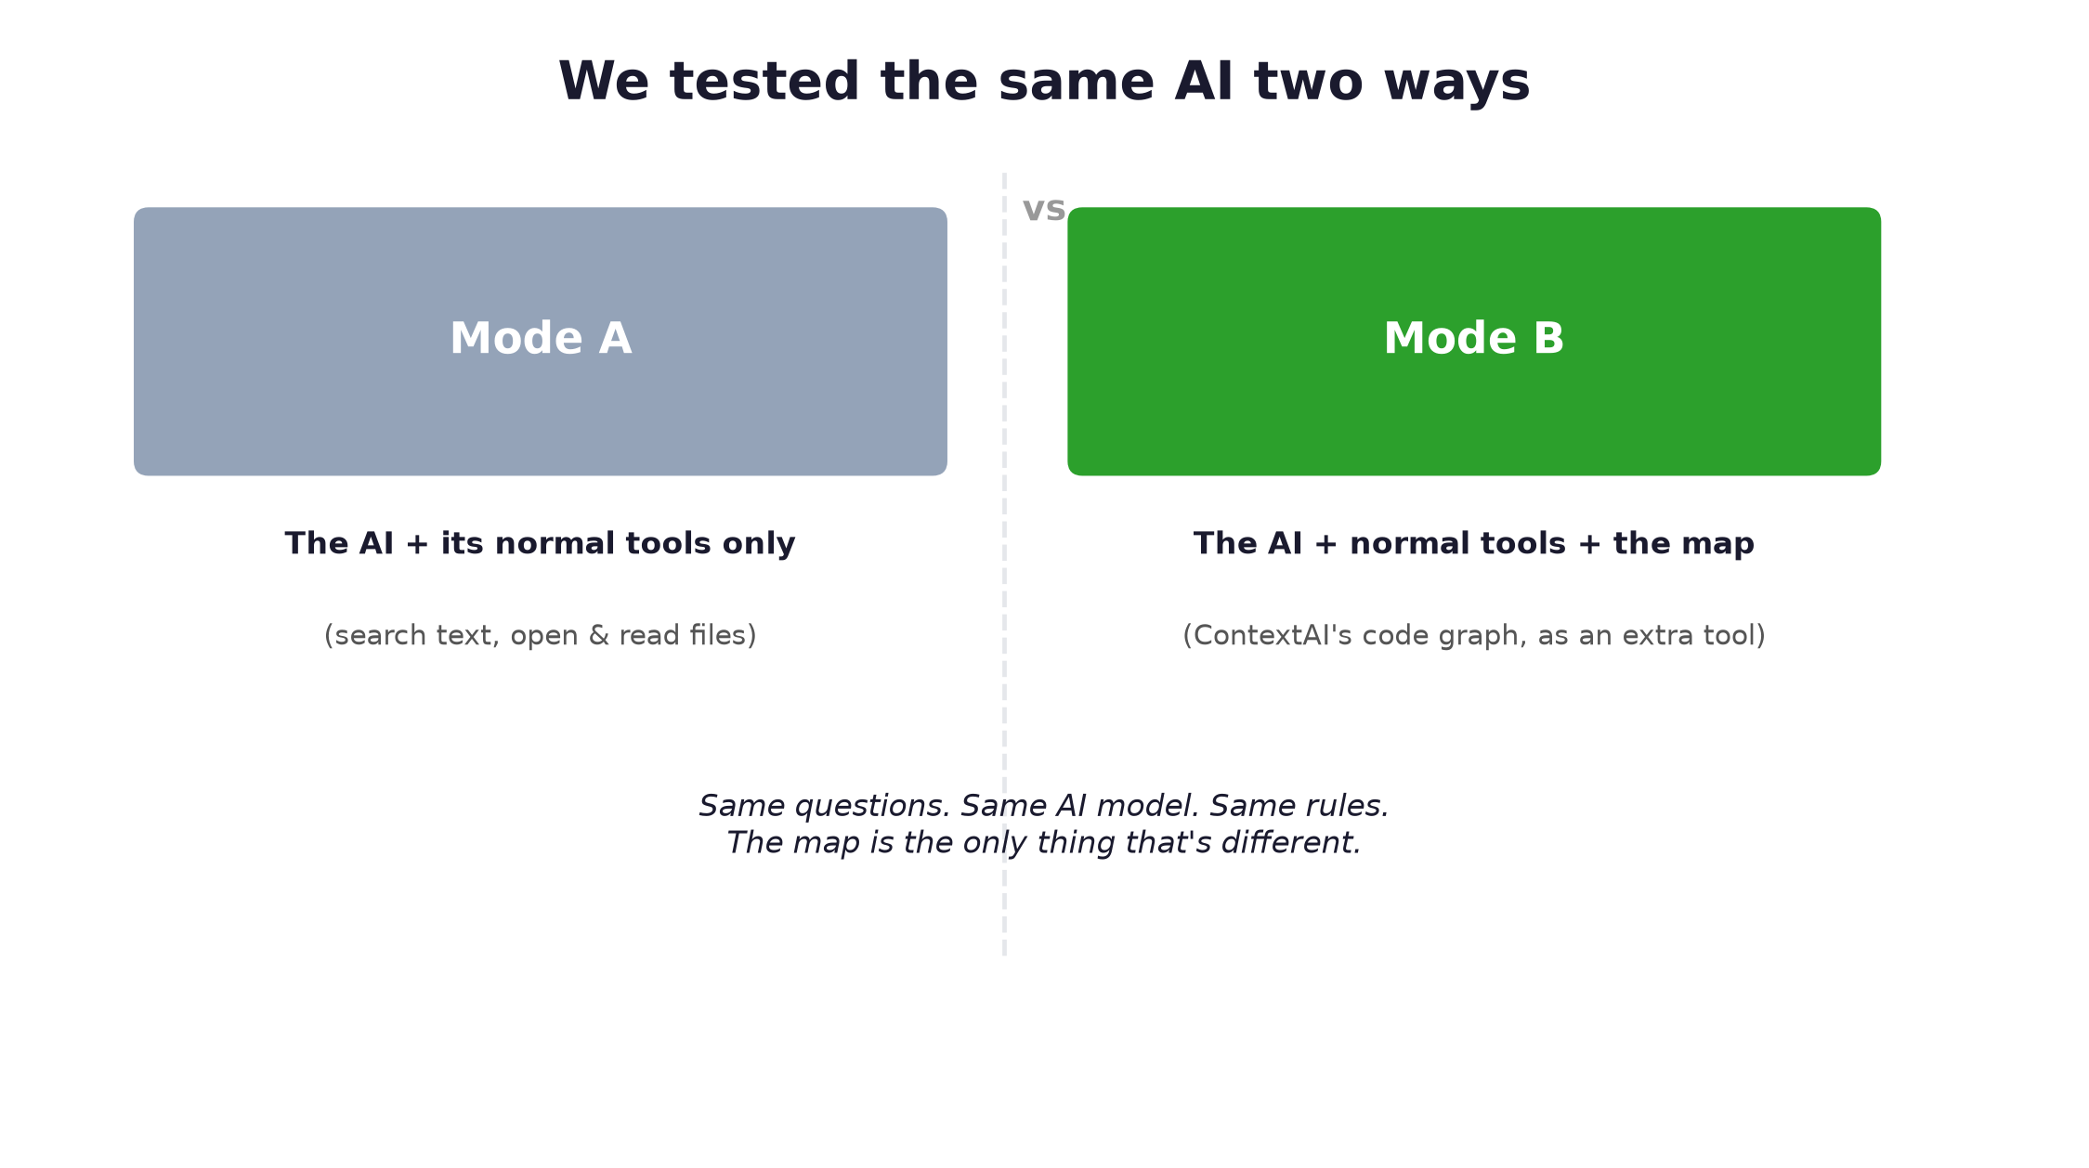
Project 3: this evaluation — what we built
2 · THE THREE PROJECTS
▸ 4 real open-source projects (Flask, Click, HTTPX, Rich), 9k–26k lines each.
▸ 48 realistic questions (“who calls this,” “what breaks if I change this,” and more).
▸ A real AI coding agent (OpenAI's Codex) — not a toy stand-in.
▸ ConnectContext plugged in exactly the way a real developer would.
Same questions. Same AI. Same rules. The map is the only thing that's different.

Slide 8
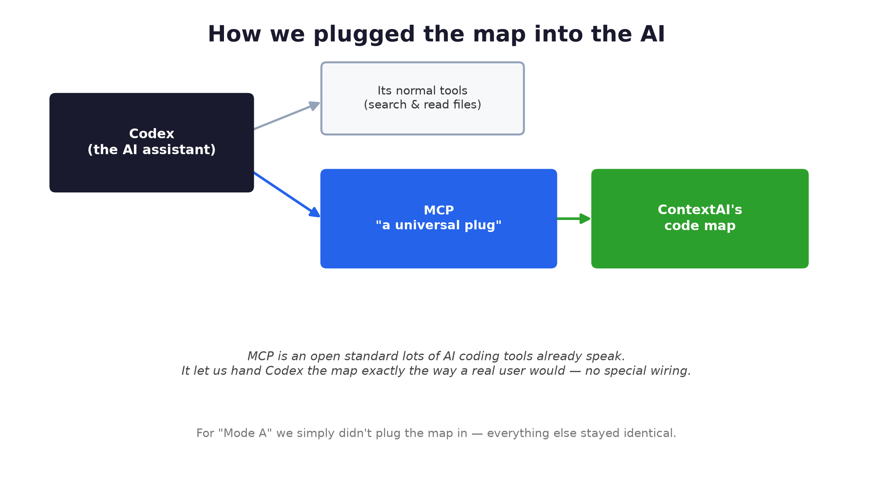
Wiring it up — and two real hiccups
3 · TESTING
🐛 Hidden naming clash
Flask ships a file with the same name as a core Python module, which silently broke the map-builder when run inside it. Fixed by keeping it in its own safe folder.
⏱️ Permissions limitation
Run unattended, the AI tool wouldn't let the map get used at all — it waited for a permission click that could never come. Fixed with a setting, applied identically to both modes.

Slide 9
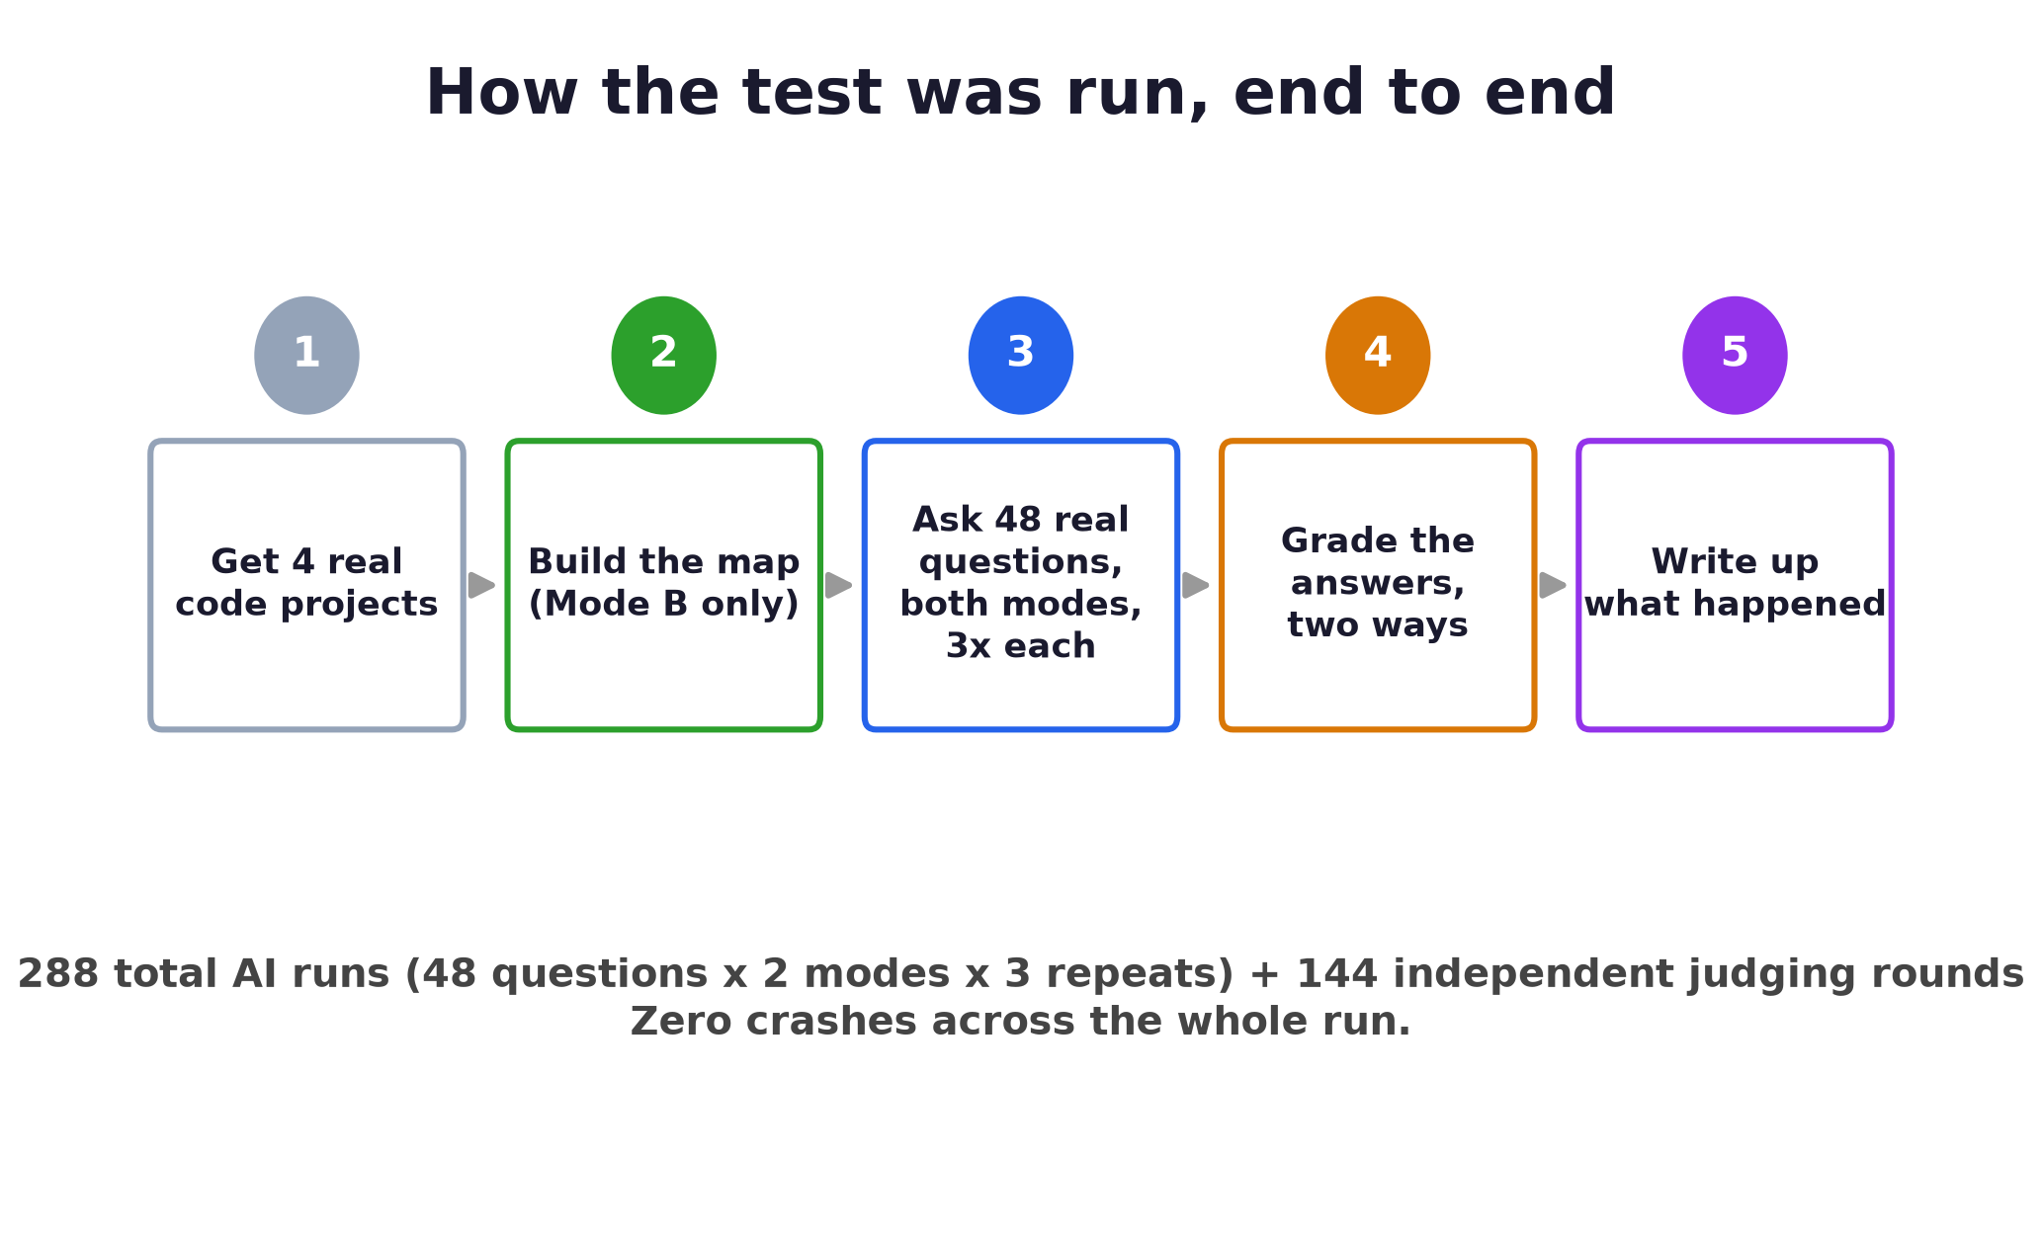
How we ran it, end to end
3 · TESTING

Slide 10
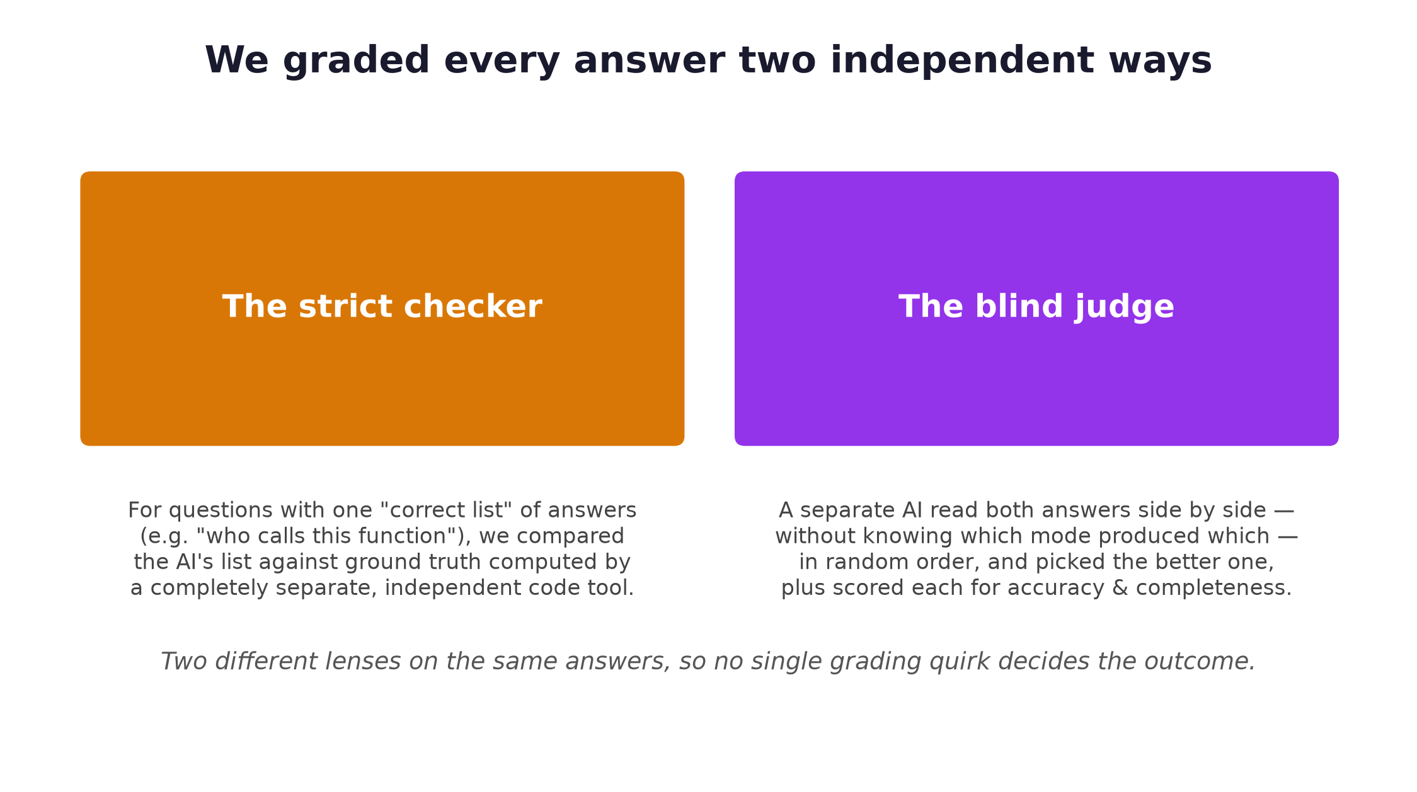
How we graded every answer
3 · TESTING

Slide 11
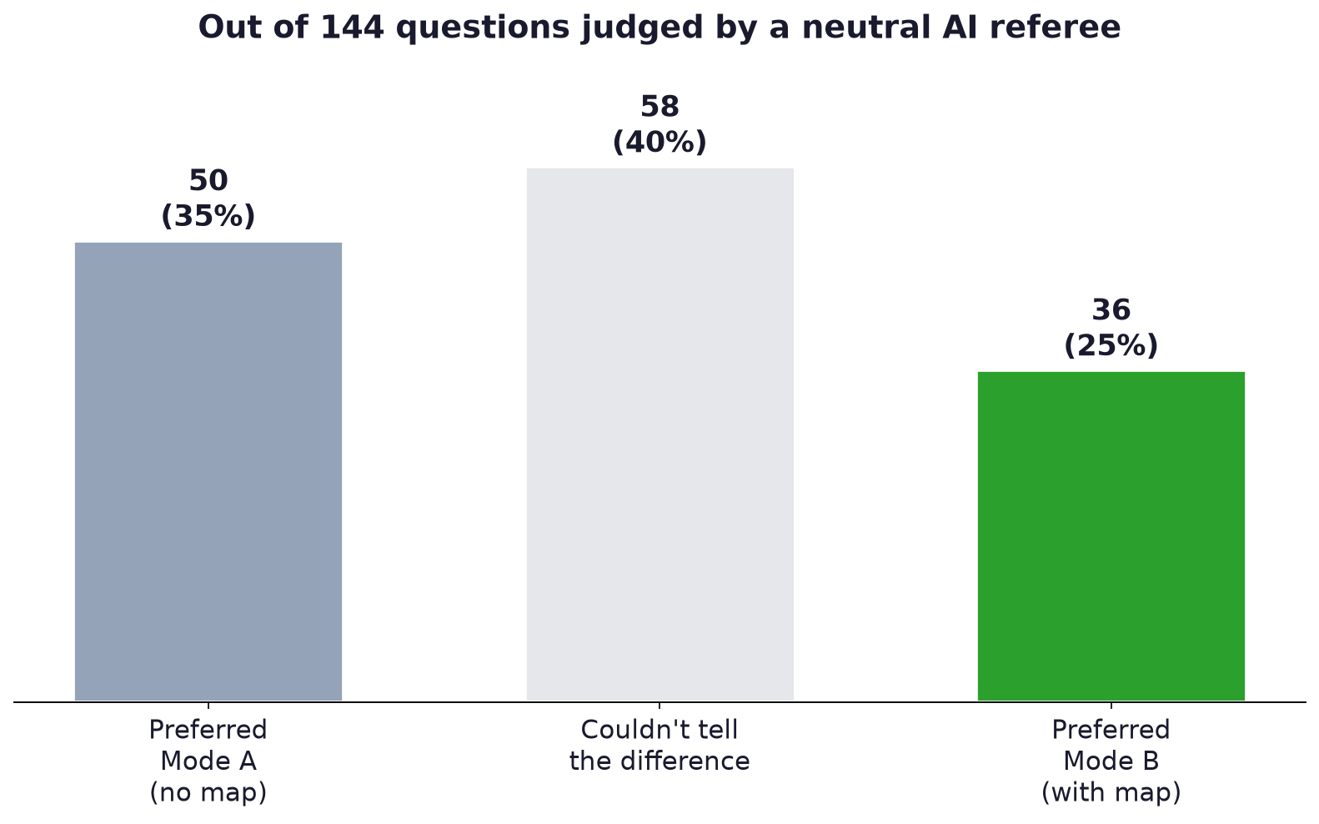
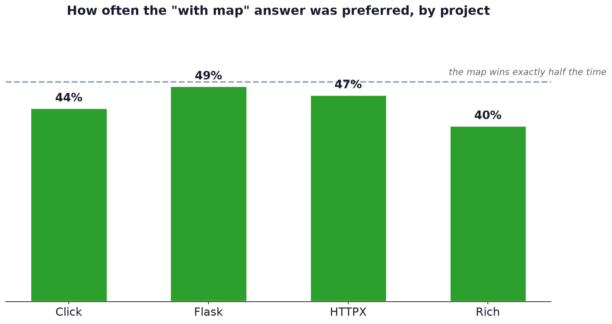
The results: roughly a coin flip
4 · RESULTS

Slide 12
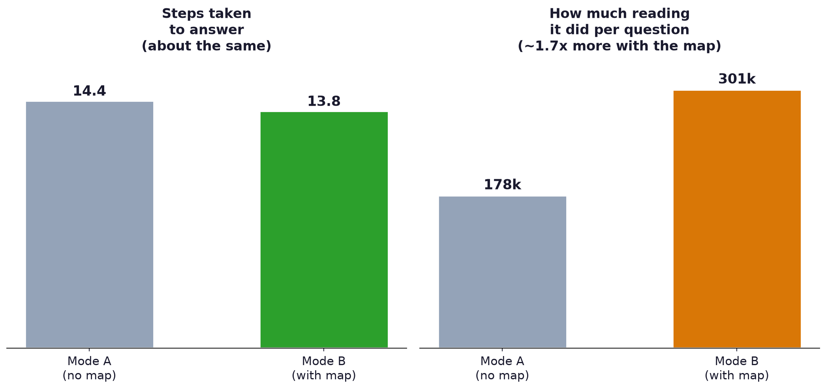
The map wasn't free
4 · RESULTS
Same number of steps, but ~70% more material “read” per question when the map was available.

Slide 13
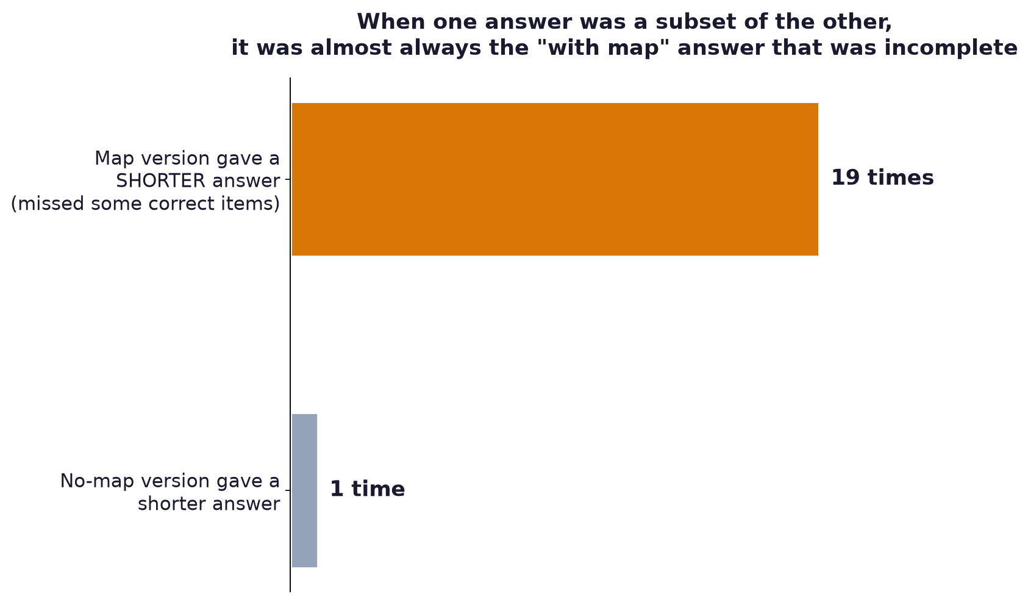
Why didn't it help more? Two real reasons
5 · WHY
1. The referee itself was sometimes wrong
2. Trusting the map too much
We hand-checked one “loss”: the map-assisted answer was actually correct (verified against the real source code) — the AI judge simply made a mistake. The true gap is probably smaller than the headline number suggests.
Bottom line: the extra map didn't clearly make the AI better at understanding code — it used the tool eagerly, but that didn't translate into better answers.

Slide 14
A personal note, 4 months later
When this problem first came up about 4 months ago, it felt urgent: AI models couldn't hold a big codebase “in their head,” so a pre-built map felt essential.
In just those few months, AI models have gotten dramatically better at holding and reasoning over much more code at once, and simply gotten smarter overall. That original problem — the one this tool was built to solve — has largely shrunk on its own, just from the base AI models improving.
Our results fit that story: a modern, capable AI agent with just its ordinary tools already does a solid job — the extra map no longer clears as high a bar as it once would have.

Slide 15
What this means going forward
6 · REFLECTION
▸ Tools like this still have a place — but the bar for “worth adding” keeps rising as base AI models improve.
▸ The AI should be encouraged to double-check the map's answer, not just trust it outright — especially for “list everything” style questions.
▸ The token/reading cost of extra tools is real and should be weighed against the (currently unclear) benefit.
▸ Worth re-running periodically — as models keep improving, the answer to “does this tool help” can keep changing.
Thank you — full write-up, charts & raw data: eval/report/REPORT.md

