Slide 1

Asish Chowdhury-205120023
Amar Sarkar-205120012
Priya Chowdhury-205120077
Ruchi Panse-205120083
Shobhit Samaria-205120099
1
WEBNOCRATES

Slide 2

READY2HIRE
2
WE GROW BY LIFTING OTHERS…
STARTUP

Slide 3
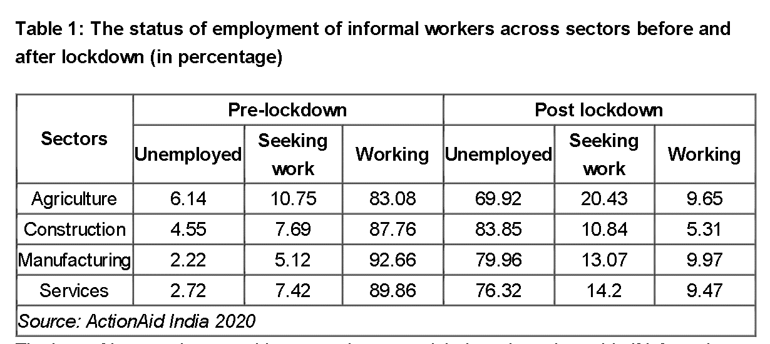
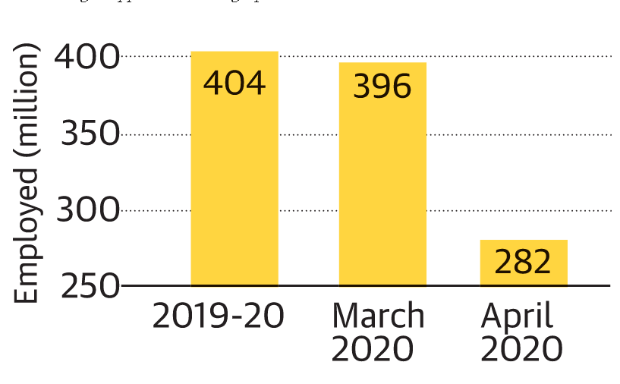
WHY??
READY2HIRE
3
3

Slide 4




Ready2Hire is a platform, which will act as a common ground for both, the one who is searching for some Talent or Service, and the one who is ready to serve his/her talent.
WHAT IS READY2HIRE?
4

Slide 5




Content Writers
4
Event Managers
3
2
Home Tutors
Psychiatrist
1
PROFESSIONS

Slide 6



Search in the domain of Fashion Designers
3
Create your profile
As a wedding planner
2
Visit Ready2Hire’s Website
Sign up for hiring.
1
Suppose you are a Wedding Planner and you need to hire a fashion designer for the bride..

Slide 7



Hire the person if you like them
6
Directly contact the person via options on our website.
5
Select among the variety of options.
4

Slide 8
Reach out to the domains you want to apply to.
3
Create your profile
as a fashion designer.
2
Visit Ready2Hire’s Website,
Sign up for finding work.
1
Suppose you are a fashion designer looking for some work..

Slide 9
Get the opportunity to get job of your choice.
6
Directly contact the person via options on our website.
5
Select among the variety of options.
4

Slide 10





BACK-END
2
PYTHON-FLASK
FRONT-END
1
HTML
CSS
JAVA-SCRIPT
JQUERY
Technology Used

Slide 11



Personal Experience Wall
3
Recommendations
2
Ratings
1
FUTURE SCOPE

