Slide 1
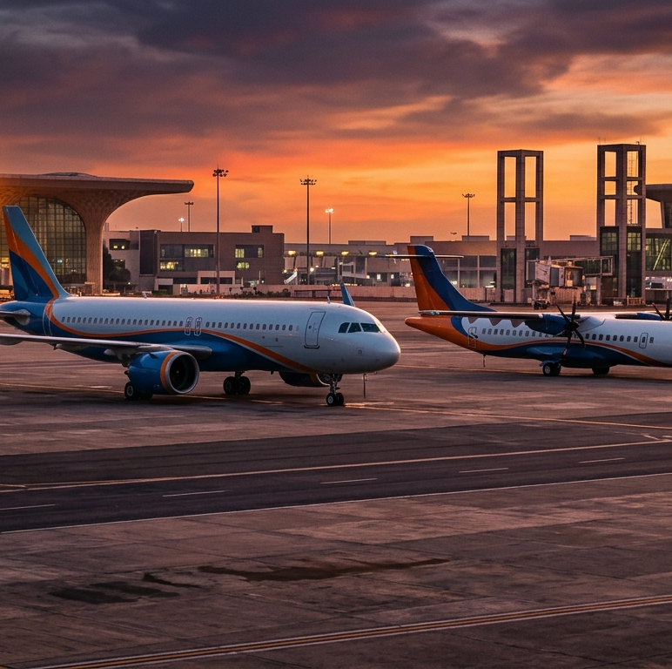
Navigating an ATF Price Shock: Regional Airline Strategy
Route-Level P&L Diagnosis, Breakeven Load Factor Decomposition, and 24-Month Turnaround Roadmap
CFA Club, IIT Indore | PS1 Consulting & Product Management

Slide 2
EXECUTIVE SUMMARY | SITUATION, DIAGNOSIS & TURNAROUND IMPACT
Phased Turnaround Swings Network EBITDAR by +₹155.1 Cr
Exiting 2 unviable sub-390 km routes, ring-fencing Tier-3 spokes via UDAN, and swapping 4 A320s for ATR 72-600s lowers BLF to 71.1%
FY25 ATF SHOCK EBITDAR
STRUCTURAL ROUTE LOSS
TURNAROUND EBITDAR (YR 2)
BREAKEVEN LOAD FACTOR
-₹78.3 Cr
₹72.9 Cr
+₹76.8 Cr
71.1% BLF
At ₹1,04,927/kl (+22% ATF spike)
Gross loss on R4-R8 (gauge & rail)
+15.2% margin via phased A+B+C
Cut by -15.4 pts vs. 86.5% shock
Strategic Scenario | Routes | ASK (M) | Load Factor | RASK (₹) | CASK (₹) | Network BLF | Annual EBITDAR
1. Pre-Shock Baseline (@ ₹86,000/kl ATF) | 8 | 1,001.6 | 73.2% | 4.31 | 4.61 | 78.3% | -₹29.9 Cr
2. FY25 ATF Shock Status Quo (@ ₹1,04,927/kl) | 8 | 1,001.6 | 73.2% | 4.31 | 5.10 | 86.5% | -₹78.3 Cr
3. Standalone Option A (Pruning + Dynamic RM) | 6 | 746.1 | 78.4% | 5.14 | 5.06 | 77.1% | +₹6.2 Cr
4. Standalone Option B (UDAN Expansion on A320) | 8 | 1,001.6 | 78.9% | 4.88 | 5.08 | 82.1% | -₹19.8 Cr
5. Standalone Option C (ATR 72-600 Fleet Swap) | 8 | 844.7 | 82.1% | 5.02 | 4.73 | 77.3% | +₹24.5 Cr
6. RECOMMENDED INTEGRATED PATH (A + B + C) | 6 | 950.5 | 83.8% | 5.32 | 4.51 | 71.1% | +₹76.8 Cr
Source: Model Tab 1 (1_Exec_Summary_KPIs); IOCL ATF Archives; IndiGo FY25 Results; MoCA UDAN Scheme
Slide 1 of 10

Slide 3
STEP 1: PROBLEM DIAGNOSIS | FUEL-DRIVEN VS. STRUCTURALLY EMBEDDED LOSSES
₹72.9 Cr of Route Losses Are Structural; ₹48.4 Cr Is Fuel Shock
Decomposing route P&L at pre-shock (₹86,000/kl) vs. post-shock (₹1,04,927/kl) ATF isolates true root causes across 3 route archetypes
THREE ROUTE ARCHETYPES IN OUR NETWORK
Cat 1 - Core Feeders (R1-R3: 510-640 km): Generate +₹43.0 Cr pre-shock profit at 82%-84% LF. The +22% ATF spike erodes -₹28.8 Cr (100% Fuel-Driven), leaving them at +₹14.2 Cr.
Cat 2 - Gauge Mismatch (R4-R6: 410-620 km): Flying 180-seat A320s on ~110-pax Tier-3 demand yields 60%-64% LF. Of their -₹30.9 Cr post-shock loss, 64% (-₹19.9 Cr) is structural gauge mismatch.
Cat 3 - Sub-390 km Rail Trap (R7-R8: 320-390 km): High landing/cycle costs push CASK to ₹6.73-₹6.95/ASK while Vande Bharat Express caps fares. Over 86% (-₹53.0 Cr of -₹61.6 Cr) is structural.
Diagnostic Imperative: Across R4-R8, ₹72.9 Cr of gross losses are structurally embedded while ₹48.4 Cr network-wide is fuel-driven. Hedging alone cannot fix gauge errors.
Source: Model Tab 2 (2_Route_PnL_and_BLF); IndiGo Q1 FY25 Release (CASK ₹4.62); SpiceJet Q3 FY25 Report (CASK ₹6.50)
Slide 2 of 10

Slide 4
STEP 1: PROBLEM DIAGNOSIS | BREAKEVEN LOAD FACTOR (BLF = CASK / YIELD)
Routes R7 & R8 Require >116% Load Factor Just to Break Even
Comparing Actual Load Factor against Pre-Shock and Post-Shock BLF separates temporarily depressed routes from impossible sectors
Route | Actual LF | Shock BLF | Action Verdict
R1 (510km) | 84.0% | 78.0% | Retain & Reprice
R2 (600km) | 82.0% | 79.0% | Retain & Reprice
R3 (640km) | 83.0% | 79.8% | Retain & Reprice
R4 (410km) | 62.0% | 79.8% | ATR72 + UDAN
R5 (540km) | 60.0% | 79.7% | ATR72 + UDAN
R6 (620km) | 64.0% | 79.7% | ATR72 + UDAN
R7 (320km) | 56.0% | 116.2% | EXIT MONTH 1
R8 (390km) | 58.0% | 116.4% | EXIT MONTH 1
Source: Model Tab 2 (2_Route_PnL_and_BLF); DGCA Domestic Route Load Factors (https://dgca.gov.in/digigov-portal/)
Slide 3 of 10

Slide 5
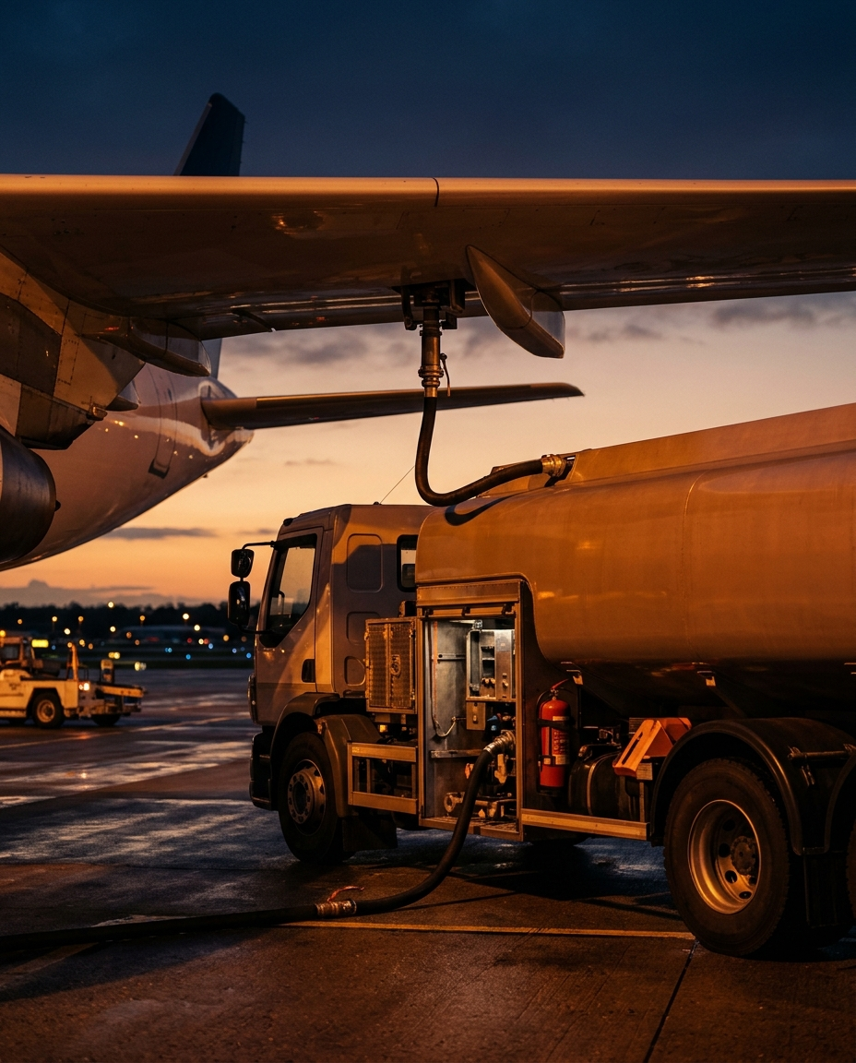
STEP 1: PROBLEM DIAGNOSIS | SYSTEMS-LEVEL SHOCK PROPAGATION
How a +22% ATF Spike Triggers a Spiral
Frequency cuts inflate Ex-Fuel CASK and replicate SpiceJet's crisis
1. MACRO & TAX SHOCK
Brent volatility + INR fall + 20-29% State VAT push ATF +22% to ₹1,04,927/kl.
2. UNIT COST BREACH
Fuel CASK jumps to ₹2.05/ASK; Network BLF surges from 78.3% to 86.5%.
3. UTILIZATION TRAP
Ad-hoc cuts on R4-R8 drop aircraft utilization to 8.2 hrs/day (+28% Ex-Fuel CASK).
4. LIQUIDITY FREEZE
Cash burn hits ₹6.5 Cr/mo; carrier delays lease rentals and oil PSU payments.
5. FLEET GROUNDING
Lessors enforce 'Cash-and-Carry' groundings; credit downgrades freeze capital.
Source: SpiceJet Q3 FY25 Analysis (CASK ₹6.50/km); IOCL ATF Archives
Slide 4 of 10

Slide 6
STEP 2: STRATEGIC OPTIONS ASSESSMENT | OPTION A: NETWORK OPTIMIZATION & DYNAMIC PRICING
Option A Eliminates ₹61.6 Cr in Losses and Lifts EBITDAR to +₹6.2 Cr
Immediate exit of ultra-short routes R7-R8 stops cash bleed, while dynamic fare buckets capture inelastic corporate demand on R1-R3
QUANTITATIVE MECHANICS & LIMITATIONS
Immediate Route Pruning (R7 & R8): Exiting Nashik-Mumbai (320 km) and Kanpur-Delhi (390 km) eliminates -₹61.6 Cr in annual operating losses, incurring only -₹4.5 Cr in one-time station closure friction.
Dynamic Yield Management (R1-R3): Raising peak morning/evening corporate fares by +7.5% to +8.0% with price elasticity e = -0.42 to -0.45 trims LF by only -2.5 pts while lifting RASK by +4.6%.
Frequency Consolidation (R4-R6): Cutting Tier-3 frequencies from 2x to 1x daily lifts cabin Load Factor from 60%-64% to 69%-72%, halving route losses.
Why Option A Alone Is Insufficient: Standalone Option A swings network EBITDAR by +₹84.5 Cr (to +₹6.2 Cr, +1.6% margin), but R4-R6 still lose -₹26.7 Cr because a 180-seat A320 is oversized.
Source: Model Tab 3 (3_Strategic_Options_ABC - Option A Block); HBS/HBR American Airlines Revenue Management Case (https://www.hbs.edu/faculty/Pages/item.aspx?num=3408)
Slide 5 of 10

Slide 7
STEP 2: STRATEGIC OPTIONS ASSESSMENT | OPTION B: RCS-UDAN ROUTE EXPANSION
UDAN Subsidies Cut CASK by 13%, But 40-Seat Cap Traps 180-Seat Jets
MoCA Viability Gap Funding (VGF) and 1% ATF VAT lower unit costs, yet capping fares on 40 seats leaves 140 A320 seats exposed
UDAN Provision | Statutory Benefit (MoCA / AAI) | Trade-Off on 180s A320
VGF Subsidy | ₹4,150-₹4,450/seat (80% MoCA, 20% State) | Capped at MAX 40 SEATS/flight (22% of A320)
State VAT on ATF | 1%-2% VAT vs. 20%-29% at non-RCS metros | Saves ~13% CASK, limited to RCS spoke uplift
Airport Charges | 100% waiver on Landing, Parking & RNFC | Daytime VFR limits high-frequency turns
3-Yr Exclusivity | Statutory monopoly on RCS route (36 mos) | MoCA fare cap (~₹2,750) anchors local yields
Receivables & Cliff | Modified UDAN extended through FY2037 | 180-day State VGF delay + Year-3 VGF cliff
KEY INSIGHT: Standalone Option B leaves Network EBITDAR at -₹19.8 Cr because 140 unsubsidized A320 seats go unsold. Pairing UDAN with 78-seat ATR 72-600s covers 51.3% of the cabin with VGF!
Source: MoCA Modified UDAN Scheme v1.2 (https://www.civilaviation.gov.in); PIB UDAN Release (₹4,091 Cr VGF across 657 routes)
Slide 6 of 10

Slide 8
STEP 2: STRATEGIC OPTIONS ASSESSMENT | OPTION C: FLEET MIX & COST RESTRUCTURING
Right-Sizing Tier-3 Routes to 78-Seat ATR 72-600s Cuts Trip Cost 52%
Swapping 4 leased A320s for regional turboprops lifts Tier-3 Load Factors from 62% to 84% and swings network EBITDAR to +₹24.5 Cr
Metric (500km Spoke) | A320ceo (180s) | ATR 72-600 (78s)
Block Fuel Burn / Trip | 2,450 Litres | 1,120 Litres (-54%)
Total Trip Operating Cost | ₹4.85 Lakh | ₹2.32 Lakh (-52%)
Achievable Load Factor | 60%-64% (112 pax) | 84%-88% (67 pax)
Route Total CASK (₹/ASK) | ₹5.21-₹5.79 | ₹4.32-₹4.52 (UDAN)
Route Breakeven LF (BLF) | 79.7%-79.8% | 68.9%-71.4%
PBH Maintenance Savings | Fixed Reserve Heavy | -4.5% Ex-Fuel CASK
Source: Model Tab 3 (Option C Block); IndiGo FY25 Annual Report (45 ATRs) & Star Air Fleet Benchmark (https://www.starair.in/Home/ourfleet)
Slide 7 of 10

Slide 9
STEP 3: STRATEGIC RECOMMENDATION | INTEGRATED TURNAROUND PATH & TRADE-OFFS
Why Sequenced Hybrid (A -> B -> C) Beats Every Standalone Option
Combining immediate route pruning with ATR 72-600 gauge right-sizing and selective UDAN delivers +₹76.8 Cr EBITDAR (+15.2% margin)
CONSCIOUS STRATEGIC TRADE-OFFS
1. Do NOT Compete with Vande Bharat on <390 km Sectors: We permanently exit R7 (ISK-BOM 320 km) and R8 (KNU-DEL 390 km). High cycle costs and <4-hour premium rail caps make BLF >116% structurally unfixable.
2. Do NOT Fly 180-Seat Narrow-Bodies on UDAN Spokes: We reject standalone Option B on A320s. We only enter UDAN on R4-R6 once matched with 78-seat ATR 72-600s where the 40-seat VGF cap covers 51.3% of seats.
3. Accept a -5.1% Gross ASK Reduction for +₹155 Cr Profit: We consciously sacrifice headline seat capacity (from 1,001.6M to 950.5M ASKs) and exit 2 stations to shift from -18.1% distress to +15.2% EBITDAR margin.
4. Redeploy Freed A320 Slots to High-Margin Hub Feeders: Slots freed from R7-R8 boost R1-R3 from 4x to 5x daily A320 flights, generating +₹53.4 Cr EBITDAR on core corporate corridors.
Source: Model Tab 1 & Tab 3; McKinsey Future of Aviation / Retail Reinvention Analysis
Slide 8 of 10

Slide 10
STEP 3: IMPLEMENTATION ROADMAP | PHASED 24-MONTH EXECUTION & GOVERNANCE KPIS
Three-Horizon Execution Plan with Gate-Controlled Financial KPIs
Sequencing zero-CapEx cash stabilization (Months 1-3) before damp/dry-lease fleet transition protects liquidity throughout turnaround
PHASE 1: MONTHS 1-3
PHASE 2: MONTHS 4-9
PHASE 3: MONTHS 10-24
Stop Cash Burn & Reprice
UDAN Shield & Damp Lease
Dual-Gauge Scale & PBH Reset
Exit R7 & R8 Immediately: Cease Nashik & Kanpur flights with 30-day DGCA notice; save ₹61.6 Cr/yr gross loss.
Slot Redeployment: Shift freed A320 aircraft to 5x daily frequency on R1 (IDR-BOM), R2 (BHO-DEL), R3 (STV-BLR).
Dynamic RM & Ancillary: Launch +7.5% peak corporate buckets & ₹460/pax baggage/seat unbundling.
Gate 1 KPIs (Month 3): Cash burn flips to +₹1.5 Cr/mo EBITDAR; Network LF >= 78%; BLF <= 77.0%.
Selective UDAN Bidding: Convert R4 (IXG), R5 (JLR), R6 (GOP) to RCS-UDAN for ₹4,450/seat VGF + 1% ATF VAT.
Fuel Tankering Protocol: Uplift maximum safe return fuel at 1% VAT RCS stations to cut network Fuel CASK by 7%.
Induct 2x ATR 72-600s: Introduce initial 78-seat turboprops via 6-month damp lease while training crew.
Gate 2 KPIs (Month 9): Blended Fuel CASK <= ₹1.62/ASK; Tier-3 LF >= 84%; Utilization >= 11.2 hrs/day.
Complete 4x ATR Dry Lease: Transition R4-R6 fully to dry-leased ATR 72-600s; sub-lease 2 older A320ceos abroad.
PBH Maintenance Reset: Convert engine/component MRO to Power-by-the-Hour contracts (-4.5% Ex-Fuel CASK).
Pre-Sunset Yield Shift: Gradually shift 25% of ATR seats to commercial corporate fares ahead of Year-3 VGF taper.
Gate 3 KPIs (Month 24): Annual EBITDAR +₹76.8 Cr (+15.2% margin); Blended CASK ₹4.51; BLF 71.1%.
Source: Model Tab 1 & Tab 3; IndiGo / SpiceJet Fleet Transition & PBH Leasing Benchmarks
Slide 9 of 10

Slide 11
STEP 4: RISK & MITIGATION | TWO-WAY SENSITIVITY MATRIX & STRESS SCENARIOS
Network Remains Profitable Up to ₹1,25,000/kl ATF Under Hybrid Path
Two-way sensitivity across ATF prices (₹85k-₹125k/kl) vs. Yield shifts (-6% to +6%) plus 3 institutional mitigation triggers
TWO-WAY SENSITIVITY: ANNUAL EBITDAR (₹ CR)
MANDATORY STRESS SCENARIOS & MITIGATION TRIGGERS
ATF \ Yield | -6.0% | -3.0% | Base 0% | +3.0% | +6.0%
₹85,000/kl | +76.0 | +91.2 | +106.4 | +121.5 | +136.7
₹95,000/kl | +61.2 | +76.3 | +91.5 | +106.7 | +121.9
₹1,04,927/kl | +46.5 | +61.6 | +76.8 | +92.0 | +107.1
₹1,15,000/kl | +31.5 | +46.7 | +61.9 | +77.0 | +92.2
₹1,25,000/kl | +16.7 | +31.9 | +47.0 | +62.2 | +77.4
Risk 1 - Severe Crude ($105/bbl) & FX (₹89/USD) Spike: Trigger: ATF hits ₹1,22,000/kl (-₹24.8 Cr hit). Mitigation: Automatic ₹250/pax fuel surcharge indexation + maximum tankering from 1% VAT UDAN spokes + 40% crack-spread collar recovers +₹19.4 Cr (Post-Mitigation EBITDAR: +₹71.4 Cr).
Risk 2 - 180-Day State VGF Delay & Year-3 Subsidy Cliff: Trigger: State 20% VGF reimbursement arrears lock up ₹16.2 Cr. Mitigation: Discount receivables via an AAI/Bank Guarantee escrow facility and shift 25% of ATR seats to commercial corporate fares by Month 18 (+₹13.5 Cr recovery).
Risk 3 - 6-Month Delay in ATR 72-600 Dry-Lease Delivery: Trigger: OEM supply chain bottleneck (-₹14.5 Cr hit). Mitigation: Bridge with 2x short-term damp-leased ATRs and cap R4-R6 at 1x daily A320 frequency until turboprop arrival (+₹11.2 Cr recovery).
RESILIENCE FINDING: Even if Domestic Metro ATF surges another +19% to ₹1,25,000/kl AND yields slip by -6.0% simultaneously, the restructured dual-gauge network stays EBITDAR-positive (+₹16.7 Cr) because BLF is anchored at 71.1%.
Source: Model Tab 4 (4_Risk_Sensitivity_Matrix); IOCL ATF Archives; MoCA UDAN Escrow Guidelines
Slide 10 of 10

Slide 12
From Fuel Crisis to Sustainable Regional Leadership
Phased Route Rationalization, Selective UDAN Shielding, and ATR 72-600 Fleet Right-Sizing Deliver +₹76.8 Cr EBITDAR
CFA Club, IIT Indore - PS1 Strategy Deck & Financial Model

