Slide 1
Hadoop and MapReduce
An introduction and practice

Slide 2
Outline
Midterm project
Hadoop and HDFS
MapReduce
Amazon’s Elastic MapReduce (and practice!)

Slide 3
Requirements
(20%) Come up with a set of (3 or more) questions you are interested in that can be answered with web data.
(30%) Write python code that:
pulls the data from the web to answer this question
validates the obtained data
generates plots that gives insight into the questions
(30%) Write a 2+ page report (plus graphics) explaining:
what the questions are and why they are interesting
what data was obtained
what the data answer about the questions (using plots as illustration)
(20%) Evaluate teammates' contributions to the project

Slide 4
Example
What Flickr tags co-occur with political keywords?
What are the demographics of Flickr users who use political keywords?
What is the distribution of friends and tags for political vs. non-political users?
What is the probability two political users are friends, compared to the probability two random users are friends?

Slide 5
Example
How often are companies’ stock tickers (e.g. $MSFT) actually tweeted?
When they are, is the company name also mentioned in the same tweet?
How often do these co-occur with the words “buy” or “sell”?
How do mentions (or change in mentions) relate to stock prices?

Slide 6
Example
http://www.d4d.orange.com/home

Slide 7
Problem
Big Data is big!
What to do when you want to process 100’s of terabytes of data?
Takes 11 days to read on 1 computer
Need lots of cheap computers
Fixes speed problem (15 minutes on 1000 computers), but…
Reliability problems
In large clusters, computers fail every day
Cluster size is not fixed
Need common infrastructure
Must be efficient and reliable

Slide 8
Solution
Open Source Apache Project
Hadoop Core includes:
Distributed File System - distributes data
Map/Reduce - distributes application
Written in Java
Runs on
Linux, Mac OS/X, Windows, and Solaris
Commodity hardware

Slide 9
Hadoop distributed filesystem

Slide 10

Namenode and Datanodes
HDFS cluster consists of a single Namenode, a master server that manages the file system namespace and regulates access to files by clients.
There are a number of DataNodes usually one per node in a cluster.
HDFS exposes a file system namespace and allows user data to be stored in files.
The DataNodes manage storage attached to the nodes that they run on.
A file is split into one or more blocks and set of blocks are stored in DataNodes.
DataNodes: serves read, write requests, performs block creation, deletion, and replication upon instruction from Namenode.
Namenode
File1
1
2
3
4
1
2
1
3
2
1
4
2
4
3
3
4
Datanodes

Slide 11
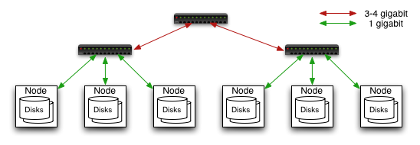
Commodity Hardware Cluster
Typically in 2 level architecture
Nodes are commodity PCs
40 nodes/rack
Uplink from rack is 8 gigabit
Rack-internal is 1 gigabit

Slide 12
HDFS Architecture
Namenode
Metadata(Name, replicas..)
(/home/foo/data,6. ..
Metadata ops
Client
Block ops
Read
Datanodes
Datanodes
B
replication
Blocks
Rack1
Write
Rack2
Client

Slide 13
File system Namespace
Hierarchical file system with directories and files
Create, remove, move, rename etc.
Namenode maintains the file system
Any meta information changes to the file system recorded by the Namenode.
An application can specify the number of replicas of the file needed: replication factor of the file. This information is stored in the Namenode.

Slide 14
Namenode
Keeps image of entire file system namespace and file Blockmap in memory.
4GB of local RAM is sufficient to support the above data structures that represent the huge number of files and directories.
Periodic checkpointing is done. So that the system can recover back to the last checkpointed state in case of a crash.

Slide 15
Data Replication
HDFS is designed to store very large files across machines in a large cluster.
Each file is a sequence of blocks.
All blocks in the file except the last are of the same size.
Blocks are replicated for fault tolerance.
Block size and replicas are configurable per file.
The Namenode receives a Heartbeat and a BlockReport from each DataNode in the cluster.
BlockReport contains all the blocks on a Datanode.

Slide 16
Replica Selection
Replica selection for READ operation: HDFS tries to minimize the bandwidth consumption and latency.
If there is a replica on the Reader node then that is preferred.
HDFS cluster may span multiple data centers: replica in the local data center is preferred over the remote one.

Slide 17
Datanode
A Datanode stores data in files in its local file system.
Datanode has no knowledge about HDFS filesystem
It stores each block of HDFS data in a separate file.
Datanode does not create all files in the same directory.
It uses heuristics to determine optimal number of files per directory and creates directories appropriately.
When the filesystem starts up it generates a list of all HDFS blocks and send this report to Namenode: Blockreport.

Slide 18
HDFS key points
Clients interact with the filesystem through the NameNode
Data is stored in chunks across DataNodes
Data is replicated across DataNodes to prevent data corruption or loss
HDFS wraps the complicated process of splitting and replicating data across multiple computers with a simple filesystem

Slide 19
Map/Reduce

Slide 20
Map/Reduce
It works like a Unix pipeline:
cat input | grep | sort | uniq -c | cat > output
Input | Map | Shuffle & Sort | Reduce | Output
It should really be called Map/Sort/Reduce!
The shuffle & sort is done behind the scenes…

Slide 21
Map & Reduce
map(key, val) is run on each item in set
emits new-key / new-val pairs
reduce(key, vals) is run for each unique key emitted by map()
emits final output

Slide 22
Example: Word Count
def mapper(line):
foreach word in line.split():
output(word, 1)
def reducer(key, values):
output(key, sum(values))

Slide 23
Word Count Execution
Input
Map
Shuffle & Sort
Reduce
Output
the, 1
brown, 1
fox, 1
the quick
brown fox
Map
brown, 2
fox, 2
how, 1
now, 1
the, 3
Reduce
the, 1
fox, 1
the, 1
the fox ate
the mouse
Map
quick, 1
how, 1
now, 1
brown, 1
ate, 1
mouse, 1
ate, 1
cow, 1
mouse, 1
quick, 1
Reduce
how now
brown cow
Map
cow, 1

Slide 24
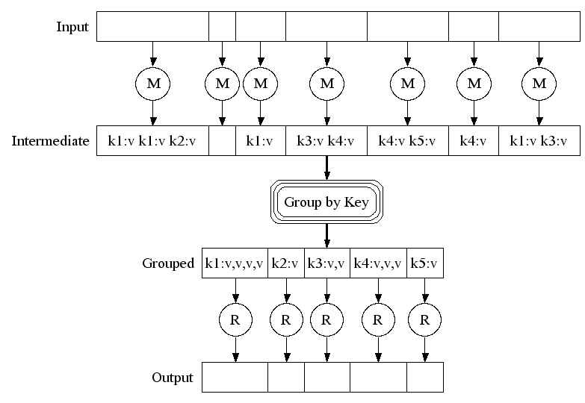
Execution

Slide 25
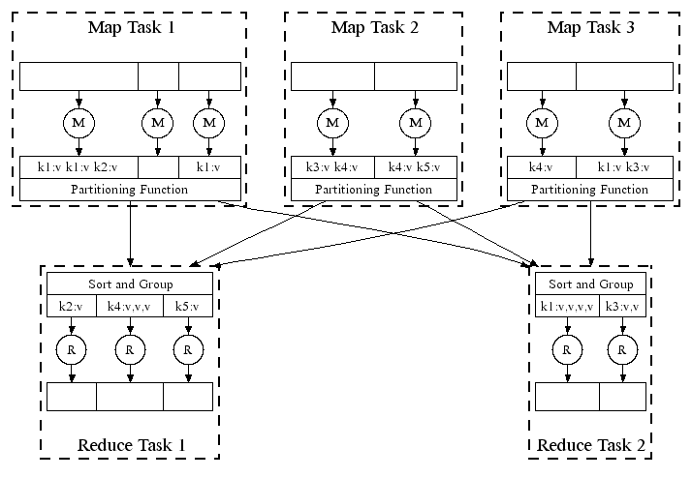
Parallel Execution

Slide 26
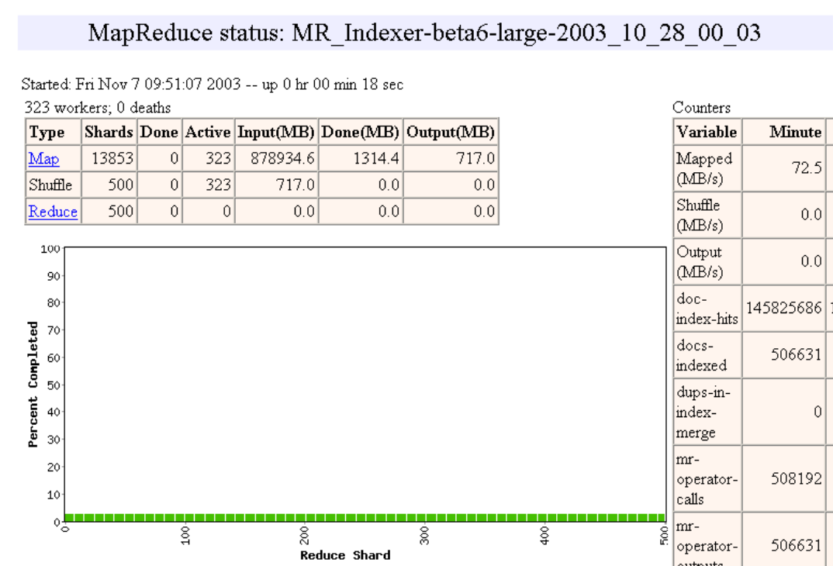

Slide 27
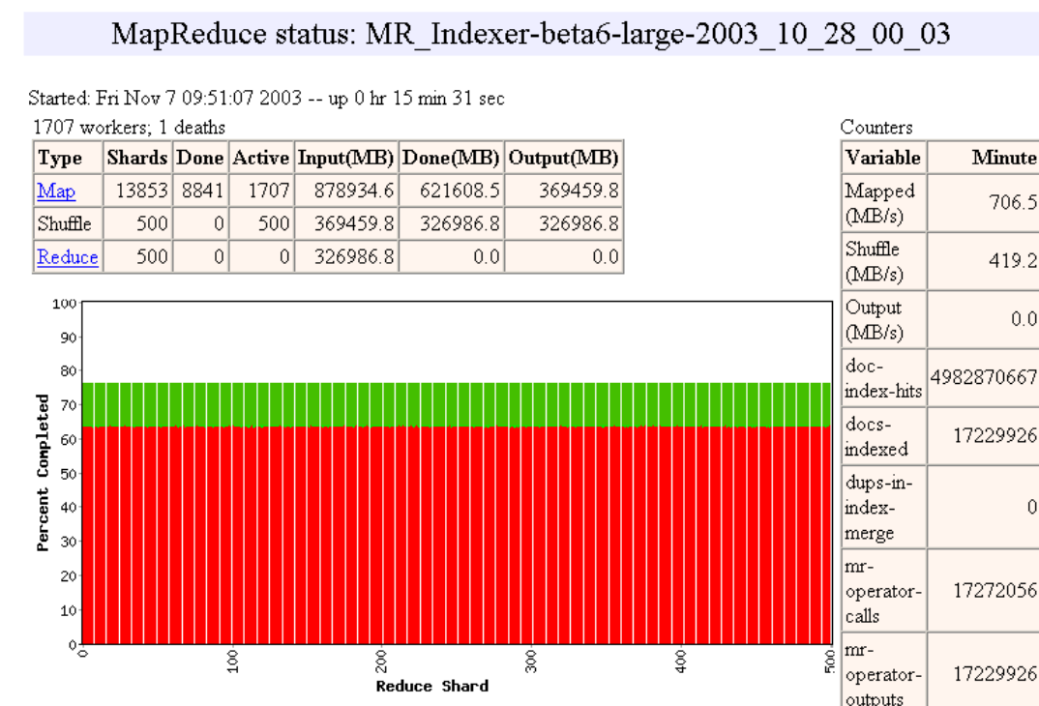

Slide 28
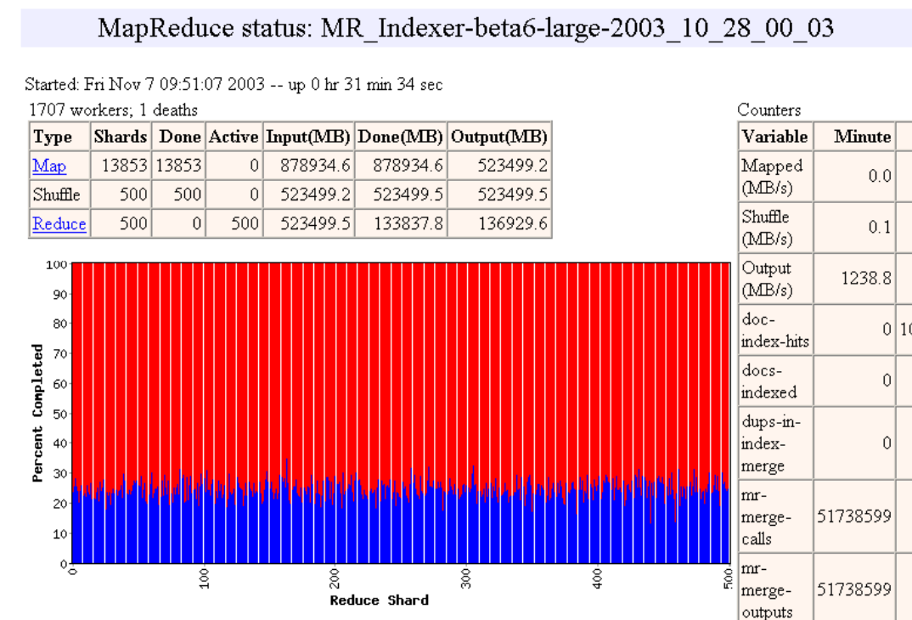

Slide 29
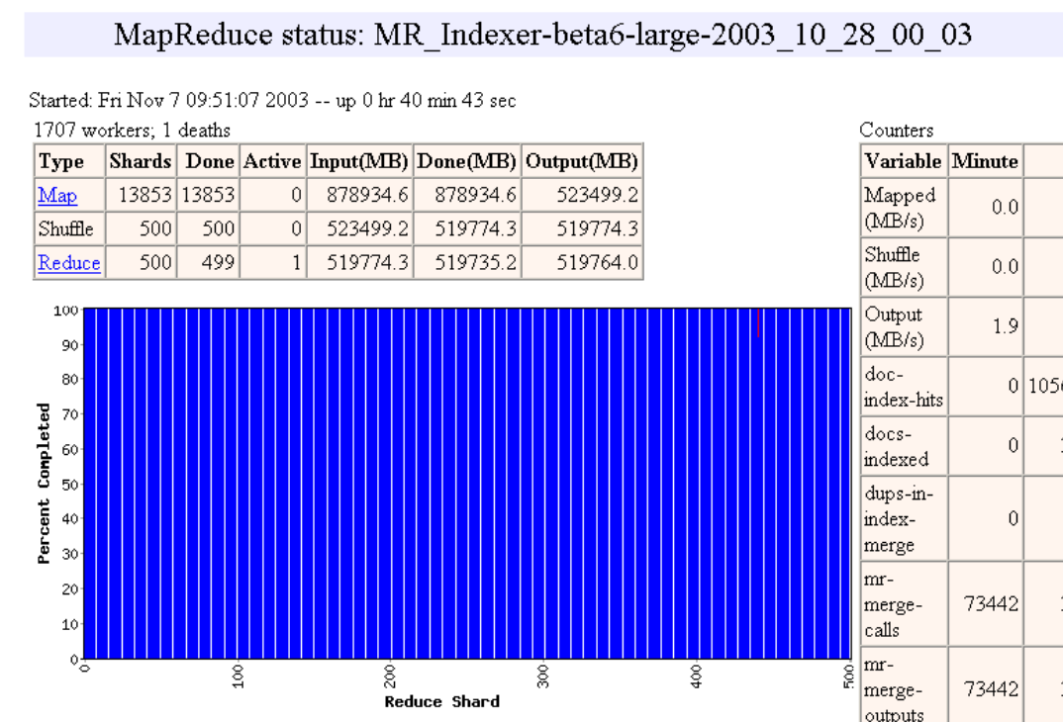

Slide 30
Reverse Web-Link Graph
Map
For each URL linking to target, …
Output <target, source> pairs
Reduce
Concatenate list of all source URLs
Outputs: <target, list (source)> pairs

Slide 31
Amazon’s Elastic MapReduce

Slide 32
Amazon Web Services
Elastic Computing (EC2)
Amazon Simple Storage Service (S3)
Elastic MapReduce (EMR)
…
Mechanical Turk!

Slide 33
Signing up for AWS
Create an AWS account – http://aws.amazon.com
Sign up for EC2 cloud computing services http://aws.amazon.com/ec2/
Set up Security Credentials (under menu Account → Security Credentials)
Sign up for S3 storage services: http://aws.amazon.com/s3/
Sign up for Elastic MapReduce: http://aws.amazon.com/elasticmapreduce/
Notes:
Don’t sign up for AWS support

Slide 34
S3 buckets
Streaming EMR projects use Simple Storage Service (S3) Buckets for data, code, logging and output.
Bucket
“A bucket is a container for objects stored in Amazon S3. Every object is contained in a bucket.” Bucket names must be globally unique.
Object
“Entities stored in Amazon S3. Objects consist of object data and metadata.” Metadata consists of key-value pairs. Object data is opaque.
Objects Keys
“An object is uniquely identified within a bucket by a key (name) and a version ID.”

Slide 35
Accessing objects in S3
Want to:
Move data into and out of S3 buckets
Set access privileges
Tools:
S3 console in your AWS control panel is adequate for managing S3 buckets and objects one at a time
Other browser options: good for multiple file upload/download - Firefox S3 https://addons.mozilla.org/en-US/firefox/addon/3247/ ; or minimal - S3 plug-in for Chrome https://chrome.google.com/ extensions/detail/appeggcmoaojledegaonmdaakfhjhchf
Programmatic options: Web Services (both SOAP-y and REST-ful): wget, curl, Python, Ruby, Java . . .

Slide 36
Getting S3 data with Python
from boto.s3.connection import S3Connection
conn = S3Connection(’key-id’, ’secret-key’)
bucket = conn.get_bucket(’bsi-test’)
k = bucket.get_key(’image.jpg’)
print "Value for key ’x-amz-meta-s3fox-modifiedtime’ is:"
print k.get_metadata(’s3fox-modifiedtime’) k.get_contents_to_filename(’deleteme.jpg’)
k = bucket.get_key(’foobar’)
print "Object value for key ’foobar’ is:" print k.get_contents_as_string()
print "Value for key ’x-amz-meta-example-key’ is:"
print k.get_metadata(’example-key’)

Slide 37
Getting S3 data with Python
$ ./botoExample.py
Value for key ’x-amz-meta-s3fox-modifiedtime’ is: 1273869756000
Object value for key ’foobar’ is:
This is a test of S3
Value for key ’x-amz-meta-example-key’ is:
This is an example value.

Slide 38
Elastic MapReduce
Hadoop
Hosted Hadoop framework running on EC2 and S3.
Job Flow
Processing steps EMR “runs on a specified dataset using a set of Amazon EC2 instances.”
S3 Bucket(s)
Input data, output, scripts, jars, logs.

Slide 39
Controlling Job Flows
Want to:
Configure jobs
Start jobs
Check status or stop jobs
Tools:
AWS Management Console
https://console.aws.amazon.com/elasticmapreduce/home
Command Line Tools (requires Ruby [sudo apt-get install ruby libopenssl-ruby])
http://developer.amazonwebservices.com/connect/entry. jspa?externalID=2264&categoryID=262
API calls defined by the service (REST-ful and SOAP-y)

Slide 40
Public Datasets
http://aws.amazon.com/datasets

