Slide 1


UNIVERSITY INSTITUTE OF ENGINEERING AND TECHNOLOGY, CHHATRAPATI SHAHU JI MAHARAJ UNIVERSITY CAMPUS, KANPUR
MEDI-AI: Intelligent Disease Prediction and Medicine Recommendation & Health Blogging System
Major Project (MCA 4061)
Master of Computer Applications
Submitted By: Shobhit Shukla
Roll No.: 31222391644
Group No.:59
Under the Supervision of Dr. Mamta Tiwari | Assistant Professor
Mr. Arpit Dubey | Assistant Professor
Department of Computer Application School of Engineering & Technology (UIET)

Slide 2
Introduction
Problem Statement:
Lack of accessible, timely healthcare in rural/remote areas.
Delayed medical consultations lead to worsened conditions.
Solution: MEDI-AI: AI-powered web platform for symptom-based disease prediction, medicine recommendations, and health blogging.
Key Features:
SVM-based disease prediction.
Personalized advice on:
Medications
Precautions
Workouts
Diet plans
Interactive health blogging community
Goal: Leverage AI to improve accessibility and preventive healthcare.

Slide 3
Objectives
Disease Prediction System:
AI/ML-based system to predict diseases based on symptoms.
Lifestyle Recommendations:
Personalized advice on precautions, workouts, and diets.
User-Friendly Interface:
Intuitive UI for seamless interaction and symptom input.
Reliable AI Models:
High accuracy using robust machine learning models.
Promote Preventive Care:
Encourage early diagnosis and actionable healthcare advice.
Health Blogging Platform:
High accuracy using robust machine learning models.

Slide 4
Methodology
Symptom Collection:
User inputs symptoms via Check Box.
Data Preprocessing:
Symptom validation and standardization.
Disease Prediction:
SVM-based model predicts disease with high accuracy.
Recommendation Generation:
Tailored advice: medications, diets, workouts, and precautions.
User Results Display:
Interactive, categorized output (easy-to-understand).

Slide 5
Technology Stack
Hardware Requirements:
Intel i3+, 4GB RAM, 10GB storage
Software Requirements:
OS: Windows/macOS/Linux
Programming: Python, HTML, CSS, Bootstrap
Framework: Flask
Libraries:
Scikit-learn (ML models)
Pandas, NumPy (Data processing)
Streamlit/Flask (UI).
Tools Used: VS Code, Jupyter Notebook, Google Colab.

Slide 6
Key Module
User Management: Secure registration/login (password hashing).
Symptom Checker: Multi-select symptoms → AI prediction.
Recommendations: Dynamically fetched from datasets.
Blogging System: CRUD operations, comments, reactions.

Slide 7
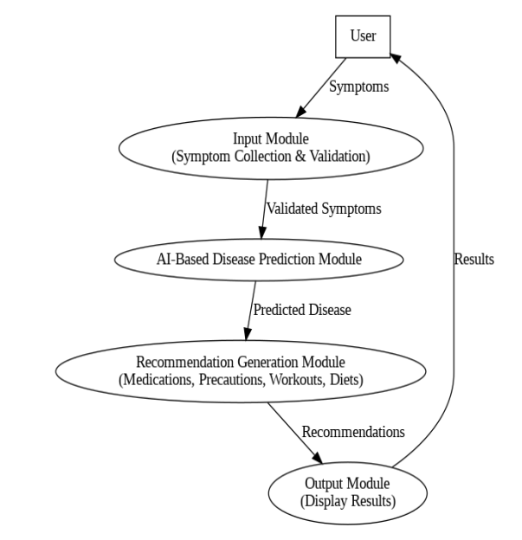
Use Case Diagram
Actors: User
Functions: Input symptoms, Predict disease, Generate advice, View results.

Slide 8
Testing Methodology
Unit Testing: Tested individual modules.
System Testing: Ensured smooth integration of all modules.
User Acceptance Testing (UAT): Real-world symptom inputs verified accuracy and usability.
Deployment & Maintenance
Deployment:
Platform: Flask-based web server (Heroku, AWS).
Runs locally or on lightweight servers.
Maintenance:
Bug fixes for new symptoms.
Enhancements:
Improve AI model with larger datasets.
Periodic recommendation updates based on user feedback.

Slide 9
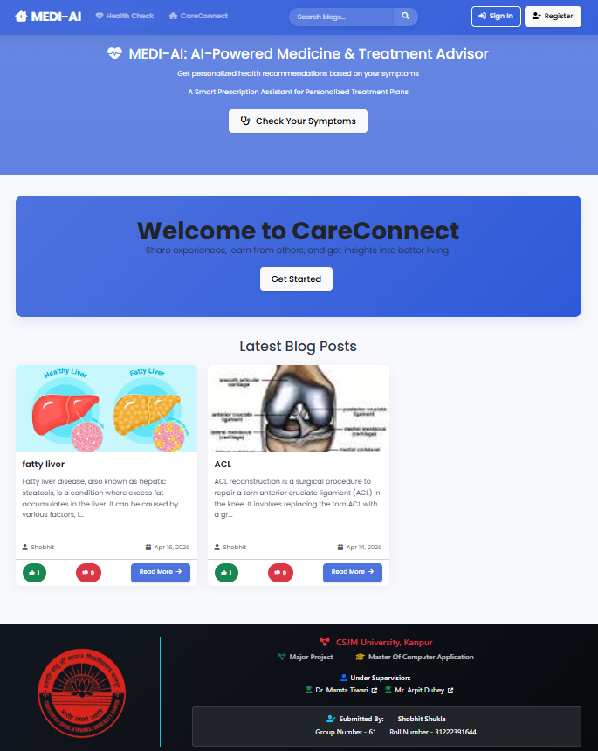
Screensots
Homepage (symptom checker + blog preview).

Slide 10
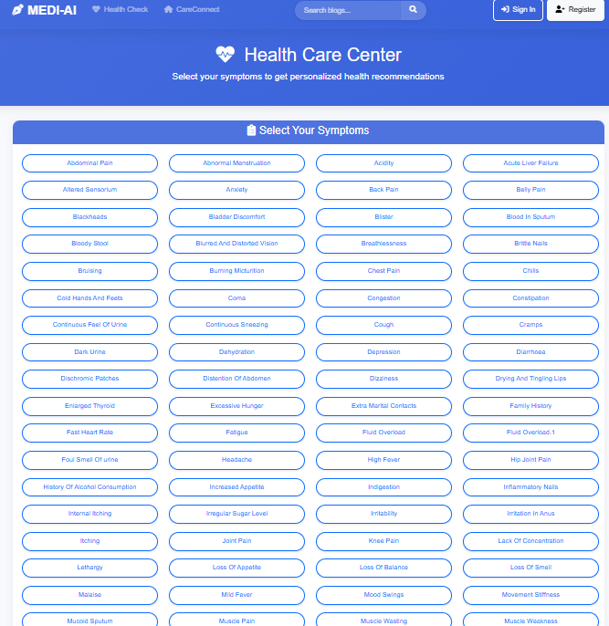
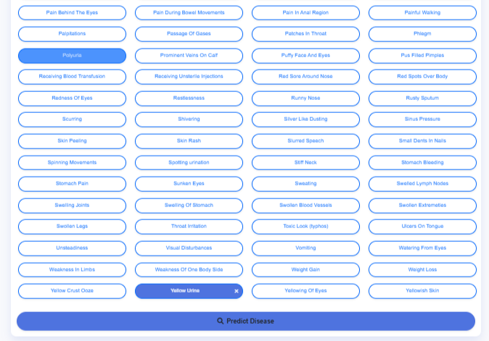
Screensots
Symptom selection interface

Slide 11
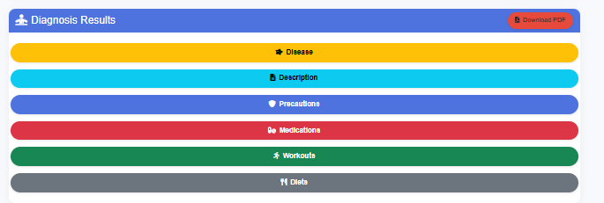
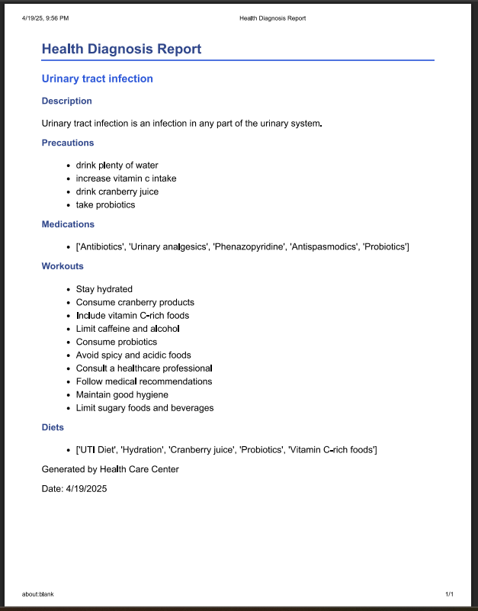
Screensots
Diagnosis Results And Report (For Download)

Slide 12
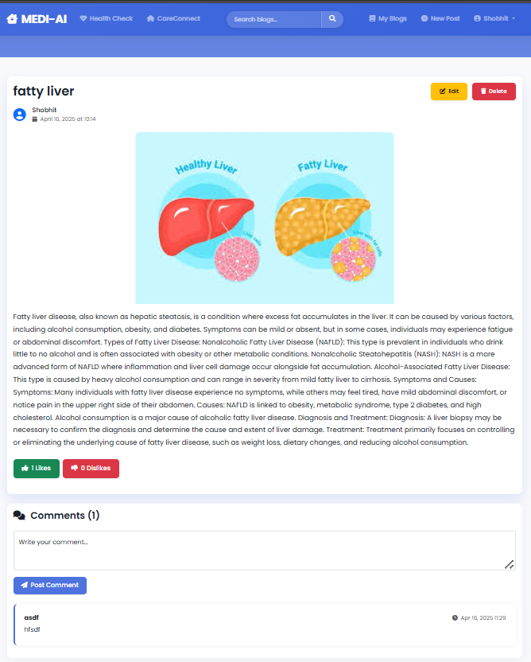
Screensots
Full Article

Slide 13
Applications & Advantages
Applications:
Healthcare assistance for early diagnosis.
Educational tool for symptom understanding.
Fitness & wellness promotion.
Advantages:
Quick and cost-effective healthcare insights.
Promotes healthier living through personalized advice.
Scalable for broader use.
Time-saving solution for common health concerns.
Community-Driven.

Slide 14
Conclusion
Achievements:
AI-driven system predicts diseases and provides personalized recommendations.
User-friendly and accessible design.
Promotes early diagnosis and preventive healthcare.
Results:
Accurate predictions and actionable advice.
Positive user feedback on usability.
Interactive Health care community.
Future Scope:
Integrate real-time APIs for live health data.
Expand dataset for broader disease prediction.

Slide 15
Thank You

