Slide 1
PwC Power BI Internship Program
Power BI
Dashboard Portfolio
Three interactive dashboards analyzing Call Centre Operations,
Customer Churn, and Workforce Diversity & Inclusion
Call Centre
Customer Churn
Diversity & Inclusion
Shobhita Sohal | Data & BI Analyst

Slide 2
What's Inside
Three Power BI dashboards | One internship program | Real business impact
01
Call Centre Performance
5,000 calls analyzed across agents, topics & time periods to uncover service gaps and staffing opportunities
02
Customer Churn Analysis
$1.7M revenue at risk — segmenting 7,000+ customers to identify who is churning, why, and how to retain them
03
Diversity & Inclusion
Workforce equity analysis across hiring, promotions, turnover & performance — by gender, level, and department

Slide 3
Dashboard 01
Call Centre
Performance
Identifying service gaps, staffing bottlenecks, and agent performance across 5,000 customer calls
5,000
81%
90%
Total Calls
Answer Rate
Resolution Rate

Slide 4
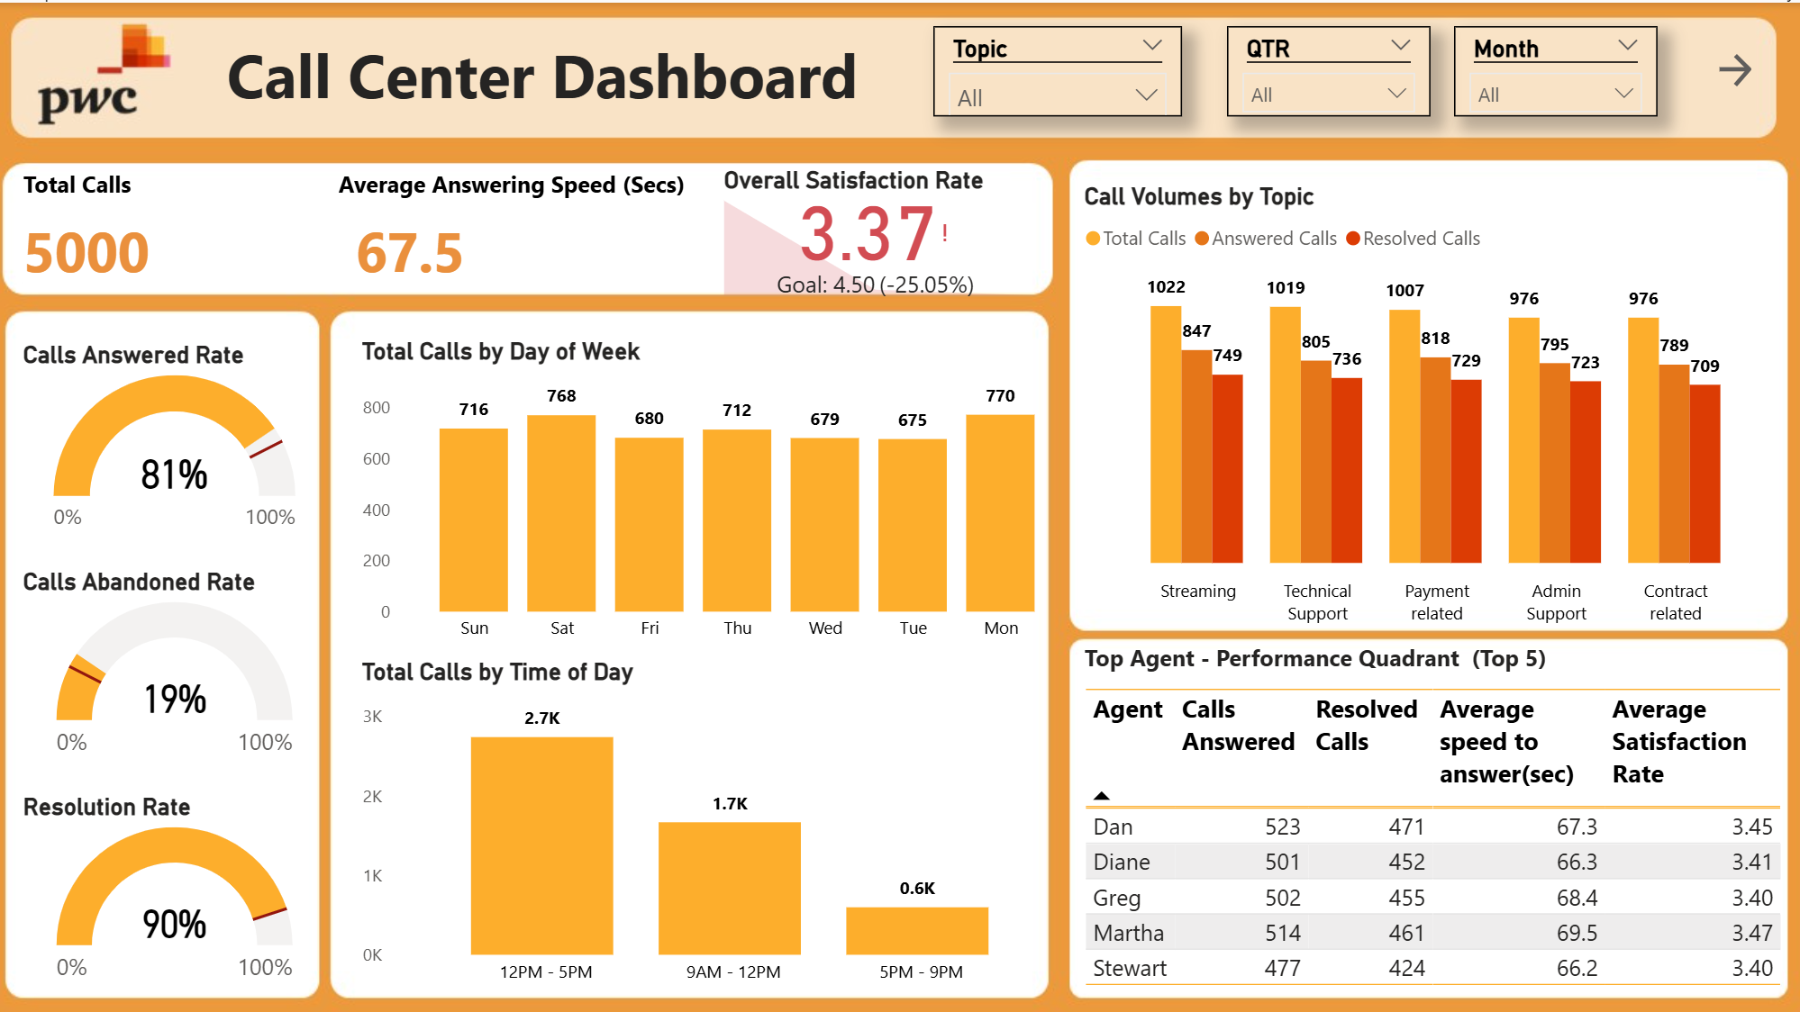
Dashboard Preview
Call Centre Performance Dashboard

Slide 5
Business Problem
Call Centre Performance Dashboard
A telecom call centre managing 5,000 monthly customer interactions had no centralized view of agent performance, call resolution rates, or demand patterns — making it impossible to optimize staffing, identify service gaps, or improve customer satisfaction, which was tracking 25% below the target of 4.50.
📉
👥
📅
Satisfaction Gap
No Agent Visibility
No Demand Patterns
3.37 actual vs 4.50 target — 25% below goal with no diagnostic data
No way to compare agent performance or identify coaching needs
Staffing decisions made without insight into call volume peaks

Slide 6
Solution
Call Centre Performance Dashboard
1
Data Connection & Modelling
Connected raw call centre data and built relationships between agent, call, and time dimension tables
2
DAX Measures
Engineered KPIs: Avg Answering Speed, Calls Answered Rate, Resolution Rate, Overall Satisfaction Score, Abandoned Rate
3
Interactive Dashboard
Built KPI cards, day/time bar charts, and call volume by topic — with Topic, Quarter, and Month slicers
4
Agent Performance Quadrant
Ranked Top 5 agents across calls answered, resolved calls, speed to answer, and satisfaction rating

Slide 7
Business Outcome
Call Centre Performance Dashboard
3.37
19%
12PM–5PM
vs 4.50 target
peak in February
2,700 calls
Satisfaction Score
Abandoned Call Rate
Peak Demand Period
Key Recommendations
Streaming services and payment inquiries had the highest unresolved call volume — targeted agent coaching recommended
Weekends busier for payment and contract calls; streaming spikes on Thursdays — enabling smarter scheduling
Weekly coaching sessions recommended for all agents until satisfaction targets are consistently met

Slide 8
Dashboard 02
Customer Churn
Analysis
Understanding who is leaving, why, and how to retain them before it's too late
1,869
26.5%
$1.7M
Customers Churned
Churn Rate
Annual Revenue Lost

Slide 9
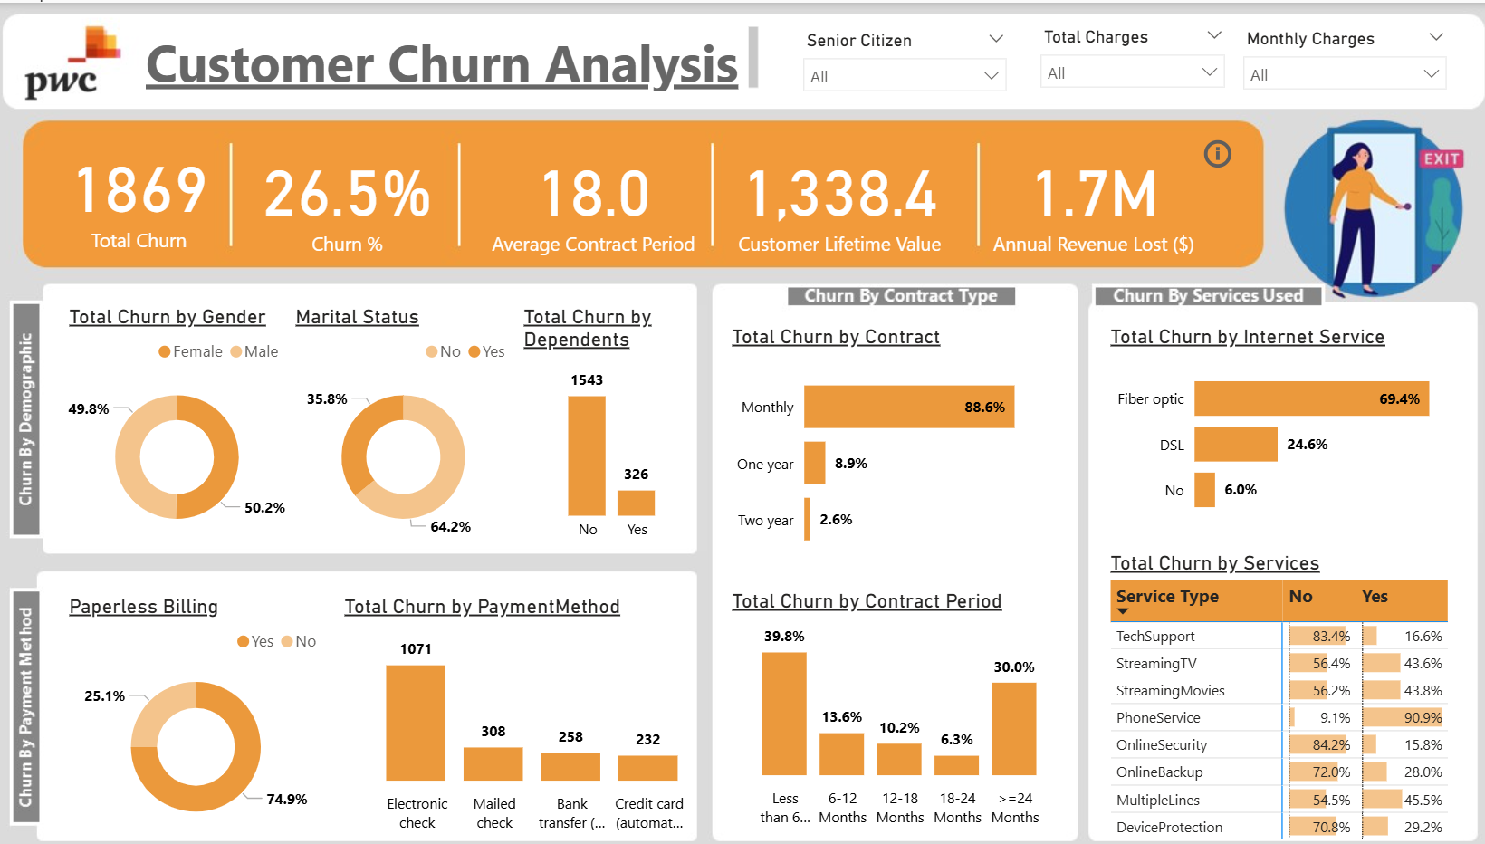
Dashboard Preview
Customer Churn Analysis Dashboard

Slide 10
Business Problem
Customer Churn Analysis Dashboard
A telecom company was losing 1,869 customers (26.5% churn rate), resulting in $1.7M in annual revenue loss, with no structured analysis of who was churning, why they were leaving, or which segments were most at risk — making proactive retention impossible.
💸
❓
🚨
Revenue Blindspot
No Churn Profile
Reactive Retention
$1.7M annual loss with no segment-level attribution to guide where to act
No data on who was churning — by contract, service, demographics, or tenure
No early warning system — the business could only react after customers had already left

Slide 11
Solution
Customer Churn Analysis Dashboard
1
Data Preparation
Imported and cleaned 7,000+ customer records across demographics, contracts, services, and payment behaviour
2
DAX Measures
Built measures for Total Churn, Churn %, Customer Lifetime Value, Annual Revenue Lost, and Churn by Segment
3
Segmentation Dashboard
Created multi-dimensional visuals segmenting churn by gender, contract type, internet service, payment method, and tenure
4
Insight & Recommendations
Identified highest-risk customer profiles and delivered targeted retention recommendations for each key segment

Slide 12
Business Outcome
Customer Churn Analysis Dashboard
88.6%
41.7%
69.4%
of churn
churn rate
of churn
Month-to-Month Contracts
Senior Citizens
Fiber Optic Customers
Key Recommendations
39.8% of customers churn within the first 6 months — early onboarding identified as the highest-impact retention lever
83.4% of churning customers never used technical support — proactive outreach recommended to improve engagement
Proactive outreach recommended at 3-month and 24-month milestones with exclusive cost-saving retention offers

Slide 13
Dashboard 03
Diversity &
Inclusion
Analyzing gender equity across hiring, promotions, turnover and performance to surface where progress is stalling
59% / 41%
9%
10%
Male / Female Split
Overall Turnover
Promoted FY21

Slide 14
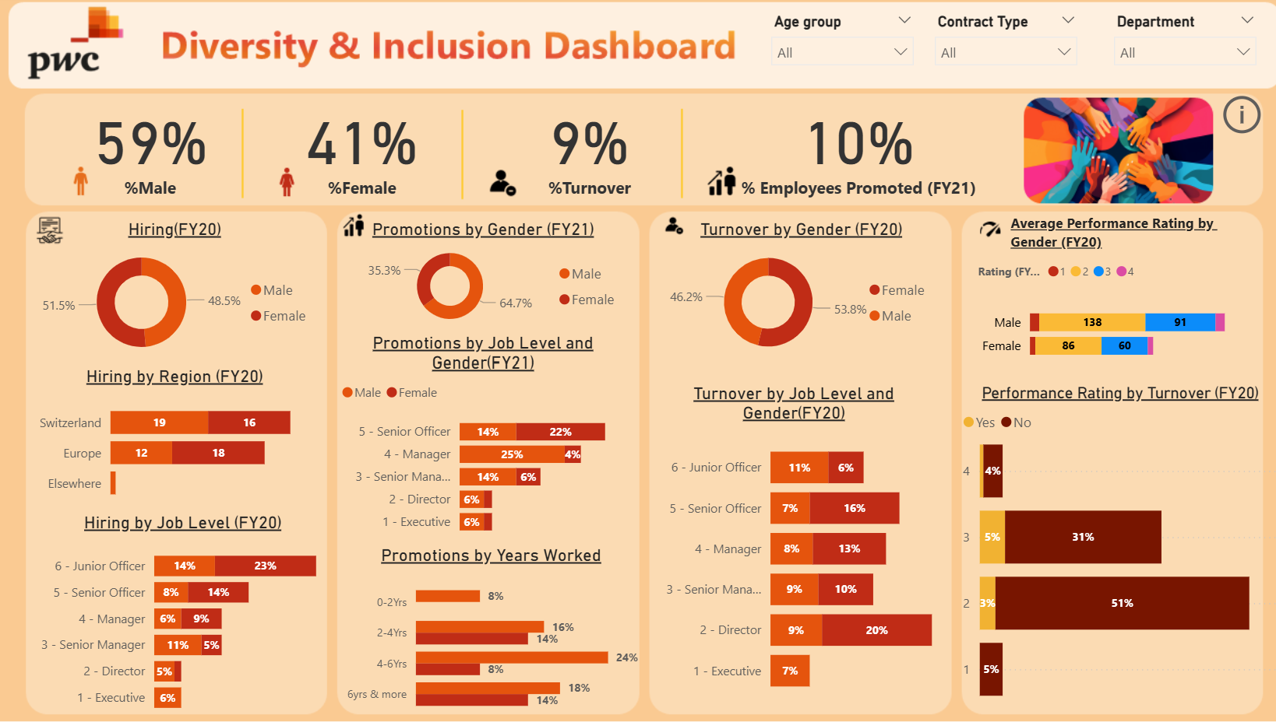
Dashboard Preview
Diversity & Inclusion Dashboard

Slide 15
Business Problem
Diversity & Inclusion Dashboard
An organization struggling with gender imbalance at the executive level had no data infrastructure to understand where diversity gaps were occurring across hiring, promotions, and turnover — or why progress toward gender balance targets was stalling despite stated organizational commitments.
⚖️
📊
🚪
No Equity Data
Promotion Gap Unknown
Turnover Blindspot
No centralized view of gender representation across job levels, departments, or regions
No analysis of whether men and women were being promoted at the same rate or point in tenure
No visibility into whether women were leaving at higher rates and at which level in the organization

Slide 16
Solution
Diversity & Inclusion Dashboard
1
Data Preparation
Imported HR data covering FY20 hiring, FY21 promotions, FY20 turnover, and performance ratings across all departments
2
DAX Measures
Built KPIs: % Male/Female, % Promoted, % Turnover by Gender, Avg Performance Rating, Promotion Rate by Job Level
3
Multi-Dimensional Dashboard
Segmented all metrics by gender, job level, department, age group, contract type, and tenure for root cause analysis
4
Equity Gap Analysis
Identified where in the talent pipeline gender gaps widened and which departments carried the highest equity risk

Slide 17
Business Outcome
Diversity & Inclusion Dashboard
64.7%
100%
50%
promotions to men
female turnover
female turnover
FY21 Promotion Gap
Executive Part-Time Roles
Director Level (Operations)
Key Recommendations
Finance department has the highest overall turnover (11%) — understanding attrition drivers is critical to retention strategy
56% of employees received a performance rating of 2 — mentorship and leadership development programs recommended
Unconscious bias training and structured career development programs recommended to address female leadership attrition

Slide 18
Tools & Skills Demonstrated
Power BI
Data Modelling · DAX Measures · KPI Cards · Dynamic Slicers · Drill-through · Interactive Filtering
Analytics
Customer Segmentation · Churn Analysis · Workforce Analytics · KPI Development · Trend Analysis
Communication
Data Storytelling · Executive Reporting · Insight Generation · Business Recommendations
Shobhita Sohal
Data & Business Intelligence Analyst
shobhita.sohal@gmail.com | linkedin.com/in/shobhitasohal | shobhitasohal.carrd.co

