Slide 1
Retail Mart Analytics
Advanced SQL
+ Power BI
A 4-phase SQL analytics pipeline across 17,975 customers,
219 products & $29.3M in revenue — powered by Power BI
Phase 1: EDA
Phase 2: KPIs
Phase 3: Analytics
Phase 4: Views
Shobhita Sohal | Data & BI Analyst

Slide 2
Project Overview
Business Context · Objective · Approach
💼 Business Context
A retail business with 3 years of sales data (2011–2013) had no structured analytics to monitor revenue trends, understand customer behaviour, or evaluate product performance across 3 categories — Bikes, Accessories, and Clothing.
🎯 Objective
Build a structured 4-phase SQL analytics pipeline and a 3-page Power BI dashboard to answer: Who are our customers? What products drive revenue? Is the business growing?
1
2
3
4
Phase 1
Phase 2
Phase 3
Phase 4
EDA
KPIs
Advanced Analytics
SQL Views
Validate data quality, check nulls, confirm date range & orphan records
Revenue, YoY growth, moving average & category share calculations
Product vs. average, customer segmentation & cost tiers
5 optimized views as single source of truth for Power BI

Slide 3
Phase 01
Exploratory
Data Analysis
Validate data shape, quality, date ranges, and referential integrity across all 3 tables

Slide 4
Phase 1 — EDA
Data Shape & Quality Checks
Phase_1_-_EDA.sql
Key Concepts
-- Phase 1: EDA — Understand shape, quality & range
SELECT COUNT(*) AS sales_rows FROM [gold].[fact_sales];
SELECT COUNT(*) AS customer_rows FROM [gold].[dim_customers];
SELECT COUNT(*) AS product_rows FROM [gold].[dim_products];
-- Date range & active trading days
SELECT MIN(order_date) AS earliest,
MAX(order_date) AS latest,
COUNT(DISTINCT order_date) AS active_days
FROM [gold].[fact_sales];
-- Data quality check (nulls & orphans)
SELECT
SUM(CASE WHEN sales_amount IS NULL THEN 1 ELSE 0 END) AS null_sales,
SUM(CASE WHEN c.customer_key IS NULL THEN 1 ELSE 0 END) AS orphan_cust,
SUM(CASE WHEN p.product_key IS NULL THEN 1 ELSE 0 END) AS orphan_prod
FROM [gold].[fact_sales] s
LEFT JOIN [gold].[dim_customers] c ON s.customer_key = c.customer_key
LEFT JOIN [gold].[dim_products] p ON s.product_key = p.product_key;
Row Counts
Validated 60K+ sales rows, 18K customers, 293 products
Date Range
Confirmed 2011–2013 as analysis window; excluded incomplete 2010 & 2014
Null Check
17 missing DOB records in customer table — flagged for downstream handling
Orphan Check
LEFT JOIN verified all sales rows join cleanly to customers & products
Data Copy
Working copy created to protect source data from transformation

Slide 5
Phase 02
KPI
Calculations
Revenue, YoY growth, 3-month moving average & category revenue share

Slide 6
Phase 2 — KPI Calculations
Revenue, Growth & Moving Average
Phase_2_-_KPIs_Calculations.sql
Key Concepts
-- Phase 2: KPIs — Revenue, YoY Growth & Moving Average
-- Annual KPIs
SELECT YEAR(order_date) AS yr,
COUNT(DISTINCT order_number) AS total_orders,
SUM(sales_amount) AS total_revenue,
AVG(sales_amount) AS avg_order_value
FROM gold.fact_sales
GROUP BY YEAR(order_date);
-- YoY Revenue Growth using LAG()
WITH yearly AS (
SELECT YEAR(order_date) AS yr,
SUM(sales_amount) AS revenue
FROM gold.fact_sales GROUP BY YEAR(order_date)
)
SELECT yr, revenue,
LAG(revenue) OVER (ORDER BY yr) AS prev_yr_rev,
ROUND((revenue - LAG(revenue) OVER (ORDER BY yr))
* 100.0 / NULLIF(LAG(revenue) OVER (ORDER BY yr),0),2)
AS yoy_growth_pct
FROM yearly WHERE yr BETWEEN 2011 AND 2013;
Annual KPIs
Total revenue, orders, units sold, avg order value & revenue per customer by year
YoY Growth
LAG() window function computes prior year revenue for % change calculation
Moving Avg
3-month rolling average using ROWS BETWEEN 2 PRECEDING AND CURRENT ROW
Category Share
SUM() OVER (PARTITION BY yr) calculates each category's % of annual total
Result
Revenue grew 179.5% from 2012 → 2013 ($5.8M → $16.3M)

Slide 7
Phase 03
Advanced
Analytics
Product performance benchmarking, customer segmentation & cost tier classification

Slide 8
Phase 3 — Advanced Analytics
Product Performance & Customer Segmentation
Phase_3_-_Advanced_Analytics.sql
Key Concepts
-- Phase 3: Advanced Analytics
-- Product Performance vs Category Average
WITH product_sales AS (
SELECT YEAR(f.order_date) AS yr, p.category,
p.product_name, p.cost,
SUM(f.sales_amount) AS total_revenue,
COUNT(DISTINCT f.order_number) AS total_orders
FROM [gold].[fact_sales] f
JOIN [gold].[dim_products] p ON f.product_key = p.product_key
GROUP BY YEAR(f.order_date), p.product_name, p.category, p.cost
)
SELECT *,
AVG(total_revenue) OVER (PARTITION BY yr, category)
AS category_avg_revenue,
CASE
WHEN total_revenue > AVG(total_revenue)
OVER (PARTITION BY yr, category) THEN 'Above Average'
WHEN total_revenue < AVG(total_revenue)
OVER (PARTITION BY yr, category) THEN 'Below Average'
ELSE 'Average'
END AS performance_tag
FROM product_sales;
Product vs Avg
AVG() OVER(PARTITION BY yr, category) benchmarks each product against its category
Performance Tag
CASE labels each product: Above Average, Below Average, or Average
Age Segments
DATEDIFF() groups 17,975 customers into Under 30, 30-44, 45-59, 60+
Customer Status
4 statuses: Active, Churned, One-Time Buyer, Churned One-Time
Cost Tiers
Products classified into Low (<$100), Mid, High, Premium (≥$1,500) segments

Slide 9
Phase 04
SQL Views
for Power BI
5 optimized views as a single source of truth — eliminating ad hoc CSV exports

Slide 10
Phase 4 — SQL Views
Single Source of Truth for Power BI
Phase_4_-_Views.sql
Key Concepts
-- Phase 4: SQL Views — Single Source of Truth for Power BI
-- Customer Segmentation View
CREATE OR ALTER VIEW customer_segmentation AS
WITH aggregated AS (
SELECT customer_key,
SUM(sales_amount) AS total_spend,
COUNT(DISTINCT order_number) AS total_orders,
MAX(order_date) AS last_purchase_date
FROM [gold].[fact_sales]
GROUP BY customer_key
)
SELECT c.first_name, c.last_name, c.gender,
DATEDIFF(year, c.birthdate, '2013-12-31') AS age,
CASE
WHEN DATEDIFF(year,c.birthdate,'2013-12-31') < 30 THEN 'Under 30'
WHEN DATEDIFF(year,c.birthdate,'2013-12-31') < 45 THEN '30-44'
WHEN DATEDIFF(year,c.birthdate,'2013-12-31') < 60 THEN '45-59'
ELSE '60+'
END AS age_group,
f.total_spend, f.total_orders,
CASE
WHEN f.total_orders = 1
AND DATEDIFF(month, f.last_purchase_date,'2013-12-31') >= 10
THEN 'Churned One-Time'
WHEN f.total_orders = 1 THEN 'One-Time Buyer'
WHEN DATEDIFF(month, f.last_purchase_date,'2013-12-31') >= 10
THEN 'Churned'
ELSE 'Active'
END AS customer_status
FROM [gold].[dim_customers] c
JOIN aggregated f ON c.customer_key = f.customer_key;
product_performance
Product revenue vs category avg with Above/Below Average tag
customer_segmentation
Full customer profile — age group, spend, orders, status
revenue_monthly
Monthly revenue with cumulative totals & 3-month moving avg
category_annual
Category revenue share %, YoY change & growth % by year
product_cost_segment
Cumulative portfolio growth by cost tier (Low → Premium)

Slide 11
Power BI Dashboard
3-Page Interactive
Dashboard
SQL Views → Power BI data model → Executive-ready visuals
across Revenue, Customers & Product Performance
Page 1
Page 2
Page 3
Executive Overview
Customer Analysis
Product Performance

Slide 12
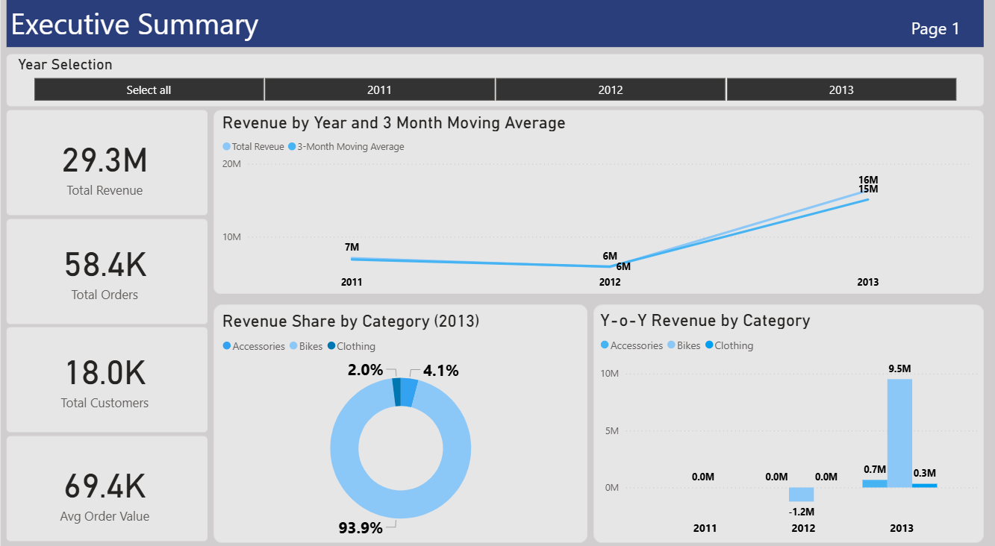
Power BI — Page 1
Executive Overview
Key Insights
$29.3M Revenue
Total revenue across 2011–2013 with 3-month moving average trend
58.4K Orders
Total orders processed across all customers and categories
Bikes Dominate
93.9% of 2013 revenue — Road Bikes lead at $14.5M
179% Growth
Revenue grew from $5.8M (2012) to $16.3M (2013)
YoY by Category
Accessories & Clothing emerged as new revenue streams in 2013

Slide 13
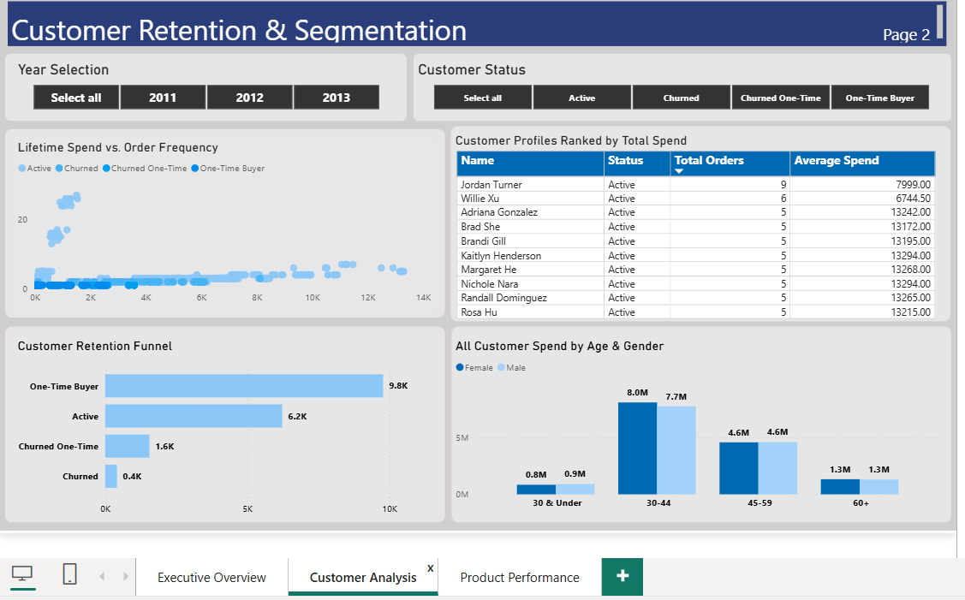
Power BI — Page 2
Customer Retention & Segmentation
Key Insights
54.4% One-Time
9,778 customers purchased only once — top retention opportunity
6,228 Active
Repeat buyers driving consistent revenue — priority for loyalty programs
Age 30–44 Leads
$15.7M combined spend — primary demographic for marketing investment
1,969 Churned
Win-back campaign candidates flagged with last purchase date
Spend vs Frequency
Scatter plot maps lifetime spend against order count by status

Slide 14
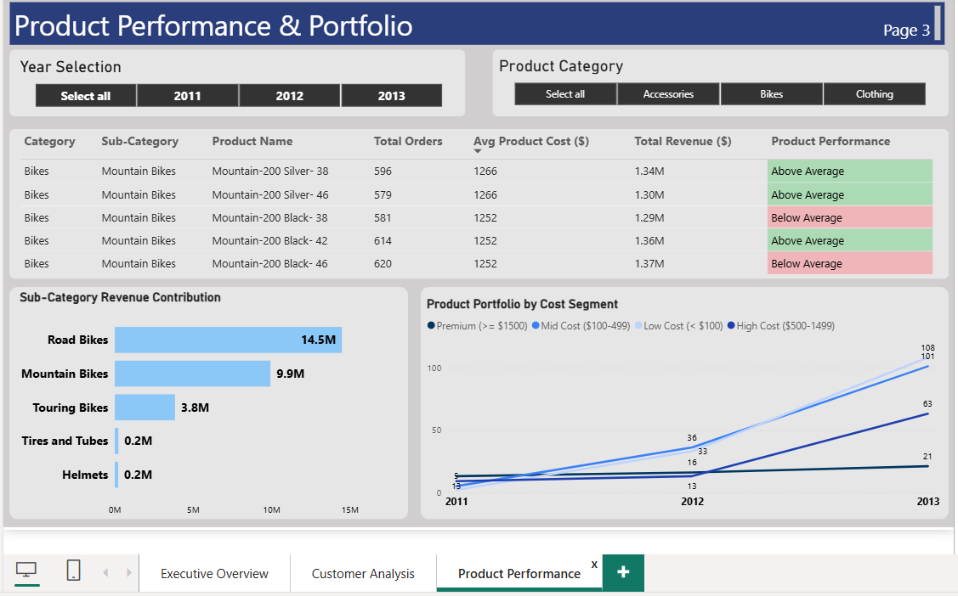
Power BI — Page 3
Product Performance & Portfolio
Key Insights
76 Above Average
Products beating their category avg — shortlist for upsell focus
143 Below Average
Candidates for pricing review, bundling, or portfolio rationalization
Road Bikes #1
$14.5M sub-category revenue — clear market leader
Premium Growing
Portfolio grew from 13 to 63 premium products (2011–2013)
Cost Tiers
4 segments tracked: Low, Mid, High, Premium (≥$1,500)

Slide 15
Key Findings & Business Outcome
Insights that drive decisions across Revenue, Customers & Products
💰
🚲
🔴
Revenue
Category
Retention
$29.3M
93.9%
54.4%
Total revenue tracked across 58,400 orders — grew 179.5% from 2012 to 2013
Bikes drove 93.9% of 2013 revenue ($15.4M); Road Bikes alone contributed $14.5M
9,778 customers (54.4%) are one-time buyers — biggest single retention opportunity
👥
⬆️
📊
Demographics
Products
SQL Views
30–44
76
5
Age group 30–44 generated $15.7M — primary target for loyalty and marketing
76 products tagged Above Average; Premium portfolio grew from 13 → 63 items
5 optimized SQL views power all 3 Power BI dashboard pages — single source of truth

Slide 16
Tools & Skills Demonstrated
SQL (4 Phases)
CTEs · Window Functions (LAG, RANK, AVG OVER) · Self-JOIN · CASE · Date Functions · SQL Views
Analytics
EDA · KPI Development · YoY Analysis · Customer Segmentation · Product Benchmarking · Cost Segmentation
Power BI
Data Modelling · DAX Measures · 3-Page Dashboard · Interactive Slicers · Executive Reporting
Shobhita Sohal
Data & Business Intelligence Analyst
shobhita.sohal@gmail.com | linkedin.com/in/shobhitasohal | shobhitasohal.carrd.co

