Slide 1
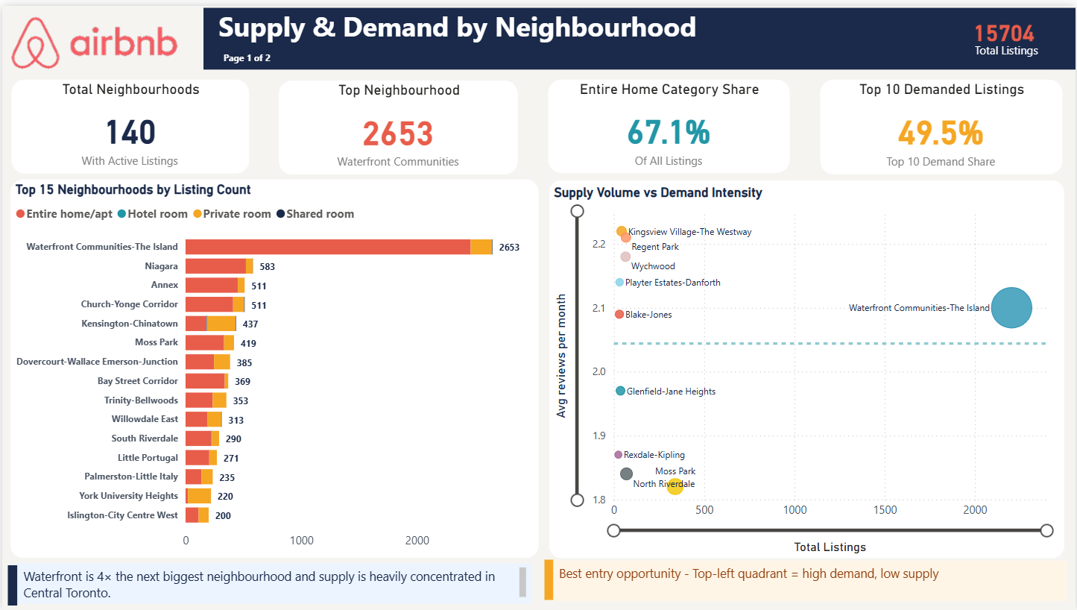
Supply & Demand by Neighbourhood
Toronto Short-Term Rental Market · Page 1 of 2
Key Insights
Demand is heavily concentrated in central Toronto
The top 10 neighbourhoods account for 49.5% of all booking activity despite there being 140 neighbourhoods across the city.
Waterfront Communities dominates supply
Holds 2,653 listings — nearly 4× the next largest neighbourhood (Niagara at 583) — representing ~17% of all citywide listings alone.
High-demand, low-supply pockets identified
Kingsview Village, Regent Park, Wychwood, Playter Estates-Danforth and Blake-Jones show 2.1–2.2 avg reviews/month with very few listings.
Entire home/apt is the dominant product type
67.1% of all listings are entire home/apartment — the highest-value room type and the right product for a property management operator.
Recommendation
Prioritise high-demand, low-supply neighbourhoods in the top-left quadrant of the bubble chart — best return on new inventory with the least competition.

Slide 2
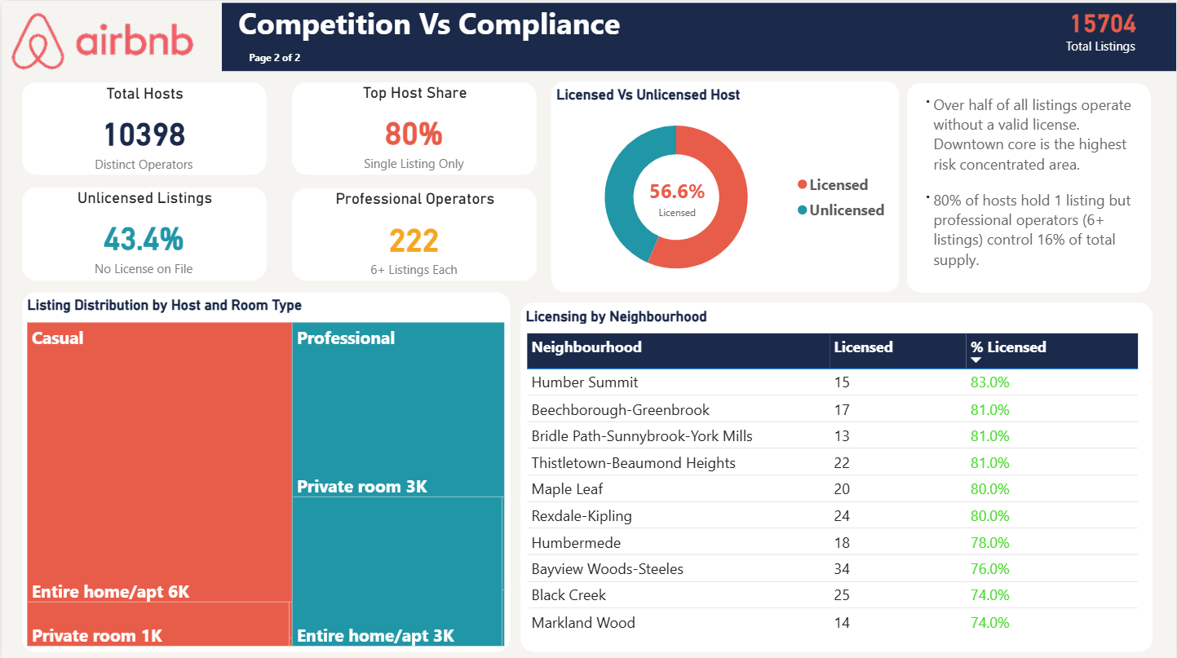
Competition & Compliance
Toronto Short-Term Rental Market · Page 2 of 2
Key Insights
Market is dominated by casual individual hosts
80% of all 10,398 hosts hold just one listing — most of the market is individual casual hosts, not organised professional operators.
Professional operators are few but control significant supply
Only 222 hosts (2.1%) run 6+ listings, yet collectively control ~16% of total supply. Low barrier to becoming a top-tier operator.
43.4% of all listings operate without a valid license
Non-compliance grows with portfolio size — casual hosts show 69% compliance while the largest operators (21+ listings) show only 13.5%.
Compliance is highest in outer Toronto neighbourhoods
Humber Summit (83%), Beechborough-Greenbrook (81%) and Thistletown-Beaumond Heights (81%) lead. Downtown core carries the highest non-compliance risk.
Recommendation
Enter fully licensed. If Toronto tightens STR enforcement, unlicensed competitors face removal from the platform — a compliant operator captures their demand and gains immediate market share.

