Slide 1
Introduction to Cantera
April 11, 2023

Slide 2
Getting Started with Cantera
General Information
Overview of Cantera
Installation options
Examples
Adiabatic Flame Temperature Calculations
Ignition Delays, Flame Speeds, and Other Applications.

Slide 3
Overview of Cantera
Property Calculator
Set state of your phase object(s)
Evaluate individual properties via function calls.
Canonical Simulations
Cantera comes pre-packaged with a number of simulation tools and examples for a limited set of classic problems
0-D reactors
1-D flames, flows, and reactors
These models take user inputs for initial/inlet conditions, reactor geometry, etc.
The model sets the state of Cantera objects and evaluating properties to provide terms required to solve/integrate conservation equations.

Slide 4
Cantera installation in Python:
First install Python on your system, then jupyter notebook.
Launch jupyter notebook.
To install cantera type “ pip install cantera” .

Slide 5
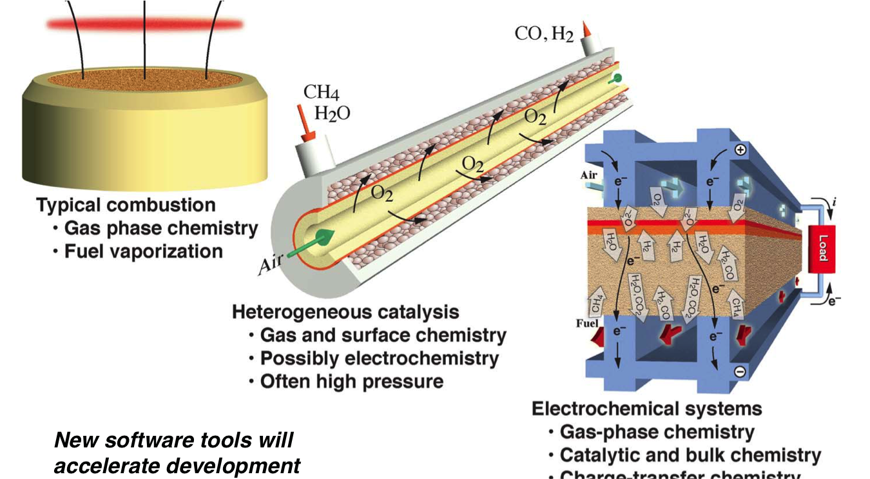
Application Areas

Slide 6
Application Areas
Cantera can be used in a wide variety of applications
Combustion
Electro-chemistry
Surface chemistry
Non-ideal equations of state.
Cantera strength is that it is (relatively) easy to add new functionality.

Slide 7
Examples
Examples are available from the Cantera documentation in several formats
Python scripts: https://cantera.org/examples/python
Jupyter Notebooks: https://cantera.org/examples/jupyter
Matlab scripts: https://cantera.org/examples/matlab
C++: https://cantera.org/examples/cxx
Fortran: https://cantera.org/examples/fortran

