Slide 1
Mental Health Meme Classification
NLP Project
Manan Aggarwal (202273)
Shobhit Raj (2022482)
Souparno Ghose (2022506)
NLP Group - 12

Slide 2
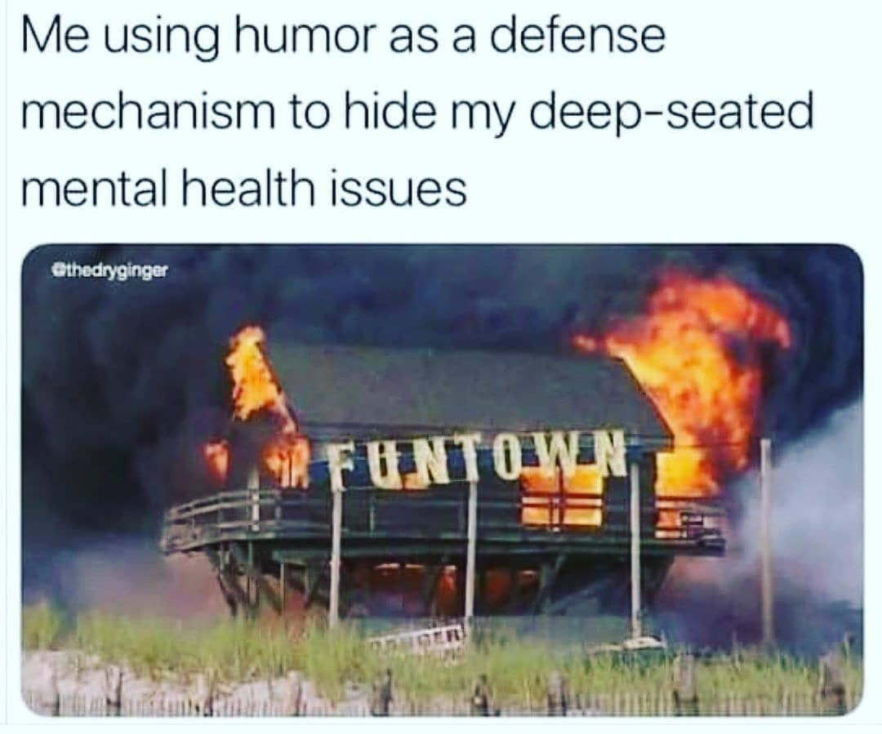
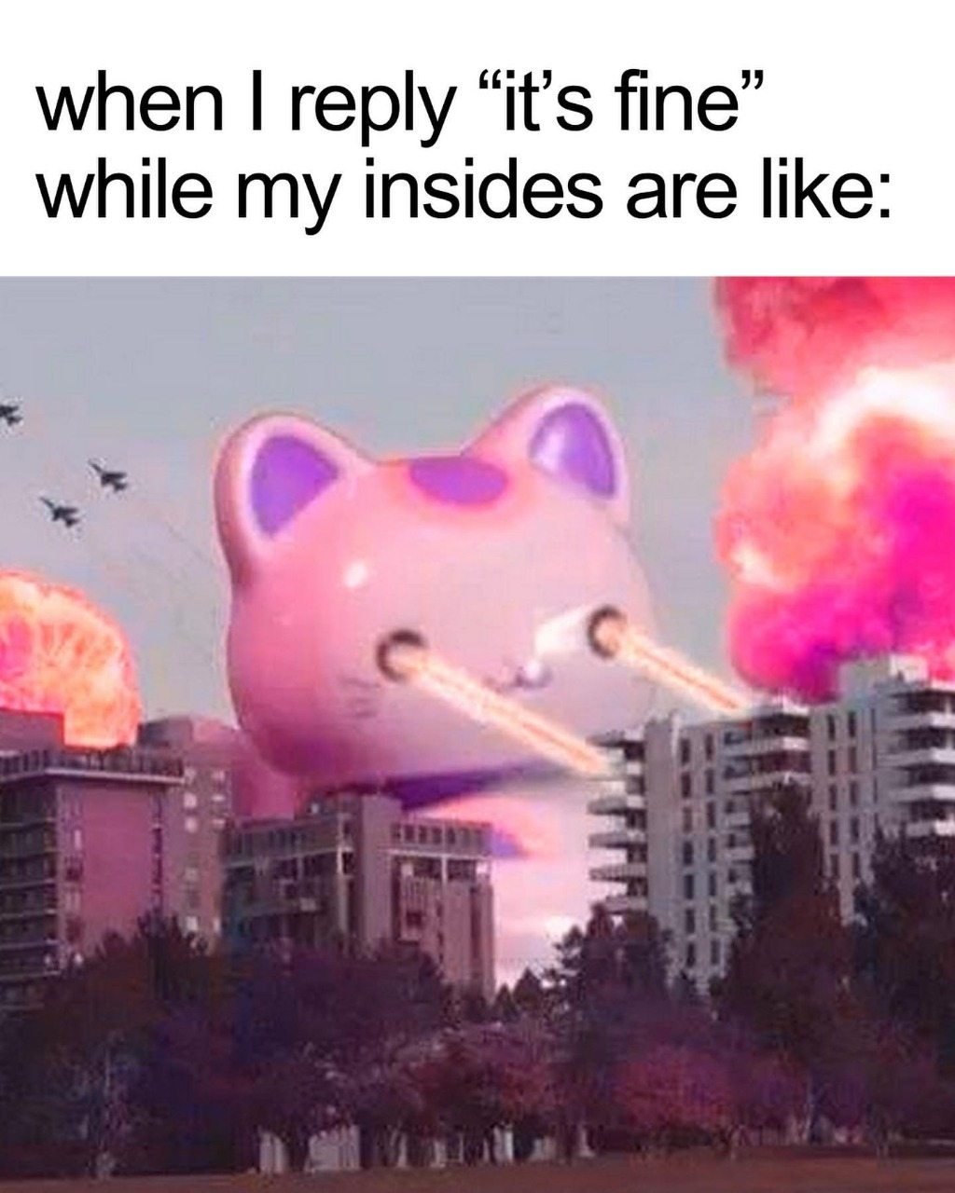
Introduction
In today’s digital age, social media platforms have become powerful outlets for individuals to express emotions, struggles, and personal experiences, often through humor and satire. Internet memes, in particular, serve as a relatable medium for younger audiences to communicate complex feelings in a lighthearted, visually engaging way. Beneath their humor, however, many memes subtly reflect deeper mental health issues like anxiety and depression. Our project explores how computational models can be used to interpret these subtle cues by developing a multimodal framework that identifies and classifies mental health symptoms from memes.
On the right, the first meme shows a burning amusement park labeled “FUNTOWN” with a caption about using humor to mask distress, while another features a chaotic scene with a cartoon cat, capturing the disconnect between saying “I’m fine” and feeling overwhelmed inside

Slide 3
Related Work
Depression Symptom Classification (Yadav et al., 2023):
Introduced the RESTORE dataset, comprising memes annotated with depression symptoms based on the PHQ-9 clinical questionnaire.
Used transformer-based models with orthogonal constraints to enable non-redundant learning across modalities.
Anxiety Symptom Classification (Mazhar et al., 2025):
Released the AxiOM dataset, targeting anxiety symptom detection through multimodal meme classification.
Proposed the M3H framework, which enhances multimodal models with domain-specific knowledge and figurative reasoning.
Our Contribution:
We propose modular baselines and fusion strategies, evaluating the incremental impact of OCR-extracted text, visual features, and LLM-generated figurative reasoning using transformer encoders.
Introduce a lightweight multimodal attention mechanism, enhanced with a contrastive learning objective to align visual and textual embeddings, improving semantic coherence and robustness.

Slide 4
Methodology
Input Processing:
Textual: Extracted via OCR and enriched with figurative reasoning, then encoded with a Mental-RoBERTa Transformer for context-aware features.
Visual: Processed using a CLIP-based encoder to capture spatial and structural details.
Fusion Strategy:
Custom cross-attention modules merge visual and textual features into a cohesive representation.
A mixture-of-experts framework further refines the integrated multimodal features for flexibility and interpretability.
Task Adaptation:
Supports both single-label anxiety classification (AxiOM dataset) and multi-label depression classification (RESTORE dataset) through tailored processing pipelines.

Slide 5
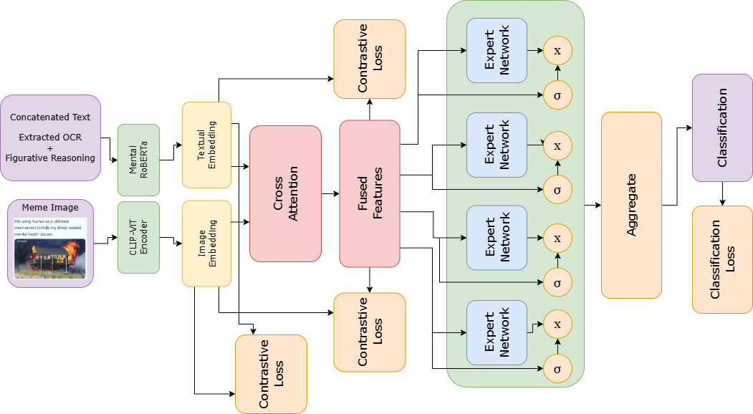
Methodology
Dual-Loss Framework:
Combines primary classification loss with a contrastive loss to ensure robust semantic alignment across modalities.
Cross-entropy loss is used for anxiety, while binary cross-entropy is applied for depression.
Contrastive Learning:
Reinforces semantic similarity among multimodal, text-only, and image-only embeddings for improved representation quality.
Training Process:
Systematic data splitting into training and validation sets with iterative updates using state-of-the-art optimization techniques.
Continuous evaluation using macro-F1 and weighted-F1 metrics to address class imbalances and ensure strong generalization.

Slide 6
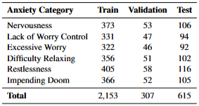
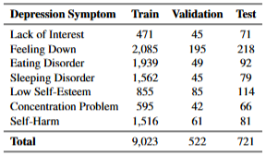


Dataset/Experimental Setup/Results
All experiments were conducted in a Kaggle Notebook environment using 2 GPUs.
For data processing, we extracted text via Google OCR and enhanced it with figurative reasoning using the LLAVA model, while visual features were obtained with a CLIP-based encoder.
We implemented and compared three baselines OCR + BERT, OCR + Mental-BERT, and OCR + LLAVA + Mental-BERT using cross-entropy loss for the anxiety task, and binary cross-entropy loss for the depression task.
Our proposed approach, which leverages multimodal fusion and contrastive learning, significantly improved both macro-F1 and weighted-F1 scores over the baselines.

Slide 7
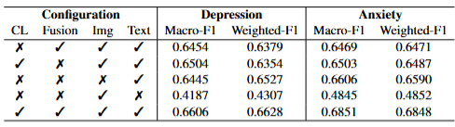
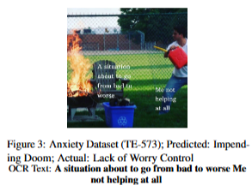
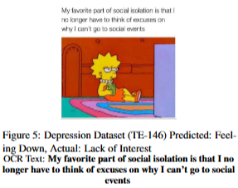
Discussion/Analysis/Observations
Objective: Evaluate the contribution of each component in the multimodal framework.
Key Findings:
The complete model with contrastive learning and cross-attention fusion performs best for both Anxiety (Macro-F1: 0.6851) and Depression (Macro-F1: 0.6606).
Removing contrastive learning or fusion module degrades performance.
Text encoding is crucial for both tasks, while image encoding has secondary importance.
Error Analysis & Performance Comparison:
Anxiety Errors: Model showed correct direction of prediction but wrong intensity. E.g. “Lack of Worry Control” predicted as “Impending Doom”
Depression Errors: Model was getting confused between similar labels like “Feeling Down” and “Lack of Interest”
Insights: Fine-grained misclassifications suggest overemphasis on certain cues, highlighting a need for more granular detection of emotional nuances.
Performance Gains: Our approach outperforms baselines by >6% in Macro-F1, emphasizing the value of multimodal fusion and contrastive learning.

Slide 8
Conclusion and Future Work
Conclusion:
Proposed a novel multimodal framework to classify mental health symptoms in memes using text, vision, and figurative reasoning.
Utilized cross-attention fusion and a Mixture-of-Experts module to capture nuanced emotional cues.
Achieved over 6% improvement in Macro-F1 on anxiety classification and 3% improvement in Macro-F1 on depression classification.
Ablation studies confirmed the importance of contrastive learning and fusion strategy.
Future Work:
Explore advanced fusion techniques like adaptive gating or graph-based semantic integration.
Enhance model explainability to improve transparency and support real-world mental health applications.

