Slide 1
Typescript
TypeScript Fundamentals
Notes:
Add instructor notes here.

Slide 2
Lesson Objectives
Introduction to Typescript
JavaScript & Typescript
The type system-Variable, Array
Defining class and interface
Arrow Functions
Template Strings
Defining a module
Importing a module
Generics
Notes:
Add instructor notes here.

Slide 3
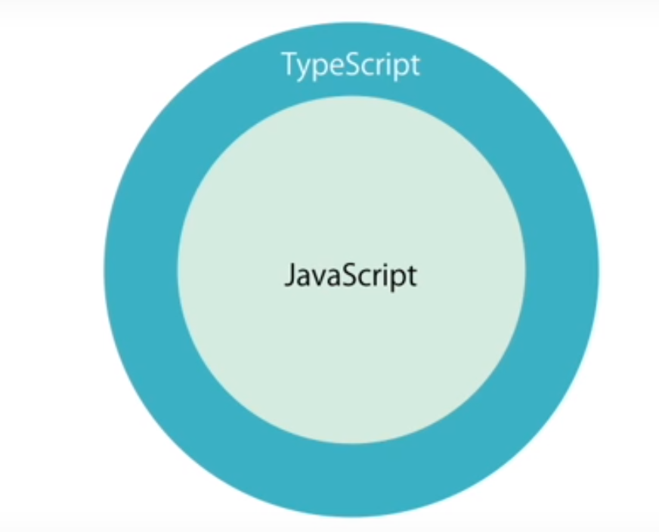
TypeScript
TypeScript is an open-source programming language developed and maintained by Microsoft.
It is superset of JavaScript.
It is a strict syntactical superset of JavaScript, and adds optional static typing to the language.
Anders Hejlsberg, lead architect of C# and creator of Delphi & Pascal, has worked on the development of TypeScript.
TypeScript may be used to develop JavaScript applications for client-side or server-side -Node.js execution.
Notes:
TypeScript is designed for development of large applications and transpile to JavaScript.As TypeScript is a superset of JavaScript, existing JavaScript programs are also valid TypeScript programs.
TypeScript supports definition files that can contain type information of existing JavaScript libraries, much like C++ header files can describe the structure of existing object files. This enables other programs to use the values defined in the files as if they were statically typed TypeScript entities. There are third-party header files for popular libraries such as jQuery, MongoDB, and D3.js. TypeScript headers for the Node.js basic modules are also available, allowing development of Node.js programs within TypeScript.
The TypeScript compiler is itself written in TypeScript and compiled to JavaScript. It is licensed under the Apache 2 License
TypeScript is included as a first-class programming language in Microsoft Visual Studio 2013 Update 2 and later, beside C# and other Microsoft languages An official extension allows Visual Studio 2012 to support TypeScript as well
Add instructor notes here.

Slide 4
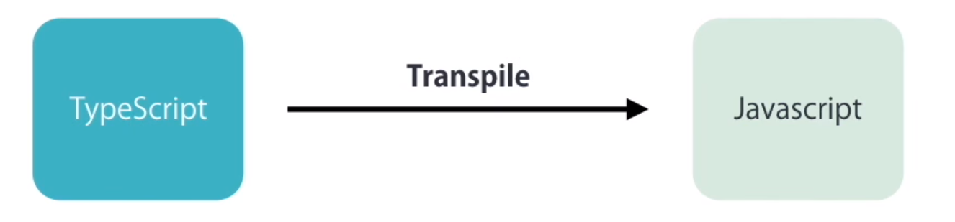
TypeScript
Strong Typing
Object Oriented features
Compile time catching error
Browser don’t understand typescript so we need to compile or trans pile into JavaScript. So Browser can understand it
Notes:
Compilation − JavaScript is an interpreted language. Hence, it needs to be run to test that it is valid. It means you write all the codes just to find no output, in case there is an error. Hence, you have to spend hours trying to find bugs in the code. The TypeScript transpiler provides the error-checking feature. TypeScript will compile the code and generate compilation errors, if it finds some sort of syntax errors. This helps to highlight errors before the script is run.
Strong Static Typing − JavaScript is not strongly typed. TypeScript comes with an optional static typing and type inference system through the TLS (TypeScript Language Service). The type of a variable, declared with no type, may be inferred by the TLS based on its value.
TypeScript supports type definitions for existing JavaScript libraries. TypeScript Definition file (with .d.ts extension) provides definition for external JavaScript libraries. Hence, TypeScript code can contain these libraries.
TypeScript supports Object Oriented Programming concepts like classes, interfaces, inheritance, etc.
At its heart, TypeScript has the following three components −
Language − It comprises of the syntax, keywords, and type annotations.
The TypeScript Compiler − The TypeScript compiler (tsc) converts the instructions written in TypeScript to its JavaScript equivalent.
The TypeScript Language Service − The "Language Service" exposes an additional layer around the core compiler pipeline that are editor-like applications. The language service supports the common set of a typical editor operations like statement completions, signature help, code formatting and outlining, colorization, etc.

Slide 5
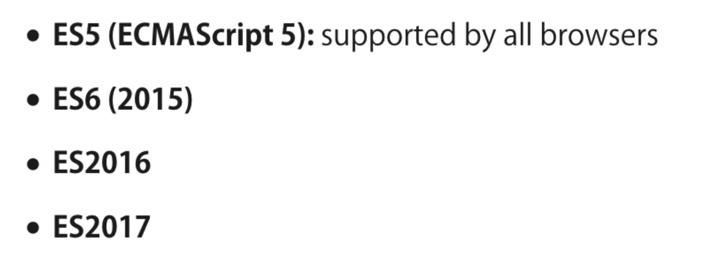
Why TypeScript
TypeScript can be used for cross browser development and is an open source project.
Using TypeScript developers can apply class-based approach, compile them down to JavaScript without waiting for the next version of JavaScript.
With TypeScript existing JavaScript code can be easily incorporated with popular JavaScript libraries like jQuery, Backbone, Angular and so on.
Enable scalable application development with optional Static types, classes and modules. Static types completely disappear at runtime.
TypeScript converts JavaScript Programming from loosely typed to strongly typed.
JavaScript Version:
Notes:
Syntax defines a set of rules for writing programs. Every language specification defines its own syntax. A TypeScript program is composed of −
Modules
Functions
Variables
Statements and Expressions
Comments
Add instructor notes here.

Slide 6
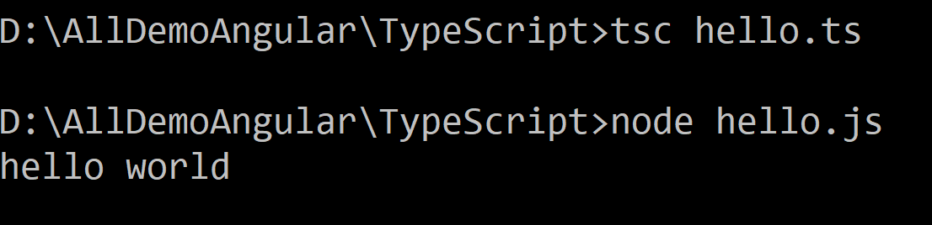
Installing TypeScript
First Install Node
Via npm (the Node.js package manager)--npm install -g typescript
Or DownLoad typescript compiler –master & set in class path & work
https://www.typescriptlang.org/play/ ---- work online
Open Eclipse
Create Typescript project name as ‘hello.ts’
Open command prompt & redirect to that eclipse folder
For NPM users & use typescript without downloading
npm install -g typescript
At the command line, run the TypeScript compiler:
tsc hello.ts
When we write tsc hello.ts it will convert into js
Then write node hello.js
Notes:
The TypeScript Compiler
The TypeScript compiler is itself a .ts file compiled down to JavaScript (.js) file. The TSC (TypeScript Compiler) is a source-to-source compiler (transcompiler / transpiler).
The TSC generates a JavaScript version of the .ts file passed to it. In other words, the TSC produces an equivalent JavaScript source code from the Typescript file given as an input to it. This process is termed as transpilation.
However, the compiler rejects any raw JavaScript file passed to it. The compiler deals with only .ts or .d.ts files.
Installing Node.js
Node.js is an open source, cross-platform runtime environment for server-side JavaScript. Node.js is required to run JavaScript without a browser support. It uses Google V8 JavaScript engine to execute code. You may download Node.js source code or a pre-built installer for your platform. Node is available here − https://nodejs.org/en/download

Slide 7
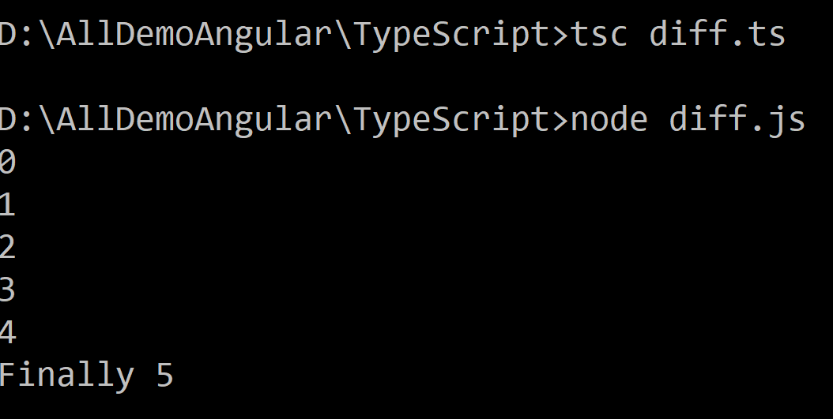
Difference between let & var
Using var
Now if you use ‘let’ instead of ‘var’ it will give compilation error, because scope is limited
So in typescript we have to use ‘let’ instead of ‘var’
function doGet()
{
for(var i = 0; i < 5; i++)
{
console.log(i);
}
console.log(“Finally ” + i);
}
doGet();
Notes:
Var
The JavaScript variables statement is used to declare a variable and, optionally, we can initialize the value of that variable.
Example: var a =10;
Variable declarations are processed before the execution of the code.
The scope of a JavaScript variable declared with var is its current execution context.
The scope of a JavaScript variable declared outside the function is global.
function nodeSimplified(){
var a =10;
console.log(a); // output 10
if(true){
var a=20;
console.log(a); // output 20
}
console.log(a); // output 20
}
let
The let statement declares a local variable in a block scope. It is similar to var, in that we can optionally initialize the variable.
Example: let a =10;
The let statement allows you to create a variable with the scope limited to the block on which it is used.
It is similar to the variable we declare in other languages like Java, .NET, etc.
function nodeSimplified(){
let a =10;
console.log(a); // output 10
if(true){
let a=20;
console.log(a); // output 20
}
console.log(a); // output 10
}

Slide 8
Type Annotations
Type annotations in TypeScript are lightweight ways to record the intended contract of the function or variable.
let empId: number; --- number
let empName: string; --- string
let empFeedback: boolean; --- Boolean
let anyType: any; --- any
let myArray: number[] = [1, 2, 3]; --- number
let anyArrayType: any[] = [1, ‘Rahul’, false, true]; --- any array

Slide 9
Type Annotations
Enum & Constant
const colored = 0;
const colorBlue = 1;
const colorGreen = 2;
enum Color { Red = 0, Green = 1, Blue = 2 };
let backgroundColor = Color.Red;
console.log(backgroundColor);

Slide 10
Type Assertion in TypeScript
TypeScript allows changing a variable from one type to another.
TypeScript refers to this process as Type Assertion.
The syntax is to put the target type between < > symbols and place it in front of the variable or expression.
let str: string;
str.substring(2,3);
let str2;
(<string>str2).length;
(str2 as string).length;
Assertion in TypeScript

Slide 11
Arrow Functions
=> is a and also called a Arrow function
let log = function(message)
{
console.log('Welcome to Arrow');
}
//Arrow function equivalent to above function
let doLog = (message) => console.log(message);
//Arrow function equivalent to no parameter function
let withoutparameter = () => console.log();

Slide 12
Interfaces
Interfaces plays many roles in TypeScript code. Its work same as other OOPs concept .
interface Employee{
firstName: string;
lastName: string;
age: number;
salary: number;
}
let employee: Employee={
firstName: “Rahul”,
lastName: “Vikash”,
age: 32,
salary: 1000
}
document.write(“Full Name is ” + this.employee.firstName + “ ” + this.employee.lastName + “ Age is ” + this.employee.age + “<br />”);
Notes:
Code Snippet
Declaring Interfaces
The interface keyword is used to declare an interface. Here is the syntax to declare an interface −
Syntax
interface interface_name { }
Add instructor notes here.

Slide 13
Interface with array
interface Employee{
firstName: string;
lastName: string;
age: number;
salary: number;
}
//with array concept
let empArray: Employee[] = [];
empArray.push({
firstName: “Abcd”,
lastName: “Bcde”,
age: 21,
salary: 6000
});
document.write(“With array Full name is ” + this.empArray[0].firstName + “ ” + this.empArray[0].lastName + “ Age is ” + this.empArray[0].age);
Notes:
Interfaces and Arrays
Interface can define both the kind of key an array uses and the type of entry it contains. Index can be of type string or type number.

Slide 14
Function:
Creating Functions
//2 parameter with number as return type
function getsum(numOne: number, numTwo: number): number{
return numOne + numTwo;
}
let add = getsum(10,6);
document.write(“Sum is ” + add + “<br />”);
//any number of data--know as rest parameter
function sumAll(...num: number[]){
let sum: number = 0;
for (let data of num) {
sum = sum + data;
document.write(“Addition of number ” + data + “<br />”);
}
document.write(“Sum is ” + sum + “<br />”);
}
sumAll(6, 7, 8, 9);
Notes:
Optional Parameters
Optional parameters can be used when arguments need not be compulsorily passed for a function’s execution. A parameter can be marked optional by appending a question mark to its name. The optional parameter should be set as the last argument in a function. The syntax to declare a function with optional parameter is as given below −
function function_name (param1[:type], param2[:type], param3[:type])
Rest Parameters
Rest parameters are similar to variable arguments in Java. Rest parameters don’t restrict the number of values that you can pass to a function. However, the values passed must all be of the same type. In other words, rest parameters act as placeholders for multiple arguments of the same type.
To declare a rest parameter, the parameter name is prefixed with three periods. Any nonrest parameter should come before the rest parameter.

Slide 15
Optional, Default
? Is know as optional parameter
//Optional parameter----? for optional & Default parameter
function doGet(one: number, two = 5, three?: number): void{
//alert("hii");
document.write(one.toString());
document.write(two.toString());
document.write(three.toString());
}
//doGet(10);
doGet(10);
Notes:
Default Parameters
Function parameters can also be assigned values by default. However, such parameters can also be explicitly passed values.

Slide 16
Classes in TypeScript
Traditional JavaScript focuses on functions and prototype-based inheritance, it is very difficult to built application using object-oriented approach.
Starting with ECMAScript 6 (the next version of JavaScript), JavaScript programmers can build their applications using this object-oriented class-based approach.
TypeScript supports public , private and protected access modifiers. Members of a class are public by default.
Notes:
Code Snippet
Creating classes
Use the class keyword to declare a class in TypeScript. The syntax for the same is given below −
class class_name { //class scope }
The class keyword is followed by the class name. The rules for identifiers must be considered while naming a class.
A class definition can include the following −
Fields − A field is any variable declared in a class. Fields represent data pertaining to objects
Constructors − Responsible for allocating memory for the objects of the class
Functions − Functions represent actions an object can take. They are also at times referred to as methods
A constructor is a special function of the class that is responsible for initializing the variables of the class. TypeScript defines a constructor using the constructor keyword. A constructor is a function and hence can be parameterized.
The this keyword refers to the current instance of the class. Here, the parameter name and the name of the class’s field are the same. Hence to avoid ambiguity, the class’s field is prefixed with the this keyword.
Add instructor notes here.

Slide 17
Classes in TypeScript (Contd…)
class Employee {
empId: number;
empName: string;
empsalary: number;
static emppf: number = 12;
static company: string = ‘CAPGEMINI’;
}
let emp = new Employee();
emp.empId = 1001;
emp.empName = “Vikash”;
emp.empsalary = 1111;
document.write(“ID is ” + emp.empId + “ Name is ” + emp.empName + “ company ” + Employee.company);
Notes:
Code Snippet
Creating classes
Use the class keyword to declare a class in TypeScript. The syntax for the same is given below −
class class_name { //class scope }
The class keyword is followed by the class name. The rules for identifiers must be considered while naming a class.
A class definition can include the following −
Fields − A field is any variable declared in a class. Fields represent data pertaining to objects
Constructors − Responsible for allocating memory for the objects of the class
Functions − Functions represent actions an object can take. They are also at times referred to as methods
A constructor is a special function of the class that is responsible for initializing the variables of the class. TypeScript defines a constructor using the constructor keyword. A constructor is a function and hence can be parameterized.
The this keyword refers to the current instance of the class. Here, the parameter name and the name of the class’s field are the same. Hence to avoid ambiguity, the class’s field is prefixed with the this keyword.
Add instructor notes here.

Slide 18
Constructor -Typescript
class EmployeeOne {
empId: number;
empName: string;
constructor(id: number, name: string) {
this.empId = id;
this.empName = name;
}
doGet(): void{
document.write(this.empId + “ ” + this.empName);
}
}
let empOne = new EmployeeOne(1001, “Abcd”);
empOne.doGet();
Notes:
Data hiding
1 public
A public data member has universal accessibility. Data members in a class are public by default.
2.private
Private data members are accessible only within the class that defines these members. If an external class member tries to access a private member, the compiler throws an error.
3.protected
A protected data member is accessible by the members within the same class as that of the former and also by the members of the child classes.

Slide 19
Static Property
In TypeScript we can also create static members of a class, those that are visible on the class itself rather than on the instances.
Notes:
The static Keyword
The static keyword can be applied to the data members of a class. A static variable retains its values till the program finishes execution. Static members are referenced by the class name.

Slide 20
Static Property (Contd…)
class EmployeeOne {
empId: number;
empName: string;
static numberOfEmployee: number = 0;
constructor(id: number, name: string) {
this.empId=id;
this.empName=name;
EmployeeOne.numberOfEmployee++;
}
doGet(): void{
document.write(this.empId+" "+this.empName);
}
static getNumber(): number{
return EmployeeOne.numberOfEmployee;
}
}
let empOne=new EmployeeOne(1001, “Abcd”);
empOne.doGet();
EmployeeOne.getNumber();
Notes:
The static Keyword
The static keyword can be applied to the data members of a class. A static variable retains its values till the program finishes execution. Static members are referenced by the class name.

Slide 21
Inheritance
TypeScript allows us to extend existing classes to create new ones using inheritance.
'extends' keyword is used to create a subclass.
'super()' method is used to call the base constructor inside the sub class constructor.
Notes:
Code Snippet
Class Inheritance
TypeScript supports the concept of Inheritance. Inheritance is the ability of a program to create new classes from an existing class. The class that is extended to create newer classes is called the parent class/super class. The newly created classes are called the child/sub classes.
Inheritance can be classified as −
Single − Every class can at the most extend from one parent class
Multiple − A class can inherit from multiple classes. TypeScript doesn’t support multiple inheritance.
Multi-level − The following example shows how multi-level inheritance works.
Add instructor notes here.

Slide 22
Inheritance (Contd…)
class Animal {
constructor(public name: string) { }
move(distanceInMeters: number = 0) {
console.log(`${this.name} moved ${distanceInMeters}m.`);
}
}
class Snake extends Animal {
constructor(name: string) { super(name); }
move(distanceInMeters = 5) {
console.log(“Slithering...”);
super.move(distanceInMeters);
}
}
class Horse extends Animal {
constructor(name: string) { super(name); }
move(distanceInMeters = 45) {
console.log(“Galloping...”);
super.move(distanceInMeters);
}
Notes:
Code Snippet
Class Inheritance
TypeScript supports the concept of Inheritance. Inheritance is the ability of a program to create new classes from an existing class. The class that is extended to create newer classes is called the parent class/super class. The newly created classes are called the child/sub classes.
Inheritance can be classified as −
Single − Every class can at the most extend from one parent class
Multiple − A class can inherit from multiple classes. TypeScript doesn’t support multiple inheritance.
Multi-level − The following example shows how multi-level inheritance works.
Add instructor notes here.

Slide 23
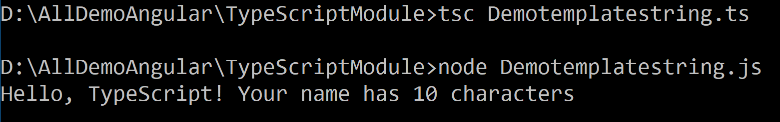
Template Strings
In ES6 new template strings were introduced.
The two salient features of template strings are
Variables within strings (without being forced to concatenate with +)
Multi-line strings (using backticks ` )
TypeScript now supports ES6 template strings. These are an easy way to embed arbitrary expressions in strings:
When compiling to pre-ES6 targets, the string is decomposed:
var name = "TypeScript";
var greeting = `Hello, ${name}! Your name has ${name.length} characters`;
var name = “TypeScript!”;
var greeting = “Hello, ” + name + “ ! Your name has ” + name.length + “ characters”;
Notes:
Code Snippet
Add instructor notes here.

Slide 24
Generics
Generics plays a vital role in creating reusable components.
Component can be created to work over a variety of types rather than a single one.
function GetType<T>(val: T): string{
return typeof(val);
}
let ename = “Abcd”;
let one = 10;
document.write(“Call Generics” + GetType(ename) + “ ” + GetType(one));
//class -generics
class GetNumber<T>{
add:(one: T, two: T) => T;
}
var result = new GetNumber<number>();
result.add = function(x, y){
return x+y;
}
document.write(“Addition of 5+2” + result.add(5,2));
Notes:
TypeScript 2.3 implemented generic parameter defaults which allow you to specify default types for type parameters in a generic type.
type Constructor<T> = new (...args: any[]) => T; type Constructable = Constructor<{}>;
Add instructor notes here.

Slide 25
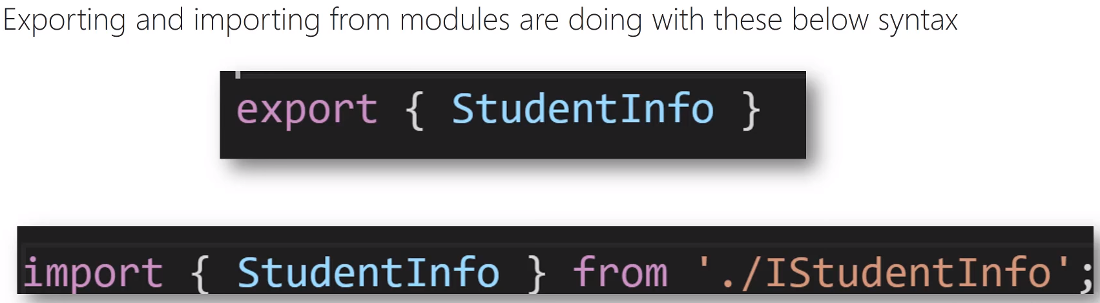
Modules
Starting with the ECMAscript 2015,javascript has a concept of modules Typescript shares this concept.
Modules are executed within their own scope, not in the global scope; this means that variables, functions, classes etc. declared un a module are not visible outside the module unless they are explicitly exported using one of the export forms.
To consume a variable function class interface etc. exported from a different module.
Notes:
Add instructor notes here.

Slide 26
Modules (Contd…)
Product.ts
export class IProduct {
productId: number;
productName: string;
}
export const company: string = “Capgemini”;

Slide 27
Modules (Contd…)
import {IProduct} from "./Product";
import {company} from "./Product";
//Declare Product
let prod: IProduct={
productId:1001,
productName:"iPhone"
}
let productArray: IProduct[]=[
{productId: 1002, productName: “LG”},
{productId: 1003, productName: “CoolPad”},
{productId: 1004, productName: “Mi”} ];
console.log(prod.productId);
console.log(prod.productName);
for (let pro of productArray) {
console.log(prod.productId);
console.log(prod.productName);
}
console.log(company);

Slide 28
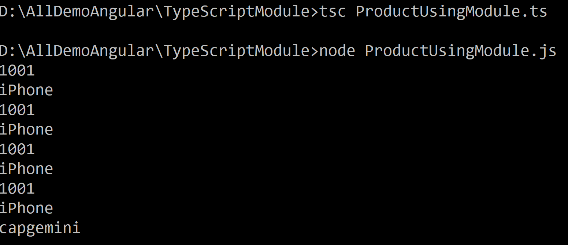
Modules (Contd…)

Slide 29
Summary
TypeScript is an open source project maintained by Microsoft.
TypeScript generates plain JavaScript code which can be used with any browser.
TypeScript offers many features of object oriented programming languages such as classes, interfaces, inheritance, overloading and modules, some of which are proposed features of ECMA Script 6.
TypeScript is a promising language that can certainly help in writing neat code and organize JavaScript code making it more maintainable and extensible.
Angular 2 is built in typescript
Notes:
Add instructor notes here.

Slide 30
Demo
TypeScript Demo
Typescript Module Demo

Slide 31
Lab
Lab 1.1
Notes:
Add the notes here.
Add instructor notes here.

