Slide 1

Employee Survey Insights for
Advocate Health
TEAM 113:
Kyle Hester, Shobitha Bhaskar, Shubham Prasad, Nayana Reddy

Slide 2


INTRODUCTION
Advocate Health, formed through the merger of Advocate Aurora Health and Atrium Health in December 2022, is one of the largest non-profit integrated health systems in the U.S., serving six states with 67 hospitals and over 150,000 employees. To enhance employee retention and satisfaction, the organization places strong emphasis on engagement as a key performance indicator. Other critical KPIs include maintaining financial stability, advancing sustainability goals with a target of carbon neutrality by 2030, and making strategic community investments such as hospital redevelopment in underserved areas. Advocate Health also prioritizes patient financial support, relieving medical debt to improve access to care and reduce economic burden.

Slide 3



Business Problem
Advocate Health's workforce analytics system processes structured and unstructured survey data using machine learning techniques such as clustering, NLP, and topic modeling to extract meaningful insights. However, its current processing time of 8 minutes for 10,000 rows of data presents a significant bottleneck, limiting real-time decision-making and scalability.
Accelerating this process will enable real-time workforce insights, facilitate the extraction of richer and more comprehensive insights from employee feedback, and uncover deeper patterns in sentiment. This empowers leadership to proactively address concerns, strengthen employee commitment, and ensure alignment with organizational goals.

Slide 4
METHODS AND TECH
The data included structured responses and open-ended feedback from 10,000+ employees.
01
Clustering
K-Means (structured data), DBSCAN (comment embeddings)
01
02
03
04
02
Embeddings:
Sentence-BERT (all-MiniLM-L6-v2) to analyze open-text responses
03
NLP:
To extract employee sentiment from open-text responses
04
Cloud Infrastructure: AWS S3, Glue, Athena, Lambda, SageMaker, Cognito for secure, scalable analytics

Slide 5
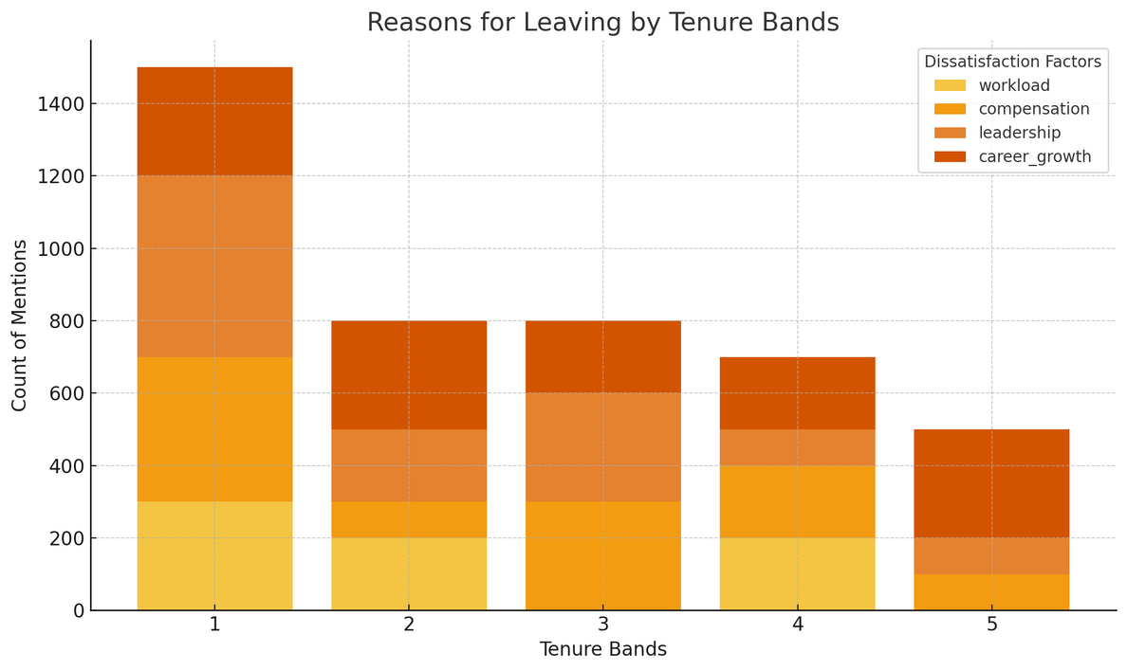
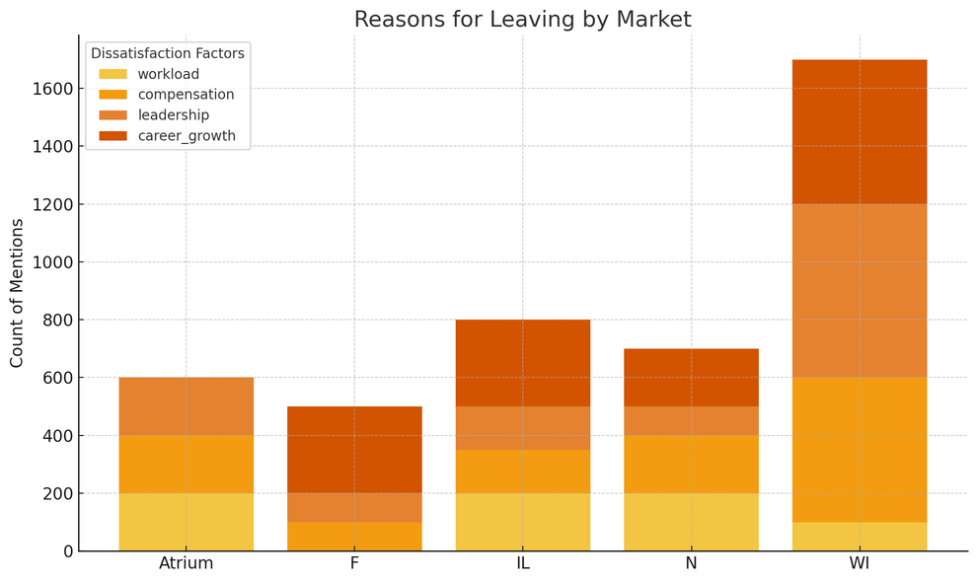

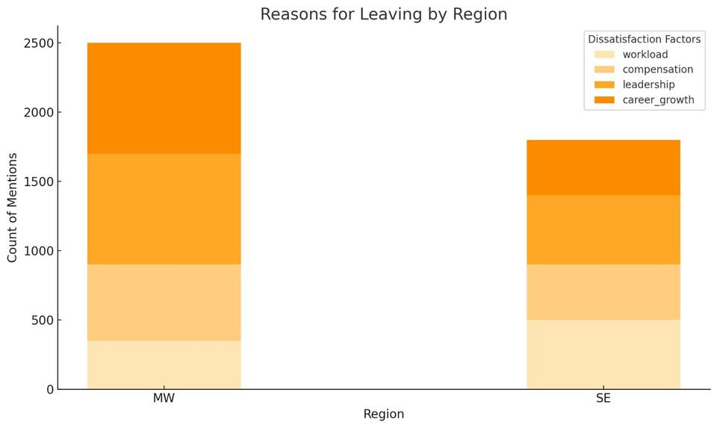
FINDINGS
Employees with the lowest tenure (Band 1) report the highest dissatisfaction, especially related to career growth, leadership, and compensation.
The WI market has the highest number of complaints across all dissatisfaction factors, indicating potential burnout, poor compensation, and leadership issues in this region.
The Midwest (MW) region has higher dissatisfaction levels compared to the Southeast (SE).

Slide 6












RESULTS
Tenure Insights:
Key issues:
Perspectives:
Patterns:
Opportunities:
Value Addition:
Tenure Band 1 employees (new hires) showed highest dissatisfaction.
Workload
Compensation
Lack of leadership support.
Women focused more on career growth, men on compensation and workload.
Midwest region (especially Wisconsin) showed highest dissatisfaction.
Clustering revealed distinct workforce segments needing targeted strategies.
A 25-30% reduction in processing time is projected with the new system.

Slide 7



CONCLUSION
Our results confirm that early-tenure employees and those in the Wisconsin region report the highest dissatisfaction, driven by workload and compensation concerns. Using AI-based clustering and NLP, Advocate Health can now identify trends more effectively. The upgraded system reduces processing time from 8 to 6 minutes per 10,000 rows—saving 30,000 minutes weekly across 150,000 employees, or 120,000 minutes monthly. Enhanced clustering accuracy also provides clearer, more actionable insights, empowering leadership to make faster, data-driven HR decisions tailored to gender and regional needs.
AI-enhanced survey analysis allows real-time insights and targeted action.
Proactive retention strategies can be designed using data-driven models.
Final deployment of our system will lead to improved employee engagement, predictive HR analytics, and broader organizational value.

Slide 8

NEXT STEPS
Extend Beyond HR
Apply the machine learning framework to other business areas like patient satisfaction, operational workflows, and clinical feedback.
Conduct Impact Assessment
Evaluate measurable outcomes from the new system, such as improved engagement scores, reduced attrition, and faster HR response times.
Enhance Model Capabilities
Incorporate additional data sources (e.g., performance reviews, pulse surveys) to improve clustering precision and insight depth.

Slide 9
Thank you!!!

