Slide 1
Transfer Learning in Machine Learning
Presented by Michael Shobowale
26/12/2024

Slide 2
Outline
What is Transfer Learning?
Types of Transfer Learning
Examples in Practice
Advantages of Transfer Learning
Challenges and Limitations
Code Example
Summary and Q&A

Slide 3
What is Transfer Learning?
Transfer Learning is a machine learning technique where a model trained on one task is reused on a different but related task.
Saves time, resources, and improves performance on tasks with limited data.

Slide 4
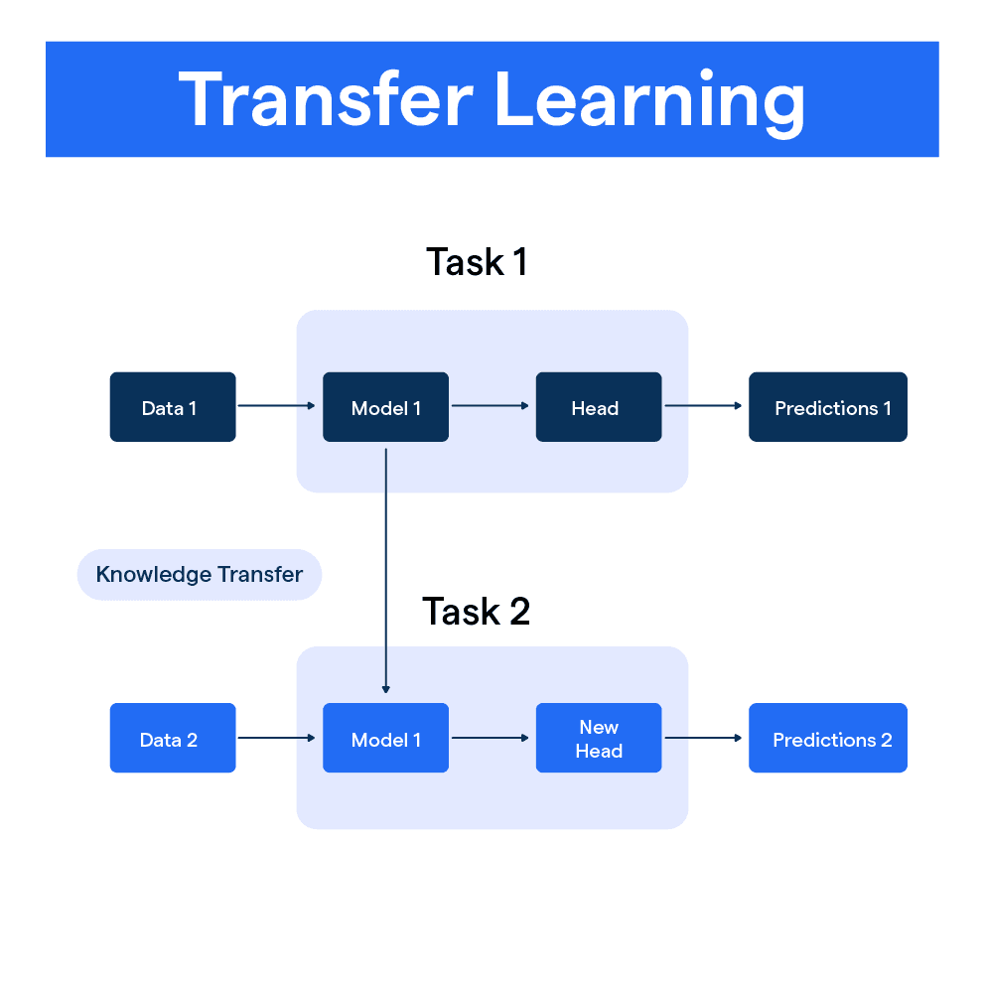

Slide 5
Types of Transfer Learning
Domain Adaptation: Adapting a model from one domain to another (e.g., text translation).
Task Transfer: Applying knowledge from one task to another (e.g., image classification to object detection).
Model Reuse: Using pre-trained models as a starting point.

Slide 6
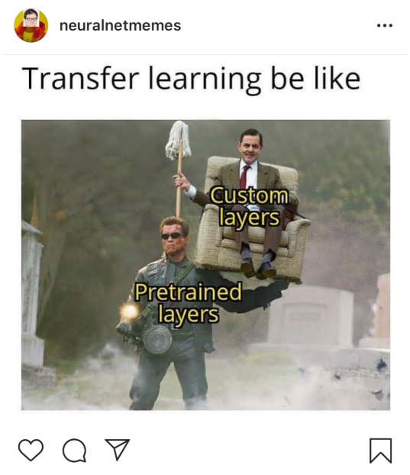


Slide 7
Examples in Practice
Computer Vision: Pre-trained CNNs for object detection.
NLP: BERT, GPT for text classification and summarization.
Healthcare: Transfer learning for rare disease diagnosis using limited datasets.

Slide 8
Advantages of Transfer Learning
Requires less data.
Reduces training time.
Leverages knowledge from large, diverse datasets.
Often leads to improved accuracy.

Slide 9
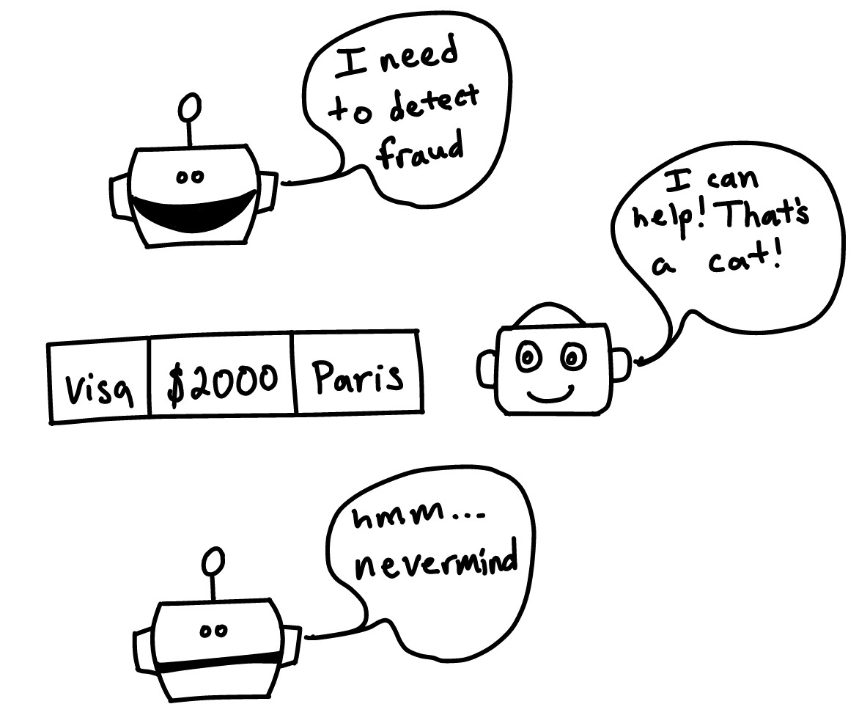
Image source: https://tinyurl.com/4nenf9c9

Slide 10
Challenges and Limitations
Negative transfer: When the source and target tasks are too dissimilar.
Computational cost of large pre-trained models.
Fine-tuning can still require significant resources.

Slide 11
Code example
Code Example

Slide 12
Summary
Transfer learning enables efficient and effective machine learning by leveraging existing knowledge.
Make sure to use the right base model for the new task to save time and resources

Slide 13



Slide 14

Image source: https://medium.com/@meghanabhange13/the-hitchhikers-intro-guide-to-transfer-learning-9a96090e12f2

Slide 15
QUESTIONs?
Thank you for your attention!
Any questions?

