Slide 1
Transfer Learning in Machine Learning
Presented by Michael Shobowale
26/12/2024

Slide 2
What is Transfer Learning?
Transfer Learning is a machine learning technique where a model trained on one task is reused on a different but related task.
Saves time, resources, and improves performance on tasks with limited data.

Slide 3
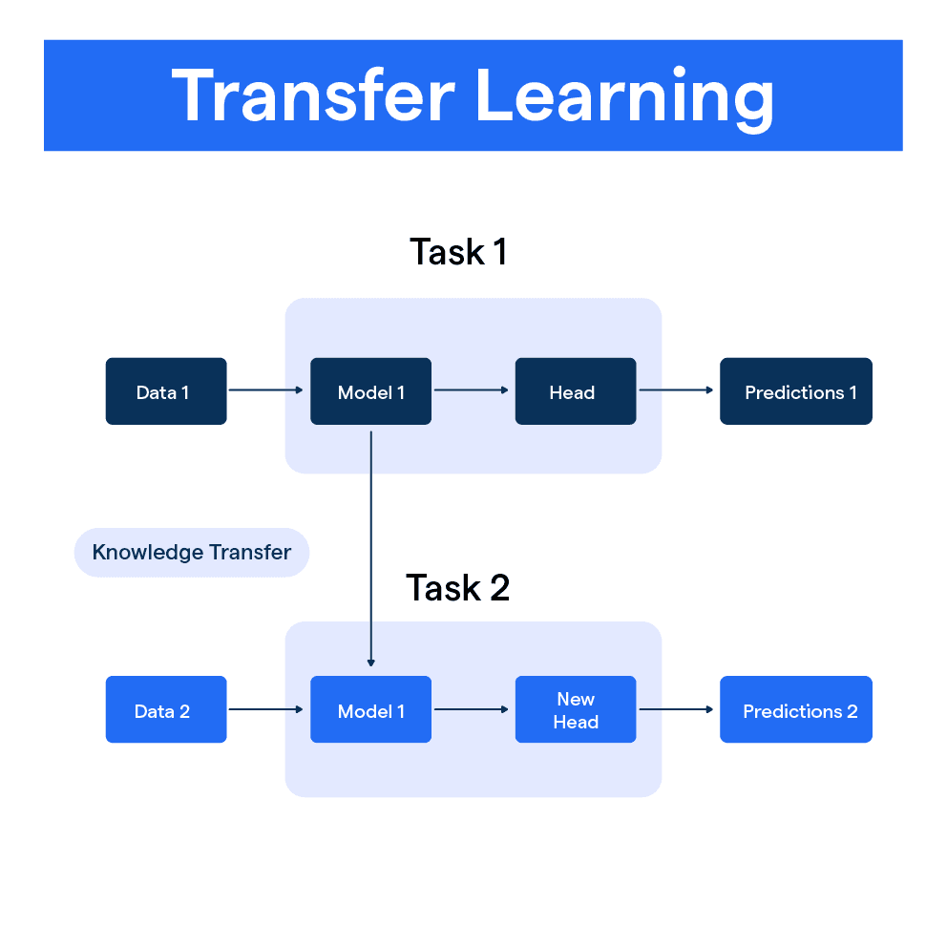

Slide 4
Types of Transfer Learning
Domain Adaptation: Adapting a model from one domain to another (e.g., text translation).
Task Transfer: Applying knowledge from one task to another (e.g., image classification to object detection).
Model Reuse: Using pre-trained models as a starting point.

Slide 5
Examples in Practice
Computer Vision: Pre-trained CNNs for object detection.
NLP: BERT, GPT for text classification and summarization.
Healthcare: Transfer learning for rare disease diagnosis using limited datasets.

Slide 6
Advantages of Transfer Learning
Requires less data.
Reduces training time.
Leverages knowledge from large, diverse datasets.
Often leads to improved accuracy.

Slide 7
Challenges and Limitations
Negative transfer: When the source and target tasks are too dissimilar.
Computational cost of large pre-trained models.
Fine-tuning can still require significant resources.

Slide 8
Code example
Code Example

Slide 9
Summary and Q&A
Transfer learning enables efficient and effective machine learning by leveraging existing knowledge.
Thank you for your attention! Any questions?

