Slide 1



Slide 2




IQRA
INVESTMENT PROPOSAL
Authenticated Islamic knowledge for the age of generative AI
SEED ROUND · 2026 · CONFIDENTIAL
2026 Iqra.live & iqra.chat. All rights reserved
01 / 15

Slide 3

EXECUTIVE SUMMARY
IQRA is a live, source-grounded Islamic assistant raising $2.5M to reach scale
01
General AI answers faith questions probabilistically, producing unverifiable rulings
02
IQRA is a live assistant that grounds answers in a curated Islamic source library
03
The market: 2 billion Muslims and a $2.4 trillion Islamic economy
04
The model scales from donations to premium tooling to B2B licensing
05
The ask: $2.5M to target 1M daily active users and B2B revenue within 24 months
2026 Iqra.live & iqra.chat. All rights reserved
02 / 15

Slide 4

PROBLEM
Generative AI is manufacturing religious rulings it cannot authenticate
General LLMs predict plausible text, not verified rulings
The result is doctrinal drift: fabricated citations, blended traditions, confident errors at scale
Muslims increasingly seek guidance online; a wrong answer can carry serious spiritual and trust consequences
Mainstream assistants are not designed around a curated, scholar-governed Islamic source library
2026 Iqra.live & iqra.chat. All rights reserved
03 / 15
Market context source: Pew Research Center (global Muslim population).

Slide 5

SOLUTION
IQRA grounds answers in curated sources with scholarly governance
Retrieval-grounded assistant: retrieved answers are grounded in indexed source material rather than unsupported model output
Five knowledge domains: creed, jurisprudence of transactions, hadith authentication, ethics, and history
Zero Comparative Religion policy and a total ban on optimizing Haram activity — guardrails built in, not bolted on
Grounded answers include citations and confidence labels so users can assess and verify the supporting source context.
2026 Iqra.live & iqra.chat. All rights reserved
04 / 15

Slide 6
TRACTION
A working product already answers grounded questions today
BUILT | STATUS
Live web app + installable PWA, secure accounts, multi-thread chat | Live at iqra.live & iqra.chat
26,710 active indexed knowledge files from 26,711 uploaded at the review date | Ingested
405 curated training rows guiding answer quality | Active
Donations, admin knowledge management, growth analytics | Operational
2026 Iqra.live & iqra.chat. All rights reserved
05 / 15

Slide 7



MARKET
Two billion Muslims anchor a $2.4 trillion Islamic economy
2.2B
$3.36T
$7.5T
Muslims worldwide by 2030
Consumer spending by 2028
Finance assets by 2028
Up from 2.0B in 2025
Growing ~2x the global rate
Up from $2.43T in 2023
Across core halal sectors
Up from $4.9T in 2023
Deep, compounding capital base
Near-term wedge: the 1B+ Muslims already online and underserved by authentic tools
Sources: Pew Research Center (2025); DinarStandard, State of the Global Islamic Economy 2024/25; Standard Chartered.
2026 Iqra.live & iqra.chat. All rights reserved
06 / 15

Slide 8



BUSINESS MODEL
Revenue scales from donations to premium tooling to B2B licensing
PHASE 1
Philanthropy
PHASE 2
Premium Tooling
PHASE 3 · YEAR 2+
B2B Licensing
In-app donations fund operations today
Automated chatbots, Zakat calculator, Halal investment checklist, estate planning, corporate Zakat audits
API access and compliance chatbots for Halal marketplaces and institutions
Cost per query targeted to fall ~40% over 12 months as knowledge confidence rises (management target)
2026 Iqra.live & iqra.chat. All rights reserved
07 / 15

Slide 9




GROWTH
Reaching one million daily users runs on three growth engines
Community
Product Depth
Partnerships
Mosque, university, and scholar networks; shareable, source-cited answers
Premium tools convert engaged users; PWA install lowers friction.
Islamic institutions and libraries drive credibility and distribution.
Milestone path: live product → engaged base → 1M daily active users as a 24-month management target (target, not current)
2026 Iqra.live & iqra.chat. All rights reserved
08 / 15

Slide 10



EXPANSION
Expansion advances across knowledge, language, and market
Knowledge
Language
Market
Scale the current indexed corpus through staged library partnerships, subject to rights, quality checks, and scholar review.
Extend beyond English to Arabic, Urdu, and Bahasa Indonesia, with later regional localization; 60% of Muslims live in Asia-Pacific.
Consumer app first, then B2B API and compliance tooling for the Halal economy.
Source: Pew Research Center (regional distribution).
2026 Iqra.live & iqra.chat. All rights reserved
09 / 15

Slide 11
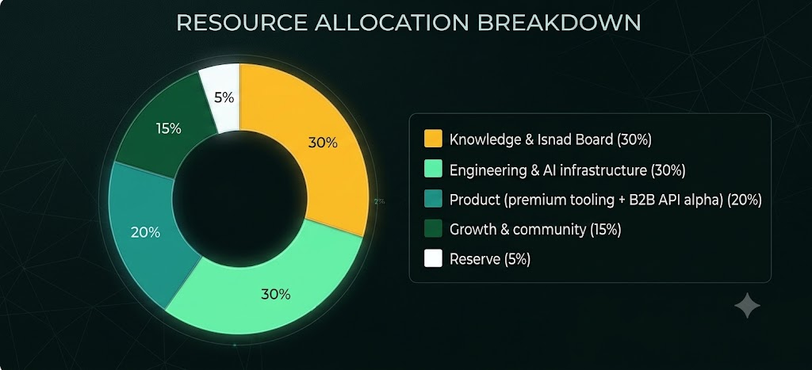
THE ASK
We are raising $2.5M to target one million daily active users and B2B revenue within 24 months
Indicative terms: $2.5M seed for ~15% equity (~$16.7M post-money), via SAFE or priced round
Values-aligned capital only: partners uphold the Zero Comparative Religion policy and Isnad Board independence.
2026 Iqra.live & iqra.chat. All rights reserved
10 / 15

Slide 12
JUSTIFICATION
The raise funds a clear path from live product to recurring revenue
~24 months of runway to hit the milestones investors underwrite.
Funds the jump from the current indexed corpus toward a scaled, scholar-reviewed library — the core defensibility.
Targets a ~40% reduction in cost per query (management target) as knowledge confidence rises.
Stands up the B2B API alpha that opens high-margin recurring revenue in Year 2+.
Right-sized: enough to reach scale and B2B, small enough to keep the round efficient.
2026 Iqra.live & iqra.chat. All rights reserved
11 / 15

Slide 13

REVENUE PROJECTIONS
3-Year Trajectory to Sustainable Scale
YEAR 1 (Illustrative target)
YEAR 2 (Illustrative target)
YEAR 3 (Illustrative target)
$250K - $400K
$1.2M - $1.8M
$4.5M - $6.5M
Core user acquisition
Launch of premium tools
Management target: scale to 1M daily active users
Individual & corporate donations
Commercial B2B API contracts
Enterprise institution licensing
Initial API developer alpha
40% reduction in query cost
Full operational self-sustainability
2026 Iqra.live & iqra.chat. All rights reserved
12 / 15

Slide 14




INVESTOR ROI OUTLOOK
Risk-Adjusted Returns & Strategic Value
Equity Appreciation
Dividend / Profit Share
Impact & Legacy
Illustrative upside case: 5×–8× valuation expansion over five years, contingent on execution and recurring B2B revenue.
Potential distributions only if permitted by final financing documents and approved after achieving sustainable surplus.
Unprecedented strategic foothold in safeguarding verified Islamic knowledge infrastructure globally.
2026 Iqra.live & iqra.chat. All rights reserved
13 / 15

Slide 15





CONFIDENTIAL
Investing in the integrity of Islamic knowledge
The defensible position in authenticated Islamic AI
Shaikh Javed Mahmood
FOUNDER & CEO
Iqra.live
contact@iqra.live
+880 1771144221
2026 Iqra.live & iqra.chat. All rights reserved
14 / 15

