Slide 1
Introduction to Android Development
Rosco Schock
rosco.schock@gmail.com

Slide 2
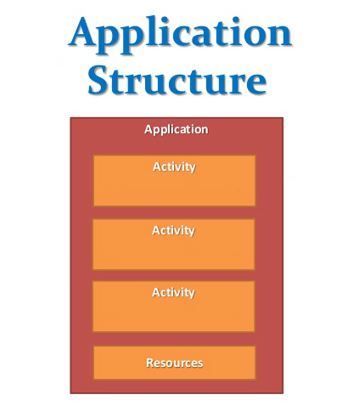
Application Structure

Slide 3
Setup Emulator
Open Android Studio
Click AVD Manager
Create Virtual Device
Pick Phone > Nexus 4 > Next
Pick x86 > Lollipop > x86_64 > Download
When done, click Next
Click Finish

Slide 4
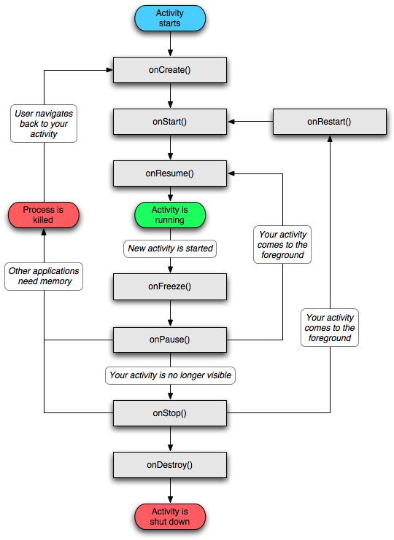
Application Lifecycle

Slide 5
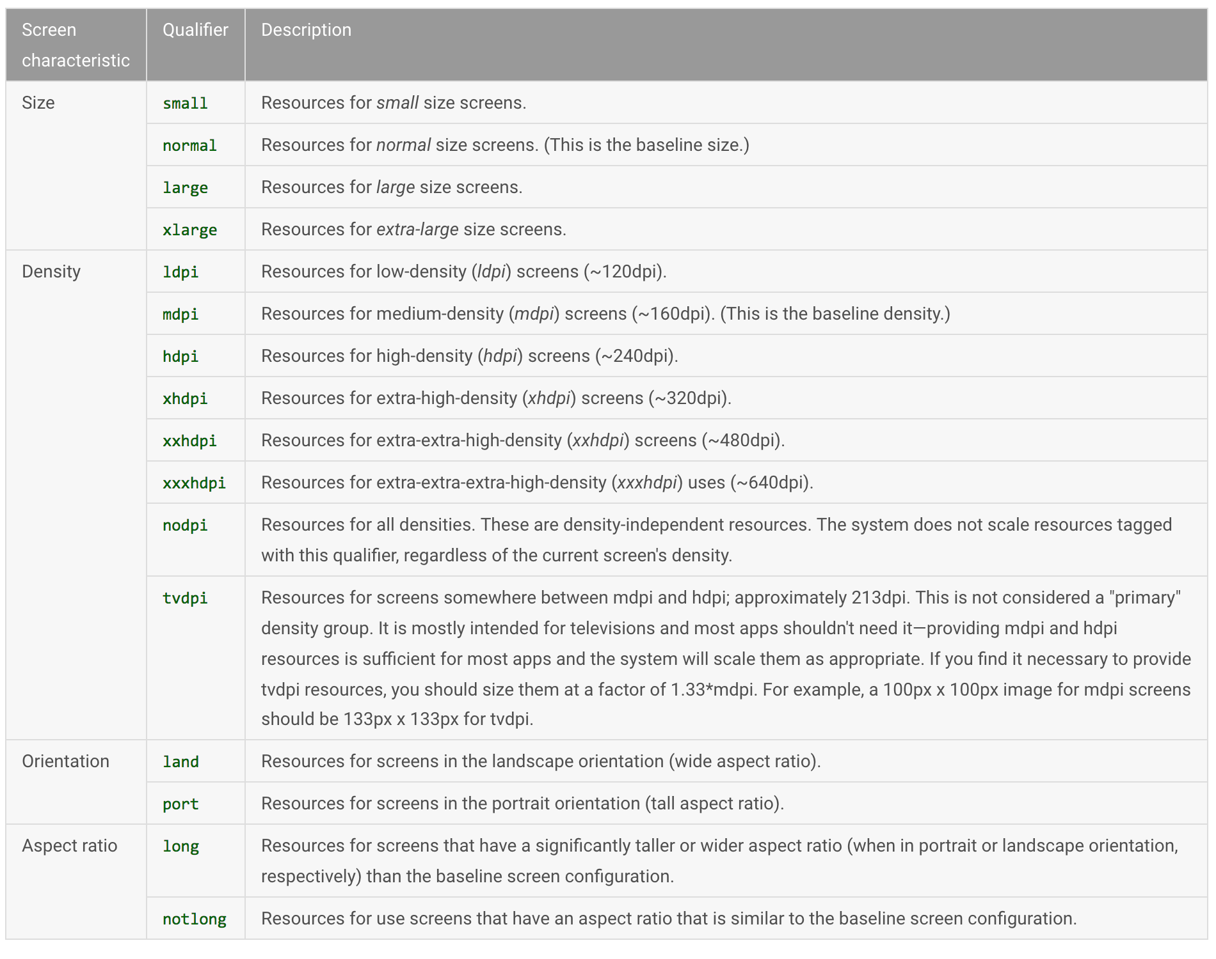
Screen Variations

Slide 6
Project Assets
https://github.com/shockrock/convert-to-code

