Slide 1
Project presentation
118010095
Yao He

Slide 2
Overview
Service Robot
amcl
Move_base
Robot control node
Rtab Map
AR_track_ depth
Gazebo simulation world

Slide 3
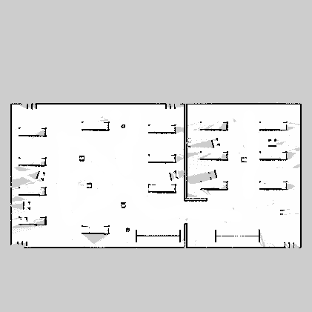
Overview
Service Robot
amcl
Move_base
Robot control node
Rtab Map
AR_track_ depth
Gazebo simulation world

Slide 4
Robot control node
Service Robot
Subscribed Topics
Published Topics
/ar_pose_marker
/odom
/move_base/status
/scan
/move_base/goal
/move_base/cancel
/cmd_vel
amcl
Move_base
Robot control node
Rtab Map
AR_track_ depth
Gazebo simulation world

Slide 5
Robot control node
Service Robot
Subscribed Topics
Published Topics
/ar_pose_marker
/odom
/move_base/status
/scan
/move_base/goal
/move_base/cancel
/cmd_vel
amcl
Move_base
Robot control node
Rtab Map
AR_track_ depth
All coordinate are manipulated in world frame /odom. TF is used for coordinate transformation.
(TF transformation is not accurate because
1. no orientation information about tag is provided in ar_track_depth
2. Tag position from ar_track_depth is not accurate in long distance）
Gazebo simulation world

Slide 6
Robot States
Service Robot
amcl
Move_base
Robot control node
Search
Deliver
Terminate
Rtab Map
AR_track_ depth
Gazebo simulation world

Slide 7
Robot States
Service Robot
amcl
Move_base
Robot control node
Search
Deliver
Terminate
Randomly sample navigation target in possible ranges
Explore the area to find targets
Go to Deliver if locates the next tag
Rtab Map
AR_track_ depth
Gazebo simulation world

Slide 8
Robot States
Service Robot
amcl
Move_base
Robot control node
Search
Deliver
Terminate
Deliver to target once find a tag
Go to Search if does not achive Tag 8
Go to Terminate if achieve Tag 8
Rtab Map
AR_track_ depth
Gazebo simulation world

Slide 9
Robot States
Service Robot
amcl
Move_base
Robot control node
Search
Deliver
Terminate
Terminate the robot after delivering to all the tags
Rtab Map
AR_track_ depth
Gazebo simulation world

Slide 10
Exception avoidance
Timers are used to monitor robot states. If the robot is stuck at one position for a long time or does not reach the navigation goals for a certain time (usually results from poor performance of move_base), the robot will start a new path planning
Subscribe to /move_base/status to monitor path planning results. If the path planning terminates or the path is invalid, the robot will start a new path planning.
Subscribe to /scan for collision avoidance.
The robot is only allowed to travel for a limited distance for safety every time it selects a new navigation goal.
Certain offsets are added to the coordinates of target during Deliver task for more possible paths.

