Slide 1
UzCrafts
National handicraft products
NORKULOV SH
MATYAKUBOV M

Slide 2
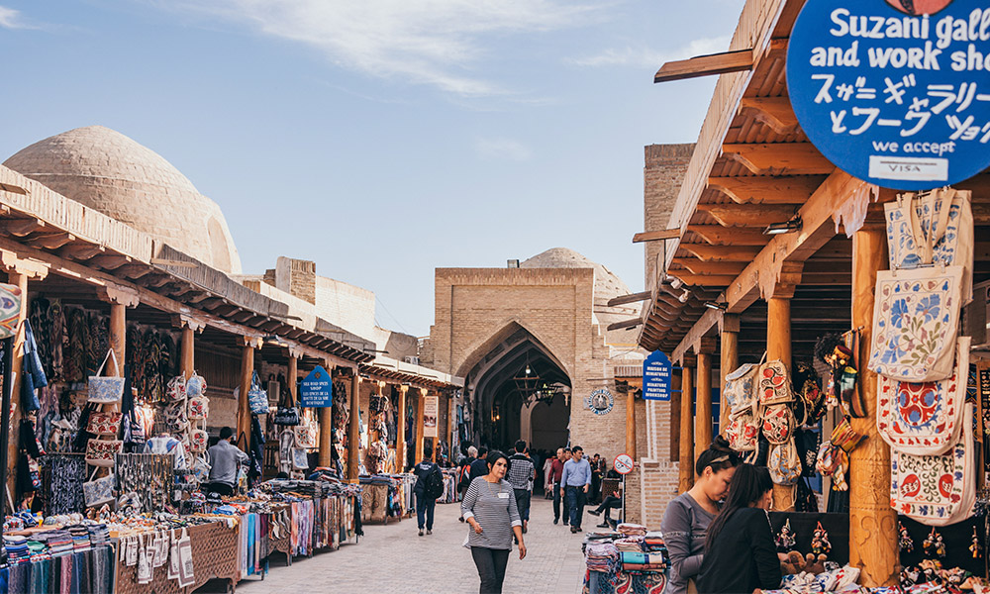
INTRODUCTION
Currently, Uzbekistan is paying great attention to the development of tourism. The development of tourism contributes to the growth of the gross domestic product, the inflow of foreign currency and additional jobs. Take Dubai, UAE as an example. Currently, the profit from tourism is 30-40 percent of the gross domestic product of the emirate.
The main historical tourism of Uzbekistan is developing. Most of the tourists coming to our country come to see our culture, traditions, historical monuments and buy handicrafts. Currently, handicraft products are mainly made in cities such as Margilon, Samarkand, Chust,

Slide 3
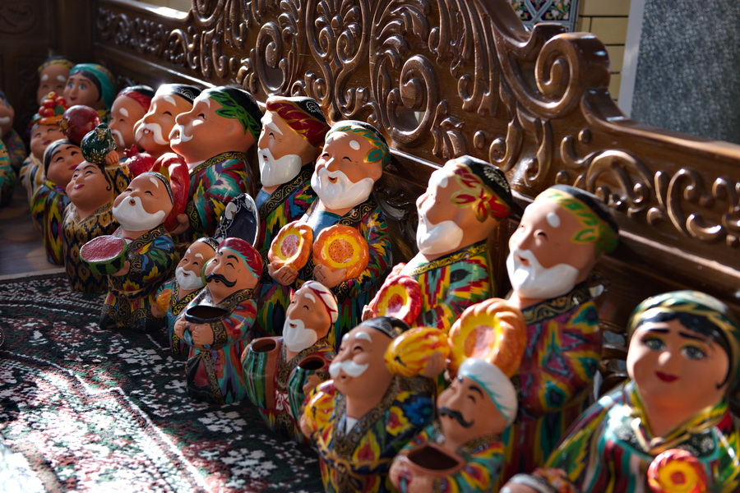
Statistics
If we pay attention to the statistics of 2021, about 1.5 million tourists visited our country, according to the statistics provided by the Ministry, tourists from far foreign countries spend an average of 709.4 dollars during their trip. The average cost of tourists from CIS countries, in particular Russia, Belarus, Armenia is 635 dollars.
It is not known that there is great interest in handmade products abroad. Every tourist returns to his country and shows or presents the handicraft products he bought to his relatives. Then this person will also be interested in our products, but he may not have enough time or money to visit Uzbekistan. Then he can order milly craft products online.

Slide 4
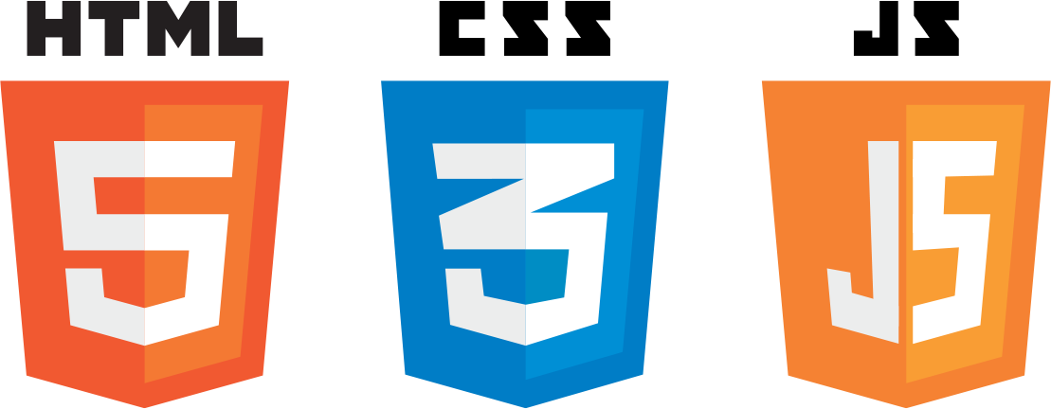


TECHNOLOGIES WE WANT TO USE
Front-end
HTML / CSS
JavaScript
Back-end
Java( Spring MVC)
MySQL

Slide 5
WHY JAVA
Java is one such programming language and was designed to create content for the early World Wide Web. It has evolved into one of the best and most comprehensive tools for the creation of enterprise websites, mobile applications, and other server-side and client-side software technologies
more than 50 million websites use Java for all types of services and dynamic content. That includes Java’s role in:
online stores
search engines
content management systems
games

Slide 6
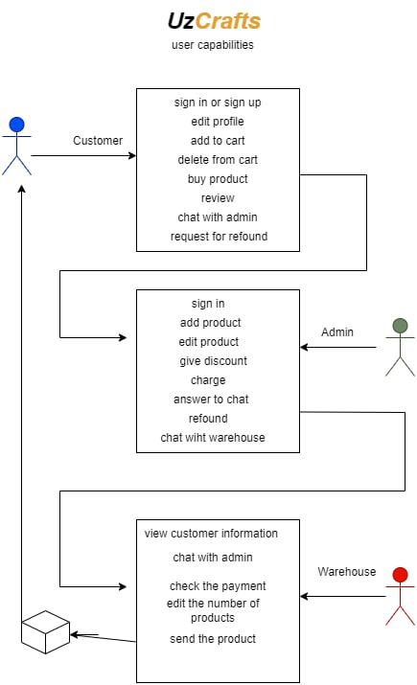
USER CAPABILITIES

Slide 7
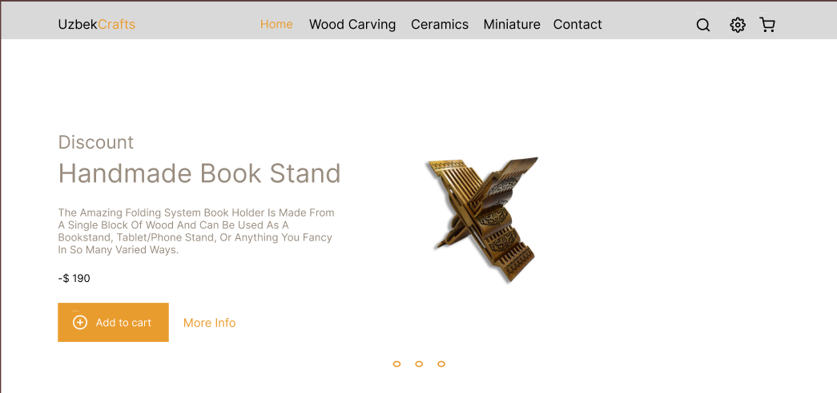
What the design looks like

Slide 8
Main page

Slide 9
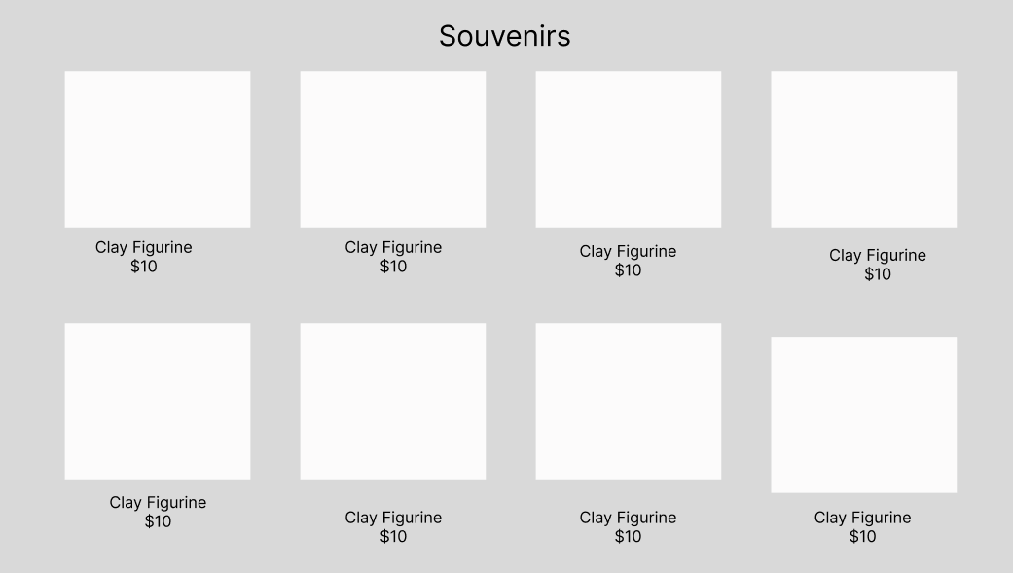
CATEGORIES

Slide 10
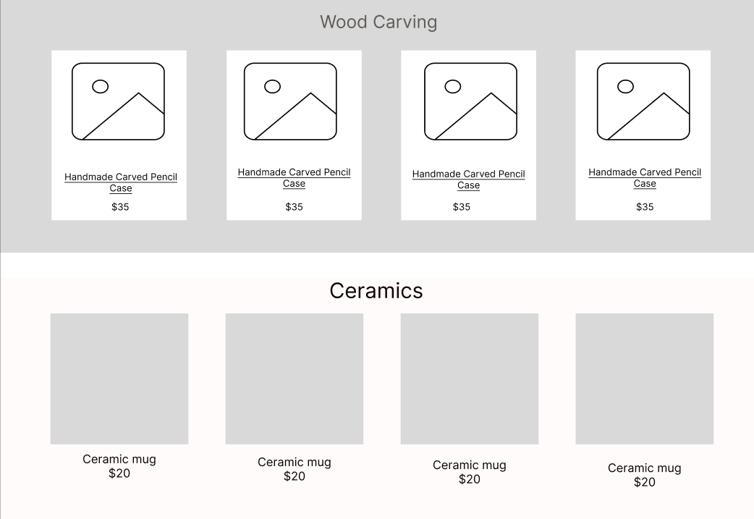

Slide 11
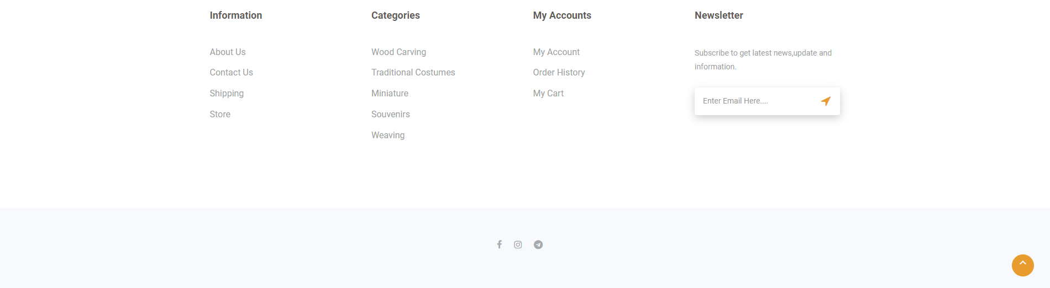
FOOTER

