Slide 1
Introduction to Hybrid MPI/Open MP
By Prof. Roman Voronov
New Jersey Institute of Technology

Slide 2
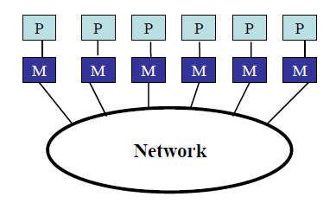
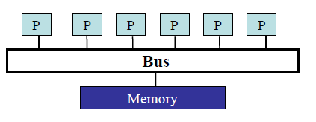
Concept Review: Shared vs Distributed Memory
Shared memory:
Each processor can access all memory
Single address space
Single OS Image
Hardware of processor interconnect :
-Bus
-Crossbar
Cluster:
Each processor has its own local memory.
Uses message passing (MPI) to exchange data between processors.
Multiple OS Images
Hardware of processor interconnect:
-Network Interface Cards & Switch

Slide 3
Concept Review: Shared vs Distributed Memory
Shared memory:
Easy to program
Good price-performance
(for small numbers of CPUs)
Uniform Memory Access (UMA)
Predictable performance
Cluster:

Slide 4

References:
We graciously thank Profs. Barth and Milfeld of the Texas Advanced Supercomputing Center (TACC) for sharing their supercomputing lecture notes, which were used as a reference for developing these course materials.

