Slide 1
Blue Waters Petascale Semester Curriculum v1.0 Unit 10: Productivity and Visualization Lesson 2: Python Scripting 2 Developed by Michael N. Groves for the Shodor Education Foundation, Inc.

Slide 2
Except where otherwise noted, this work by The Shodor Education Foundation, Inc. is licensed under CC BY-SA 4.0. To view a copy of this license, visit https://creativecommons.org/licenses/by-sa/4.0 Browse and search the full curriculum at http://shodor.org/petascale/materials/semester-curriculum We welcome your improvements! You can submit your proposed changes to this material and the rest of the curriculum in our GitHub repository at https://github.com/shodor-education/petascale-semester-curriculum We want to hear from you! Please let us know your experiences using this material by sending email to petascale@shodor.org

Slide 3
Learning Objectives
Upon completion of this lesson, students will be able to
Take a set of data, plot it, and fit it to a polynomial
Take a set of data and plot it as a histogram

Slide 4
Review: Lists
Building vectors and matrices in Python involves a structure called a List. Lists are enclosed by square brackets and can be made of any data type:
Vector: a = [0,’t’,2,’Y’,4]
Matrix: b = [[1,2,3],[4,5,6]]
Strings are just a list of characters.
c = ‘Python’
We will use Lists to store data to plot

Slide 5

NumPy logo 2020.svg by Isabela Presedo-Floyd is licensed under CC-BY-SA-4.0
NumPy contains a set of numerical routines that support scientific computing in Python. We will be using it in this lesson and it can be included in a script by typing:
import numpy as np
Then any of the numpy functions can be called by typing
np.NumPyFunction

Slide 6

A comprehensive library for creating static, animated, and interactive visualizations in Python
A complete list of functionality and HowTos are found on its website: matplotlib.org
We will examine two functions in particular: plot and hist

Slide 7
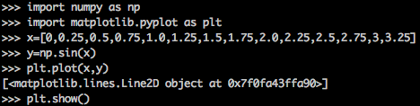
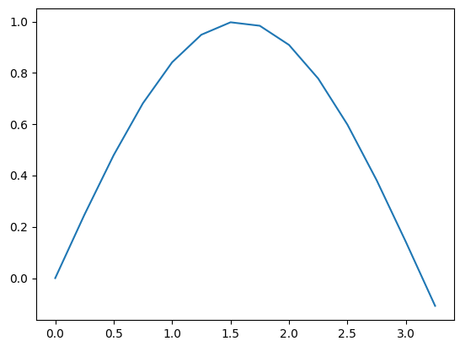
matplotlib.pyplot.plot
The plot function included in matplotlib exists in a library called pyplot. A first plot can be made by following this example:
Note
that without any other options the plot
function connects the data with straight
lines.
‘plt.show()’ makes the plot appear

Slide 8
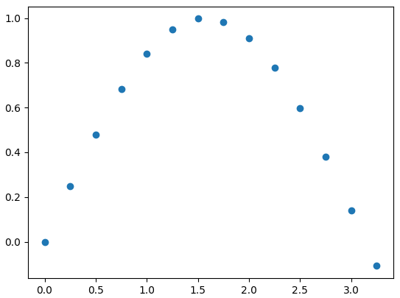
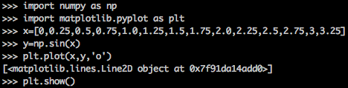
Formatting the Data
The basic syntax for the plot function is
plot(xdata, ydata, format)
‘format’ can be substituted with a string
that where the user can change the
marker, line and color. See the references
for more details

Slide 9
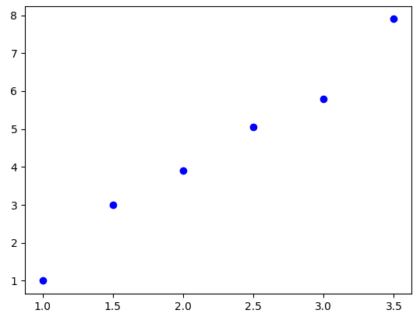
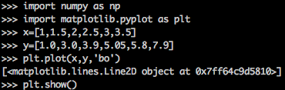
Fitting Data to a Line - Data
We will fit a line to the following data

Slide 10
numpy.polyfit
The polyfit function included in numpy will fit data to polynomials of degree n using a least squares method. Its basic syntax is:
fit = np.polyfit(x, y, degree)
where
np invokes the numpy library previous imported
x,y are the data
degree is the degree of the polynomial. For a line, this is 1

Slide 11
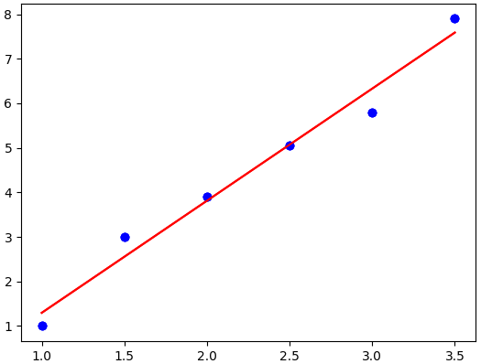
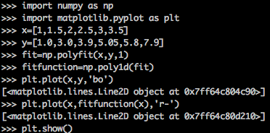
Fitting Data to a Line - Using polyfit
Here is an example using polyfit. We use another numpy function (poly1d) to convert the output of polyfit so that it can be used as a function with the data.
Notice the ‘r-’ in the format of the second
plot function which gives the line its color.

Slide 12

polyfit - Slope and y-intercept
If you print the information saved in the fit variable from the output of polyfit
You will get the slope and the y-intercept
For the fitted line the equation is
In general, polyfit will output a list of
coefficients from the highest to lowest
polynomial order term

Slide 13
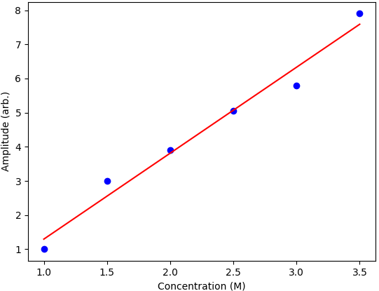
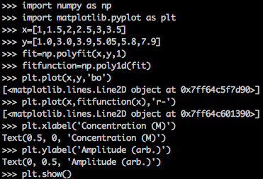
Adding Axis Labels
Using the plt.xlabel(x-axis label) and plt.ylabel(y-axis label), the axes can be labeled
Note that the arguments are strings

Slide 14
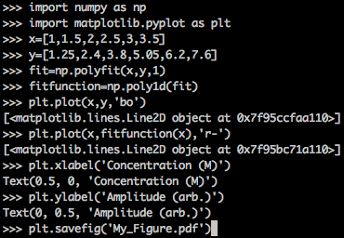
Saving the Plot to a PDF
The savefig command will save the figure to a file.
The type of file is defined by the extension so to save a .pdf add
plt.savefig(‘My_Figure.pdf’)
after defining all the parts of the figure.

Slide 15
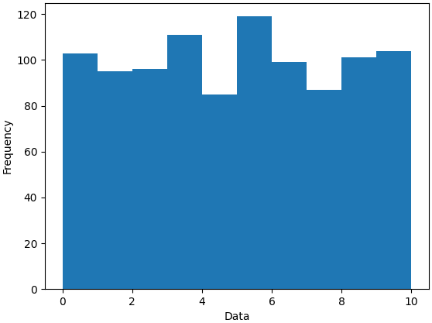
Histograms
Histograms are plots that illustrates the frequency of a certain group of data
They are typically plotted as vertical bars where
x-axis label identifies the group
y-axis label identifies the frequency

Slide 16
MatPlotLib hist Function
In MatPlotLib, the hist is the histogram function. The basic usage is
import matplotlib.pyplot as plt
data=[list of histogram data]
mybins=[list of group limits]
plt.hist(x=data, bins=mybins)
The data is the list of information you want to group
The bins is how you want to group it

Slide 17
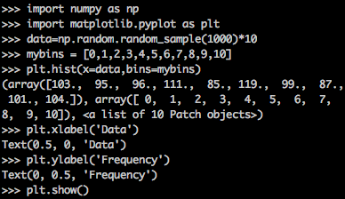
hist Example
-Data comes from random number
generator between 0-10
-Bins set to group data by the integer

Slide 18
Summary
MatPlotLib is a fully featured plotting suite
The plot function will plot x,y data points in a scatter or join data by lined segments
The hist function will plot grouped data using bars that indicate the frequency each data point appears

