Slide 1
Blue Waters Petascale Semester Curriculum v1.0 Unit 2: Parallel Computing Concepts Lesson 1: Types of Parallel Work: Data and Task Parallelism Developed by Peter J. Hawrylak for the Shodor Education Foundation, Inc.

Slide 2
Except where otherwise noted, this work by The Shodor Education Foundation, Inc. is licensed under CC BY-SA 4.0. To view a copy of this license, visit https://creativecommons.org/licenses/by-sa/4.0 Browse and search the full curriculum at http://shodor.org/petascale/materials/semester-curriculum We welcome your improvements! You can submit your proposed changes to this material and the rest of the curriculum in our GitHub repository at https://github.com/shodor-education/petascale-semester-curriculum We want to hear from you! Please let us know your experiences using this material by sending email to petascale@shodor.org

Slide 3
Lesson Learning Objectives
Define data parallelism and describe an example of data parallelism.
Define task parallelism and describe an example of task parallelism.
Justify data parallelism aspects of a given problem.
Justify task parallelism aspects of a given problem.

Slide 4
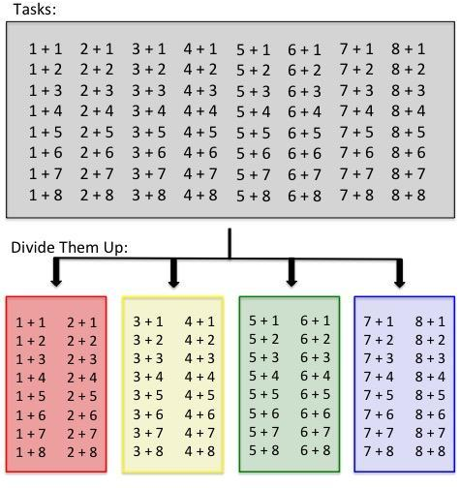
Data Parallelism
Building an addition table for 0-9:
(Adding a bunch of numbers together.)
Data Parallelism
Each processing element performs the same (or nearly same) computation on a small piece of the larger problem.
Problem is broken down into smaller chunks and each processing element performs the same task on one chunk of the larger problem.
Data Parallelism ➔
Notes:
Example at right shows the process of building an addition table for 0-9 (adding a bunch of numbers together). Here the data are divided into 4 chunks and each processing element computes the sums for each chunk.

Slide 5
Task Parallelism
Task Parallelism
Each processing element performs one task in solving the larger problem.
Each task handles all of the problem data set
Assembly line type process

Slide 6
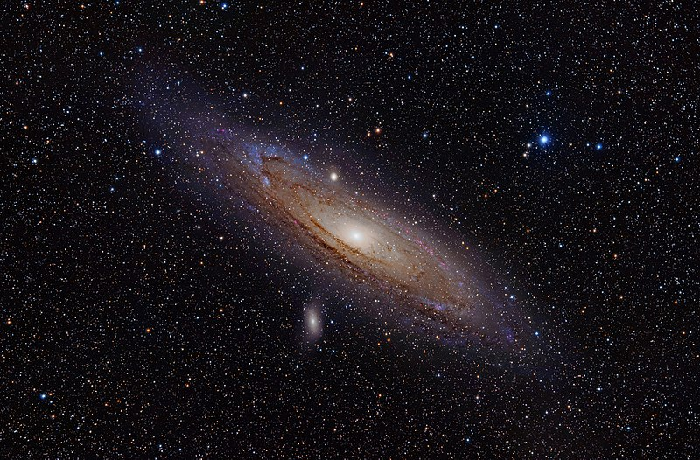
Example 1 – Data or task parallel? Why?
Simulating Galaxy Formations
n-Body Problem
Many particles moving in 3D
Particles exert force of all other particles
Each particle changes velocity and acceleration due to these forces
Need to know position of each particle at each point in time
Image: M31, the Andromeda Galaxy (now with h-alpha) by Adam Evans is licensed under CC BY-SA 3.0
Notes:
A good resource is: GalaxSee HPC Module 1: The N-Body Problem, Serial and Parallel Simulation by David A. Joiner Kean University, Union, New Jersey located at: http://shodor.org/petascale/materials/UPModules/NBody/
This has aspects of both data and task parallelism.
There are specific tasks:
Updating particle positions, velocities, and accelerations
Communicating this information to the other particles
There are specific data parallelism:
Assign one particle per processing element – this computes the position, velocity, and acceleration for that particle

Slide 7
Example 2 - Data or task parallel? Why?
Need to build 50 computers for a lab
IT has a team of 5
Notes:
This is both.
Task parallel:
(1) Each team member performs 1 out of 5 steps in building the computer – assembly line type operation.
Data parallel:
(1) Each team member builds 10 computers from start to end

Slide 8
Example 3 - Data or task parallel? Why?
Matrix multiplication
Multiply 2 n x n matrices
n x n
Row
n x n
Column
x
Notes:
This is data parallelism – divide data of rows in left matrix to compute one row of the result.

Slide 9
Summary
Define data parallelism and describe an example of data parallelism.
Different data, same operations on many processing elements
Define task parallelism and describe an example of task parallelism.
Different tasks processing all of the data set.
Think of an assembly line.
Justify data parallelism aspects of a given problem.
Justify task parallelism aspects of a given problem.
Problems may have both data and task parallelism.

