Slide 1
Blue Waters Petascale Semester Curriculum v1.0 Unit 6: Hybrid MPI + OpenMP Lesson 2: When to Use OpenMP vs. MPI vs. Both Developed by Colleen Heinemann for the Shodor Education Foundation, Inc.

Slide 2
Except where otherwise noted, this work by The Shodor Education Foundation, Inc. is licensed under CC BY-SA 4.0. To view a copy of this license, visit https://creativecommons.org/licenses/by-sa/4.0 Browse and search the full curriculum at http://shodor.org/petascale/materials/semester-curriculum We welcome your improvements! You can submit your proposed changes to this material and the rest of the curriculum in our GitHub repository at https://github.com/shodor-education/petascale-semester-curriculum We want to hear from you! Please let us know your experiences using this material by sending email to petascale@shodor.org

Slide 3
Goal
Here, we are going to look at the higher level concepts associated with programming for shared memory and distributed memory combined
Look at when to use a hybrid OpenMP+MPI model vs. an OpenMP model vs. an MPI model
Refresh: What is shared memory? What are examples of when it’s useful?
Refresh: What is distributed memory? What are examples of when it’s useful?

Slide 4
Introduction
Hybrid parallelism maximizes of the strengths of distributed memory and shared memory at the same time
One possible combination of programming models for this is OpenMP+MPI

Slide 5
Why Hybrid Parallelism over Other Types?
Works well for complex problems that can split data up across distributed memory and do a large number of complex computations
Works for problems that would take too long to run or wouldn’t be feasible without using the maximum amount of parallelism possible
Works for problems that can be divided across distributed memory and those disjoint parts (with some communication) can be split across multiple threads

Slide 6
How Does it Work?
Multiple MPI processes exist and each process forks into multiple OpenMP threads
Threads of one process are able to share memory with each other, but those threads cannot share memory with threads of another process; thus, messages must be passed back and forth to share data
fork/join threads using OpenMP
t0
t1
t2
t3
t0
t1
t2
t3
t0
t1
t2
t3
Process 0
Process 1
Process 2
send messages using MPI

Slide 7
Exercises

Slide 8
Exercise #1: When to Use Hybrid?
Now that we understand what hybrid parallelism is and why you might use it, let’s look at some examples and see if we can figure out what type of parallelism would be the most useful for each: shared memory, distributed memory, or hybrid shared+distributed memory
Note that there are many times where any type of parallelism would provide some type of speedup, but the goal is to find the right type of parallelism for the specific problem you’re looking at

Slide 9
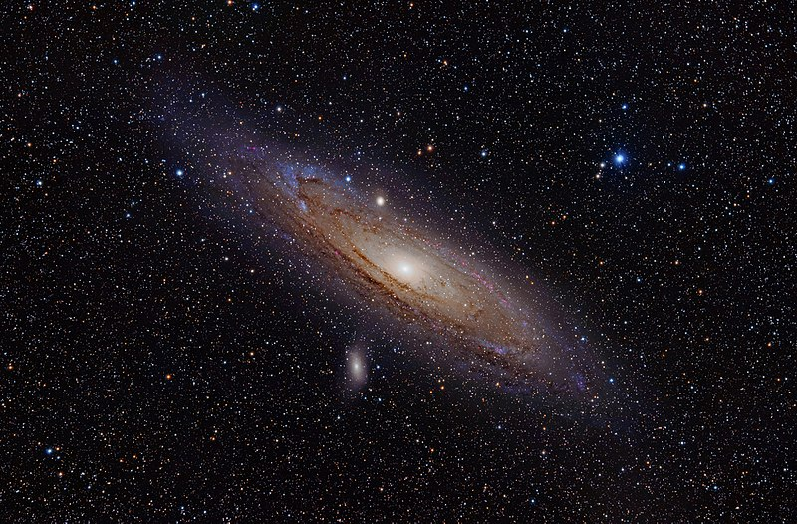
Exercise #1, cont.
An astronomical model where we want to analyze 16 disjoint galaxies. Calculations will be run on every individual star in each galaxy
OpenMP, MPI, or hybrid?
WHY?
Image: Andromeda Galaxy (with h-alpha).jpg by Adam Evans is licensed under CC-BY-2.0

Slide 10
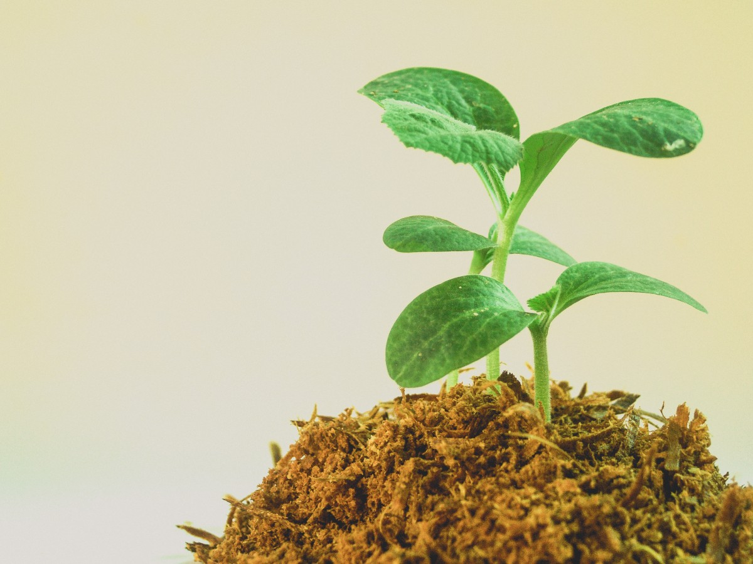
Exercise #1, cont.
We want to calculate the photosynthetic rate of each individual leaf of 10,000 different plants. The photosynthetic rate of one plant does not affect the photosynthetic rate of another, but the photosynthetic rate of one leaf of a plant can affect the photosynthetic rate of another leaf on the same plant
OpenMP, MPI, or hybrid?
WHY?
Image: Young tree is in the public domain

Slide 11

Exercise #1, cont.
We need to analyze the amount of traffic that goes through a neighborhood with 4 intersections to determine whether or not putting traffic lights in would be helpful
OpenMP, MPI, or hybrid?
WHY?
Image: Traffic Light is in the public domain

Slide 12
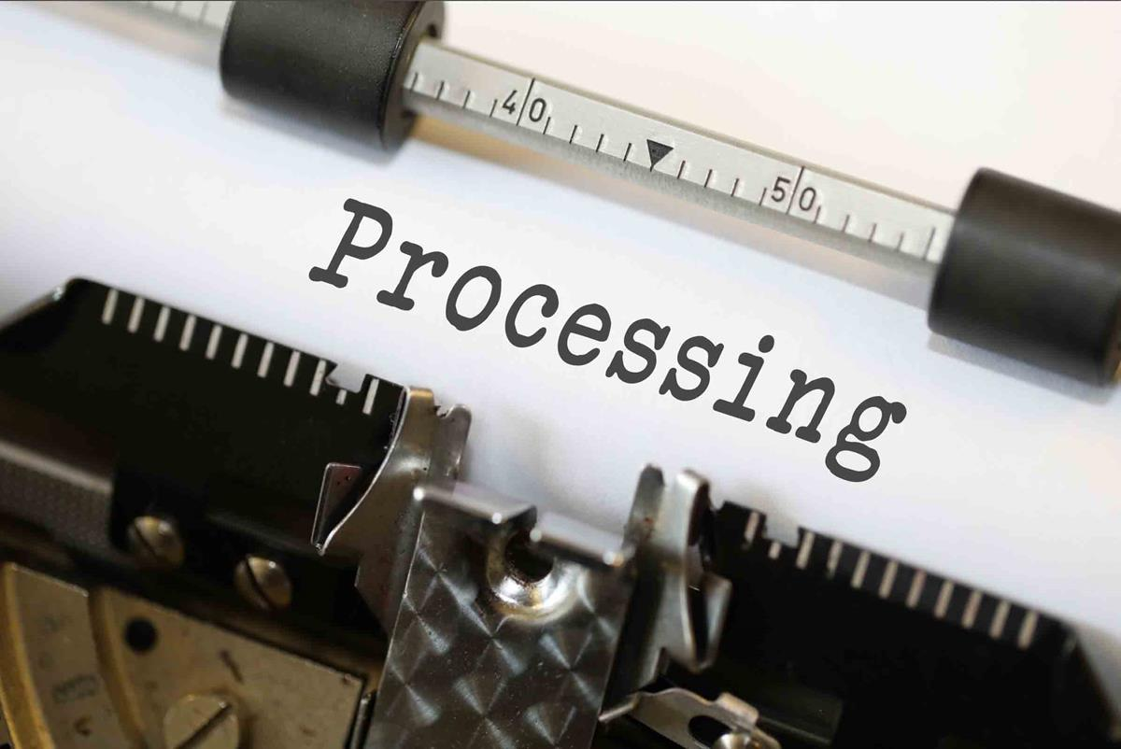
Exercise #1, cont.
We will perform a scalability student on an image processing algorithm to see how well the algorithm scales with really large datasets. The example dataset you will run your strong and weak scalability studies on is 4 TB in size
OpenMP, MPI, or hybrid?
WHY?
Image: Processing by Nick Youngson is licensed under CC BY-SA 3.0

Slide 13
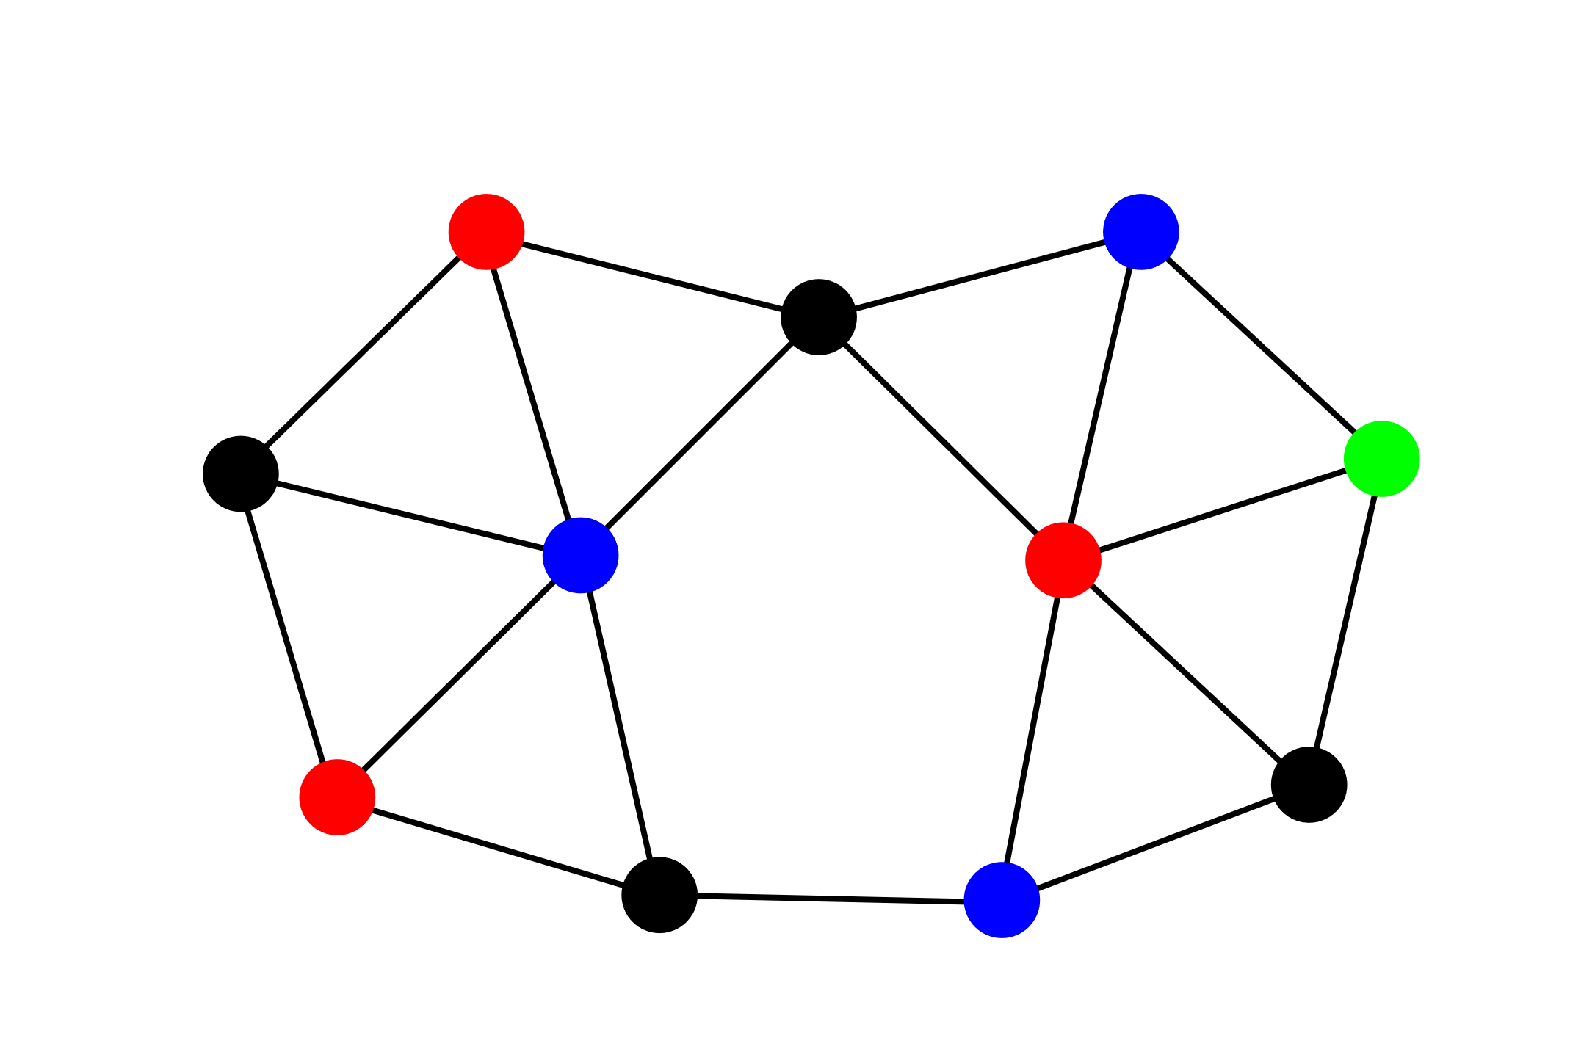
Exercise #1, cont.
The goal is to build a graph that represents a photograph of a landscape as seen from up above (image that it is a picture taken from an airplane). The nodes of the graph will represent different sections of the landscape, but each pixel of the graph requires information about other pixels so that it can determine whether or not the pixels are in the same section of the graph that is being generated. Your image is 512x512 pixels
OpenMP, MPI, or hybrid?
WHY?
Image: Penny graph 11 nodes.svg by Syp is licensed under CC0 1.0

Slide 14

Exercise #1, cont.
The visualization we want to build contains 27 billion total elements laid out as a cube. There are 3072 files that will be read into the visualization software. Each file is a sub-grid of the full cube that contains 192x129x256 cells
OpenMP, MPI, or hybrid?
WHY?
Image: Nested Winding Cubic is in the public domain

Slide 15
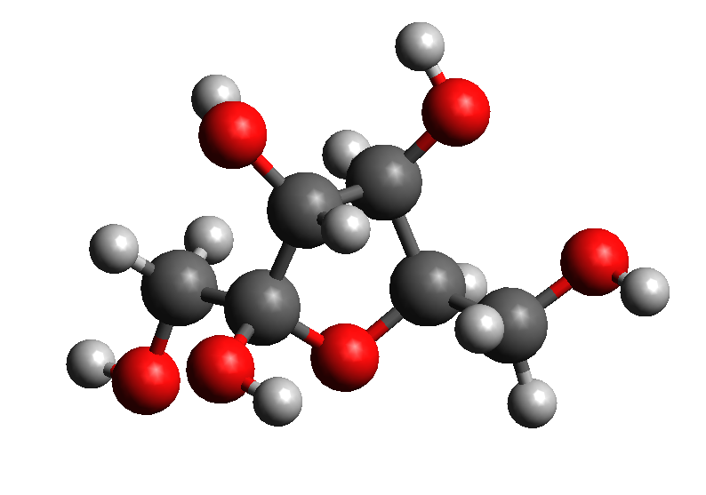
Exercise #1, cont.
We want to run 8 completely different chemical reactions and from the data gathered, we can the build the output molecular model. Two additional pieces of information are gathered from each chemical reaction: the final amount of the reactant and the final amount of the product
OpenMP, MPI, or hybrid?
WHY?
Image: Fructose 3D ball-and-stick model.png by That kiwi guy is licensed under CC-BY-SA-3.0

Slide 16
Exercise #2: Running Applications with OpenMP, MPI, and OpenMP+MPI
This example involves running numerous different applications with OpenMP, with MPI, and with hybrid OpenMP+MPI to see which version works the best for each application
Analyze the results from the combination of version and application as well as the scalability of each application with each version
Instructions are in Exercise Instructions document

