Slide 1
Introduction to Linux Command Line Interface (Terminal)
Linh B. Ngo

Slide 2
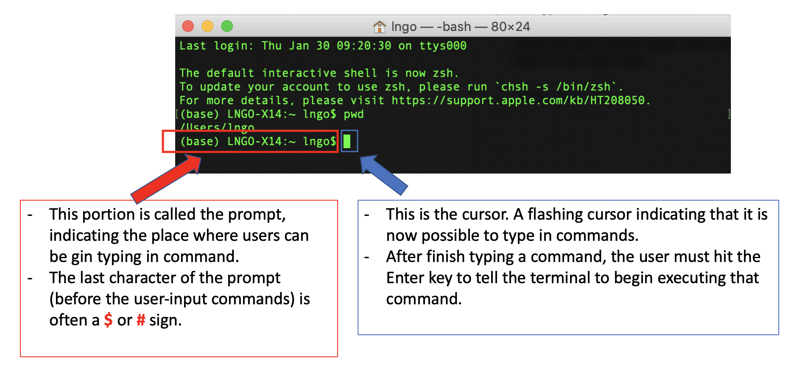
Linux Terminal
Remote access
Linux terminal is the CLI interface to interact with Linux-based systems.

Slide 3
Linux Terminal
REPL
READ
EVALUATE
PRINT
LOOP

Slide 4
Exercise
In a terminal, types “Hello, World” and hits Enter.
What happens?
In a terminal, types echo “Hello, World” and hits Enter.
What happens?
Make the terminal display another message.

Slide 5
Directory and File Structures
Path: a sequence of directories connected together by the slash “/” character.
The root directory of a Linux (or Unix-based) file system is also represented by a “/”.
Absolute path.
Relative path.
Working directory: “pwd”.
Special designations:
“~”: Users home directory
“.”: The current directory.
“..”: The directory one level above the current directory.
To view directory and file contents, we can use the “ls” command (listing).

Slide 6
Navigating inside the Linux filesystem
Terminal-based
Command: “cd”

Slide 7
Create Directories
mkdir
mkdir -p

Slide 8
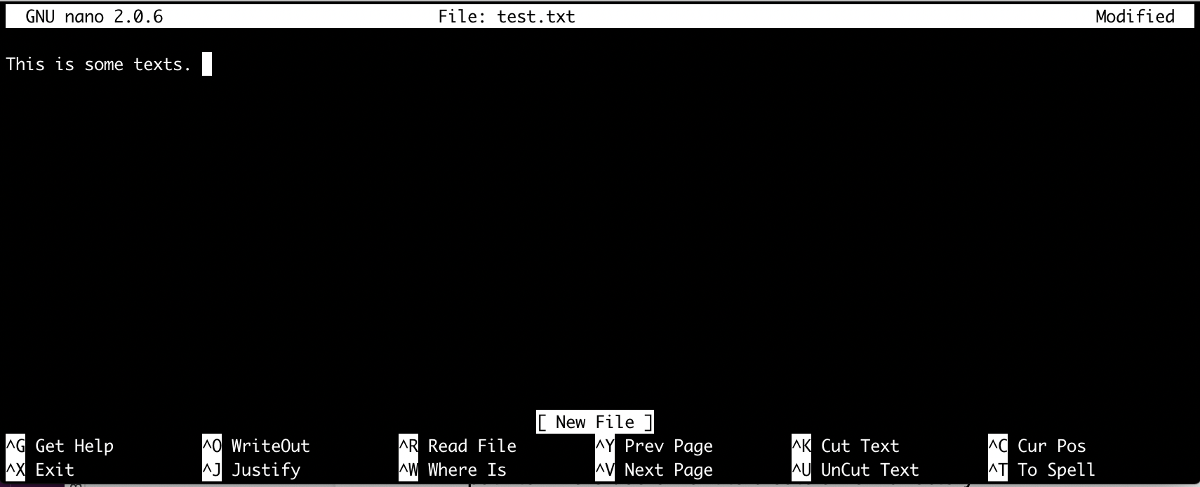
Create and edit files with nano

Slide 9
Delete file and directories
rm
rm -R
rm -Rf

