Slide 1
Blue Waters Petascale Semester Curriculum v1.0 Unit 11: Domain Science: Astrophysical Fluid Dynamics Lesson 4: MPI Simulations and Visualization Developed by Marc Gagné and Roman Voronov for the Shodor Education Foundation, Inc.

Slide 2
Except where otherwise noted, this work by The Shodor Education Foundation, Inc. is licensed under CC BY-NC 4.0. To view a copy of this license, visit https://creativecommons.org/licenses/by-nc/4.0 Browse and search the full curriculum at http://shodor.org/petascale/materials/semester-curriculum We welcome your improvements! You can submit your proposed changes to this material and the rest of the curriculum in our GitHub repository at https://github.com/shodor-education/petascale-semester-curriculum We want to hear from you! Please let us know your experiences using this material by sending email to petascale@shodor.org

Slide 3
PLUTO Setup
Modern codes like PLUTO are built with a large number of available modules, which users switch on based on the type of problem they want to solve.
You learned in 11.3 Activity 1 that you select the modules you wish to employ in the definitions.h file (a C include file), you define the mesh, the length of your simulation, and the output format and frequency in the pluto.ini file.
The init.c file (a C source code file) is used to define initial conditions, and boundary conditions.

Slide 4
Initial Conditions
Initial conditions define the state (density, pressure, velocity, magnetic field, etc.) of our simulation volume (at every zone in space) at the start of the simulation (t=0).
In PLUTO, initial conditions are set within the main Init call, and are executed once at the start of the simulation.
In today’s lesson we will consider a simple initial condition: an interface separating two fluids with different densities in hydrostatic balance. Though simple to start, this leads to a classic phenomenon called the Rayleigh–Taylor instability.
For example, water, which is denser than oil, is suspended atop oil. We model the problem with two plane-parallel layers of fluid; both fluids subject to the Earth's gravity.

Slide 5
Boundary Conditions
Boundary conditions dictate what the fluid does at the boundaries of the mesh. “These boundary conditions include inlet boundary conditions, outlet boundary conditions, wall boundary conditions, constant pressure boundary conditions, axisymmetric boundary conditions, symmetric boundary conditions, and periodic or cyclic boundary conditions. Transient problems require one more initial condition, where initial values of flow variables are specified at nodes in the flow domain.”
In our problem, the boundary conditions are periodic at the side of the container, and periodic at the bottom boundary of our rectangular 2D container. We will modify these boundary conditions at the end of the first activity.

Slide 6
The Rayleigh-Taylor Instability
“The equilibrium here is unstable to any perturbations or disturbances of the interface: if a parcel of heavier fluid is displaced downward with an equal volume of lighter fluid displaced upwards, the potential energy of the configuration is lower than the initial state. Thus the disturbance will grow and lead to a further release of potential energy, as the more dense material moves down under the (effective) gravitational field, and the less dense material is further displaced upwards. This was the set-up as studied by Lord Rayleigh. The important insight by G. I. Taylor was his realisation that this situation is equivalent to the situation when the fluids are accelerated, with the less dense fluid accelerating into the more dense fluid. This occurs deep underwater on the surface of an expanding bubble and in a nuclear explosion.” - Wikipedia

Slide 7
The Rayleigh-Taylor Instability
This problem illustrates that a simple set of initial conditions, boundary conditions, and physical processes (gravitational acceleration of two fluids of different density) leads to very complex, non-deterministic phenomena.
These phenomena arise from small seed fluctuations that are amplified as the program solves the Navier-Stokes PDEs forward in time from the simple initial condition. The remarkable (and somewhat mysterious) result is that, just like reality, each simulation is qualitatively similar, but different in detail.
Think about that next time you’re stirring cream in your coffee.
Further reading: https://en.wikipedia.org/wiki/Rayleigh-Taylor_instability

Slide 8
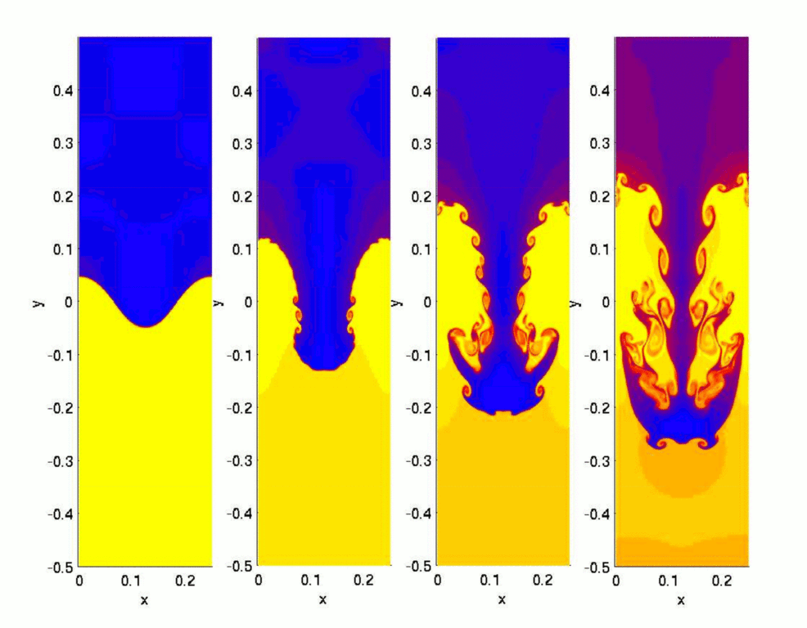
The Rayleigh-Taylor Instability
This image shows the time evolution of a 2D simulation of the Rayleigh-Taylor Instability problem.
Note the swirls that form along the interface between the denser blue fluid and the lighter yellow fluid. This is caused by velocity shear as the blue fluid moves past the yellow fluid. This is a related phenomenon known as the Kelvin-Helmholtz instability.

Slide 9
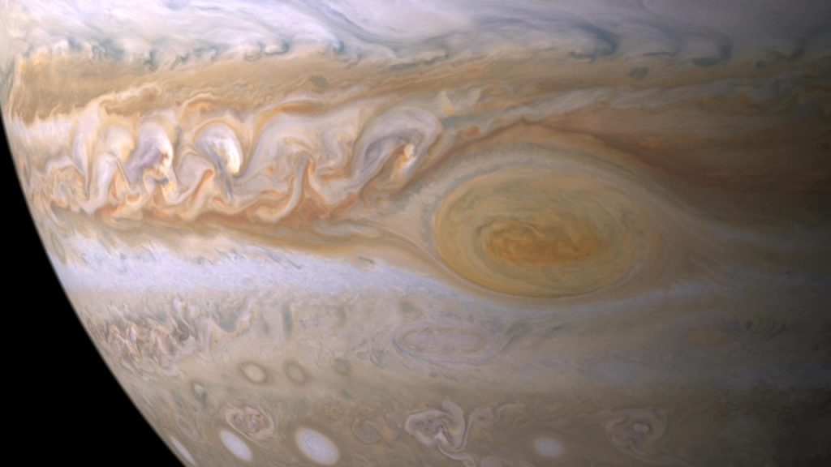
The Kelvin-Helmholtz Instability
“Spatially developing 2D Kelvin-Helmholtz instability at low Reynolds number. Small perturbations, imposed at the inlet on the tangential velocity, evolve in the computational box. High Reynolds number would be marked with an increase of small scale motions.” - Wikipedia
The cloud layers on Jupiter are stratified in latitude creating alternating bands. The bands flow in opposite directions, creating shear at the interface. The resulting Kelvin-Helmholtz instability creates the swirls seen here in Jupiter’s upper atmosphere. Image credit: NASA/ESA/GSFC

Slide 10
11.4 Activity 1
We will initialize, and run a set of PLUTO MPI simulations of the Rayleigh-Taylor Instability. See:
http://plutocode.ph.unito.it/Doxygen/Test_Problems/_m_h_d_2_rayleigh___taylor_2init_8c.html
The problem can be setup in 2D or 3D, with or without a horizontal magnetic field, and with different time-stepping, and interpolation schemes.
The system is destabilized by perturbing the vertical velocity in near the interface using a single mode perturbation (in 2D) or a Gaussian perturbation (in 3D). Alternatively, a random perturbation can be used by setting USE_RANDOM_PERTURBATION to YES in your definitions.h. The runtime parameters that are read from pluto.ini are:
[ETA]: sets the density of the upper fluid;
[GRAV]: sets gravity (must be < 0);
[CHI]: sets the magnetic field strength in units of the critical magnetic field Bc;

Slide 11
11.4 Activity 2
In the second activity we will use VisIt to visualize the output from run01 and run05 of our Rayleigh-Taylor Instability simulations.
run01 was run on the default grid, with no magnetic field, density contrast of 2.0, and periodic boundary conditions.
run05 was run on a larger grid, with magnetic field 0.2, density contrast 2.5, and reflective boundary conditions.
We will use a Pseudocolor plot of density to examine the evolution of the instability, and compare the effects of the magnetic field, and the reflective/periodic boundary conditions.

