Slide 1
Blue Waters Petascale Semester Curriculum v1.0 Unit 3: Using a Cluster Lesson 2: Parallel Architecture 2 Developed by Peter J. Hawrylak for the Shodor Education Foundation, Inc.

Slide 2
Except where otherwise noted, this work by The Shodor Education Foundation, Inc. is licensed under CC BY-NC 4.0. To view a copy of this license, visit https://creativecommons.org/licenses/by-nc/4.0 Browse and search the full curriculum at http://shodor.org/petascale/materials/semester-curriculum We welcome your improvements! You can submit your proposed changes to this material and the rest of the curriculum in our GitHub repository at https://github.com/shodor-education/petascale-semester-curriculum We want to hear from you! Please let us know your experiences using this material by sending email to petascale@shodor.org

Slide 3
Lesson Learning Objectives
Evaluate a loop to see if it is a candidate for parallelization using a vector architecture.
Employ Foster’s methodology (see: Designing and Building Parallel Programs, by Ian Foster, available at: https://www.mcs.anl.gov/~itf/dbpp/ ) for designing parallel programs for a given architecture.

Slide 4
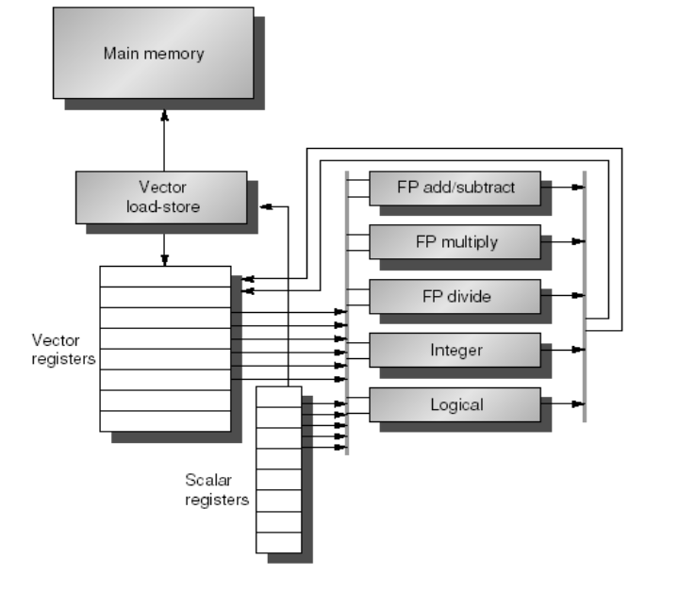
Vector Architecture Review
Same operation on multiple data → SIMD approach
“Vector” contains the data
GPUs excel at this
Loop-carried dependencies reduce parallelism
Must identify these → parallelizing this will yield incorrect results
May be able to restructure code to eliminate → try this

Slide 5
Loop Unrolling
Vector architectures basically unroll loops
Goal is to completely unroll the loop
Unrolling the loop does more work per iteration
Basically undoing the feature of the loop → fewer lines of code
Small loops are more easily understood and coded → let the tools do the behind-the-scenes work and focus on the algorithm
Loop unrolled 1 time
Array y is an array of integers
FOR x = 1 to n/2
y[x] ← y[x] * 7
y[x+(n/2)] ← y[x+(n/2)] * 7
END FOR
Original code - loop not unrolled
Array y is an array of integers
FOR x = 1 to n
y[x] ← y[x] * 7
END FOR
Loop Unrolled
1 Time
Notes:
Unrolled loop goes through the loop half as many times as the original

Slide 6
Why unroll a loop?
Original code - loop not unrolled
Array y is an array of integers
FOR x = 1 to n
y[x] ← y[x] * 7
END FOR
Reduce/eliminate loop overhead
Instructions to update loop counters → x in the example
Instructions to check loop exit or continue conditions → Is x less than n/2?
Conditional Branches are VERY COSTLY in terms of hardware and performance
Excellent fit for SIMD architectures --> GPUs
Many math-based problems fall into this category
Do not forget vector instructions on CPUs
Loop unrolled 1 time
Array y is an array of integers
FOR x = 1 to n/2
y[x] ← y[x] * 7
y[x+(n/2)] ← y[x+(n/2)] * 7
END FOR

Slide 7
Loop Carried Dependencies
Iteration X depends on data from iteration (X-1)
Serialization is enforced → previous iterations must finish first
Parallelizing this will yield incorrect results
Parallel code MUST yield the SAME result as the serial code
It must be correct
Compilers are getting better at identifying these cases and not parallelizing the loop
Not all cases can be identified
Not all compilers support this
Loop Carried Dependency Example:
Array y is an array of integers
FOR x = 1 to n
y[x] ← y[x-1]*y[x]
END FOR
Note: Dependencies may be multi-level and difficult to spot for the compiler and the human (coder)
Notes:
Example shows a simple for loop with a loop carried dependence due to the update of y[x] needing the previous value y[x-1]

Slide 8
Employing Foster’s Methodology (1)
Parallelize matrix multiplication
Multiply 2, N x N matrices, A ← B x C
Step 1: Partitioning
Domain or Functional Decomposition? Both?
1) Multiply row of B by a column of C
2) Sum the product vector together to get 1 element of A
Develop a partitioning strategy for this problem.
Notes:
Have students work through this in class
Domain decomposition – break up by rows or elements of matrix A
Functional decomposition – break up by computations – all multiplications and then computing the sums
Are the tasks load-balanced?

Slide 9
Employing Foster’s Methodology (2)
Parallelize matrix multiplication
Multiply 2, N x N matrices, A ← B x C
Step 2: Communication
What messages must be communicated between tasks?
What data must be shared?
Is communication overhead too large?
Can communication overhead be reduced/minimized? If so, how?
Look at other methods for computing the product of 2 matrices.
Develop a communication strategy for this problem.
Notes:
Have students work through this in class
Domain decomposition – How will data be shared? What data must be transmitted between processes? What is communication overhead? Ways to reduce? Is blocking an approach that would help?
Functional decomposition – break up by computations – How will data be shared? What data must be transmitted between processes? What is communication overhead? Ways to reduce? Is blocking an approach that would help? What will the summing step look like? Is it too complex?
Is the communication load-balanced?
Are the operations concurrent or serial? Try to get as much concurrency as possible.

Slide 10
Employing Foster’s Methodology (3)
Parallelize matrix multiplication
Multiply 2, N x N matrices, A ← B x C
Step 3: Agglomeration
What architecture(s) would be well suited for this problem?
How will you map tasks to processes?
What are the data sharing and communication needs with the grouping?
Can the approach easily adapt to different numbers of processing elements? If not, what can be done to make it more adaptable?
Develop an agglomeration strategy for this problem.
Notes:
Have students work through this in class
SIMD architecture is a good choice for this problem. Consider blocking and other techniques to reduce communication or improve memory access during the computation.

Slide 11
Employing Foster’s Methodology (4)
Parallelize matrix multiplication
Multiply 2, N x N matrices, A ← B x C
Step 4: Mapping
How will you map processes to processing elements?
Are concurrent operations on different processing elements?
What are the data sharing and communication needs with the grouping?
What are the costs of communication and manager processes? Can these be reduced?
Develop an agglomeration strategy for this problem.
Notes:
Have students work through this in class
SIMD architecture is a good choice for this problem. Consider blocking and other techniques to reduce communication or improve memory access during the computation.
Load-balancing is a good approach for data decomposition problems
Task-scheduling is a good approach for function decomposition problems
Students may have done this in Step 3 by combining Steps 3 and 4. → this is fine

Slide 12
Summary
Evaluate a loop to see if it is a candidate for parallelization using a vector architecture.
No loop-carried dependencies
Loop-carried dependencies will lead to incorrect results
Employ Foster’s methodology for designing parallel programs for a given architecture.
Create multiple options at each step – select best option but have other options if later steps show approach does not scale well
Recheck scalability after each step.

