Slide 1
Blue Waters Petascale Semester Curriculum v1.0 Unit 3: Using a Cluster Lesson 3: Using a Linux Command Line Developed by Linh B. Ngo for the Shodor Education Foundation, Inc.

Slide 2
Except where otherwise noted, this work by The Shodor Education Foundation, Inc. is licensed under CC BY-NC 4.0. To view a copy of this license, visit https://creativecommons.org/licenses/by-nc/4.0 Browse and search the full curriculum at http://shodor.org/petascale/materials/semester-curriculum We welcome your improvements! You can submit your proposed changes to this material and the rest of the curriculum in our GitHub repository at https://github.com/shodor-education/petascale-semester-curriculum We want to hear from you! Please let us know your experiences using this material by sending email to petascale@shodor.org

Slide 3
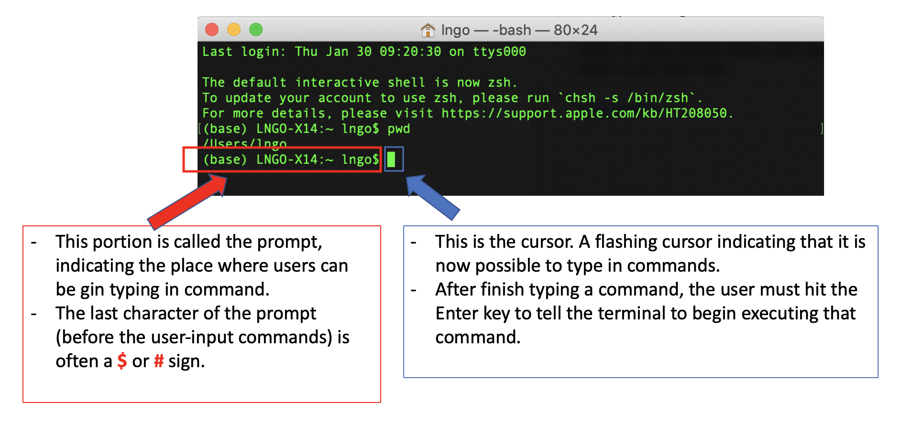
Linux Terminal
Remote access
Linux terminal is the CLI interface to interact with Linux-based systems.

Slide 4
Linux Terminal
REPL
READ
EVALUATE
PRINT
LOOP

Slide 5
Exercise
In a terminal, types “Hello, World” and hits Enter.
What happens?
In a terminal, types echo “Hello, World” and hits Enter.
What happens?
Make the terminal display another message.

Slide 6
Directory and File Structures
Path: a sequence of directories connected together by the slash “/” character.
The root directory of a Linux (or Unix-based) file system is also represented by a “/”.
Absolute path.
Relative path.
Working directory: “pwd”.
Special designations:
“~”: Users home directory
“.”: The current directory.
“..”: The directory one level above the current directory.
To view directory and file contents, we can use the “ls” command (listing).

Slide 7
Navigating inside the Linux filesystem
Terminal-based
Command: “cd”

Slide 8
Create Directories
mkdir
mkdir -p

Slide 9
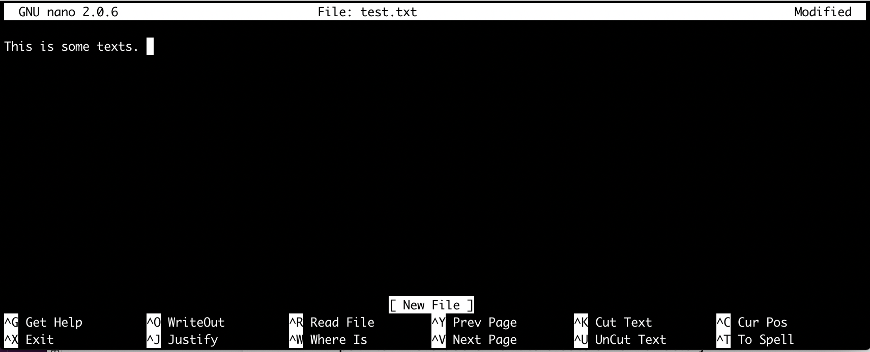
Create and edit files with nano

Slide 10
Delete file and directories
rm
rm -R
rm -Rf

