Slide 1
Blue Waters Petascale Semester Curriculum v1.0 Unit 3: Using a Cluster Lesson 7: Scaling on a Cluster 2 Developed by Hyacinthe Aboudja for the Shodor Education Foundation, Inc.

Slide 2
Except where otherwise noted, this work by The Shodor Education Foundation, Inc. is licensed under CC BY-NC 4.0. To view a copy of this license, visit https://creativecommons.org/licenses/by-nc/4.0 Browse and search the full curriculum at http://shodor.org/petascale/materials/semester-curriculum We welcome your improvements! You can submit your proposed changes to this material and the rest of the curriculum in our GitHub repository at https://github.com/shodor-education/petascale-semester-curriculum We want to hear from you! Please let us know your experiences using this material by sending email to petascale@shodor.org

Slide 3
Outline
Clusters
Workload Scheduler & Resources Manager
Description
Existing and commonly used
PBS/TORQUE, SLURM
Example of WLRM across universities and institutions
OU SLURM
OSU TORQUE
Blue Water PBS/TORQUE
Equivalent Basic Commands across Workload schedulers
Structure of Job Scripts
Resource Manager (computing nodes, Memory, software application, job size)
Scheduling Partition (time duration needs)
Examples of Programs & Job scripts (hello_world_mpi, Area_curve)
Screenshots

Slide 4
Workload Scheduler & Resources Manager
Description
Existing and commonly used
PBS/TORQUE, SLURM

Slide 5
Equivalence of Basic Commands
User Command | PBS/TORQUE | SLURM
Job Submission | qsub [script file] | sbatch [script file]
Job Status(by job) | qstat [job ID] | squeue [job ID]
Job Status (by User) | qstat –u [User_Name] | squeue –u [User Name]
Job Deletion | qdel [job ID] | scancel [job ID]
Job hold | qhold [Job ID] | scontrol hold [job ID]
Queue List | qstat -Q | squeue

Slide 6
Example of WLRM across universities and institutions
OU : SLURM
OSU : TORQUE
Blue Water : PBS/TORQUE
Lawrence National Laboratory:

Slide 7
Equivalent Basic Commands across Workload Schedulers
module load OpenMPI
sbatch myJobScript
squeue –u haboudj

Slide 8
Structure of Job Scripts
Resource Manager (computing nodes, Memory, software application, job size)
Scheduling Partition (time duration needs)

Slide 9
Examples of Programs & Job scripts (hello_world_mpi, Area_curve)

Slide 10
Introduction
- Once you know what is a cluster?
What is its architecture?
What is it used for ?
How to use it
Slurm
PBS (Torque)

Slide 11
SLURM (Simple Linux Utility Resources Manager)
Open Source, cluster resource management and job scheduler system for small and large Linux computers clusters connected as HPC( High Performance Computers)

Slide 12
Batch Scheduler and Resource Manager
In SLURM system, both the resource manager and the job batch scheduler (work load manager) work hands in hands to run and complete the job request of the user.
Job Batch Scheduler: identifies, allocate in optimized time the requested resources and launch to run and complete the job.

Slide 13
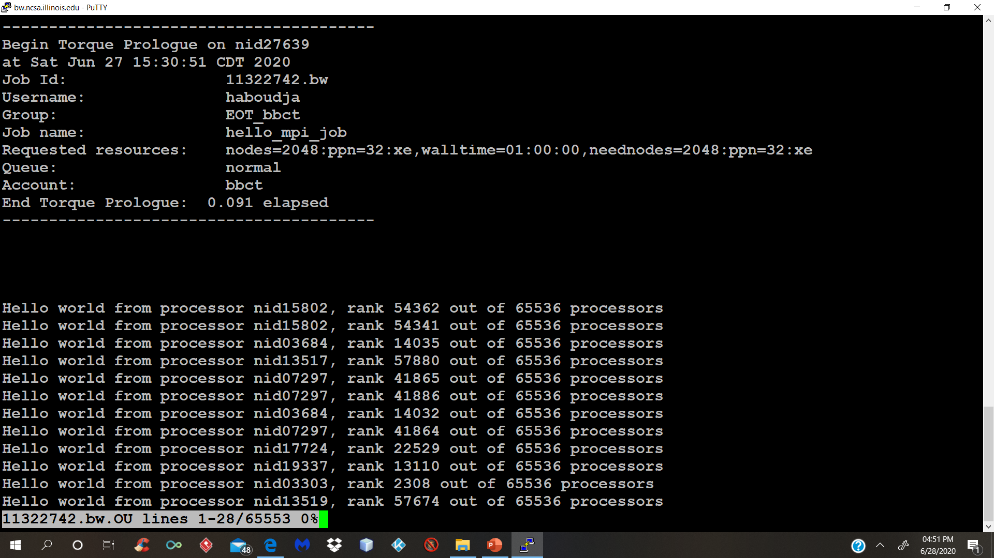
Screenshots

Slide 14
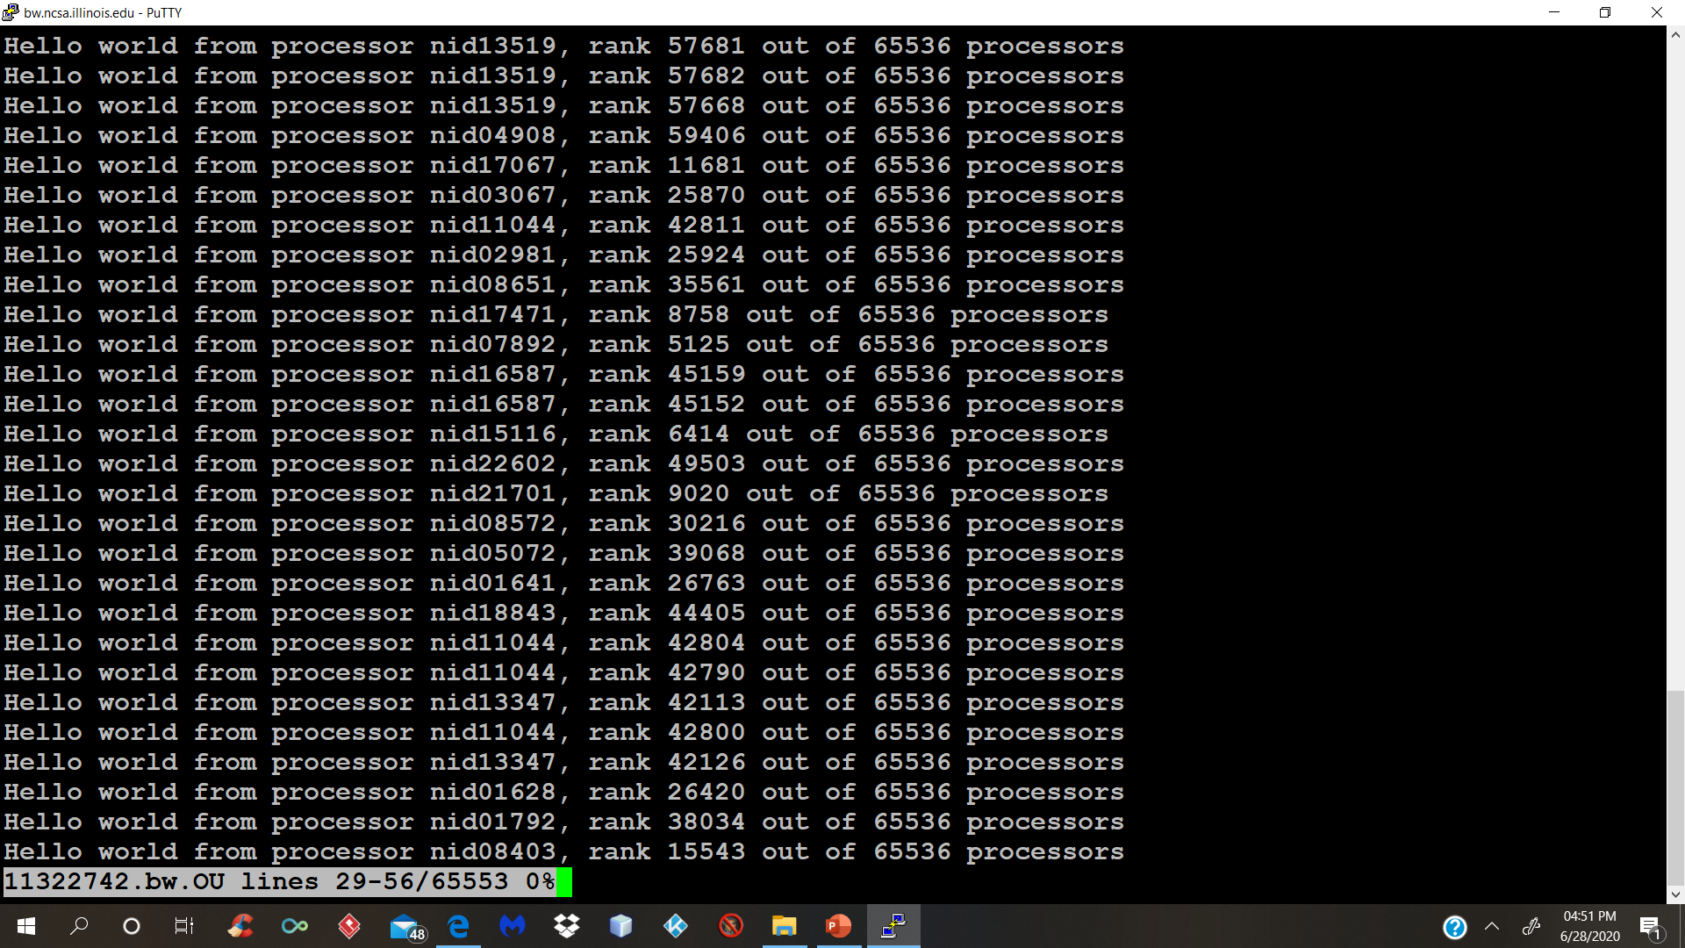

Slide 16
References
https://slurm.schedmd.com/quickstart.html
https://hpc.llnl.gov/banks-jobs/running-jobs/slurm-commands

