Slide 1
Blue Waters Petascale Semester Curriculum v1.0 Unit 4: OpenMP Lesson 3: Introduction to OpenMP Developed by Nitin Sukhija for the Shodor Education Foundation, Inc.

Slide 2
Except where otherwise noted, this work by The Shodor Education Foundation, Inc. is licensed under CC BY-NC 4.0. To view a copy of this license, visit https://creativecommons.org/licenses/by-nc/4.0 Browse and search the full curriculum at http://shodor.org/petascale/materials/semester-curriculum We welcome your improvements! You can submit your proposed changes to this material and the rest of the curriculum in our GitHub repository at https://github.com/shodor-education/petascale-semester-curriculum We want to hear from you! Please let us know your experiences using this material by sending email to petascale@shodor.org

Slide 3
Intro to OpenMP

Slide 4
Parallel Computer Memory Architectures
There are three possible parallel computers’ memory architectures:
1. Shared memory
Uniform Memory Access (UMA)
Non-Uniform Memory Access (NUMA)
2. Distributed memory
3. Hybrid Distributed Shared memory

Slide 5
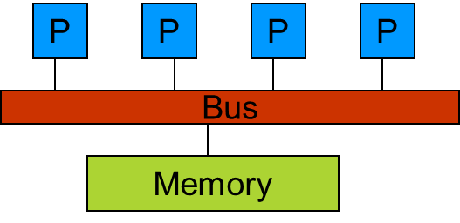
Shared Memory Architecture
In shared memory parallelism, threads share a memory space among them.
Threads are able to read and write to and from the memory of other threads.
One of the standard for shared memory considered is OpenMP, which uses a series of pragmas, or directives for specifying parallel regions of code in C, C++ or Fortran to be executed by threads.
In this architecture, the programmer’s task is to specify the activities of a set of processes that communicate by reading and writing shared memory.

Slide 6
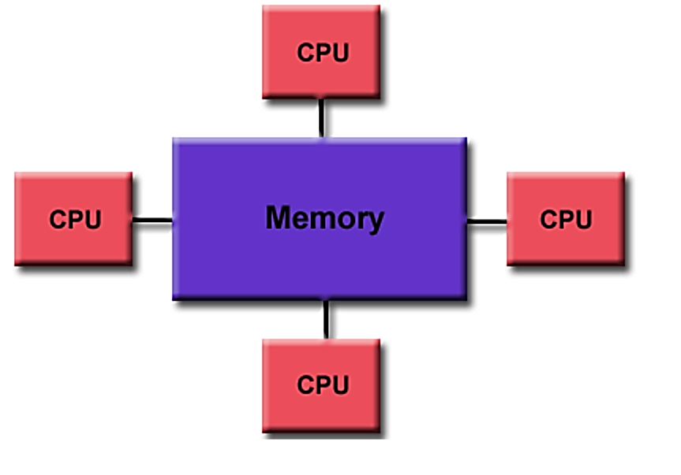
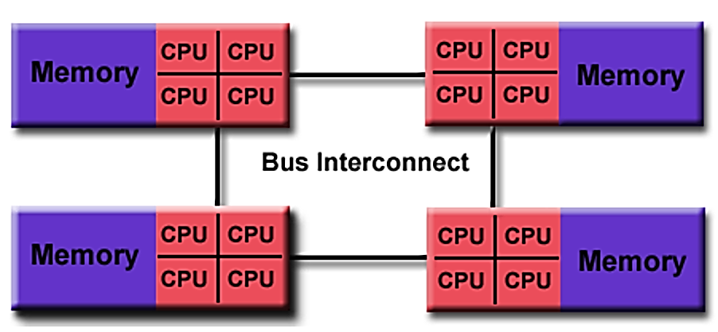
Shared Memory Architectures
Uniform Memory Access (UMA): in this architecture, the identical processors have equal access times to memory; commonly used in symmetric multiprocessor (SMP) systems.
Non-Uniform Memory Access (NUMA): ): in this architecture many SMPs are linked together, however all processors donot have equal access times to the memories of allother SMPs. Moreover, the memory access across the link is slower.

Slide 7
Thread v. Process
Process:
A process is created by the OS to execute a program with given resources (e.g., memory, registers)
Different processes do not share their memory with another.
Thread:
A thread is a subset of a process, and it shares the resources of its parent process,.
Exists within a process and uses the process resources
Has its own stack to keep track of function calls and its own independent flow of control
Multiple threads of a process will have access to the same memory (but can have local variables).
Is "lightweight" because most of the overhead has already been accomplished through the creation of its process.
Dies if the parent process dies

Slide 8
OpenMP
OpenMP
is an API built for shared-memory parallelism.
Simplifies writing multi-threaded (MT) applications.
The OpenMP API is comprised of three distinct components:
compiler directives,
runtime library routines
environment variables

Slide 9
OpenMP API
The OpenMP API:
Compiler directives: typed in your source code, these are instructions for the compiler regarding how to parallelize your code. If you set the right flags at compilation, these directives are read and understood, else, they are ignored. #pragma omp construct [clause [clause]…]
Runtime library routines: typed in your source code, these are function calls to functions of the OpenMP library (omp.h in C/C++). #include <omp.h>
Environment variable: typed in the terminal, this is a variable used by the system that can be modified or retrieved.

Slide 10
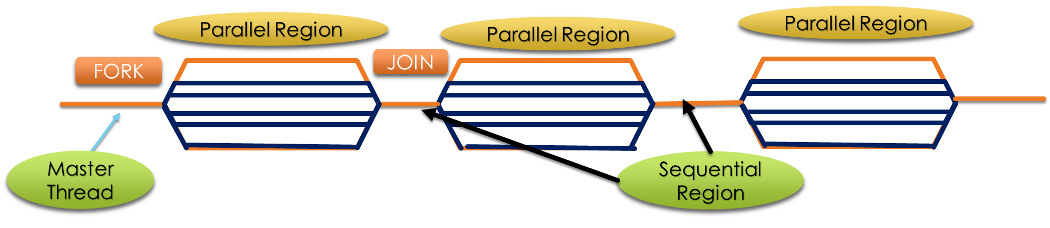
OpenMP Programming Model
Fork-Join Parallelism:
Group of threads are spawned by the master thread to permit parallel execution as needed. [FORK]
The parallel execution merge at a subsequent point to resume sequential execution.[JOIN]
Parallelism is added incrementally until performance goals are met.

Slide 11
OpenMP Compiler Directives
parallel compiler directive
USAGE:
#pragma omp parallel [options] {
Code inside here runs in parallel
Among options available: declaring private/shared vars
}
EXAMPLE: #pragma omp parallel private(var1, var2) shared(var3) {
The parallel pragma starts a parallel block. It creates a team of N threads (where N is determined at runtime), all of which execute the next statement or block (a block of code requires a {…} enclosure). After the statement, the threads join back into one.

Slide 12
OpenMP Compiler Directives
for compiler directive
USAGE:
#pragma omp for [clause]{
for loop
}
EXAMPLE:
# pragma omp parallel for
for (index = 0; index < length; index++) {
array[index] = index * index;
}
The iterations of the loop will be computed in parallel (note that they are independent of one another).

Slide 13
OpenMP Environment Variable
OMP_NUM_THREADS environment variable
USAGE: OMP_NUM_THREADS=number
EXAMPLE: export OMP_NUM_THREADS=16 Sets the value in the shell
This environment variable tells the library how many threads that can be used in running the program. If dynamic adjustment of the number of threads is enabled, this number is the maximum number of threads that can be used, else, it is the exact number of threads that will be used.
The default value is the number of online processors on the machine.

Slide 14
OpenMP Functions
omp_get_thread_num function
EXAMPLE: uid = omp_get_thread_num()
This function asks the thread that is executing it to identify itself by returning it's unique number. [answers "Who am I?"]

Slide 15
OpenMP Functions
omp_get_num_threads function
EXAMPLE: threadCount = omp_get_num_threads()
This function returns the number of threads in the team currently executing the parallel block from which it is called. [answers "How many of us?"]. If this "get" function exists, might there be a corresponding function?

Slide 16
OpenMP Reduction
The reduction command
USAGE: reduction ( operator : list )
A reduction is a repeated operation that operates over multiple values and yields one value. So, the reduction command performs an operation (using a specified operator) on all of the variables that are in its list. The reduction variable(s) is a shared variable, not a private variable. Operators can include: +, *, -, /, &, ^, |, &&, ||.
EXAMPLE: #pragma omp parallel for private(privateVar) reduction(+:runningTotal)

Slide 17
OpenMP Scheduling Strategies
OpenMP supports three scheduling strategies:
Static: The default, as described in the previous slides – good for iterations that are inherently load balanced.
Dynamic: Each thread gets a chunk of a few iterations, and when it finishes that chunk it goes back for more, and so on until all of the iterations are done – good when iterations aren’t load balanced at all.
Guided: Each thread gets smaller and smaller chunks over time – a compromise.

Slide 18
OpenMP Scheduling
The PARALLEL DO directive allows a SCHEDULE clause to be appended that tell the compiler which variables are shared and which are private:
!$OMP PARALLEL DO … SCHEDULE(STATIC)
This tells that compiler that the schedule will be static.
Likewise, the schedule could be GUIDED or DYNAMIC.
However, the very best schedule to put in the SCHEDULE clause is RUNTIME.
You can then set the environment variable OMP_SCHEDULE to STATIC or GUIDED or DYNAMIC at runtime – great for benchmarking!

Slide 19
Acknowlegements
Adapted from:
Shared Memory and OpenMP Basics at http://shodor.org/~bplist/bwi/openmp.html
Supercomputing in Plain English, Distributed Multiprocessing Slides by Henry Neeman.

Slide 20
Thank You!

