Slide 1
Blue Waters Petascale Semester Curriculum v1.0
Unit 5: MPI
Lesson 10: Wave Propagation in MPI
Developed by R. Phillip Bording for the Shodor Education Foundation, Inc.

Slide 2
Except where otherwise noted, this work by
The Shodor Education Foundation, Inc. is licensed under
CC BY-NC 4.0. To view a copy of this license, visit https://creativecommons.org/licenses/by-nc/4.0
Browse and search the full curriculum at http://shodor.org/petascale/materials/semester-curriculum
We welcome your improvements! You can submit your proposed changes to this material and the rest of the curriculum in our GitHub repository at https://github.com/shodor-education/petascale-semester-curriculum
We want to hear from you! Please let us know your experiences using this material by sending email to petascale@shodor.org

Slide 3

Blue Waters Project
Lesson on MPI Waves
Other Lessons similar are:
  Lessons on MPI and OpenMP – Pebbles
  Lesson on OpenACC – Pebbles
  Lesson on Visualization of Pebbles
    This lesson builds the vis tools
    used in these other lessons

Slide 4
Parallel Computing –
Geophysical Data Processing
Topics
Historical Survey of Parallel Computing
Geophysics – Acoustic Waves
High Performance Computing
Serial computers and how they work
Parallel computers and how they work
Pipelining and how it relates to serial and parallel computers
MPI for Parallel Computing
Visualization for Acoustic Waves

Slide 5
Parallel Computing
Topics
Programming Languages
Decomposition of a Problem Data Domain
Programming Constructs for Parallel Computing
Efficiency Modeling of Parallel Computing
Cost of Operations – Algorithm Complexity

Slide 6
Parallel Compute Examples
Fortran – C codes
OpenMPI
Linux Machines – Multi-Core Laptops with GPU’s
Network machines – Local, Remote, or Cloud
  Connect with User ID and Password
  SSH w/o passwords – best if inside a very tight firewall
Exa-Scale (10^18) machines with operations per second
Network Mounted File Systems – NFS

Slide 7
History of Machines
Illiac – University of Illinois
PEPE – DOD Radar Machine
FPS – Array Processors -1980’s
Cray X machines - 1980’s
IBM Multiprocessors
Hardware – CM 2
PC clusters
IBM Blue Gene – 128,000 cpu’s
Oak Ridge Summit – IBM Power 9 - 2019
Japan’s – Number 1 in the TOP 500 - 2020

Slide 8
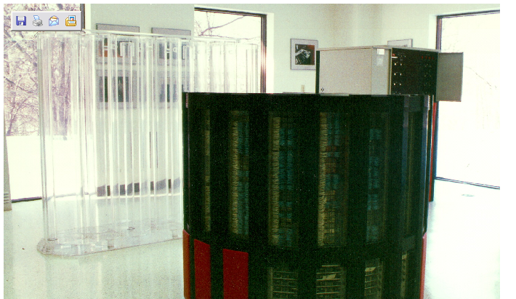
CRAY 2

Slide 9
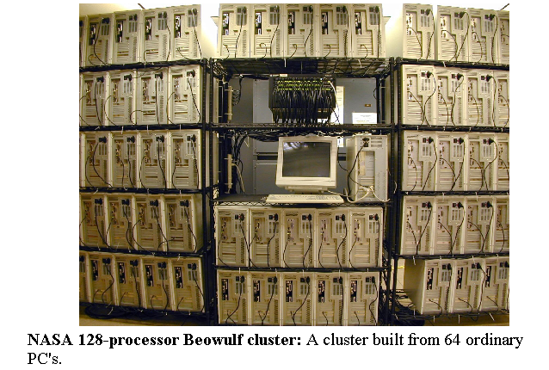
Beowulf Cluster

Slide 10

Gaming Laptop with a GPU

Slide 11
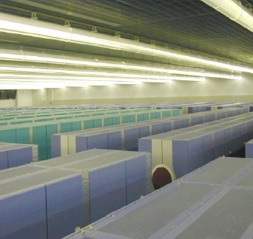
SIZE, COST, and HEAT
The EARTH Simulator
3 Megawatts
500 Million US $
It doesn’t simulate global warming, IT CAUSES IT!
Bednar, 2004

Slide 12
Chips have λ = Wire Sizes
Lambda Rules – now at 7 nanometers
½ = 4X
Transistors have wires at intersections

Slide 13
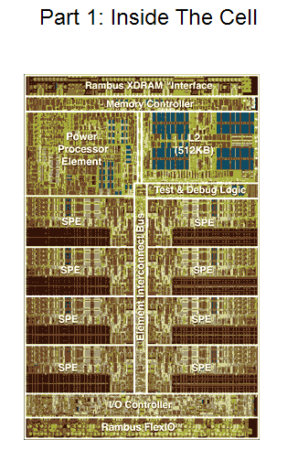
Lambda
Rules define
the wire sizes
on the chip
Here is the
IBM 8 Cell
Processor

Slide 14
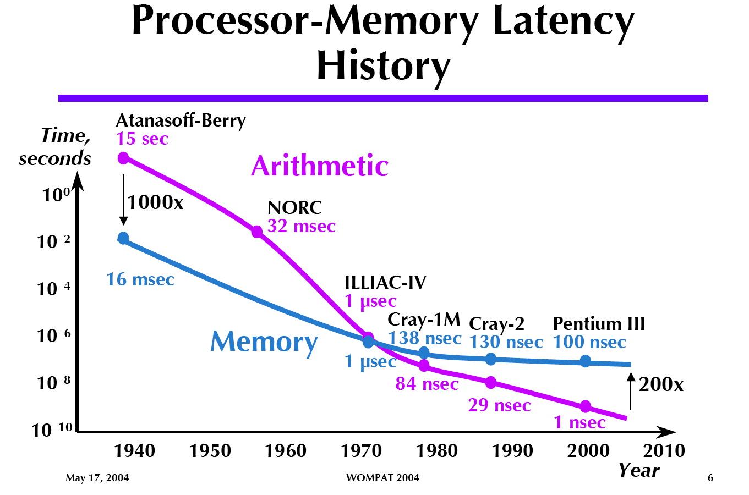
After Gustfason 2004
Arithmetic is getting faster
Memory has reached a
Limit…… around 100 nsec.
Bednar, 2004

Slide 15
Acoustic Waves – Pebble.f
Acoustic waves are used to demonstrate how parallel computing can work.
The domain is two dimensional and the waves propagate in time.
Domain decomposition is in one dimension.
Good accuracy requires a 9-point spatial derivative stencil.
Typical domain is 512 by 512 grid points.
This requires a ghost zone region of 4 memory locations.
Movie frames are written every few time steps to create an animation.
A post processing step creates a Graphics Magick animation.

Slide 16
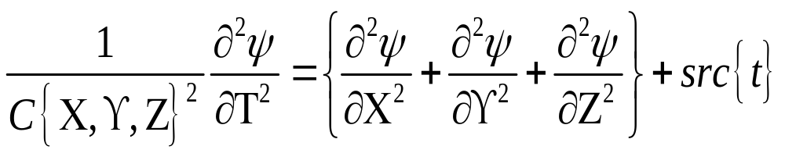

Acoustic, Constant Density
Density is so constant it does not appear in the equation.
C is the P Wave Velocity.
The source energy is in src.
Psi is the wave field.

Slide 17
Acoustic Waves in 2D
Wave Equation, Utt = (Uxx + Uzz)/c^2 where t is time and (x,z) are spatial.
Utt is the second partial derivative in time.
Uxx and Uzz are the spatial second derivatives.
Utt = (Un(new) – 2 Uc(current) + Uo(old))/2dt
Uxx = (Uc(i-1,j) – 2Uc(i,j) + Uc(i+1,j))/2dx
Uzz = (Uc(I,j-1) – 2Uc(i,j) + Uc(I,j+1))/2dz
Utt is accurate for acoustic waves.
Uxx and Uzz need more than a 3-point operator, we use a 9-point operator.

Slide 18
Acoustic Waves in 2D
Utt is accurate for acoustic waves.
Uxx and Uzz need more than a 3-point operator, we use a 9-point operator in the x and z directions.

Slide 19
Acoustic Waves in 2D
Utt is accurate for acoustic waves.
Uxx and Uzz need more than a 3-point operator, we use a 9-point operator in the x and z directions.
Topside Ghost Region in memp+1
Memory Partitions
Memp
Memp+1

Slide 20
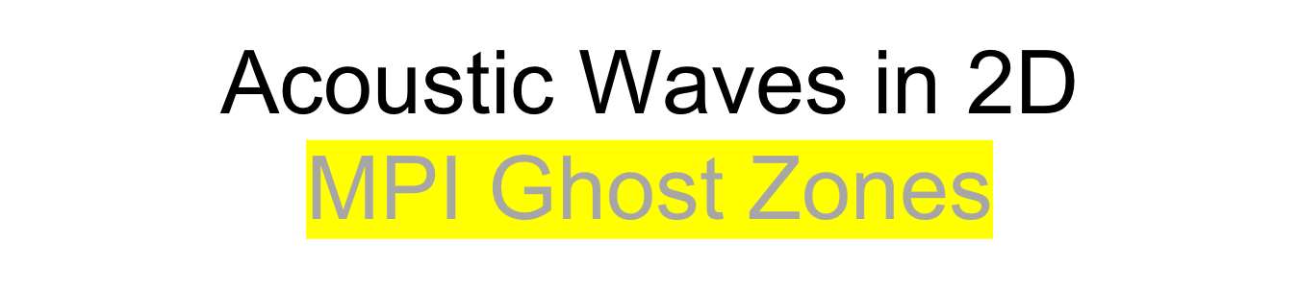
4 memory cells deep
Ghost Zones
Internal cells
Ghost Zones
….
…………………………..…….…...
One Dimensional Decomposition in Pebble.f
….

Slide 21
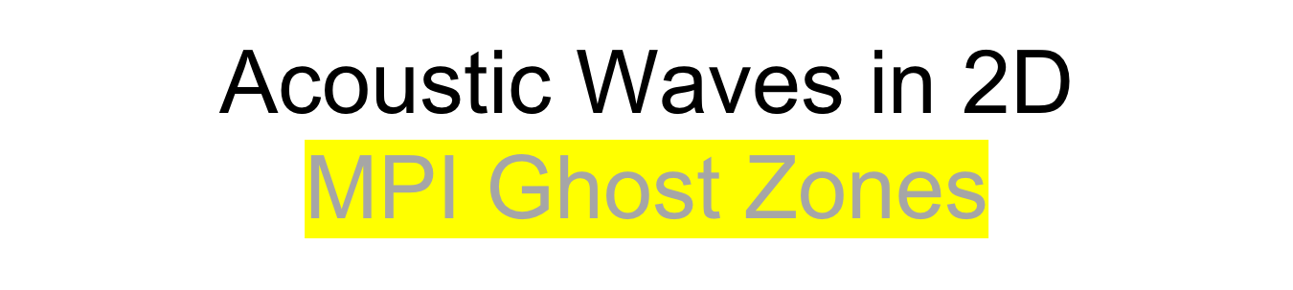
4 memory cells deep
Region 0 1 > 2
Ghost Zone 2 > 1
Ghost Zone
Region 1
Ghost Zone
Ghost Zone
Region 2
….
….
….
One Dimensional Decomposition in Pebble.f

Slide 22

Region 1 - CPU 0 Memory
Region 2 – CPU 1 Memory
Region 3 – CPU 2 Memory
CPU 0
CPU 1
CPU 2
One Dimensional Decomposition in Pebble.f

Slide 23
Time Marching
Waves work in time, so the outer compute loop is time, inner loops are spatial.
Do itime=1,ndtime
Do ix=1,ndx
Do kz=1,ndz
2D Array Time Step
End
End
End
Time
Steps
Of 2D
Arrays

Slide 24
Movie Time
Select every 4th time step result
Write to a file
Post process into a pixel map.
Movie Frames of
Floating Point Numbers
Time
Steps
Of 2D
Arrays

Slide 25
Algorithm Complexity
Count the operations for the work loop.
Do itime=1,ndtime
Do ix=1,ndx = Operations(ops,ndtime,ndx,ndz)
Do kz=1,ndz
O(nt x n^2 x 10) === > O(n^3)

Slide 27
Basic MPI Code
MPI has one version of code.
Program calls system routines for information.
How many processors are to be used.
Who am I in the list of available processors.
Include file is needed: include “mpif.h”.
Startup calls are:
  Call MPI_INIT(ierror)
  Call MPI_COMM_SIZE(MPI_COMM_WORLD, size, ierror)
  Call MPI_COMM_RANK(MPI_COMM_WORLD,rank,ierror)

Slide 28
Startup MPI Routines
How many processors are to be used - integer: size
Who am I in the list of available processors - integer: rank
A general world communicator is provided:
Error flag is an integer: ierror
MPI_COMM_WORLD
Startup calls are:
  Call MPI_INIT(ierror)
  Call MPI_COMM_SIZE(MPI_COMM_WORLD, size, ierror)
  Call MPI_COMM_RANK(MPI_COMM_WORLD, rank, ierror)
End call is a good idea as you have distributed nodes computing and communicating. So shut down cleanly by doing a:
  Call MPI_Finalize(ierror)

Slide 29
Pebble_mpi.f
MPI calls in Pebble_mpi.f are:
  Call MPI_COMM_SIZE(MPI_COMM_WORLD, size, ierror)
  Call MPI_COMM_RANK(MPI_COMM_WORLD, rank, ierror)
  Call MPI_ALL_REDUCE(ucmax,ucmaxg,1,MPI_FLOAT,MPI_MAX,MPI_COMM_WORLD,ierror)
  Call MPI_SEND(Ucur(i,j),lucur,MPI_Float,rankto,tag,MPI_COMM_WORLD,ierror)
  Call MPI_RECV(Ucur(k,l),lucur,MPI_Float,rankfrom,tag,MPI_COMM_WORLD,ierror)
  Call MPI_BARRIER(MPI_COMM_WORLD.ierror)

Slide 30
Pebble_mpi.f
MPI calls in Pebble_mpi.f are:
All_REDUCE the processors share ucmax, and what ever function MPI_MAX is applied, return that value to all processors.
  Call MPI_ALL_REDUCE(ucmax,ucmaxg,1,MPI_FLOAT,MPI_MAX,MPI_COMM_WORLD,ierror)
SEND/RECV send a variable to rankto and receive from rankfrom.
  Call MPI_SEND(Ucur(i,j),lucur,MPI_Float,rankto,tag,MPI_COMM_WORLD,ierror)
  Call MPI_RECV(Ucur(k,l),lucur,MPI_Float,rankfrom,tag,MPI_COMM_WORLD,ierror)
Barrier causes a wait in the fast processors till the slow one's catchup, then moves on…..
  Call MPI_BARRIER(MPI_COMM_WORLD.ierror)

Slide 32
Floating Point Operations per Second
Time entire run using LINUX
  Time run_pebble_mpi
Using work count of loops
Count floating point operations…
Divide flop count / run time == > FLOPS

Slide 33
Timing Code Methods
Time entire run using LINUX
  Time run_pebble_mpi
Internal call to timer routines…
  Call time(tstart)
  Do work
  Call time(tstop)
  Trun = tstop - tstart

Slide 34
Run Scripts
runclean ➔ clean up data directory.
  #!/bin/bash
  rm data/*
  rm temp_fort/*
run_pebble_mpi ➔ delete files, compile,
execute mpi program
#!/bin/bash
rm temp_fort/*
rm data/*
rm pebble_mpi
mpif77 pebble_mpi.f -o pebble_mpi -O3
mpirun -np 8 pebble_mpi

Slide 35
Serial Execution versus Multi-thread Processing
Run Time Serial Multi-Thread
< Main Thread >
Secondary Threads (3)
< Main Thread > Shared Variables
< Main Thread >
< Main Thread >
< Main Thread
< Main Thread
Organize data access
and execution between
threads
Run Time Savings

Slide 36
OpenMP Fortran Basics
PROGRAM BasicOpenMP
Integer*4 Icount
Real*4 Data(128,16)
Serial code
Beginning of parallel region. Fork a team of threads. Specify variable scoping
Master Thread
!$OMP PARALLEL PRIVATE(VAR1, VAR2) SHARED(VAR3) Thread Team
Parallel region executed by all threads
Other OpenMP directives
Run-time Library calls
All threads join master thread and disband
!$OMP END PARALLEL
Resume serial code
END
Shared
Private

Slide 37
OpenMP Fortran in two MPI ranks and five MP threads per MPI rank
Rank 0 Rank 1
Master Thread Master Thread
Thread Team Thread Team
Shared
Private
Shared
Private

Slide 38
Vis with Graphics Magick
Movie Frames Movie Frames
Of Floating Point of Integer
Numbers Pixels
Convert
32 float point number
to
32 integer ARGB
Pixel
Red, Green, and Blue with a transparency factor A.
Movie frames are made with gray scale pixels.

Slide 39
Discussion Time

Slide 40
Computing and Calculating Engines
Serial and Parallel Computers

Slide 41
Software Design Issues
Vector Programming
Cache Programming
Message Passing Programming
NUMA Programming
Grid Programming
ALL memory operations have a
Fixed Cost
Code Performance Improvements
are dominated by fixed costs

Slide 42
Hardware Design Issues
10 Years equals 100 Fold Speedup
Memory Latency – cost of getting the first word is a constant
Wires have failed to scale
Bigger cache memories are slower
Code Performance Improvements are
dominated by fixed costs

Slide 43
Serial Computer
-Linear Address Space
0 Max Address
Address Pointer
Latency is the time to access the first word
Bandwidth is the rate of accessing successive words

Slide 44
von Neumann
Architecture
Princeton
Memory
Address Pointer
Arithmetic
Logic
Unit
(ALU)
Data/Instructions
Pc = Pc + 1
Program Counter
Featuring Deterministic Execution

Slide 45
Cache Memory
Architecture
C
A
C
H
E
C
O
N
T
R
O
L
Memory
Main Memory is large and slow.
Cache is much smaller and much faster.
Control logic control keeps the main memory coherent.
Cache
Memory
Address Pointer
Featuring Non-Deterministic Execution

Slide 46
Cache Memory
- Three Levels
Architecture
Memory
Multi-
Gigabytes
Large
and
Slow
160 X
Cache
Control
Logic
2 Gigahertz Clock
2X
8X
16X
L3 Cache
Memory
L1 Cache
Memory
L2 Cache
Memory
32 Kilobytes
128 Kilobytes
16 Megabytes
Featuring Really Non-Deterministic Execution
Address Pointer

Slide 47
Pipeline Instructions
Pipeline Stages
Floating Point Add Operation
Reg 0
Reg 1
EXP 0
EXP 1
Mantissa
Alignment
Reg 0
Reg 1
Adder
Result

Slide 48
Discussion Time

Slide 49
Programming Models for
Parallel Computing

Slide 50
Distributed Computing
Message Passing Interface
Program Address Spaces
0 Max 0 Max 0 Max 0 Max
Multiple Address Pointers

Slide 51
Distributed Computing with Message Passing
Program Address Spaces
Messages Left and Right
Multiple Address Pointers

Slide 52
Distributed Computing with Message Passing
Program Address Spaces
Messages Left and Right
Multiple Address Pointers
DUAL CORE PROCESSORS

Slide 53
Distributed Computing with Message Passing
Program Address Spaces
Messages Left and Right
Multiple Address Pointers
FOUR CORE PROCESSORS

Slide 54
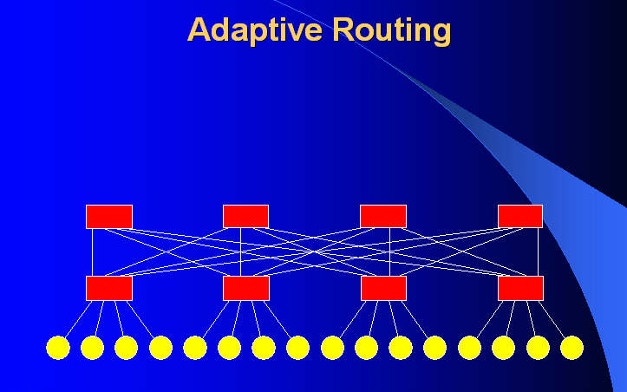
Compute Nodes
Network Switch

Slide 55
Multi-Threading
OpenMP Programming Model
Global Program Address Space
Local Local Local Local
0 n-1 n 2n-1 2n 3n-1 3n 4n-1
Address and Cache
Bus with Conflict
Resolution
Multiple Address Pointers

Slide 56
Uniqueness of Store Multi-Threading
Program Address Space
0
Multiple Address Pointers
Duplicate Pointers
to the same Location – Conflict on storing a result
So who is managing the multiple pointers?
It is the programmers responsibility.

Slide 57
Discussion Time

Slide 58
#!/bin/bash
rm data/*
rm pebble
gfortran pebble.f -o pebble -O3

Slide 59
#!/bin/bash
rm temp_fort/*
rm data/*
rm pebble_mpi
mpif77 pebble_mpi.f -o pebble_mpi -O3
mpirun -np 8 pebble_mpi

Slide 60
Discussion Time

Slide 61
GitHub Repository

Slide 62
References/Links
Pebble References:
https://en.wikipedia.org/wiki/Acoustic_wave
Seismic Modeling and Imaging with the Complete Wave Equation, SEG Course Notes Series, No. 8., by Ralph Phillip Bording and Larry R. Lines
https://en.wikipedia.org/wiki/Fortran
https://www.open-mpi.org/
https://computing.llnl.gov/tutorials/openMP/
https://www.openmp.org/resources/tutorials-articles/
https://www.openacc.org/
https://en.wikipedia.org/wiki/OpenACC
https://en.wikipedia.org/wiki/RGBA_color_model

