Slide 1
Blue Waters Petascale Semester Curriculum v1.0 Unit 5: MPI Lesson 3: Distributed Memory Concepts: Distributed Multiprocessing Developed by Widodo Samyono for the Shodor Education Foundation, Inc.

Slide 2
Except where otherwise noted, this work by The Shodor Education Foundation, Inc. is licensed under CC BY-NC 4.0. To view a copy of this license, visit https://creativecommons.org/licenses/by-nc/4.0 Browse and search the full curriculum at http://shodor.org/petascale/materials/semester-curriculum We welcome your improvements! You can submit your proposed changes to this material and the rest of the curriculum in our GitHub repository at https://github.com/shodor-education/petascale-semester-curriculum We want to hear from you! Please let us know your experiences using this material by sending email to petascale@shodor.org

Slide 3
Distributed Memory Concepts
Distributed Multiprocessing

Slide 4
Title and Content Layout
Distributed Memory Concepts: Distributed Multiprocessing - An Analogy
Distributed Parallelism
MPI

Slide 5
Distributed Memory Concepts: Distributed Multiprocessing - Analogies
Analogies:
Painters have their own brushes, palettes, and canvases. All the canvases put together on the designated big wall to make a big picture. We can think the canvases as a set of puzzle pieces that will be put on the big wall to solve the puzzle which is the big picture. Additionally, each painter has a private assistant to carry, to communicate with other private assistants, and to arrange the canvas on the big wall. They work together simultaneously at the same time.
Fishers have their own fishing poles. If only one person fishes at the lake, the fisher can only get some fishes. If many people fish together at the same lake on the same time, they can get many more fishes.

Slide 6
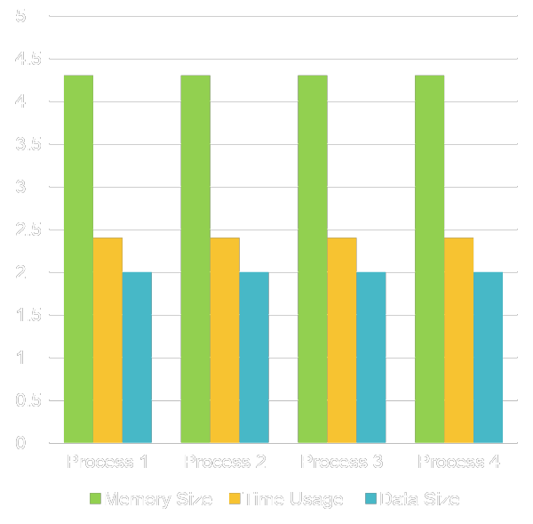
Distributed Multiprocessing
A big job divided into smaller jobs. Each smaller job assigned to a processor.
All processors work simultaneously to do their jobs.
The communications among the processors will be done through network pipelines.
The more processors work simultaneously, the bigger job they can complete at less time.

Slide 7
What Is Parallelism?
Parallelism is the use of multiple processing units – either processors or parts of an individual processor – to solve a problem, and in particular the use of multiple processing units operating concurrently on different parts of a problem.
The different parts could be different tasks, or the same task on different pieces of the problem’s data.

Slide 8
Kinds of Parallelism
Instruction Level Parallelism
Shared Memory Multithreading
Distributed Memory Multiprocessing
GPU Parallelism
Hybrid Parallelism (Shared + Distributed + GPU)

Slide 9
Why Parallelism Is Good?
The Trees: We like parallelism because, as the number of processing units working on a problem grows, we can solve the same problem in less time.
The Forest: We like parallelism because, as the number of processing units working on a problem grows, we can solve bigger problems.

Slide 10
Parallelism Jargon
Threads are execution sequences that share a single memory area (“address space”)
Processes are execution sequences with their own independent, private memory areas
… and thus:
Multithreading: parallelism via multiple threads
Multiprocessing: parallelism via multiple processes
Generally:
Shared Memory Parallelism is concerned with threads, and
Distributed Parallelism is concerned with processes.

Slide 11
Jargon Alert!
In principle:
“shared memory parallelism” 🡺 “multithreading”
“distributed parallelism” 🡺 “multiprocessing”
In practice, sadly, these terms are often used interchangeably:
Parallelism
Concurrency (not as popular these days)
Multithreading
Multiprocessing
Typically, you have to figure out what is meant based on the context.

Slide 12
Load Balancing
Suppose you have a distributed parallel code, but one process does 90% of the work, and all the other processes share 10% of the work.
Is it a big win to run on 1000 processes?
Now, suppose that each process gets exactly 1/N_{p} of the work, where N_{p} is the number of processes.
Now is it a big win to run on 1000 processes?

Slide 13
Load Balancing
Load balancing means ensuring that everyone completes their workload at roughly the same time.t pretty good speedup.

Slide 14
Load Balancing
Load balancing can be easy, if the problem splits up into chunks of roughly equal size, with one chunk per processor. Or load balancing can be very hard.

Slide 15
Load Balancing
EASY
Load balancing can be easy, if the problem splits up into chunks of roughly equal size, with one chunk per processor. Or load balancing can be very hard.

Slide 16
Load Balancing
EASY
HARD
Load balancing can be easy, if the problem splits up into chunks of roughly equal size, with one chunk per processor. Or load balancing can be very hard.

Slide 17
Load Balancing Is Good
When every process gets the same amount of work, the job is load balanced.
We like load balancing, because it means that our speedup can potentially be linear: if we run on N_{p} processes, it takes 1/N_{p} as much time as on one.
For some codes, figuring out how to balance the load is trivial (for example, breaking a big unchanging array into sub-arrays).
For others, load balancing is very tricky (for example, a dynamically evolving collection of arbitrarily many blocks of arbitrary size).

Slide 18
Parallel Strategies
Client-Server: One worker (the server) decides what tasks the other workers (clients) will do; for example, Hello World, Monte Carlo.
Data Parallelism: Each worker does exactly the same tasks on its unique subset of the data; for example, distributed meshes for transport problems (weather etc.).
Task Parallelism: Each worker does different tasks on exactly the same set of data (each process holds exactly the same data as the others); for example, N-body problems (molecular dynamics, astrophysics).
Pipeline: Each worker does its tasks, then passes its set of data along to the next worker and receives the next set of data from the previous worker.

Slide 19
MPI: The Message-Passing Interface
Most of this discussion is from [1] and [2].

Slide 20
What Is MPI?
The Message-Passing Interface (MPI) is a standard for expressing distributed parallelism via message passing.
MPI consists of a header file, a library of routines and a runtime environment.
When you compile a program that has MPI calls in it, your compiler links to a local implementation of MPI, and then you get parallelism; if the MPI library isn’t available, then the compile will fail.
MPI can be used in Fortran, C and C++.

Slide 21
MPI Calls
MPI calls in Fortran look like this:
CALL MPI_Funcname(…, mpi_error_code)
In C, MPI calls look like:
mpi_error_code = MPI_Funcname(…);
In C++, MPI calls look like:
mpi_error_code = MPI::Funcname(…);
Notice that mpi_error_code is returned by the MPI routine MPI_Funcname, with a value of MPI_SUCCESS indicating that MPI_Funcname has worked correctly.

Slide 22
MPI is an API
MPI is actually just an Application Programming Interface (API).
An API specifies what a call to each routine should look like, and how each routine should behave.
An API does not specify how each routine should be implemented, and sometimes is intentionally vague about certain aspects of a routine’s behavior.
Each platform has its own MPI implementation.

Slide 23
WARNING!
In principle, the MPI standard provides bindings for:
C
C++
Fortran 77
Fortran 90
In practice, you should do this:
To use MPI in a C++ code, use the C binding.
To use MPI in Fortran 90, use the Fortran 77 binding.
This is because the C++ and Fortran 90 bindings are less popular, and therefore less well tested.

Slide 24
Example MPI Routines
MPI_Init starts up the MPI runtime environment at the beginning of a run.
MPI_Finalize shuts down the MPI runtime environment at the end of a run.
MPI_Comm_size gets the number of processes in a run, N_{p} (typically called just after MPI_Init).
MPI_Comm_rank gets the process ID that the current process uses, which is between 0 and N_{p}-1 inclusive (typically called just after MPI_Init).

Slide 25
Example: Greetings
Start the MPI system.
Get the rank and number of processes.
If you’re not the server process:
Create a greeting string.
Send it to the server process.
If you are the server process:
For each of the client processes:
Receive its greeting string.
Print its greeting string.
Shut down the MPI system.

Slide 26
helloworldmpi.c
#include <mpi.h>
#include <stdio.h>
int main(int argc, char** argv)
{
MPI_Init(&argc, &argv);
printf(“Hello, World!\n”);
MPI_Finalize();
return 0;
}

Slide 27
Acknowledgements
1) This lesson adopted this slide:
Presentation #6: Distributed Memory Parallelism :
2) The example code from this website:
http://www.shodor.org/petascale/materials/UPModules/AreaUnderCurve/

Slide 28
References
[1] P.S. Pacheco, Parallel Programming with MPI, Morgan Kaufmann
Publishers, 1997.
[2] W. Gropp, E. Lusk and A. Skjellum, Using MPI: Portable Parallel
Programming with the Message-Passing Interface, 2nd ed. MIT
Press, 1999.

