Slide 1
Blue Waters Petascale Semester Curriculum v1.0 Unit 5: MPI Lesson 6: Convolution/Stencil Code in MPI Developed by Maria Pantoja for the Shodor Education Foundation, Inc.

Slide 2
Except where otherwise noted, this work by The Shodor Education Foundation, Inc. is licensed under CC BY-NC 4.0. To view a copy of this license, visit https://creativecommons.org/licenses/by-nc/4.0 Browse and search the full curriculum at http://shodor.org/petascale/materials/semester-curriculum We welcome your improvements! You can submit your proposed changes to this material and the rest of the curriculum in our GitHub repository at https://github.com/shodor-education/petascale-semester-curriculum We want to hear from you! Please let us know your experiences using this material by sending email to petascale@shodor.org

Slide 3
Acceleration of Stencil Code Using MPI
A Hands-on Approach

Slide 4
Learning Objectives
APPLY basic MPI functions to accelerate a common scientific pattern
USE Profiler tools to evaluate bottle necks in code
IDENTIFY which loops/task can be distributed (loop dependency)
COMPARE sequential to distributed execution times

Slide 5
Expected Time of the Activity:
Lesson Approximate Timing
Problem Introduction : 5 min
Sequential Code: 5 min
Profiling and Identification of main bottleneck, stencil loop: 2 min
Explain how to accelerate this loop using MPI : 12min
Compare Sequential vs Parallel OpenMP implementation: 1 min
Total time for the lesson: 25 minutes

Slide 6
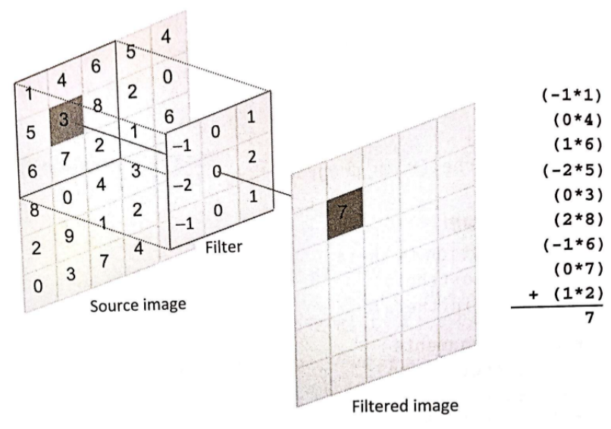
Problem Introduction : Stencil Code
Stencil code: are a class of iterative functions which update an array according to some pattern (stencil)
They are most found in:
Scientific Simulations:
(ex. Heat Transfer)
Computational Fluid Dynamics
(ex. PDE solvers, Poisson Equation)
Image Processing
(ex. Image filters)
Machine Learning
(ex. Convolutional Neural Networks)
Figure 1 Stencil code on a 2 D array, using 9 neighbors to calculate the output

Slide 7
Example Sequential 4 neighbors Code in C No Boundary Consideration
for (int i = 0; i < iter_count; ++i) {
for (int y = 0; y < N; y++) {
for (int x = 0; x <N; x++) {
//ctop,cbottom,ceast,cright are the coefficients
//of the stencil or filter
out[y][x]=in[y][x]+(ctop*in[y-1][x] +
cbottom*in[y+1][x] +
cwest*in[y][x-1] +
ceast*in[y][x+1] )/SPEED;
}
}
//swap input and output array
tmp= out; out=in; in=tmp;
}

Slide 8
Example Sequential 4 neighbors Code in C With Boundary
for (int i = 0; i < iter_count; ++i) {
for (int y = 0; y < height; y++) {
for (int x = 0; x < width; x++) {
//o[y][x] is same as o[y*N+x]
center=y*N+x;
west= (x==0) ?center:center-1; east= (x==N-1) ?center:center+1;
top= (y==0) ?center:center-N; bottom= (y==N-1) ?center:center+N;
out[y*N+x]=in[center]+ (ctop*in[top] +
cbottom*in[bottom] +
cwest*in[west] +
ceast*in[east] )/SPEED;
}
}
//swap input and output array
tmp= out; out=in; in=tmp;
}
NOTE :Explaining Boundary condition notation
If (row x is equal to 0) then west=center
else west=center-1
Can be written in C as one compound statement
west= (x==0) ?center:center-1

Slide 9
Sequential Code Profiling
Full code can be found in file: stencil.c
Compile : gcc –o stencil stencil.c
CPU: Intel i7-7820HQ 8 cores @2.90GHz
gcc –version: 9.3.0
Elapsed time 831.090 sec. (for an array of size 2^11 by 2^11, 6553 iterations(convolutions) and speed 10^8)
Use
Use gprof or perf (profilers) to analyze timings and bottleneck on code:
Function Execution %
Init function 0.1%
Stencil 99.9%
PrintResult 0%
in our case is very clear the function that needs acceleration is the Stencil for loop shown on previous slide (6)

Slide 10
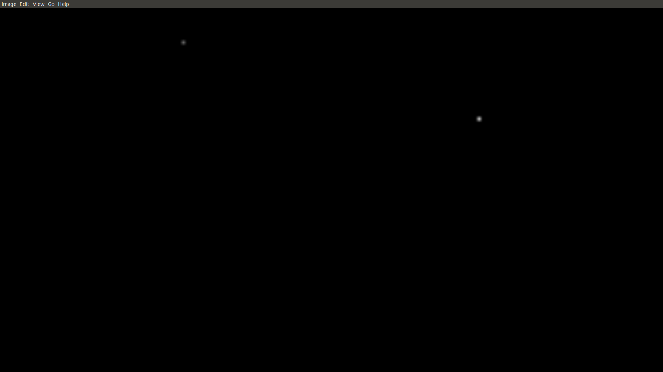
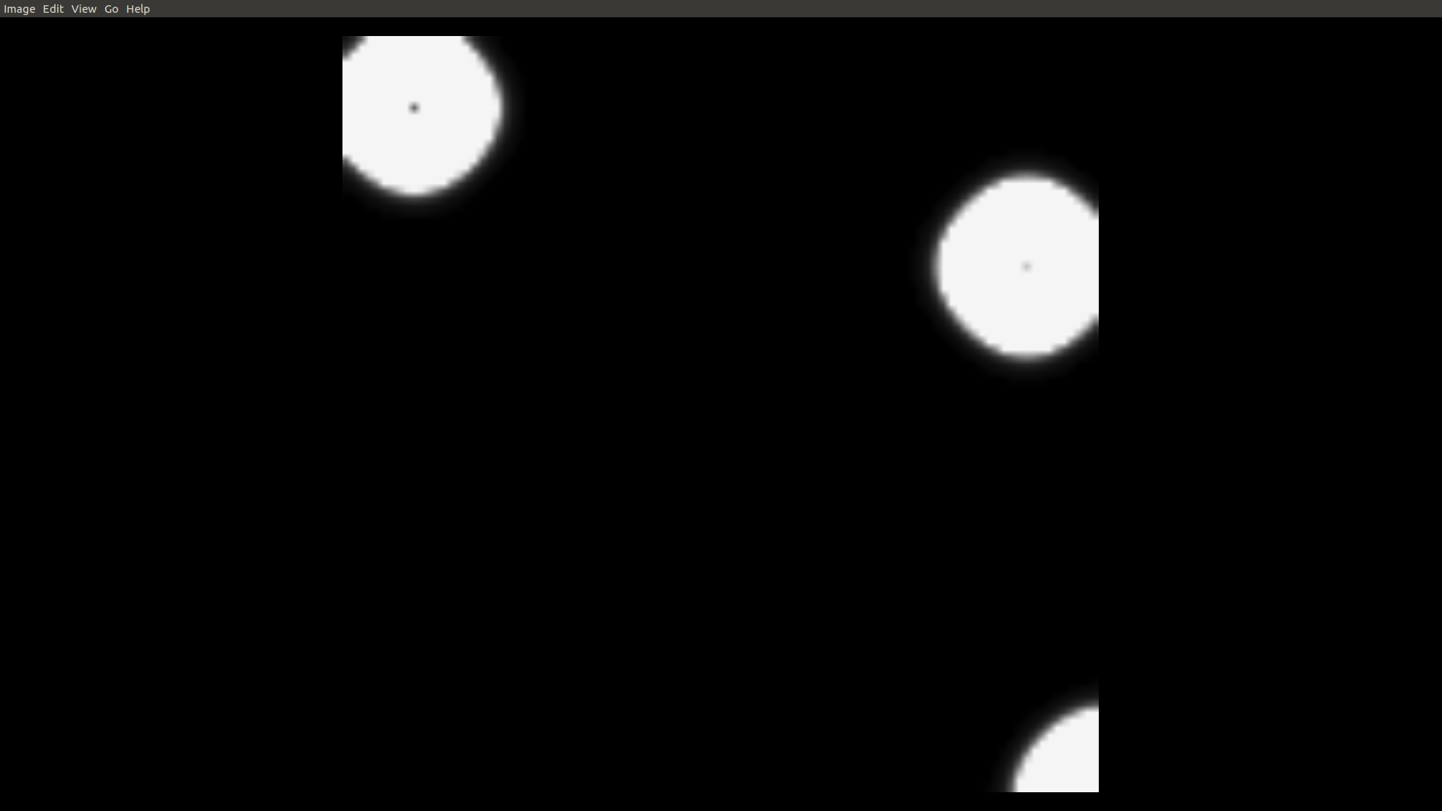
Output Visualization
The Input to the program is a 2D array , each cell in the array contains the initial temperature
The Output of the program also a 2D array , contains the temperatures after an X amount of time
The 2D arrays output can be displayed as png images

Slide 11
MPI Acceleration of main loop. Divide Array in rows
0 | 0 | 0 | 0 | 0 | 0 | 0 | 0 | 0 | 0
0 | 0 | 0 | 0 | 0 | 0 | 0 | 0 | 0 | 0
0 | 0 | 80 | 0 | 0 | 0 | 0 | 0 | 0 | 0
0 | 0 | 0 | 0 | 0 | 0 | 0 | 0 | 0 | 0
0 | 0 | 0 | 40 | 0 | 0 | 0 | 0 | 0 | 0
 | 0 | 20 | 0 | 0 | 0 | 0 | 0 | 0
 | 20 | 80 | 20 | 0 | 0 | 0 | 0 | 0
 | 0 | 20 | 10 | 0 | 0 | 0 | 0 | 0
0 | 0 | 0 | 0 | 0 | 0 | 0 | 0
0 | 80 | 0 | 0 | 0 | 0 | 0 | 0
0 | 0 | 0 | 0 | 0 | 0 | 0 | 0
0 | 0 | 40 | 0 | 0 | 0 | 0 | 0
0 | 0 | 0 | 0 | 0 | 0 | 0 | 0
0 | 0 | 40 | 0 | 0 | 0 | 0 | 0
0 | 0 | 0 | 0 | 0 | 80 | 0 | 0
0 | 0 | 0 | 0 | 0 | 0 | 0 | 0
0 | 0 | 0 | 0 | 0 | 0 | 0 | 0
0 | 0 | 0 | 0 | 0 | 0 | 0 | 0 | 0 | 0
0 | 0 | 0 | 40 | 0 | 0 | 0 | 0 | 0 | 0
0 | 0 | 0 | 0 | 0 | 0 | 0 | 0 | 0 | 0
0 | 0 | 0 | 40 | 0 | 0 | 0 | 0 | 0 | 0
0 | 0 | 0 | 0 | 0 | 0 | 80 | 0 | 0 | 0
 | 0 | 10 | 40 | 10 | 0 | 0 | 0 | 0
 | 0 | 0 | 20 | 0 | 0 | 0 | 0 | 0
 | 0 | 10 | 40 | 10 | 0 | 20 | 0 | 0
0 | 0 | 0 | 0 | 0 | 0 | 0 | 0 | 0 | 0
0 | 0 | 0 | 0 | 0 | 0 | 80 | 0 | 0 | 0
0 | 0 | 0 | 0 | 0 | 0 | 0 | 0 | 0 | 0
0 | 0 | 0 | 0 | 0 | 0 | 0 | 0 | 0 | 0
0 | 0 | 0 | 0 | 0 | 0 | 0 | 0 | 0 | 0
 | 0 | 0 | 0 | 0 | 20 | 80 | 20 | 0
 | 0 | 0 | 0 | 0 | 0 | 20 | 0 | 0
 | 0 | 0 | 0 | 0 | 0 | 0 | 0 | 0
T₀
3 Process
Each calculates 3 rows
To Calculate the Heat at T₁ each process needs its 3 rows plus the top/button boundery
T₁
T1=T0+(Ncell+Scell+Ecell+Wcell)/4

Slide 12
MPI Acceleration of main loop. Divide Array in rows
0 | 0 | 0 | 0 | 0 | 0 | 0 | 0 | 0 | 0
0 | 0 | 20 | 0 | 0 | 0 | 0 | 0 | 0 | 0
0 | 20 | 80 | 20 | 0 | 0 | 0 | 0 | 0 | 0
0 | 0 | 20 | 10 | 0 | 0 | 0 | 0 | 0 | 0
0 |  |  |  |  |  |  |  |  | 0
0 | 0 | 0 | 0 | 0 | 0 | 0 | 0 | 0 | 0
0 | 0 | 20 | 0 | 0 | 0 | 0 | 0 | 0 | 0
0 | 20 | 80 | 20 | 0 | 0 | 0 | 0 | 0 | 0
0 | 0 | 20 | 10 | 0 | 0 | 0 | 0 | 0 | 0
0 | 0 | 10 | 40 | 10 | 0 | 0 | 0 | 0 | 0
 | 10 | 40 | 10 | 0 | 0 | 0 | 0 | 0
 | 40 | 80 | 42 | 5 | 0 | 0 | 0 | 0
 | 10 | 42 | 50 | 5 | 0 | 0 | 0 | 0
 | 0 | 0 | 40 | 0 | 0 | 0 | 0 | 0
0 |  |  |  |  |  |  |  |  | 0
0 | 0 | 10 | 40 | 10 | 0 | 0 | 0 | 0 | 0
0 | 0 | 0 | 20 | 0 | 0 | 0 | 0 | 0 | 0
0 | 0 | 10 | 40 | 10 | 0 | 20 | 0 | 0 | 0
0 |  |  |  |  |  |  |  |  | 0
0 | 0 | 20 | 10 | 0 | 0 | 0 | 0 | 0 | 0
0 | 0 | 10 | 40 | 10 | 0 | 0 | 0 | 0 | 0
0 | 0 | 0 | 10 | 0 | 0 | 0 | 0 | 0 | 0
0 | 0 | 10 | 40 | 10 | 0 | 20 | 0 | 0 | 0
0 | 0 | 0 | 0 | 0 | 20 | 80 | 20 | 0 | 0
 | 2 | 25 | 40 | 20 | 2 | 0 | 0 | 0
 | 0 | 7 | 20 | 7 | 0 | 5 | 0 | 0
 | 0 | 20 | 40 | 20 | 7 | 40 | 10 | 0
0 |  |  |  |  |  |  |  |  | 0
0 | 0 | 0 | 0 | 0 | 20 | 80 | 20 | 0 | 0
0 | 0 | 0 | 0 | 0 | 0 | 20 | 0 | 0 | 0
0 | 0 | 0 | 0 | 0 | 0 | 0 | 0 | 0 | 0
0 | 0 | 0 | 0 | 0 | 0 | 0 | 0 | 0 | 0
0 | 0 | 10 | 40 | 10 | 0 | 20 | 0 | 0 | 0
0 | 0 | 0 | 0 | 0 | 20 | 80 | 20 | 0 | 0
0 | 0 | 0 | 0 | 0 | 0 | 20 | 0 | 0 | 0
0 | 0 | 0 | 0 | 0 | 0 | 0 | 0 | 0 | 0
0 | 0 | 0 | 0 | 0 | 0 | 0 | 0 | 0 | 0
 | 0 | 2 | 10 | 7 | 40 | 80 | 40 | 5
 | 0 | 0 | 0 | 0 | 10 | 40 | 10 | 0
 | 0 | 0 | 0 | 0 | 0 | 5 | 0 | 0
T₂
T₁
exchange

Slide 13
MPI Stencil
//Distribute the Data Matrix among the processes
int myRows=ROWS/numProcess;
float *myData=new float[myRows*cols];
float *buff= new float[myRows*cols] ;
MPI_Scatter(data, myRows*cols, MPI_FLOAT, myData, myRows*cols,MPI_FLOAT);
memcpy(buff,myData, myRows*cols*sizeof(float));
//exchange the boundary rows
for (int iter=0; iter<numIter;iter++){
If(myID>0){
MPI_Isend(myData,cols,MPI_Float,myID-1,0); //send first row of myData to previous process
MPI_Irecv(prevRow,cols,MPI_Float,myID-1,0); //receives last row from previous process
}
If(myID<numProcess-1){
MPI_Isend(&myData[(myRows-1)*cols],cols,MPI_Float,myID+1,0); //send last row of myData to next process
MPI_Irecv(nextRow,cols,MPI_Float,myID+1,0); //receives first row from the next process
}

Slide 14
MPI Stencil
//calculate main Loop
for(int i=1; i<myRows-1;i++){
for(int j=1; j<cols-1;j++){
buff[i*cols+j] = myData[i*cols+j]+( cbotton* myData[(i+1)*cols+j]+
cwest*cmyData[i*cols+j-1] +
ceast*myData[i*cols+j+1] +
ctop*myData[(i-1)*cols+j])/SPEED;
(full code on stencilMPI.c)

Slide 15
MPI Stencil
//calculate First row
If(myId>0){
request[1].wait(status);
for(int j=1; j<cols-1;j++){
buff[j] = myData[j]+( cbotton* myData[cols+j]+
cwest*myData[j-1] +
ceast*myData[j+1] +
ctop*prevRow[j])/SPEED;
}}

Slide 16
MPI Stencil
//calculate last row
If(myId>numP-1){
request[3].wait(status);
for(int j=1; j<cols-1;j++){
buff[(myRows-1)*cols+j]=
cbotton*nextRow[j]+
cwest*myData[(myRows-1)*cols+j-1]+
ceast*myData[(myRows-1)*cols+j+1]+
ctop*myData[(myRows-2)*cols+j];
}}
//At the end of stencil swap buffers
Swap(buff with myData and so the for loop again)

Slide 17
OpenMP Acceleration Profiling
CPU: Intel i7-7820HQ 8 cores @2.90GHz
gcc –version: 9.3.0
MPI version: OpenMPI 1.2
Compile : mpic++ -g –Wall –o3 –o stencil stencilMPI.c
Run: mpiexec –n 4
Use
a. MPI_Wtime() to time areas in your code
b. Use gprof or perf (profilers) to analyze timings and bottleneck on code
Elapsed time:
Non-Blocking: 294 sec
(for an array of size 2^11 by 2^11, 6553 iterations(convolutions) and speed 10^8)
A ~4 Speedup

Slide 18
Comparation Sequential vs MPI

Slide 19
Conclusion
Stencil Code is ubiquitous is Science:
Differential Equations Solver
System of Equations Solver
Heat Transfer
Artificial intelligence
Etc
With small changes to original sequential code we achieved speeds up of ~4x on an ”oldish and cheap” laptop, clearly only running on the multicores of the machines not on a real distributed system

Slide 20
Lesson Evaluation
Possible Advance Questions:
(code) The stencil code :
Rewrite code for stencil so instead of hardcoding in the loop the neighbor cells. Make the code more flexible and input the neighborhood and its coefficients as a filter. Pass the filter as an input to the stencil function
(code) Change it to 3D stencil code
(code) Chunk not just by rows do it also by columns

