Slide 1
Blue Waters Petascale Semester Curriculum v1.0 Unit 7: CUDA Lesson 1: Introduction to CUDA GPGPU Developed by Michael D. Shah for the Shodor Education Foundation, Inc.

Slide 2
Except where otherwise noted, this work by The Shodor Education Foundation, Inc. is licensed under CC BY-NC 4.0. To view a copy of this license, visit https://creativecommons.org/licenses/by-nc/4.0 Browse and search the full curriculum at http://shodor.org/petascale/materials/semester-curriculum We welcome your improvements! You can submit your proposed changes to this material and the rest of the curriculum in our GitHub repository at https://github.com/shodor-education/petascale-semester-curriculum We want to hear from you! Please let us know your experiences using this material by sending email to petascale@shodor.org

Slide 3
Introduction to CUDA

Slide 4

Graphics Programming Unit (GPU)
The Graphics Programming Unit (GPU) is something many of you may be familiar with:
GPUs are frequently used to power games and improve their graphics!
But modern GPU technology has allowed us to program more than just games
GPUs can be used for more general-purpose applications as well!
https://cdn.wccftech.com/wp-content/uploads/2013/08/NVIDIA-Game-Technology-Leadership.png

Slide 5

General Purpose Graphics Programming Unit - GPGPU (1/2)
General Purpose Graphics Programming Unit
This is the term given to a more rich programming interface on GPUs
NVIDIA’s CUDA API is one such Application Programming Interface (API) that allows us to write C programs on our GPU
https://en.wikipedia.org/wiki/CUDA#Programming_abilities
Before CUDA, we were very limited in how expressive of programs we could write on GPUs--again, primarily applications that handled graphics workloads
https://upload.wikimedia.org/wikipedia/en/b/b9/Nvidia_CUDA_Logo.jpg

Slide 6

General Purpose Graphics Programming Unit - GPGPU (2/2)
General Purpose Graphics Programming Unit
This is the term given to a more rich programming interface on GPUs
NVIDIA’s CUDA API is one such Application Programming Interface (API) that allows us to write C programs on our GPU
https://en.wikipedia.org/wiki/CUDA#Programming_abilities
Before CUDA, we were very limited in how expressive of programs we could write on GPUs--again, primarily applications that handled graphics workloads
Let’s go ahead and look at how a CUDA program differs from C programs that you have been writing
https://upload.wikimedia.org/wikipedia/en/b/b9/Nvidia_CUDA_Logo.jpg

Slide 7
A CPU Use Case and a GPU Use Case

Slide 8
CPU Program
To understand more about how a GPU works, let’s first look at solving a problem on the CPU
We will then solve that exact same problem using the GPU

Slide 9
Problem: Add 1 to every item in an array (1/2)
The program we are going to write is a simple one
We are going to ‘add 1’ to every element in an array
Before
myArray
76
57
42
89
...
7
Index
0
1
2
3
...
n
After
myArray
77
58
43
90
...
8
Index
0
1
2
3
...
n

Slide 10
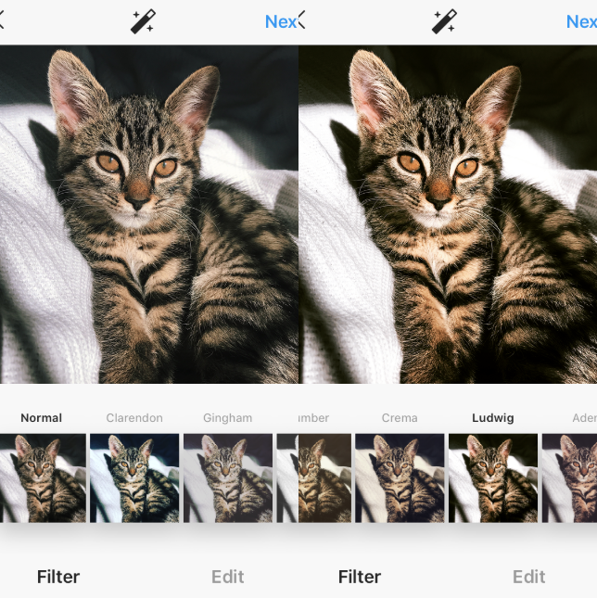
Problem: Add 1 to every item in an array (2/2)
While this is a simple program--it demonstrates a real world use case for something you might do in image processing--such as ‘brighten’ the pixels in an image
Before
myArray
76
57
42
89
...
7
Index
0
1
2
3
...
n
After
myArray
77
58
43
90
...
8
Index
0
1
2
3
...
n
https://www.artsycouture.com/blog/wp-content/uploads/2020/03/ludwig.png

Slide 11
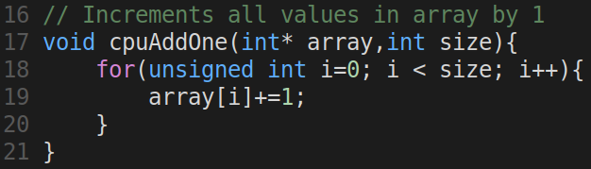
cpuAddOne (in file hello_cpu.c) (1/2)
Provided to the right, is a solution to this problem
We can write a function which iterates through every single element in the array, incrementing the value by 1
Question:
What is the complexity of this algorithm?

Slide 12
cpuAddOne (in file hello_cpu.c) (2/2)
Provided to the right, is a solution to this problem
We can write a function which iterates through every single element in the array, incrementing the value by 1
Question:
What is the complexity of this algorithm?
O(n) -- because we access every element of the array one time

Slide 13
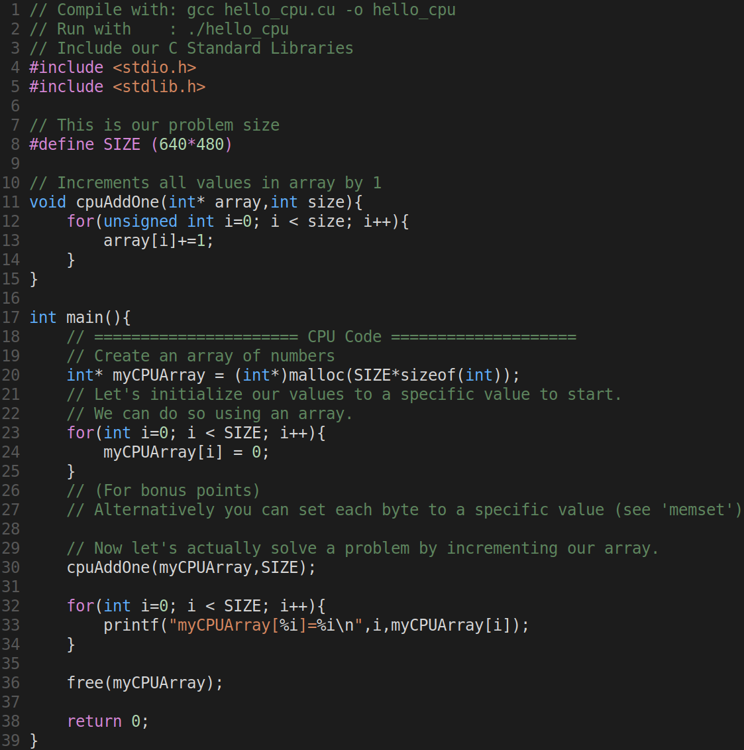
Complete CPU Program
The entire CPU program is listed to the right
We start from our main() function
We allocate memory for our array
We initialize values in our array to zero
We call our add function
Then we print our result
We can fairly easily trace through the execution of this program.

Slide 14
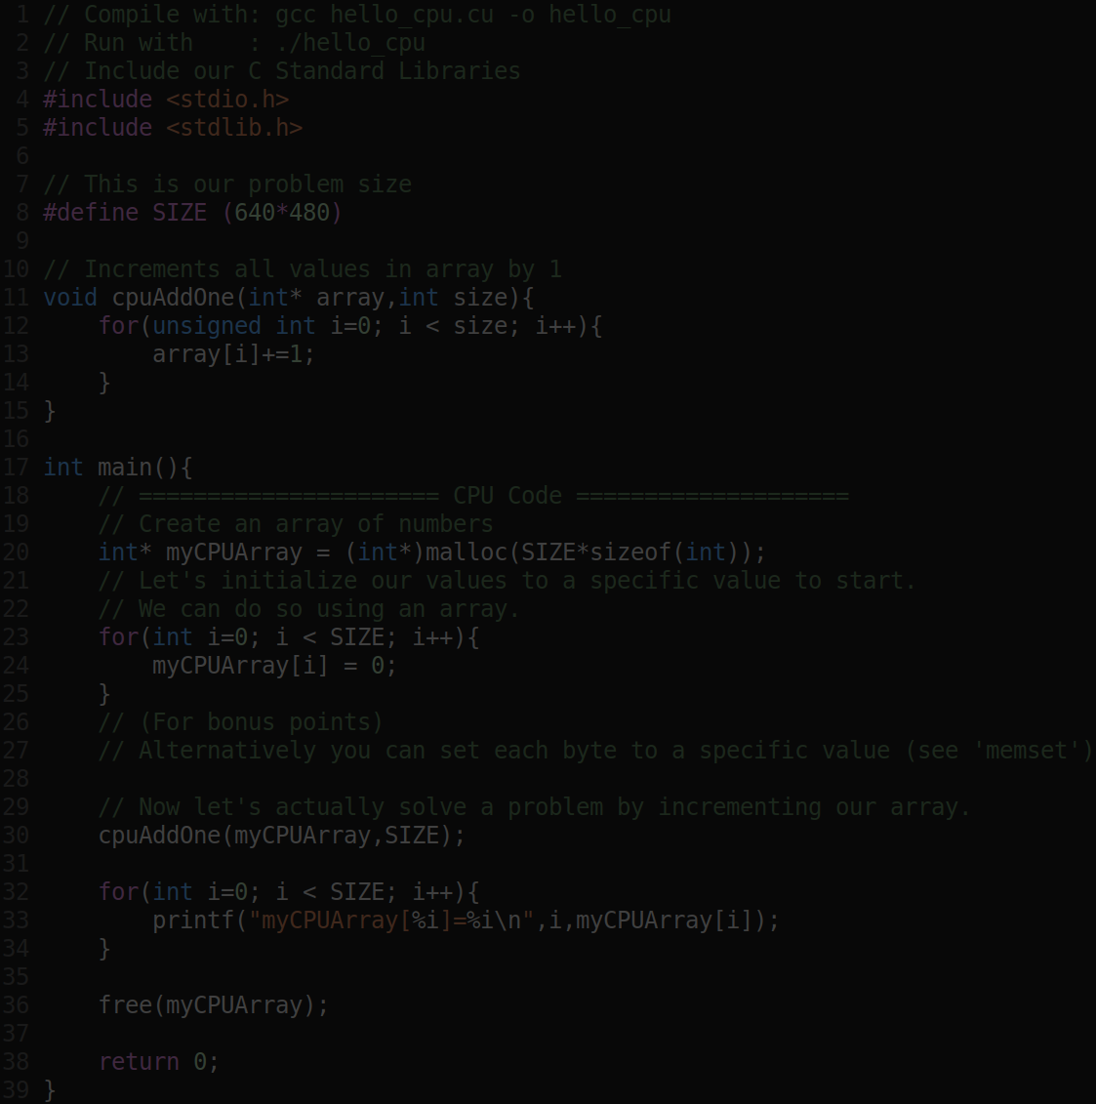
Complete CPU Program
The entire CPU program is listed to the right
We start from our main() function
We allocate memory for our array
We initialize values in our array to zero
We call our add function
Then we print our result
We can fairly easily trace through the execution of this program.
Let’s now take a look at CUDA, and run our first General Purpose GPU Program

Slide 15
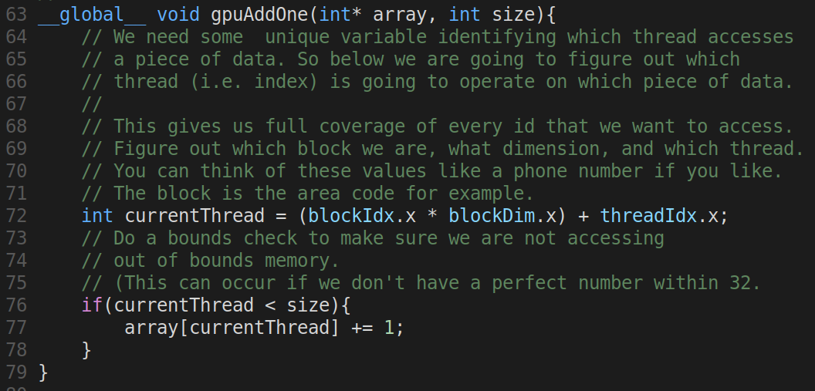
GPU Program (in file hello_gpu.cu) (1/2)
To the right is the GPU code that will do the exact same thing as before!
Don’t worry, we will walk through the code in more detail.

Slide 16
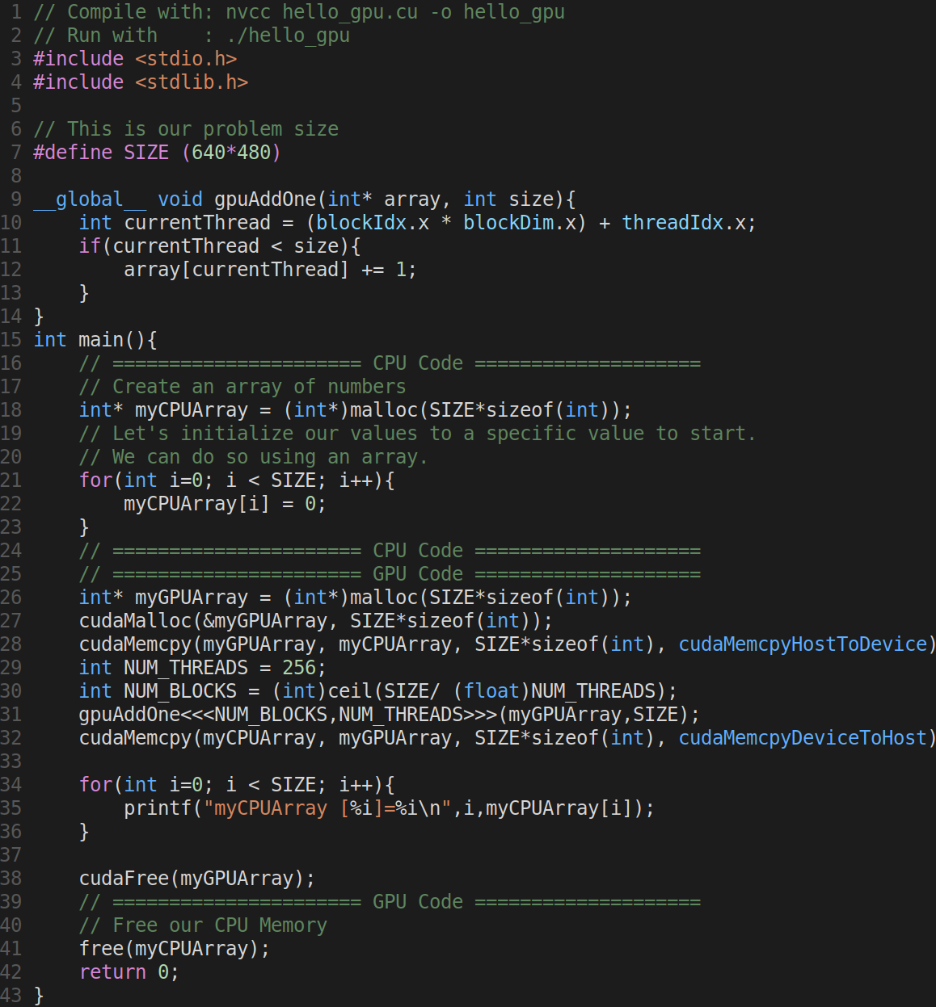
GPU Program (in file hello_gpu.cu) (1/2)
Here is a full view of the code, so we can see a full sample

Slide 17
GPU Program (in file hello_gpu.cu) (2/2)
Question to audience:
What is the O(n) of this code?
?!

Slide 18
GPU Program (in file hello_gpu.cu) (2/2)
Question to audience:
What is the O(n) of this code?
Answer is closer to O(1) -- and we’ll need to look at our GPU to understand why!

Slide 19
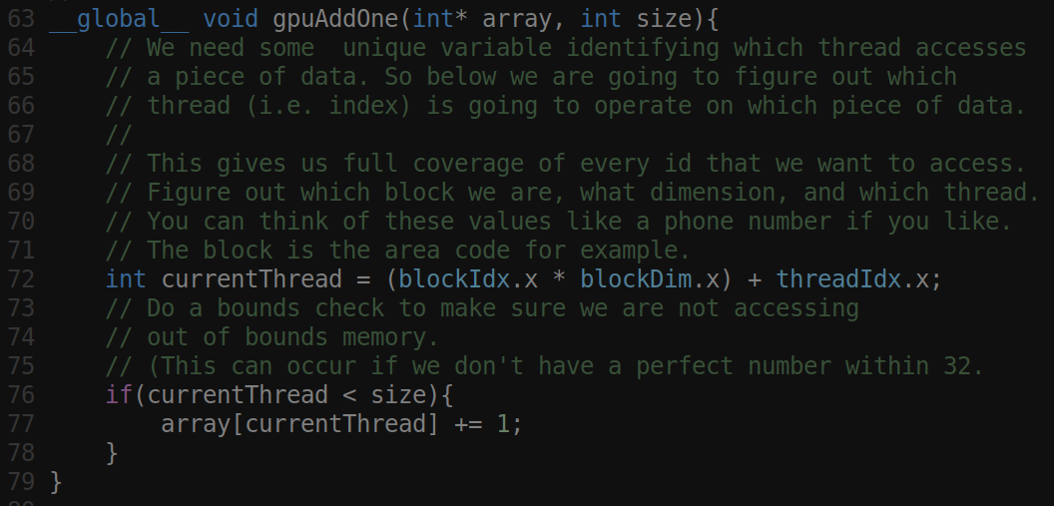
GPU Program (in file hello_gpu.cu) (2/2)
Question to audience:
What is the O(n) of this code?
Answer is closer to O(1) -- and we’ll need to look at our GPU to understand why!
Let’s understand a bit more about ‘why’

Slide 20
GPU Architecture

Slide 21
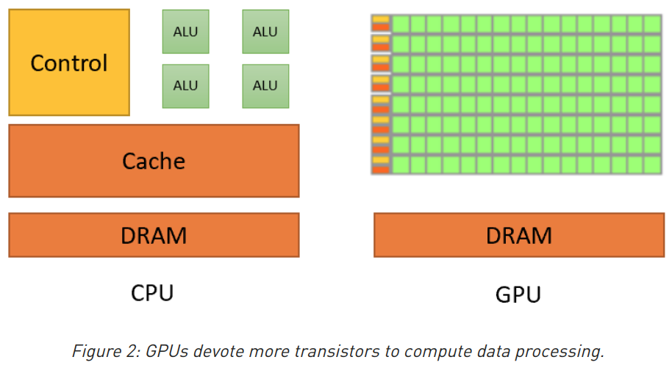
GPU Architecture (1/2)
The first thing we need to understand in our use case, is that one code is written on the CPU, and one for the GPU
GPU’s (right) are structured differently than our CPUs (left)
Notice the little ‘green’ boxes in the GPU--there are many more of these compute units--and those units are meant to execute code in parallel in individual threads.
https://developer.nvidia.com/blog/cuda-refresher-reviewing-the-origins-of-gpu-computing/

Slide 22
GPU Architecture (2/2)
The first thing we need to understand in our use case, is that one code is written on the CPU, and one for the GPU
GPU’s (right) are structured differently than our CPUs (left)
Notice the little ‘green’ boxes in the GPU--there are many more of these compute units--and those units are meant to execute code in parallel in individual threads.
So what is a thread, and how do we execute code in these ‘boxes’
https://developer.nvidia.com/blog/cuda-refresher-reviewing-the-origins-of-gpu-computing/

Slide 23
Threads
Threads are traditionally referred to as ‘lightweight’ processes
They are used to execute a part of your program concurrently while your program runs.
In CUDA, we execute many threads (100s or 1000s) in parallel in order to get a speedup in execution.
So if we look at our example to the right
We can see we a ‘single thread’ that is going to execute this tiny gpuAddOne program on our GPU

Slide 24
Threads Continued - Single Instruction Multiple Thread (SIMT)
In CUDA we call this model SIMT, for single instruction multiple thread
We are going to have many (100s or 1000s) of threads executing on each of our GPUs execution units.

Slide 25
Threads Continued - Single Instruction Multiple Thread (SIMT)
So in CUDA, the lowest granularity of execution is a 'thread'.
A thread executes a series of instructions (i.e. a small program).
Groups of threads (with consecutive thread indexes) are divided into warps which execute on a single CUDA core.
The lowest schedulable entity is known as a 'warp'

Slide 26
Threads Continued - Single Instruction Multiple Thread (SIMT)
Thread blocks are the lowest programmable entity.
A single shader core is assigned to each thread.
They are organized in a 3-D block.
Thread blocks are then further assigned to a GPU.

Slide 27
Further Resources
CUDA Programming Model
https://cvw.cac.cornell.edu/GPU/simt_warp

