Slide 1
Blue Waters Petascale Semester Curriculum v1.0 Unit 7: CUDA Lesson 2: Image Processing Developed by Michael D. Shah for the Shodor Education Foundation, Inc.

Slide 2
Except where otherwise noted, this work by The Shodor Education Foundation, Inc. is licensed under CC BY-NC 4.0. To view a copy of this license, visit https://creativecommons.org/licenses/by-nc/4.0 Browse and search the full curriculum at http://shodor.org/petascale/materials/semester-curriculum We welcome your improvements! You can submit your proposed changes to this material and the rest of the curriculum in our GitHub repository at https://github.com/shodor-education/petascale-semester-curriculum We want to hear from you! Please let us know your experiences using this material by sending email to petascale@shodor.org

Slide 3
Image Processing

Slide 4
What are some great use cases of CUDA?
We have already seen how we can use CUDA and one such use case.
Now however, we want to do a deeper dive and see some use cases where CUDA can really excel.
One such example is Image Processing

Slide 5
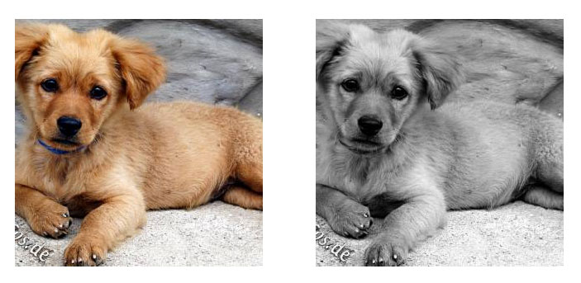
Image Processing
“In computer science, digital image processing is the use of a digital computer to process digital images through an algorithm.” (wiki)
You can think of common applications like applying a ‘grayscale’ filter to the original color photograph
This is what we will investigate today
https://codropspz-tympanus.netdna-ssl.com/codrops/wp-content/uploads/2014/10/grayscale.jpg

Slide 6
Image Storage - RGB Representation
An image (like the two on the right) store information in pixels.
You may for example have an image that is 600x400 pixels in width and height
Within each pixel, color information is stored.
Using three color channels, such as Red, Green, and Blue, those values make up the individual color of a pixel.
https://codropspz-tympanus.netdna-ssl.com/codrops/wp-content/uploads/2014/10/grayscale.jpg
R
G
B

Slide 7
Color to Grayscale
With each of these color values, we can follow an algorithm to change each pixel one at a time to a grayscale value
Pixels can be accessed individually (meaning one pixel’s information does not effect the other)
Thus, using CUDA to transform the colors of each pixel in parallel can be done faster!
https://codropspz-tympanus.netdna-ssl.com/codrops/wp-content/uploads/2014/10/grayscale.jpg
R
G
B

Slide 8
Grayscale algorithm
How we change a color (RGB) image into a grayscale image follows a simple algorithm.
We multiply each component by a specific value
Red * 0.21
Green * 0.71
Blue * 0.07
(Another way to think of it, is to take a dot product if you are familiar)
So the NewPixel at position x,y will be:
NewPixel[x,y] = r*0.21 + green*0.71 + blue*0.07
Note: There is a reason we do not just take the average of three colors, which you can read more about here.

Slide 9
Implementation

Slide 10
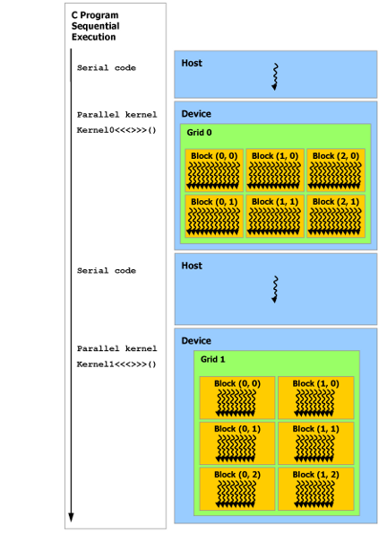
Implementation
When designing CUDA enabled programs, remember we are using a heterogeneous style of programming--meaning we have both a CPU and a GPU
So there will be some tasks we need to do on the CPU
e.g. loading a file from disk
Then there will be the task we can do in a massively parallel fashion
e.g. image processing
The image to the right illustrates a typical workflow in a CUDA program
https://docs.nvidia.com/cuda/cuda-c-programming-guide/graphics/heterogeneous-programming.png

Slide 11
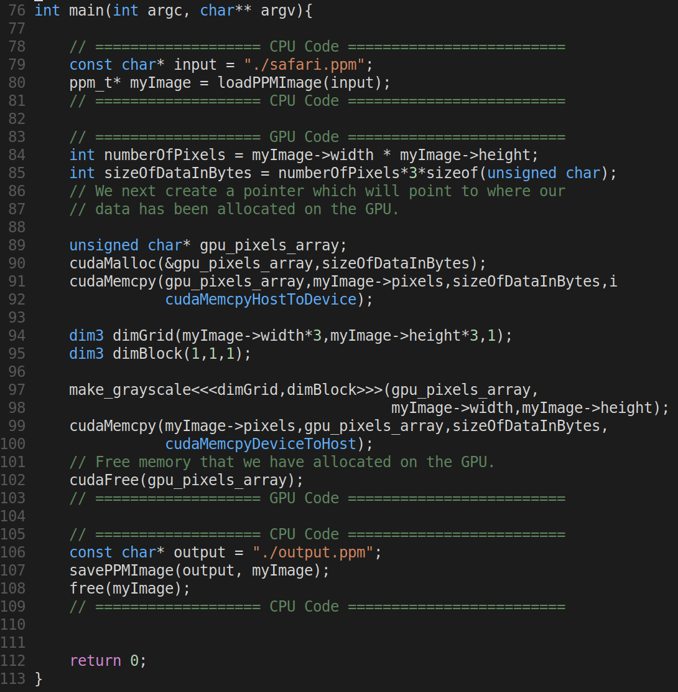
Program Structure
Pictured to the right is the structure of our code.
Observe that there are sections of CPU code where we are doing CPU tasks, and sections of GPU code for GPU tasks
In the next slide, we will reveal the kernel

Slide 12
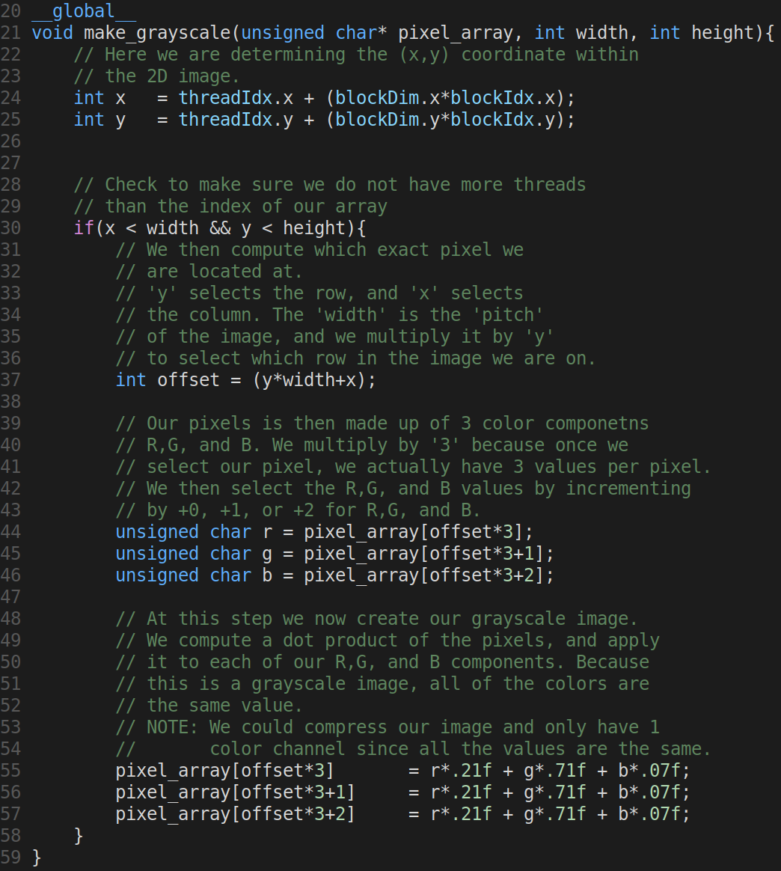
Kernel
The implementation of the kernel involves taking an input of pixel values
These are the R,G, and B values for which we will manipulate and change.
At the bottom of the function, observe that we are updating our pixel_array input to have the grayscale RGB values

