Slide 1
Blue Waters Petascale Semester Curriculum v1.0 Unit 10: Productivity and Visualization Lesson 1: Python Scripting 1 Developed by Michael N. Groves for the Shodor Education Foundation, Inc.

Slide 2
Except where otherwise noted, this work by The Shodor Education Foundation, Inc. is licensed under CC BY-NC 4.0. To view a copy of this license, visit https://creativecommons.org/licenses/by-nc/4.0 Browse and search the full curriculum at http://shodor.org/petascale/materials/semester-curriculum We welcome your improvements! You can submit your proposed changes to this material and the rest of the curriculum in our GitHub repository at https://github.com/shodor-education/petascale-semester-curriculum We want to hear from you! Please let us know your experiences using this material by sending email to petascale@shodor.org

Slide 3
Learning Objectives
Understand what is an interpreted programming language and that Python is an interpreted language
Understand basic Python programming ideas including saving variables, writing lists, for loops and conditional statements.

Slide 4
Interpreted vs Compiled Programming Languages
Interpreted
Definition: Source code is compiled when executed by an interpreter
Advantages: Development of new code and changes to existing code are generally faster than with compiled code. Prototyping code is typically simpler. Code is portable to any system.
Disadvantages: The execution of code is generally slower than compiled languages because it is ‘compiled’ on the spot each time you run the code.
Compiled
Definition: Source code is translated into machine code to be executed later
Advantages: Once compiled, the execution of code is generally faster than interpreted languages. This is important for heavy resource applications
Disadvantages: Speed of development is typically slower since each iteration must be compiled. Compiled software can only be run on the system it was compiled on.

Slide 5
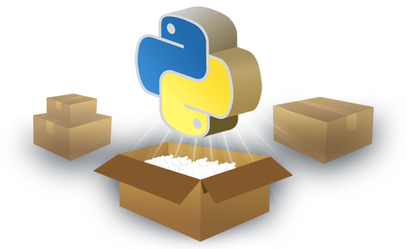
Python is an Interpreted Language
High level, general purpose programming language
Object oriented
Design philosophy emphasizes code readability
Named after the sketch comedy troupe “Monty Python”

Slide 6
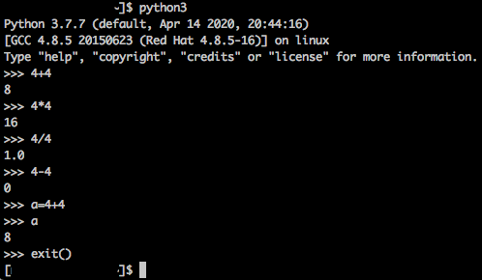
The Python Interpreter
Typing ‘python3’ on the command line will start the Python interpreter
This gives a spot to try some commands.
To exit type: exit()

Slide 7
“Hello_world.py” Python Program
It is usually better to write Python scripts so that your code is saved. The following instructions are to write a first Python Program:
Once logged into a cluster, open a text editor (eg. vi or emacs)
Type the following line: print(“Hello World!”)
Save and exit the text editor
Type: python3 Hello_world.py
“Hello World!” should be printed to the screen.
Note how the adding the name of a Python script after the python executable runs the program.

Slide 8
Lists
Building vectors and matrices in Python involves a structure called a List. Lists are enclosed by square brackets and can be made of any data type:
Vector: a = [0,’t’,2,’Y’,4]
Matrix: b = [[1,2,3],[4,5,6]]
Strings are just a list of characters.
c = ‘Python’

Slide 9
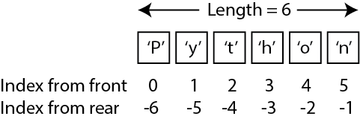
Calling List Elements
Python using an indexing scheme to call elements from a list. For example, the individual letters from the string c=’Python’ can be called according to:
So, c[0] and c[-6] will return the letter ‘P’

Slide 10
For Loops
For loops are used to iterate through a list and perform an operation on each element. For example, to print each letter of c=’Python’ using a for loop:
for letter in c:
print(letter)
Note two things:
The syntax of the for loop is ‘for element in list’ so each element of the list will take a turn as element
The indentation. Python uses significant whitespace. The end of the for loop occurs when the indented block ends.

Slide 11
Conditional Statements
If/else statements also use significant whitespace. Assume that a=2:
if a > 1:
print(‘a is greater than 1’)
elif a < 1:
print(‘a is less than 1’)
else:
print(‘a is equal to 1’)

Slide 12
Summary
Python is an interpreted language that lends itself to quick prototyping of code ideally to perform non-resource intensive operations
Variables can be saved to lists where indexing starts at 0. Indexing also starts at the end of the list with -1
Python uses significant whitespace to indicate when for loops and conditional statements are in effect.

