Slide 1
Blue Waters Petascale Semester Curriculum v1.0 Unit 10: Productivity and Visualization Lesson 4: Visualization 2 Developed by Juan R. Perilla for the Shodor Education Foundation, Inc.

Slide 2
Except where otherwise noted, this work by The Shodor Education Foundation, Inc. is licensed under CC BY-NC 4.0. To view a copy of this license, visit https://creativecommons.org/licenses/by-nc/4.0 Browse and search the full curriculum at http://shodor.org/petascale/materials/semester-curriculum We welcome your improvements! You can submit your proposed changes to this material and the rest of the curriculum in our GitHub repository at https://github.com/shodor-education/petascale-semester-curriculum We want to hear from you! Please let us know your experiences using this material by sending email to petascale@shodor.org

Slide 3

VISUALIZATION OF molecular simulations using VMD on Stampede2

Slide 4
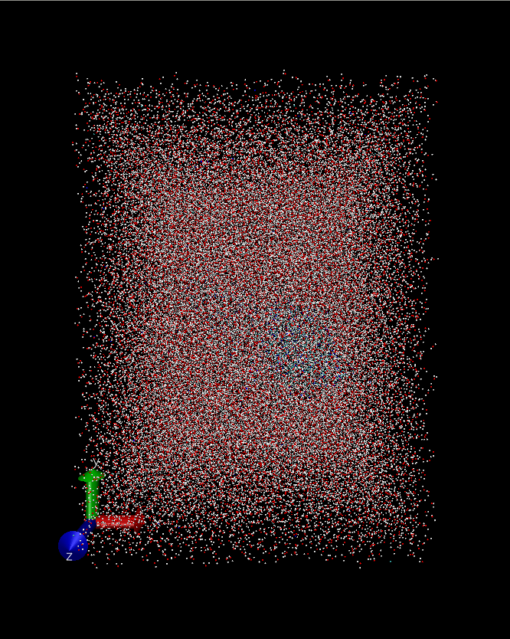

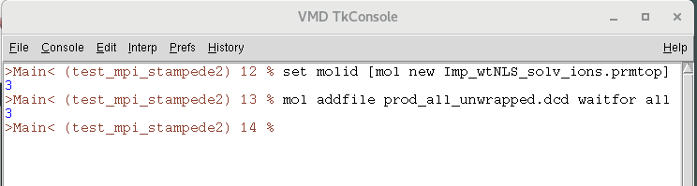
Setting VMD display settings
VMD builds on supercomputers automatically sets to default display settings. Therefore, several settings need to be adjusted according to the system of study.
Open VMD on your local machine:
Go to Extensions → Tk Console
Load the structure file (.prmtop format) and trajectory (.dcd format)
mol new assigns and an unique ID to each loaded structure. The variable $molid allows to execute commands that apply to the specific molecule

Slide 5
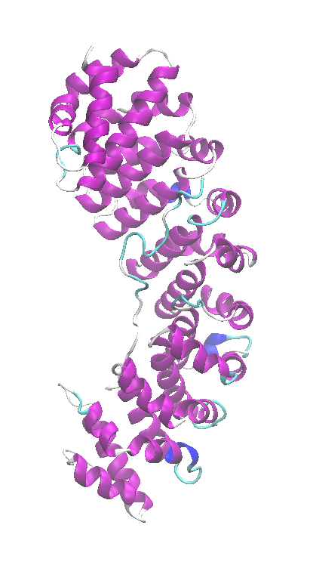
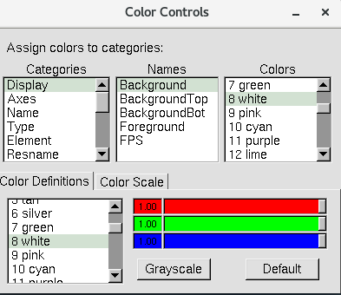
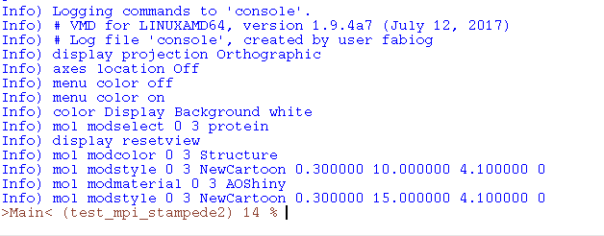
Setting up VMD display settings
The additional changes on the display setting are going to be performed through the GUI of VMD. In order to keep track of the command to add to the final rendering script, the following is done:
Go to File → Log Tcl commands to console
Set Display → Orthographic
Set Display → Axes → Off
Set Graphics → Colors → Categories: Display, Names: Background, Color: White
Visual inspection of the system
Printed commands on console
Graphics → Representations… → Coloring method: Secondary Structure, Drawing Method: New Cartoon,
Materials: AOChalky, Resolution: 50

Slide 6
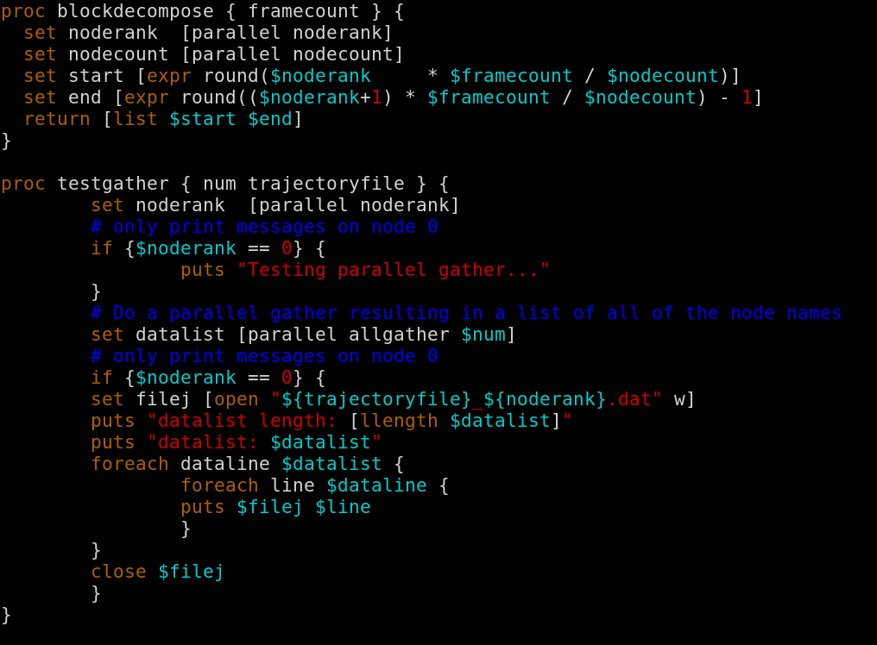
Rendering using VMD MPI
The following script describes rendering movies using MPI-supported VMD on Stampede2 supercomputer.
render_movies_mpi.tcl
Decomposition of trajectory in blocks, according to the total number of frames and number of ranks requested.
The parallel allgather command allows Tcl MPI analysis scripts to gather the results from all the nodes, in a set of per-node list of results. The output in printed on rank 0.

Slide 7
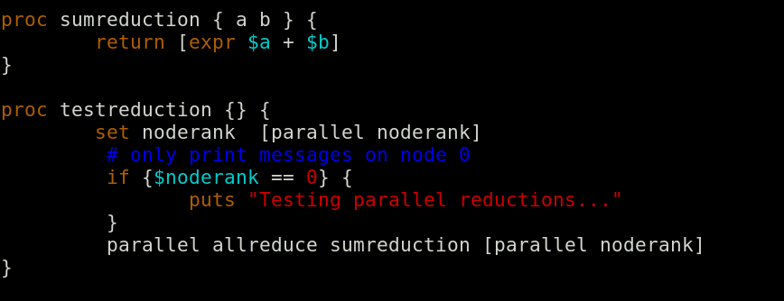
Rendering using VMD MPI
The following script describes rendering movies using MPI-supported VMD on Stampede2 supercomputer.
render_movies_mpi.tcl
Computes parallel reduction across the requested ranks, each rank contributing to one value. The final value is returned to all ranks.

Slide 8
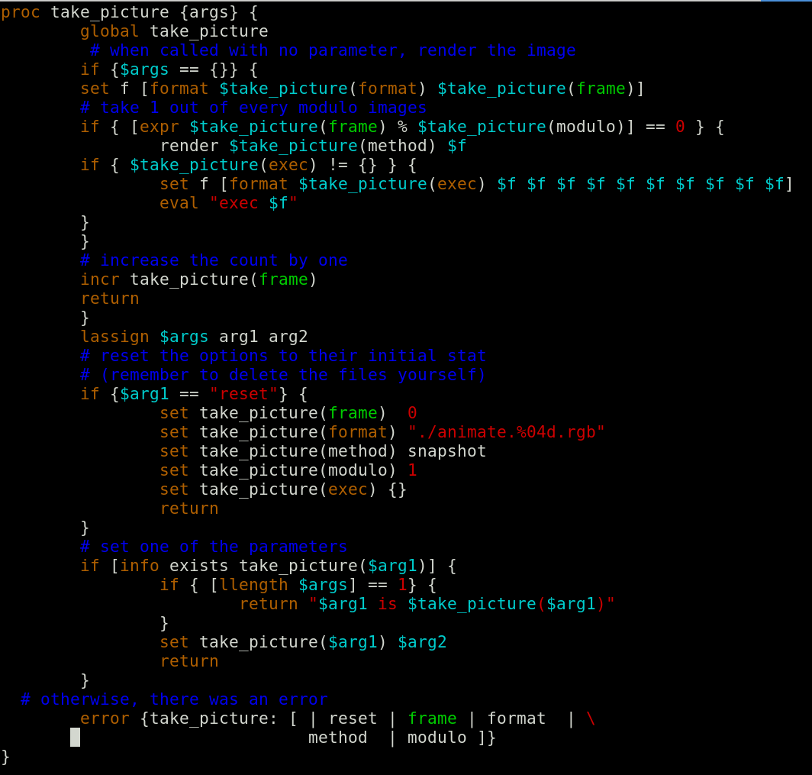
Rendering using VMD MPI
The following script describes rendering movies using MPI-supported VMD on Stampede2 supercomputer.
render_movies_mpi.tcl
Generates the data files for each frame of the trajectory (.dat). After the generation of data files, the image rendering is performed using the Very fast multiprocessor ray tracer Tachyon.

Slide 9
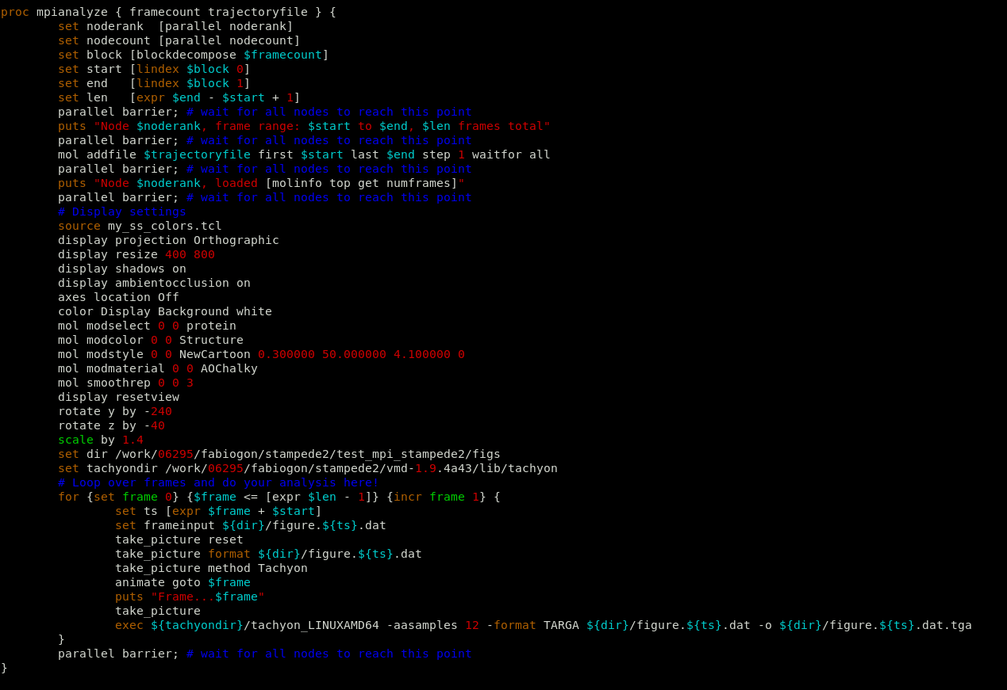
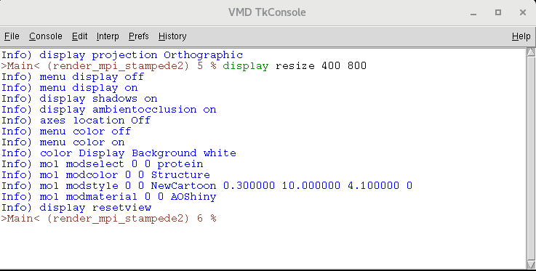
Rendering using VMD MPI
The following script describes rendering movies using MPI-supported VMD on Stampede2 supercomputer.
render_movies_mpi.tcl
my_ss_colors.tcl sources a color palette for secondary structure feature in the proteins.
Frame decomposition on ranks
Viewpoints and representations saved on the console are copied to the rendering script in the mpianalyze process
Load trajectory
Save visualization state from console to the submission script
Visual settings
Loop and rendering over frames

Slide 10
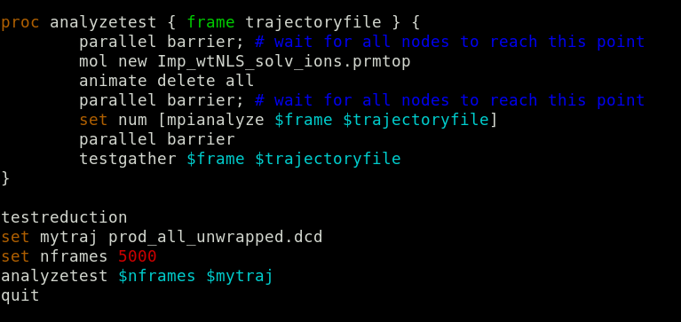
Rendering using VMD MPI
The following script describes rendering movies using MPI-supported VMD on Stampede2 supercomputer.
render_movies_mpi.tcl
Loads the structure file and preforms the rendering over the total number of ranks requested.
The example follows a trajectory with 5,000 frames.

Slide 11
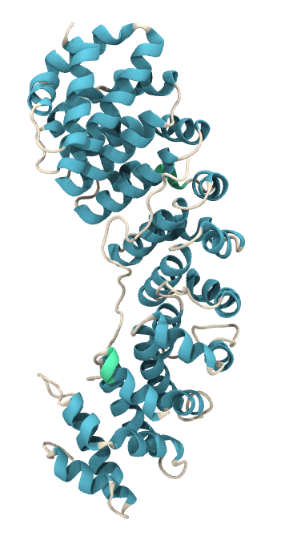
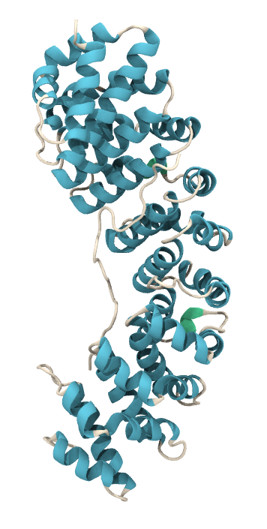
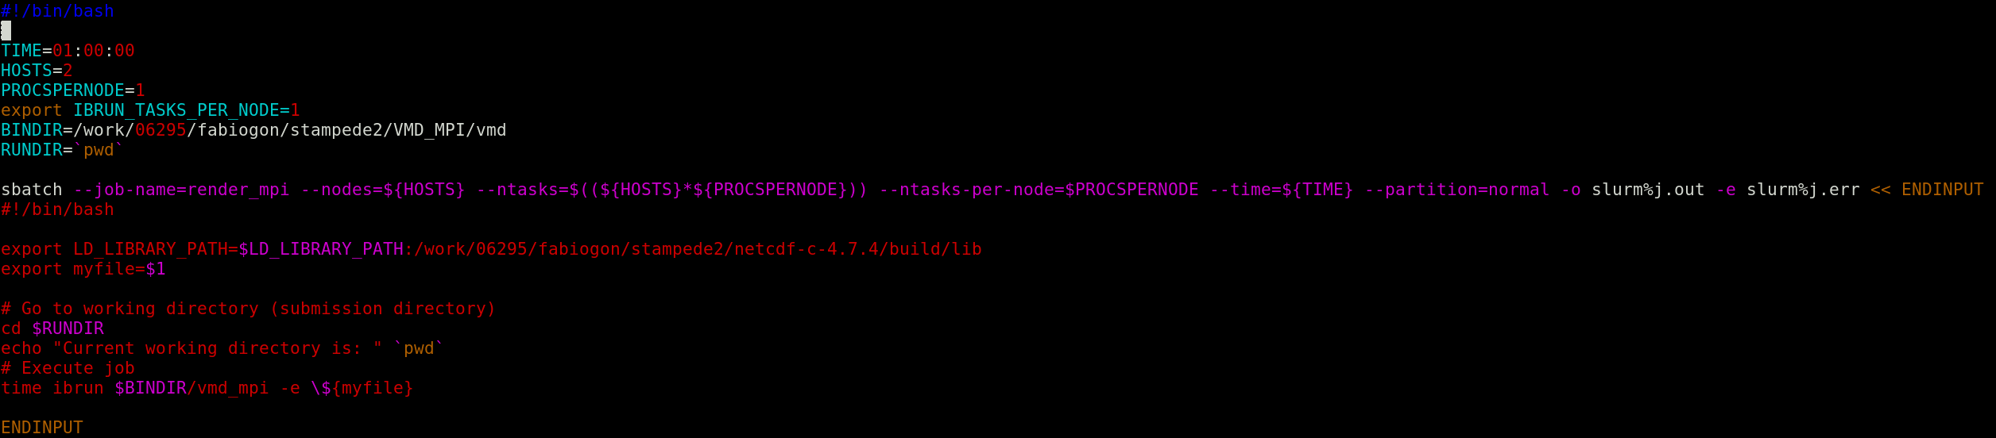
Rendering using VMD MPI
Frame 0
Frame 9
The script is submitted using Slurm Workload Manager
runbatch_mpi.sh
The resources requested correspond to 2 nodes, each one running a single process. Therefore, each node renders 2,500 frames.

Slide 12
Summary
Setting the simulation display settings.
1.1 Load the structure file and the MD trajectory on a local machine.
1.2 Enable Tcl commands to console.
1.3 Set VMD visualization settings and copy the commands to the render script, under
the mpianalize procedure.
2. Rendering using VMD MPI
2.1 Set the total resources to request with Slurm workload manager.
2.2 Submit the job rendering the figures with Tachyon.
3. Post image processing
3.1 Convert TARGA format figures to JPG/PNG extension. GNU Parallel is useful for the conversion.
3.2 Render the composition using image post-processing software such as mencoder, ffmpeg or Adobe AfterEffects.

Slide 13
References
Humphrey, W., Dalke, A., & Schulten, K. (1996). VMD: visual molecular dynamics. Journal of molecular graphics, 14(1), 33-38.
Caddigan, E., Cohen, J., Gullingsrud, J., & Stone, J. (2003). Vmd user’s guide. Urbana, 51, 61801.
Caddigan, E., Cohen, J., Gullingsrud, J., & Stone, J. (2003). VMD Installation Guide.
Stone, John E. (1998). An Efficient Library for Parallel Ray Tracing and Animation. Masters Theses.

