Slide 1
Blue Waters Petascale Semester Curriculum v1.0 Unit 7: CUDA Lesson 7: Parallel Reduce in CUDA Developed by Sanish Rai for the Shodor Education Foundation, Inc.

Slide 2
Except where otherwise noted, this work by The Shodor Education Foundation, Inc. is licensed under CC BY-NC 4.0. To view a copy of this license, visit https://creativecommons.org/licenses/by-nc/4.0 Browse and search the full curriculum at http://shodor.org/petascale/materials/semester-curriculum We welcome your improvements! You can submit your proposed changes to this material and the rest of the curriculum in our GitHub repository at https://github.com/shodor-education/petascale-semester-curriculum We want to hear from you! Please let us know your experiences using this material by sending email to petascale@shodor.org

Slide 3
Parallel Reduce with CUDA

Slide 4
Reduce Operation
The reduce operation “reduces” a set of elements according to a reduction operator
For example:
an array of numbers can be reduced using sum operator to find the total sum
an array of numbers can be reduced using max operator to find the maximum

Slide 5
Reduce: Sum operator
Assume we have an array [3, 5, 6, 8, 9,4]
We can perform a reduction as follows
3 + 5 = 8
8 + 6 = 14
14 + 8 = 22
22 + 9 = 31
31 + 4 = 35
This operation can also be represented as:
(((((3+5)+6)+8)+9)+4) = 35

Slide 6
Reduce: Sum operator
Let us visualize the sum reduction for the array [3, 5, 6, 8, 9, 4]
3
5
6
8
9
4
+
+
+
+
+
31

Slide 7
Reduce operator
For the reduce operations, it is necessary that the operator are associative and sometimes commutative
Associative:
Order of operations does not matter
For e.g.,
(1 + 2) + 3 = 1 + (2 + 3)
(1 x 2) x 3 = 1 x (2 x 3)
Commutative
Order of operands does not matter
For e.g.,
3 + 5 = 5 + 3
3 x 5 = 5 x 3

Slide 8
Serial implementation of sum operation
The sum reduce operation can be implemented using a for loop
/*
* Function - Reduce using serial loops
* ----------------------------
* Use a for loop to add the elements
*
* a: vector a
* sum: to store results
* n: maximum size of vector a
*/
void serial_reduce(int *a, int *sum, int n) {
for(int i=0;i<n;i++)
*sum+=a[i];
}

Slide 9
Parallel implementation of sum operation
Issue:
For large number of elements, it would take a lot of time for serial operation
If we can execute this operation in parallel, it can be a lot faster
We can use then use CUDA to perform the parallel computation
Can we parallelize this operation?
The associate and commutative properties of sum operation allows it to be added in any order
How do we parallelize it?
Divide the elements into groups, perform the operation for each group in parallel
Arrange the results again into groups and perform the operation in parallel
Continue until there are only two results
Perform the operation to the two results to get the final result

Slide 10
Parallel reduce example
Here is how we can do parallel reduce for the list [3, 5, 6, 8, 9, 4, 2, 1]
In parallel we perform (3+5)=8 and (6+8)=14 and (9 + 4) = 13 and (2 + 1) = 3
Now we perform (8 + 14) = 22 and (13 + 3) = 16 in parallel
Finally we perform (22 + 16) =38

Slide 11
Parallel Reduce: Sum operator
Let us visualize the sum reduction for the array [3, 5, 6, 8, 9, 4, 2, 1]
3
5
6
8
9
4
2
1
+
+
+
+
In parallel reduce, each of the + operation can be done in parallel by a thread
+
+
+
In this example, the operation is performed with the immediate neighbors of the elements
38

Slide 12
Parallel Reduce: Sum operator
The reduce operation can done in another way as well
3
5
6
8
9
4
2
1
+
+
+
+
+
+
In this example, the operation is performed with the elements at distance of half array size
+
38

Slide 13
Let us see a parallel implementation in CUDA
We can achieve it as following:
First launch 1024 blocks, each with 1024 kernels to reduce 1024 elements
Each of the block will produce 1 item, so a total of 1024 items
Then launch a block with 1024 kernels to reduce the 1024 items in previous step

Slide 14
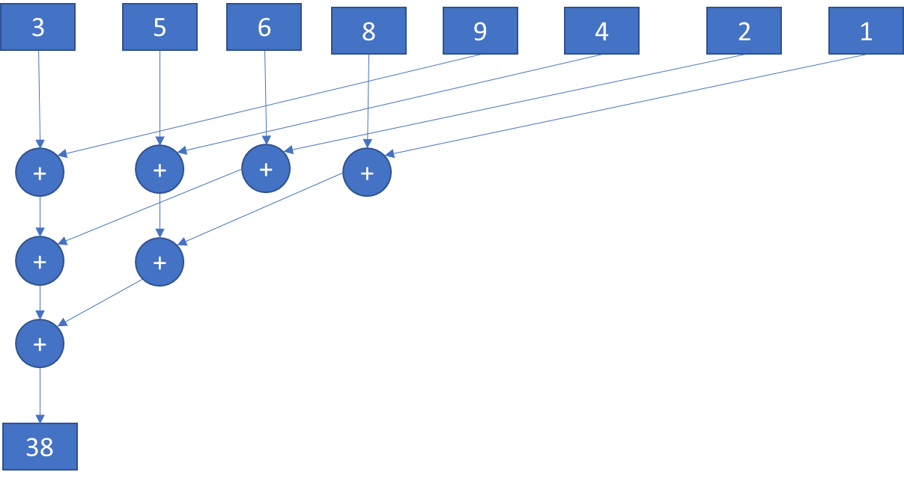
Let us see a parallel implementation in CUDA
Let us see how we can implement the reduce in kernel similar to the figure
There are 1024 blocks, each with 1024 kernels
So each block is responsible for 1024 elements from the input array
We can perform reduction as follows
For each computation, we can divide the array into half so that we have two 512 element regions
Now each of 512 threads can add its element to corresponding element in 2nd half and write back to the array in first half
This results in 512 elements, where each element represents the addition (a reduced result) of two elements
Now again we divide into two 256-element regions and 256 threads can add corresponding elements from 1st and 2nd region and save them in the 1st region
We can continue dividing the region into half until a region with only one element remains
We can write that element back to the global memory

Slide 15
Let us see how the kernel looks like
__global__ void parallel_reduce(int *in, int *out) {
//get the thread id from block and number of threads
int thread_id = blockIdx.x * blockDim.x + threadIdx.x;
//get the thread id in the block
int t_id = threadIdx.x;
//using for loop break continuously into half (1024->512->256...1), until region with 1 element
for(int i=blockDim.x/2;i>0;i >>= 1){
if (t_id < i)
in[thread_id] +=in[thread_id + i]; //add the corresponding element from other half
//we need to synchronize so that all the threads complete the first operations
__syncthreads();
}
//need to write the result from this block to global memory
if(t_id==0){
out[blockIdx.x] = in[thread_id];
}
}
Perform reduction with the element at a half the distance, continue again in the loop
Synchronization
Write back to global memory

Slide 16
Here is the main function
void serial_reduce(int *a, int *sum, int n) {
//use a serial for loop for addition operation
for(int i=0;i<n;i++)
*sum+=a[i];
}
int main(int argc, char **argv){
//size of the array 2^20
int size = 1<<20;
printf("%d",size);
//host vectors, h_in will contain the original array, we will use sum for result
int *h_in, sum=0;
//device vectors d_in will contain the original array, we will use d_inter to store intermediate results
//d_out to store final result
int* d_in, * d_inter, * d_out;
size_t size_vect = size*sizeof(int); /* size of the total vectors necessary to allocate memory */
h_in = (int*)malloc(size_vect);
//allocate memory for the vectors on device (gpu)
cudaMalloc((void **)&d_in, size_vect);
cudaMalloc((void **)&d_inter, size_vect);
cudaMalloc((void **)&d_out, sizeof(int));
//initialize the vectors each with value 1 for simplicity
for (int i = 0; i < size; i++) {
h_in[i] = 1;
}
//use serial function for sum
serial_reduce(h_in, &sum, size);
//Verify the result by adding all the sum, should be size
printf("Serial results:%d\n",sum);
//Continued on next slide
This simple program uses 1024 threads to divide 1024*1024 = 2^20 elements into half and so continues working by dividing into half.
The size needs to be divided into two equal parts to work properly in this program.
For more information check (Harris 2007): https://developer.download.nvidia.com/assets/cuda/files/reduction.pdf
Number of elements = 2^20
Host variables
Device variables
Memory allocation
Initialize to 1, you can initialize to any values, 1 used for simplicity
A serial method to add values to test result
Print serial result

Slide 17
Here is the main function
//Start CUDA processing
// Copy vector host values to device
cudaMemcpy(d_in, h_in, size_vect, cudaMemcpyHostToDevice);
//define number of threads
int threads = 1024;
//define block size in integer
int block_size = (int)ceil((float)size / threads);
//execute the kernel with block size and number of threads
//this is the first phase where the computation results 1024 elements
parallel_reduce<<<block_size,threads>>>(d_in, d_inter);
//add the 1024 elements to a single result using
parallel_reduce<<<1,block_size>>>(d_inter, d_out);
// Copy result back to host
cudaMemcpy(&sum, d_out, sizeof(int), cudaMemcpyDeviceToHost);
//Verify the result by adding all the sum
printf("Device sum global :%d\n",sum);
// Release all device memory
cudaFree(d_in);
cudaFree(d_inter);
cudaFree(d_out);
// Release all host memory
free(h_in);
}
Copy the data to device from host
Define the number of threads
Define the block size
First computation on device to reduce to 1024 elements
In the second computation, 1024 threads add the result to a single output
Copy the data back from device to host
Print the parallel result
Release the device memory
Release the host memory

Slide 18
Use of global memory in kernel
In the kernel, we are accessing the global memory quite frequently
In each iteration of the loop, we read n items from global memory at step 6 and write back n/2 items at step 10
In next step, we read n/2 items at step 6 and write back n/4 items at step 10, and so on..
Instead of writing to global memory, we can use shared memory and complete all computations in device and transfer only the final result
__global__ void parallel_reduce(int *in, int *out) {
int thread_id = blockIdx.x * blockDim.x + threadIdx.x;
int t_id = threadIdx.x;
for(int i=blockDim.x/2;i>0;i >>= 1){
if (t_id < i)
in[thread_id] +=in[thread_id + i];
}
__syncthreads();
if(t_id==0){
out[blockIdx.x] = in[thread_id];
}
}
Global memory updates

Slide 19
Use of shared memory in kernel
__global__ void parallel_reduce_shared(int *in, int *out) {
//use a shared memory
extern __shared__ int shared_data[];
//get the thread id from block and number of threads
int thread_id = blockIdx.x * blockDim.x + threadIdx.x;
//get the thread id in the block
int t_id = threadIdx.x;
//load data from global mem
shared_data[t_id]=in[thread_id];
//synchonize threads to load all data
__syncthreads();
//using for loop break continously into half (1024->512->256...1), until region with 1 element
for(int i=blockDim.x/2;i>0;i >>= 1){
if (t_id < i)
shared_data[t_id] +=shared_data[t_id]; //add the corresponding element from other half
//we need to synchronize so that all the threads complete the first operations
__syncthreads();
}
//need to write the result from this block to global memory
if(t_id==0){
out[blockIdx.x] = shared_data[0];
}
}
Use a shared memory in device
Copy global memory data to shared memory
Update shared memory instead of global memory
Finally update global memory from shared memory

Slide 20
Change in the main function
Declare the amount of shared data (bytes needed) in main function during launching the kernel
//using shared memory
parallel_reduce_shared<<<block_size,threads,threads*sizeof(int)>>>(d_in, d_inter);
parallel_reduce_shared<<<1,block_size,block_size*sizeof(int)>>>(d_inter, d_out);

Slide 21
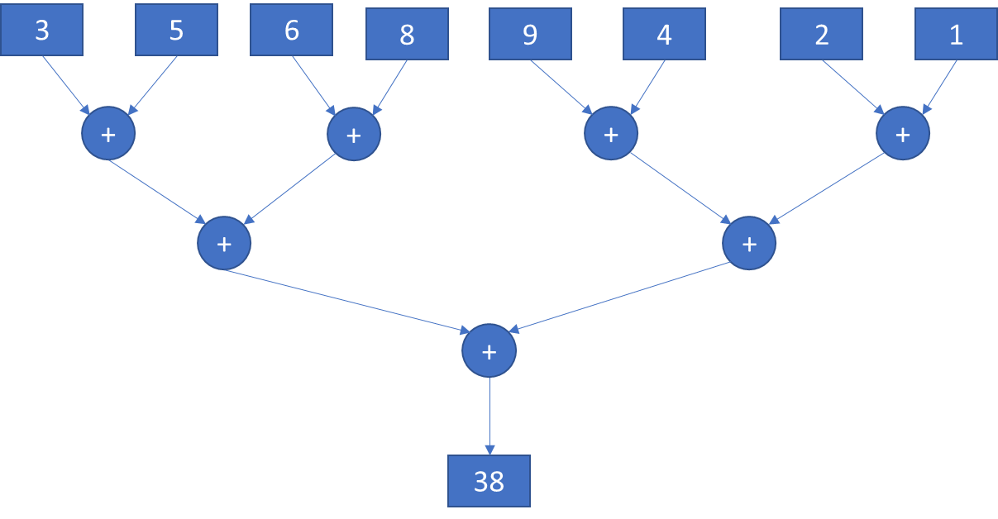
Exercise
Review the given source code for parallel reduction using sum operator for 2^20 elements
Write a kernel that performs reduction as shown in figure using shared memory. More details in the exercise document.
Write a program for parallel reduction using max operation to find the max value among 2^20 elements

Slide 22
References
Harris, M. (2007). Optimizing parallel reduction in CUDA. Nvidia developer technology, 2(4), 70.

