Slide 1
Blue Waters Petascale Semester Curriculum v1.0 Unit 8: OpenACC Lesson 2: Intro to OpenACC Developed by Mobeen Ludin for the Shodor Education Foundation, Inc.

Slide 2
Except where otherwise noted, this work by The Shodor Education Foundation, Inc. is licensed under CC BY-NC 4.0. To view a copy of this license, visit https://creativecommons.org/licenses/by-nc/4.0 Browse and search the full curriculum at http://shodor.org/petascale/materials/semester-curriculum We welcome your improvements! You can submit your proposed changes to this material and the rest of the curriculum in our GitHub repository at https://github.com/shodor-education/petascale-semester-curriculum We want to hear from you! Please let us know your experiences using this material by sending email to petascale@shodor.org

Slide 3
Introduction to GPGPU Computing with OpenACC

Slide 4
Learning Objectives
Understand what OpenACC is and its use cases in scientific applications
Learn how to compile and run programs that use OpenACC on Blue Waters.
Run an example program (diffusion model), comparing the performance difference between running serial vs. with OpenACC.
Learn about following OpenACC implementation of compiler directives:
#pragma acc parallel
#pragma acc parallel loop
#pragma acc kernel
#pragma acc data, present, copy, copyin, copyout, create
#pragma acc update

Slide 5
Getting started
Login:
$ ssh <username>@bw.ncsa.illinois.edu<ENTER>
Interactive node request:
$ qsub -I -l nodes=1:ppn=16:xk,walltime=03:00:00<ENTER>
Download code:
$ wget http://shodor.org/~mludin/BW_Capstone/openACC_intro.tar <ENTER>
Extract the tar file:
$ tar -xvvf openACC_intro.tar<ENTER>
Change folders:
$ cd openACC_intro/<ENTER>
$ ls <ENTER>
Notes:
Before the lecture is started, its always good idea to get started with getting into the system and requesting resource needed for examples and exercises. Sometimes the queue can take a while, so request for enough time that will get you through the examples and exercies.

Slide 6
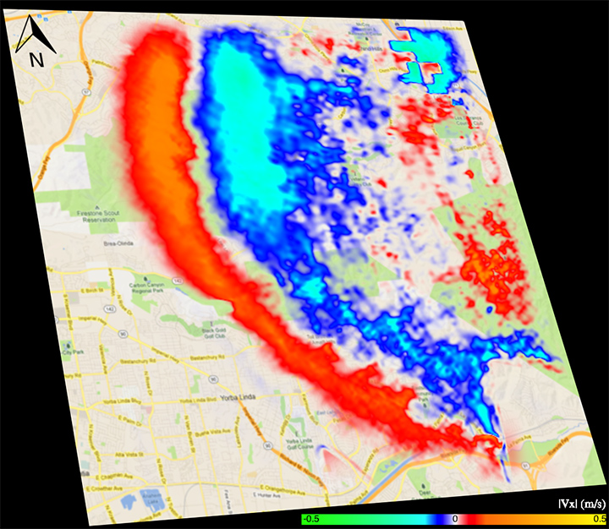
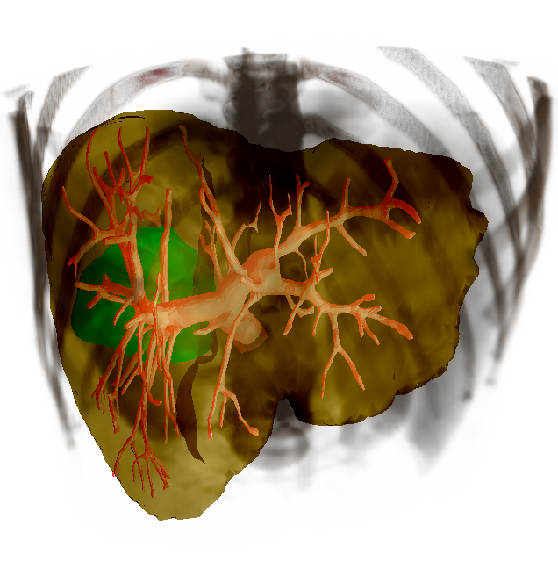
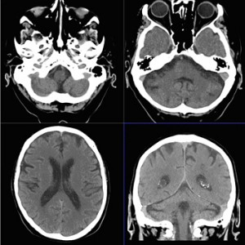
The GPU Big Bang
Notes:
Optional Slide

Slide 7
CPU vs. GPU
A GPU is tailored for highly parallel operation while a CPU executes programs serially
For this reason, GPUs have many parallel execution units and higher transistor counts, while CPUs have few execution units and higher clock speeds
GPUs have significantly faster and more advanced memory interfaces as they need to shift around a lot more data than CPUs
High bandwidth: NVIDIA Volta (2016) with 1TB/s
Nvidia Titan: 288GB/s
Notes:
Optional Slide

Slide 8
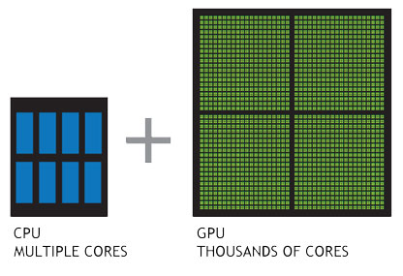
Modern CPUs Vs GPUs
So why not replace CPUs with GPGPUS?
Single GPU cores = DUMI
Group of GPU cores = FAST
Do not have features for modern Operating Systems
Less logic
No interrupts
No Virtual Memory that OS Needs
Notes:
Optional Slide

Slide 9
What is OpenACC
#pragma acc data copyin(x,y) copyout(z)
while ( dt > MAX_TEMP_ERROR && iteration <= max_iterations ) // create data region before the parallel loops
{ ...
#pragma acc parallel
{ // initiate parallel execution
#pragma acc loop gang vector //optimize loop mapping
for (i =0; i < num_itterations; i++){
z[i] = x[i] + y[i];
} // end for loop
} //end parallel execution region
} //write back data to host, and end data region and while loop
Notes:
OpenACC emerged in 2011 as a programming model that uses high-level compiler directives to expose parallelism in the code and parallelizing compilers to build the code for a variety of parallel accelerators. You add OpenACC to C/C++ code in form of #pragmas and in Fortran as comments that gives the compiler additional information on how to the code should be compiled.
CPU and GPU has its own memory, so data need to exist in both places and need to be managed correctly. We don’t have to manage two copies of same vectors data, we instead we can have OpenACC manage that for us.
The most important part of this pseudocode is the #pragma acc parallel which actually initiates the parallel region and creates a group of threads for parallel execution.
You don’t have to tell the compiler how to divide the loop iterations, it will will do it automatically based on what it knows about the system architecture.
These directives dont have to be added all together, we can just add them incrementally as we test for performance and program correctness.
Same code could be run on many different architecture without any change, except for recompiling and specifying the target compiler flags

Slide 10
Parallelizing with OpenACC
#pragma acc data copyin(x,y) copyout(z)
while ( dt > MAX_TEMP_ERROR && iteration <= max_iterations ) // create data region before the parallel loops
{ ...
#pragma acc parallel
{ // initiate parallel execution
#pragma acc loop gang vector //optimize loop mapping
for (i =0; i < num_itterations; i++){
z[i] = x[i] + y[i];
} // end for loop
} //end parallel execution region
} //write back data to host, and end data region and while loop

Slide 11
Resources:
http://www.openacc.org/sites/default/files/OpenACC_API_QuickRefGuide.pdf
https://bluewaters.ncsa.illinois.edu/openacc
http://www.openacc.org/sites/default/files/OpenACC%202%200.pdf
http://www.nvidia.com/content/PDF/kepler/NVIDIA-Kepler-GK110-Architecture-Whitepaper.pdf
http://blogs.nvidia.com/blog/2009/12/16/whats-the-difference-between-a-cpu-and-a-gpu/
http://arkanis.de/weblog/2011-04-02-finished-my-practical-term/gpgpu-origins-and-gpu-hardware-architecture.pdf
http://cinwell.wordpress.com/2013/09/06/overview-of-gpu-architecture-fermi-based/
http://electronicdesign.com/digital-ics/gpu-architecture-improves-embedded-application-support
http://www.eecs.berkeley.edu/~sangjin/2013/02/12/CPU-GPU-comparison.html
http://www.nvidia.com/content/cuda/spotlights/michael-bussmann-hzdr.html
http://www.technologytell.com/gaming/59208/video-game-gpu-used-to-improve-ct-scans/

