Slide 1
Blue Waters Petascale Semester Curriculum v1.0 Unit 6: Hybrid MPI + OpenMP Lesson 3: Pebble in Pond Wave Equation Developed by R. Phillip Bording for the Shodor Education Foundation, Inc.

Slide 2
Except where otherwise noted, this work by The Shodor Education Foundation, Inc. is licensed under CC BY-SA 4.0. To view a copy of this license, visit https://creativecommons.org/licenses/by-sa/4.0 Browse and search the full curriculum at http://shodor.org/petascale/materials/semester-curriculum We welcome your improvements! You can submit your proposed changes to this material and the rest of the curriculum in our GitHub repository at https://github.com/shodor-education/petascale-semester-curriculum We want to hear from you! Please let us know your experiences using this material by sending email to petascale@shodor.org

Slide 3

Blue Waters Project
Lesson on MPI Waves
Other Lessons similar are:
Lessons on MPI and OpenMP – Pebbles
Lesson on OpenACC – Pebbles
Lesson on Visualization of Pebbles
This lesson builds the vis tools
used in these other lessons

Slide 4
Parallel Computing – Geophysical Data Processing
Topics
Historical Survey of Parallel Computing
Geophysics – Acoustic Waves
High Performance Computing
Serial computers and how they work
Parallel computers and how they work
Pipelining and how it relates to serial and parallel computers
MPI for Parallel Computing
Visualization for Acoustic Waves

Slide 5
Parallel Computing
Topics
Programming Languages
Decomposition of a Problem Data Domain
Programming Constructs for Parallel Computing
Efficiency Modeling of Parallel Computing
Cost of Operations – Algorithm Complexity

Slide 6
Parallel Compute Examples
Fortran – C codes
OpenMPI
Linux Machines – Multi-Core Laptops with GPU’s
Network machines – Local, Remote, or Cloud
Connect with User ID and Password
SSH w/o passwords – best if inside a very tight firewall
Exa-Scale (10^18) machines with operations per second
Network Mounted File Systems – NFS

Slide 7
History of Machines
Illiac – University of Illinois
PEPE – DOD Radar Machine
FPS – Array Processors -1980’s
Cray X machines - 1980’s
IBM Multiprocessors
Hardware – CM 2
PC clusters
IBM Blue Gene – 128,000 cpu’s
Oak Ridge Summit – IBM Power 9 - 2019
Japan’s – Number 1 in the TOP 500 - 2020

Slide 8
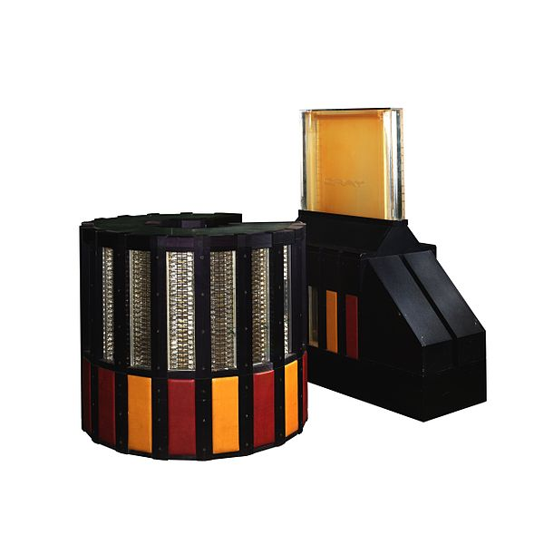
CRAY 2
Image: CRAY-2 IMG 8915-8913-8912a.jpg by Rama is licensed under Creative Commons Attribution-ShareAlike 3.0 France

Slide 9
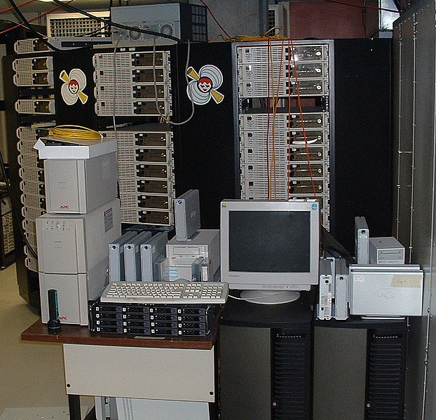
Beowulf Cluster
Image: Beowulf-cluster-the-borg.jpg is in the public domain.

Slide 10

Gaming Laptop with a GPU
Image: Falcon Northwest's TLX gaming laptop.png by Falcon Northwest is licensed under CC-BY-SA-4.0

Slide 11
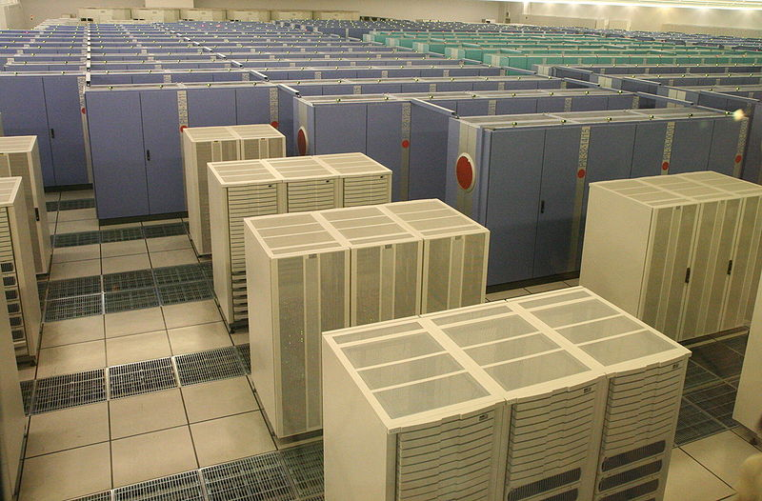
SIZE, COST, and HEAT
The EARTH Simulator
3 Megawatts
500 Million US $
It doesn’t simulate global warming, IT CAUSES IT!
Image: EarthSimulator.jpg by Manatee_tw is licensed under CC-BY-SA-4.0

Slide 12
Chips have λ = Wire Sizes Lambda Rules – now at 7 nanometers
½ = 4X
Transistors have wires at intersections

Slide 13
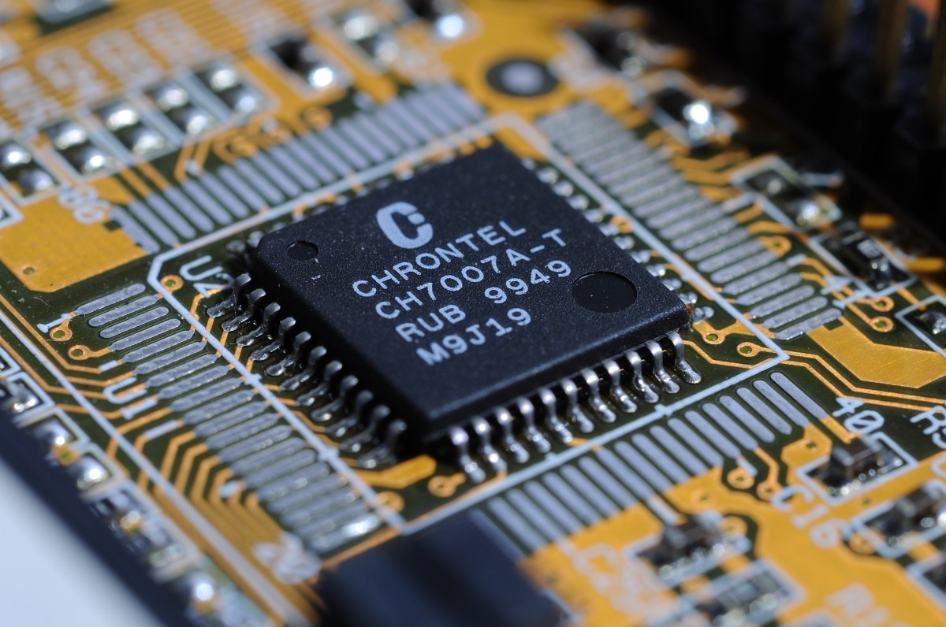
Lambda
Rules define
the wire sizes
on the chip
Image: circuit_board_high_tech.jpg is in the public domain.

Slide 14
After Gustfason 2004
Arithmetic is getting faster
Memory has reached a
Limit…… around 100 nsec.

Slide 15
Acoustic Waves – Pebble.f
Acoustic waves are used to demonstrate how parallel computing can work.
The domain is two dimensional and the waves propagate in time.
Domain decomposition is in one dimension.
Good accuracy requires a 9-point spatial derivative stencil.
Typical domain is 512 by 512 grid points.
This requires a ghost zone region of 4 memory locations.
Movie frames are written every few time steps to create an animation.
A post processing step creates a Graphics Magick animation.

Slide 16
Acoustic, Constant Density
Density is so constant it does not appear in the equation.
C is the P Wave Velocity.
The source energy is in src.
Psi is the wave field.

Slide 17
Acoustic Waves in 2D
Wave Equation, Utt = (Uxx + Uzz)/c^2 where t is time and (x,z) are spatial.
Utt is the second partial derivative in time.
Uxx and Uzz are the spatial second derivatives.
Utt = (Un(new) – 2 Uc(current) + Uo(old))/2dt
Uxx = (Uc(i-1,j) – 2Uc(i,j) + Uc(i+1,j))/2dx
Uzz = (Uc(I,j-1) – 2Uc(i,j) + Uc(I,j+1))/2dz
Utt is accurate for acoustic waves.
Uxx and Uzz need more than a 3-point operator, we use a 9-point operator.

Slide 18
Acoustic Waves in 2D
Utt is accurate for acoustic waves.
Uxx and Uzz need more than a 3-point operator, we use a 9-point operator in the x and z directions.

Slide 19
Acoustic Waves in 2D
Utt is accurate for acoustic waves.
Uxx and Uzz need more than a 3-point operator, we use a 9-point operator in the x and z directions.
Topside Ghost Region in memp+1
Memory Partitions
Memp
Memp+1

Slide 20
Acoustic Waves in 2D MPI Ghost Zones
4 memory cells deep
Ghost Zones
Internal cells
Ghost Zones
….
…………………………..…….…...
One Dimensional Decomposition in Pebble.f
….

Slide 21
Acoustic Waves in 2D MPI Ghost Zones
4 memory cells deep
Region 0 1 > 2
Ghost Zone 2 > 1
Ghost Zone
Region 1
Ghost Zone
Ghost Zone
Region 2
….
….
….
One Dimensional Decomposition in Pebble.f

Slide 22
Acoustic Waves in 2D MPI Parallel Compute Regions
Region 1 - CPU 0 Memory
Region 2 – CPU 1 Memory
Region 3 – CPU 2 Memory
CPU 0
CPU 1
CPU 2
One Dimensional Decomposition in Pebble.f

Slide 23
Time Marching
Waves work in time, so the outer compute loop is time, inner loops are spatial.
Do itime=1,ndtime
Do ix=1,ndx
Do kz=1,ndz
2D Array Time Step
End
End
End
Time
Steps
Of 2D
Arrays

Slide 24
Movie Time
Select every 4th time step result
Write to a file
Post process into a pixel map.
Movie Frames of
Floating Point Numbers
Time
Steps
Of 2D
Arrays

Slide 25
Algorithm Complexity
Count the operations for the work loop.
Do itime=1,ndtime
Do ix=1,ndx = Operations(ops,ndtime,ndx,ndz)
Do kz=1,ndz
O(nt x n^2 x 10) === > O(n^3)

Slide 27
Basic MPI Code
MPI has one version of code.
Program calls system routines for information.
How many processors are to be used.
Who am I in the list of available processors.
Include file is needed: include “mpif.h”.
Startup calls are:
Call MPI_INIT(ierror)
Call MPI_COMM_SIZE(MPI_COMM_WORLD, size, ierror)
Call MPI_COMM_RANK(MPI_COMM_WORLD,rank,ierror)

Slide 28
Startup MPI Routines
How many processors are to be used - integer: size
Who am I in the list of available processors - integer: rank
A general world communicator is provided:
Error flag is an integer: ierror
MPI_COMM_WORLD
Startup calls are:
Call MPI_INIT(ierror)
Call MPI_COMM_SIZE(MPI_COMM_WORLD, size, ierror)
Call MPI_COMM_RANK(MPI_COMM_WORLD, rank, ierror)
End call is a good idea as you have distributed nodes computing and communicating. So shut down cleanly by doing a:
Call MPI_Finalize(ierror)

Slide 29
Pebble_mpi.f
MPI calls in Pebble_mpi.f are:
Call MPI_COMM_SIZE(MPI_COMM_WORLD, size, ierror)
Call MPI_COMM_RANK(MPI_COMM_WORLD, rank, ierror)
Call MPI_ALL_REDUCE(ucmax,ucmaxg,1,MPI_FLOAT,MPI_MAX,MPI_COMM_WORLD,ierror)
Call MPI_SEND(Ucur(i,j),lucur,MPI_Float,rankto,tag,MPI_COMM_WORLD,ierror)
Call MPI_RECV(Ucur(k,l),lucur,MPI_Float,rankfrom,tag,MPI_COMM_WORLD,ierror)
Call MPI_BARRIER(MPI_COMM_WORLD.ierror)

Slide 30
Pebble_mpi.f
MPI calls in Pebble_mpi.f are:
All_REDUCE the processors share ucmax, and what ever function MPI_MAX is applied, return that value to all processors.
Call MPI_ALL_REDUCE(ucmax,ucmaxg,1,MPI_FLOAT,MPI_MAX,MPI_COMM_WORLD,ierror)
SEND/RECV send a variable to rankto and receive from rankfrom.
Call MPI_SEND(Ucur(i,j),lucur,MPI_Float,rankto,tag,MPI_COMM_WORLD,ierror)
Call MPI_RECV(Ucur(k,l),lucur,MPI_Float,rankfrom,tag,MPI_COMM_WORLD,ierror)
Barrier causes a wait in the fast processors till the slow one's catchup, then moves on…..
Call MPI_BARRIER(MPI_COMM_WORLD.ierror)

Slide 31
Floating Point Operations per Second
Time entire run using LINUX
Time run_pebble_mpi
Using work count of loops
Count floating point operations…
Divide flop count / run time == > FLOPS

Slide 32
Timing Code Methods
Time entire run using LINUX
Time run_pebble_mpi
Internal call to timer routines…
Call time(tstart)
Do work
Call time(tstop)
Trun = tstop - tstart

Slide 33
Run Scripts
runclean ➔ clean up data directory.
#!/bin/bash
rm data/*
rm temp_fort/*
run_pebble_mpi ➔ delete files, compile,
execute mpi program
#!/bin/bash
rm temp_fort/*
rm data/*
rm pebble_mpi
mpif77 pebble_mpi.f -o pebble_mpi -O3
mpirun -np 8 pebble_mpi

Slide 34
Serial Execution versus Multi-thread Processing
Run Time Serial Multi-Thread
< Main Thread >
Secondary Threads (3)
< Main Thread > Shared Variables
< Main Thread >
< Main Thread >
< Main Thread
< Main Thread
Organize data access
and execution between
threads
Run Time Savings

Slide 35
OpenMP Fortran Basics
PROGRAM BasicOpenMP
Integer*4 Icount
Real*4 Data(128,16)
Serial code
Beginning of parallel region. Fork a team of threads. Specify variable scoping
Master Thread
!$OMP PARALLEL PRIVATE(VAR1, VAR2) SHARED(VAR3) Thread Team
Parallel region executed by all threads
Other OpenMP directives
Run-time Library calls
All threads join master thread and disband
!$OMP END PARALLEL
Resume serial code
END
Shared
Private

Slide 36
OpenMP Fortran in two MPI ranks and five MP threads per MPI rank
Rank 0 Rank 1
Master Thread Master Thread
Thread Team Thread Team
Shared
Private
Shared
Private

Slide 37
OpenMP Directives
Main Program requires library
USE OPM_LIB has to be added
Put directives where the work is done
Find the nested loops and add DO Parallel

Slide 38
OpenMP Do Parallel
!$OMP DO PARALLEL Private(V1,X2) Shared (sum)
NESTED LOOPS
The more the better……………..
Skip the simple loops – why because you have to maintain this code
!$OMP END DO PARALLEL

Slide 39
Vis with Graphics Magick
Movie Frames Movie Frames
Of Floating Point of Integer
Numbers Pixels
Convert
32 float point number
to
32 integer ARGB
Pixel
Red, Green, and Blue with a transparency factor A.
Movie frames are made with gray scale pixels.

Slide 40
Discussion Time

Slide 41
Computing and Calculating Engines Serial and Parallel Computers

Slide 42
Software Design Issues
Vector Programming
Cache Programming
Message Passing Programming
NUMA Programming
Grid Programming
ALL memory operations have a
Fixed Cost
Code Performance Improvements
are dominated by fixed costs

Slide 43
Hardware Design Issues
10 Years equals 100 Fold Speedup
Memory Latency – cost of getting the first word is a constant
Wires have failed to scale
Bigger cache memories are slower
Code Performance Improvements are
dominated by fixed costs

Slide 44
Serial Computer -Linear Address Space
0 Max Address
Address Pointer
Latency is the time to access the first word
Bandwidth is the rate of accessing successive words

Slide 45
von Neumann Architecture Princeton
Memory
Address Pointer
Arithmetic
Logic
Unit
(ALU)
Data/Instructions
Pc = Pc + 1
Program Counter
Featuring Deterministic Execution

Slide 46
Cache Memory Architecture
C
A
C
H
E
C
O
N
T
R
O
L
Memory
Main Memory is large and slow.
Cache is much smaller and much faster.
Control logic control keeps the main memory coherent.
Cache
Memory
Address Pointer
Featuring Non-Deterministic Execution

Slide 47
Cache Memory - Three Levels Architecture
Memory
Multi-
Gigabytes
Large
and
Slow
160 X
Cache
Control
Logic
2 Gigahertz Clock
2X
8X
16X
L3 Cache
Memory
L1 Cache
Memory
L2 Cache
Memory
32 Kilobytes
128 Kilobytes
16 Megabytes
Featuring Really Non-Deterministic Execution
Address Pointer

Slide 48
Pipeline Instructions
Pipeline Stages
Floating Point Add Operation
Reg 0
Reg 1
EXP 0
EXP 1
Mantissa
Alignment
Reg 0
Reg 1
Adder
Result

Slide 49
Discussion Time

Slide 50
Programming Models for Parallel Computing

Slide 51
Distributed Computing Message Passing Interface
Program Address Spaces
0 Max 0 Max 0 Max 0 Max
Multiple Address Pointers

Slide 52
Distributed Computing with Message Passing
Program Address Spaces
Messages Left and Right
Multiple Address Pointers

Slide 53
Distributed Computing with Message Passing
Program Address Spaces
Messages Left and Right
Multiple Address Pointers
DUAL CORE PROCESSORS

Slide 54
Distributed Computing with Message Passing
Program Address Spaces
Messages Left and Right
Multiple Address Pointers
FOUR CORE PROCESSORS

Slide 55
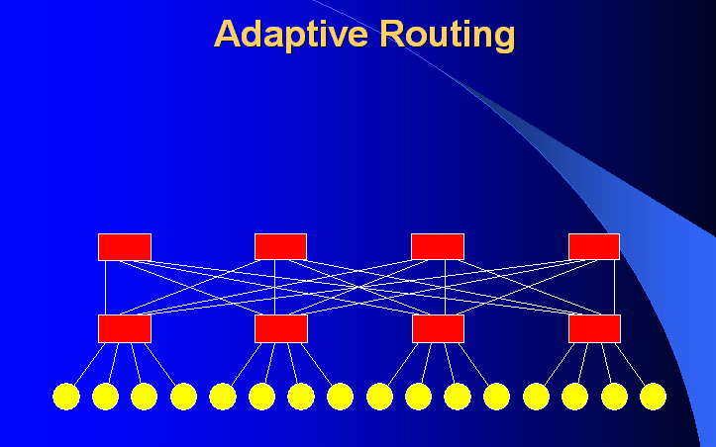
Compute Nodes
Network Switch

Slide 56
Multi-Threading OpenMP Programming Model
Global Program Address Space
Local Local Local Local
0 n-1 n 2n-1 2n 3n-1 3n 4n-1
Address and Cache
Bus with Conflict
Resolution
Multiple Address Pointers

Slide 57
Uniqueness of Store Multi-Threading
Program Address Space
0
Multiple Address Pointers
Duplicate Pointers
to the same Location – Conflict on storing a result
So who is managing the multiple pointers?
It is the programmers responsibility.

Slide 58
Discussion Time

Slide 59
#!/bin/bash
rm data/*
rm pebble
gfortran pebble.f -o pebble -O3

Slide 60
#!/bin/bash
rm temp_fort/*
rm data/*
rm pebble_mpi
mpif77 pebble_mpi.f -o pebble_mpi -O3
mpirun -np 8 pebble_mpi

Slide 61
Discussion Time

Slide 62
References/Links
Pebble References:
https://en.wikipedia.org/wiki/Acoustic_wave
Seismic Modeling and Imaging with the Complete Wave Equation, SEG Course Notes Series, No. 8., by Ralph Phillip Bording and Larry R. Lines
https://en.wikipedia.org/wiki/Fortran
https://www.open-mpi.org/
https://computing.llnl.gov/tutorials/openMP/
https://www.openmp.org/resources/tutorials-articles/
https://www.openacc.org/
https://en.wikipedia.org/wiki/OpenACC
https://en.wikipedia.org/wiki/RGBA_color_model

