Slide 1
Blue Waters Petascale Semester Curriculum v1.0 Unit 1: Computation Across the Curriculum Lesson 4: Scientific Examples on a Single Core Developed by Beau Christ for the Shodor Education Foundation, Inc.

Slide 2
Except where otherwise noted, this work by The Shodor Education Foundation, Inc. is licensed under CC BY-SA 4.0. To view a copy of this license, visit https://creativecommons.org/licenses/by-sa/4.0 Browse and search the full curriculum at http://shodor.org/petascale/materials/semester-curriculum We welcome your improvements! You can submit your proposed changes to this material and the rest of the curriculum in our GitHub repository at https://github.com/shodor-education/petascale-semester-curriculum We want to hear from you! Please let us know your experiences using this material by sending email to petascale@shodor.org

Slide 3
Scientific Examples on a Single Core

Slide 4
Outline
Scientific example #1: Drug design
Scientific example #2: Pandemic

Slide 5
Scientific Example #1
Drug Design

Slide 6
Drug Design
An extremely important problem in the biological sciences is drug design
Goal: Find small molecules (ligands) that are good candidates for use as drugs
General approach to the problem:
A protein associated with the disease of interest is identified, and its 3D structure is found either experimentally or through a molecular modeling computation
A collection of ligands is tested against the protein (that is, for every orientation of the ligand relative to the protein, computation is done to test whether the ligand binds with the protein in useful ways)
A score is set based on these binding properties, and the best scores are flagged, identifying ligands that would make good drug candidates

Slide 7
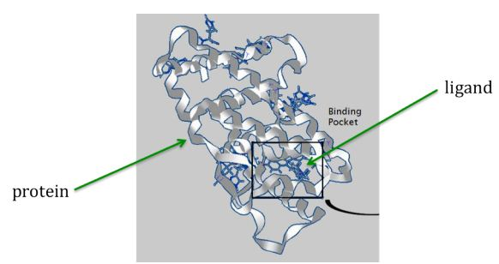
Drug Design

Slide 8
Drug Design
Working with actual ligand and protein data is beyond the scope of this example, so we will represent the computation by a simpler string-based comparison
Proteins and ligands will be represented as randomly-generated characters strings
The computation will be represented by comparing a ligand string (L) to a protein string (P)
The score for a pair [L, P] will be the maximum number of matching characters among all possibilities when L is compared to P, moving from left to right, allowing possible insertions and deletions

Slide 9


Drug Design
For example, if L is the string “cxtbcrv” and P is the string “lcacxetqvivg”, then the score is 4, arising from this comparison of L to a segment P:
Another possible match would be the following (also yielding a score of 4):
NOTE: there is no comparison that matches 5 or more characters while moving left to right, so the score is 4

Slide 10
Drug Design
The point of this lesson is not to write the code yourself, but to use a working example to explore the problem and the performance of the solution
Included with this lesson is the file dd_serial.cpp, a simple sequential (serial) solution to this problem
You can compile this C++ file as follows:
g++ -o dd_serial dd_serial.cpp
You can then run the program as follows:
./dd_serial

Slide 11
Drug Design
The dd_serial program optionally accepts up to three command-line arguments:
maximum length of the randomly generated ligand strings
number of ligands generated
protein string to which ligands will be compared
Try opening the source code file to see what the default values are for these!

Slide 12
Scientific Example #2
Pandemic

Slide 13
Pandemic
Another extremely important problem is epidemiology (the study of infectious disease)
Diseases are said to be contagious among people if they are transmittable from one person to another
Epidemiologists can use models to assist them in predicting the behavior of infectious diseases
We now look at a program that implements a simple agent-based model toward the study of infectious disease

Slide 14
Pandemic
Our model makes certain assumptions about the spread of the disease:
The disease spreads from person to person with some contagiousness factor (percent chance that the disease will be transmitted)
Diseases can only be spread from an infected person (carrying the disease) to a susceptible person (able to be infected)
The disease has an incubation period (duration) in which the disease remains in the person
The disease is only transmittable within a distance (infection radius) from an infected person
Each person moves randomly at most 1 unit in a given direction each day
After the incubation period, the person is either immune to the disease (moves around but incapable of being further infected or of infecting other people), or dead (incapable of being further infected, infecting other people, or moving)

Slide 15



Pandemic
The components of the model:
Environment
The bound in which people move (a fixed width and height)
People
Each person has location (x,y) in the environment
Each person has one state: [susceptible, infected, immune, dead]
Disease
duration = number of days a person is infected
contagiousness factor = likelihood of the disease spreading
deadliness factor = likelihood that a person will die from the disease
Timer
Counts the number of days that have elapsed in the simulation

Slide 16
Pandemic
Again, the point of this lesson is not to write the code yourself, but to use a working example to explore the problem and the performance of the solution
Included with this lesson is the directory pandemic, which contains a simple sequential (serial) solution to this problem with visualization
You can easily compile this C program by running: make clean make
You can then run the program as follows:
./pandemic_serial

Slide 17
Pandemic
The pandemic_serial program optionally accepts the following command-line arguments:
-n the number of people in the model
-i the number of initially infected people
-w the width of the environment
-h the height of the environment
-t the number of time days in the model
-T the duration of the disease (in days)
-c the contagiousness factor of the disease
-d the infection radius of the disease
-D the deadliness factor of the disease
-m the number of microseconds in between days in the model (used to speed up or slow down the animation)
Try opening the source code files to see what the default values are for these!

Slide 18
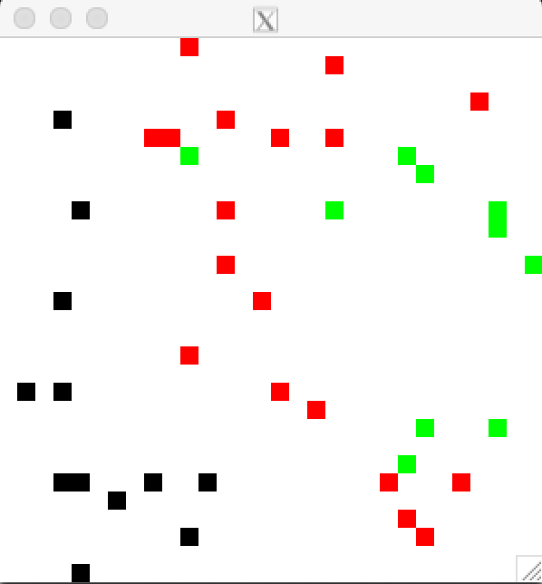
Pandemic

Slide 19
What is the problem with these?
Both programs work fine, but if you start playing around with the parameters for the models, you will quickly see the performance take a major hit
For both problems, think about:
Why do they slow down based on different parameter values?
How much do they slow down?
Would a faster processor help?
Are we able to run parts of the problem in parallel if we had more than one core?
How would you go about parallelizing these programs? No need for specifics, as you will learn how to later.

