Slide 1
Blue Waters Petascale Semester Curriculum v1.0 Unit 10: Productivity and Visualization Lesson 5: Workflows 1 Developed by Widodo Samyono for the Shodor Education Foundation, Inc.

Slide 2
Except where otherwise noted, this work by The Shodor Education Foundation, Inc. is licensed under CC BY-SA 4.0. To view a copy of this license, visit https://creativecommons.org/licenses/by-sa/4.0 Browse and search the full curriculum at http://shodor.org/petascale/materials/semester-curriculum We welcome your improvements! You can submit your proposed changes to this material and the rest of the curriculum in our GitHub repository at https://github.com/shodor-education/petascale-semester-curriculum We want to hear from you! Please let us know your experiences using this material by sending email to petascale@shodor.org

Slide 3
SCIENTIFIC WORKFLOW
METHODS AND CONCEPTS

Slide 4
CONTENTS
What is scientific workflow?
Applications
Workflow Characteristics
Notable systems
Sharing workflows
Analysis

Slide 5
Definitions
What is scientific workflow system?
A scientific workflow system is a specialized form of a workflow management system designed specifically to compose and execute a series of computational or data manipulation steps, or workflow, in a scientific application [1].
What is workflow?
Workflows are defined as a set of interrelated computational and data handling tasks designed to achieve a specific goal [1].

Slide 6
APPLICATIONS
Some projects from various scientific domains that are dealing with large-scale distributed data[1]:
Optical Astronomy
Radio astronomy
Seismology
Experimental Biology
Environmental Science
These projects, like many others, involve the challenges of data creation, exploration, exploitation, and preservation in many scientific communities. The rapidly growing and diverse data opens many new opportunities in business, research, design, policy formulation, and decision making, but these opportunities can only be exploited if we improve our knowledge discovery apparatus as we enter the data-intensive era [1].

Slide 7
Related topics to workflow
Workflow Characteristics.
Workflow Architectures.
Notable systems
Sharing workflows
Analysis

Slide 8
WORKFLOW CHARACTERISTICS
Workflow Characteristics:
—These phases are from the scientists’ perspective as they create and run workflows.
—Scientists compose, operate, analyze, and refine workflows.
—Scientific workflows are exploratory; that is, it is common to reuse workflows and refine them using trial and error.
—Scientific methods are often repeated; that is, scientists rerun workflows with different parameters and datasets.
—Runtime monitoring and diagnostics are important; that is, scientists monitor progress and may steer or decide to abort or suspend an execution.

Slide 9
WORKFLOW ARCHITECTURES
Workflow Management System (See [1] and references there in):
Pegasus [Deelman et al. 2015],
Kepler [Lud¨ascher et al. 2006], Taverna [Wolstencroft et al. 2013], Triana [Taylor et al. 2007a],
Swift [Zhao et al. 2007], Trident [Barga et al. 2008], Galaxy [Blankenberg et al. 2010],
ASKALON [Fahringer et al. 2007], WS-PGRADE/gUSE [Kacsuk et al. 2012],
Meandre [Llor`a et al. 2008], and Apache Airavata [Marru et al. 2011].

Slide 10
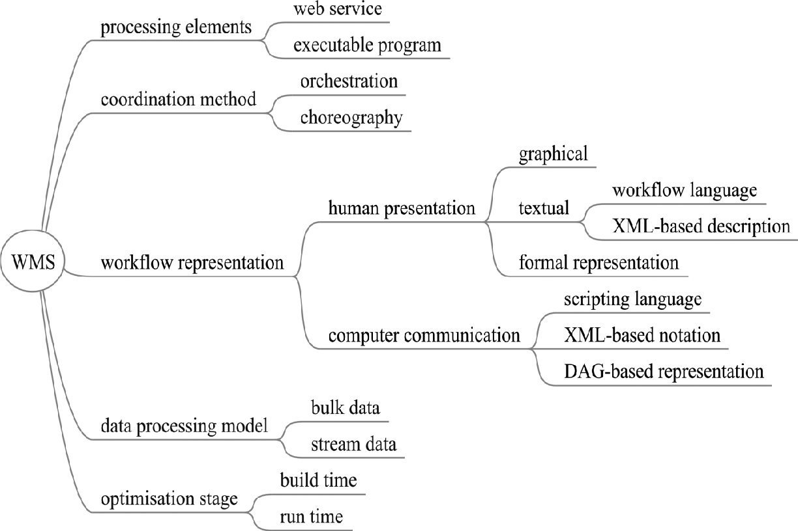
WORKFLOW ARCHITECTURES
Fig. 1. Architectural characterizations of WMSs.

Slide 11
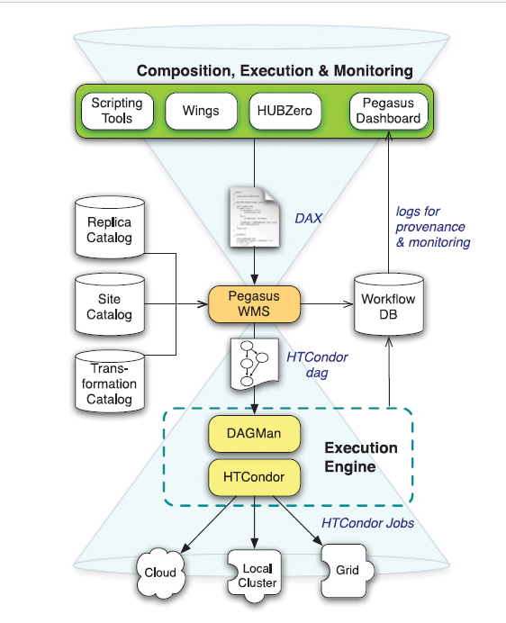
NOTABLE SYSTEMS
Workflow composition tool (colored in green), the resource mapping mechanism (colored in orange), and the workflow execution
engine (colored in yellow).
Fig. 1. Pegasus architectural diagram.

Slide 12
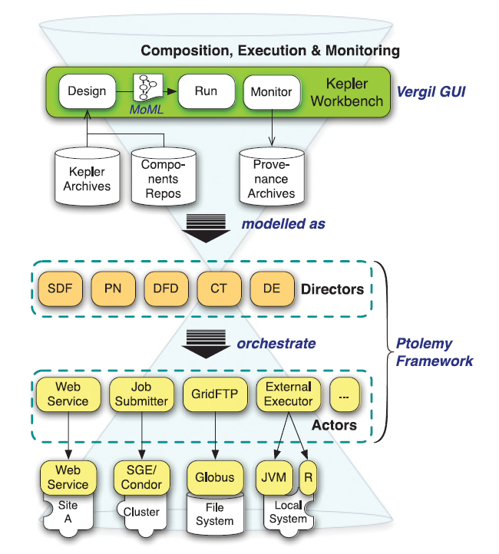
NOTABLE SYSTEMS
Fig. 2. Kepler architectural diagram.

Slide 13
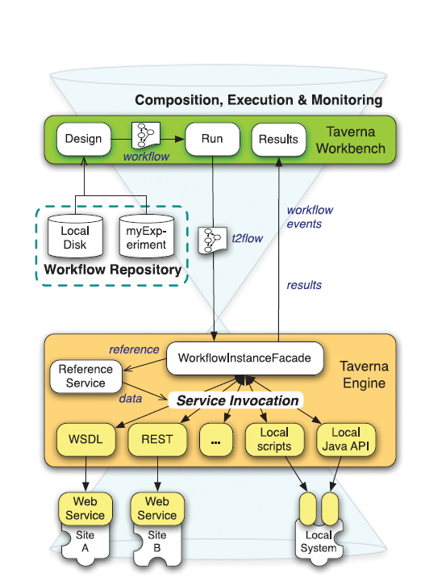
NOTABLE SYSTEMS
Fig. 3. Taverna architectural diagram.

Slide 14
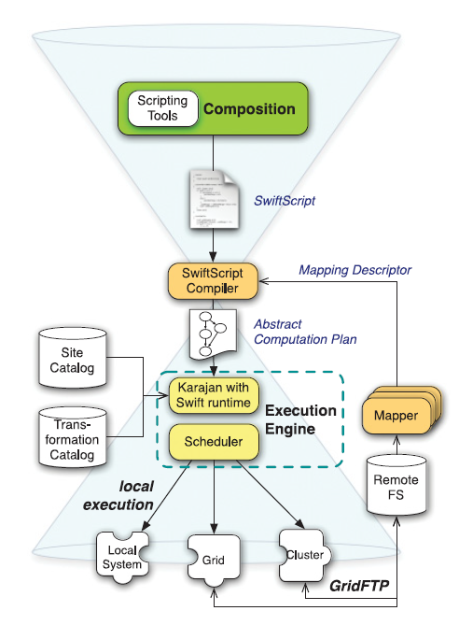
NOTABLE SYSTEMS
Fig. 3. Swift architectural diagram.

Slide 15
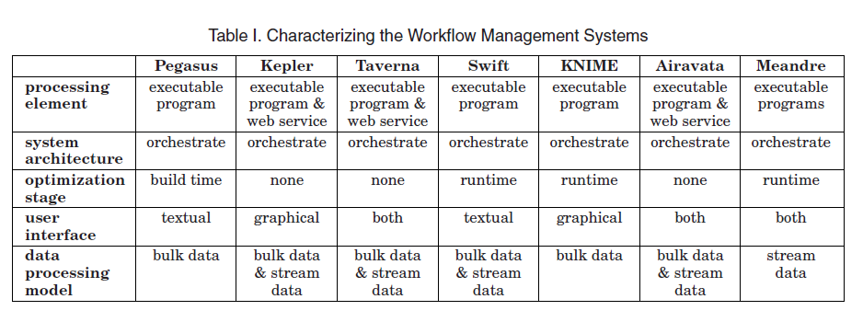
NOTABLE SYSTEMS

Slide 16
SHARING WORKFLOWS
The quantity and diversity of data are growing rapidly because the capacity of storage is increasing [Walter 2005], digital communication is pervasive and increases in capacity [Zhao et al. 2011], and the sensitivity, speed, diversity, and deployed numbers of digital data collection devices exhibit a compound growth. [1]
This is combined with a growing drive to share data Interagency Working Group on Digital Data 2009; EU Parliament 2007], enabled by many organizations’ standardization efforts (e.g., W3C, OGC, FDSN68 IVOA, and RDA) and a growing need to combine data across discipline boundaries to address today’s societal challenges. [1]

Slide 17
ANALYSIS
The benefits include
(1) increased productivity and lower error rates as tedious chores are automated,
(2) improved scientific methods as many different specialists pool advances to their parts of a method, and
(3) achievement of new goals by combining computational power with the increased wealth of data.

Slide 18
ANALYSIS
We review two questions [1]:
(1) Why are scientific workflow systems unable to support this increased use?
(2) What research will be needed to make them ready?
Each community develops its own culture—a body of knowledge, established methods,
practices, and ethics—shaped for its own research goals and professional practices.

Slide 19
WORK CITED
Chee Sun Liew, Malcolm P. Atkinson, Michelle Galea, Tan Fong Ang, Paul Martin, and Jano I. Van Hemert. 2016. Scientific workflows: Moving across paradigms. ACM Comput. Surv. 49, 4, Article 66 (December 2016), 39 pages. DOI: http://dx.doi.org/10.1145/3012429

