Slide 1
Blue Waters Petascale Semester Curriculum v1.0 Unit 2: Parallel Computing Concepts Lesson 2: Parallel Programming Patterns Developed by Nitin Sukhija for the Shodor Education Foundation, Inc.

Slide 2
Except where otherwise noted, this work by The Shodor Education Foundation, Inc. is licensed under CC BY-SA 4.0. To view a copy of this license, visit https://creativecommons.org/licenses/by-sa/4.0 Browse and search the full curriculum at http://shodor.org/petascale/materials/semester-curriculum We welcome your improvements! You can submit your proposed changes to this material and the rest of the curriculum in our GitHub repository at https://github.com/shodor-education/petascale-semester-curriculum We want to hear from you! Please let us know your experiences using this material by sending email to petascale@shodor.org

Slide 3
Parallel Programming Patterns

Slide 4
Parallel Patterns
Patterns
a “vocabulary” for designing algorithms
Parallel Patterns
A recurring combination of distribution of tasks and access of data pertaining to a specific problem in design of parallel algorithm.
aid in achieving scalability and convenience for developing parallel applications .
facilitates comparison between parallel and serial performance.
Universal in nature as patterns can be utilized any parallel programming models.

Slide 5
Parallel Patterns
Bag of Tasks
Data Parallel
Task Parallel
Pipelining
Divide and Conquer

Slide 6
Bag-of-Tasks
Bag of Tasks (BoT)
Also called Embarrassingly Parallel or loosely coupled applications
Component tasks of application are independent
Tasks don't communicate with each other
Tasks can be executed in any order
Minimal parallel overhead

Slide 7
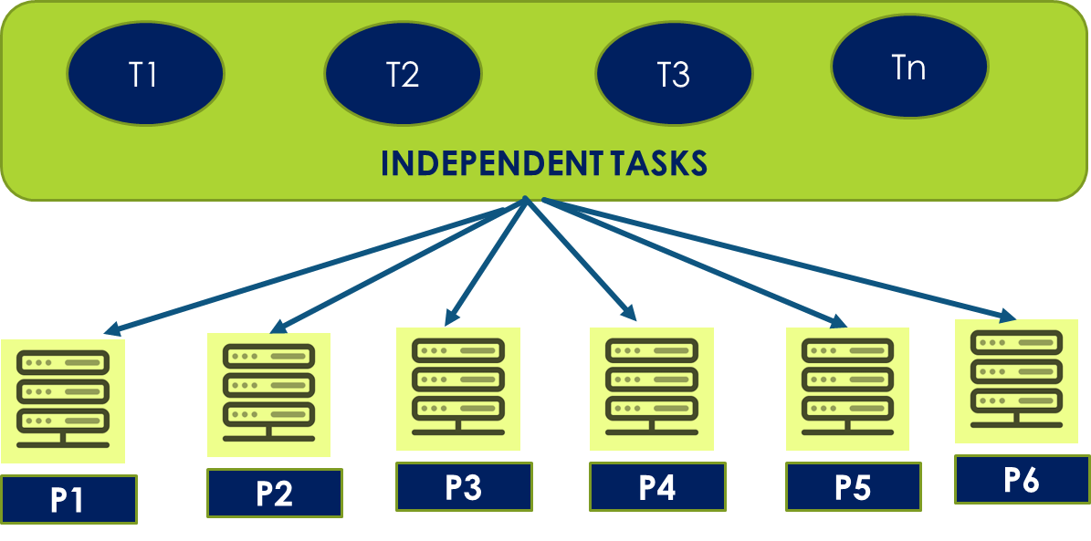
Bag-of-Tasks

Slide 8
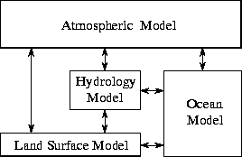
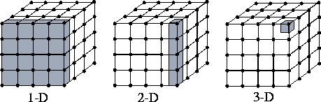
Task vs Data Parallel Programs
Data Parallel Programs
- simultaneous execution of the same task on different data elements.
Task Parallel Programs
- simultaneous execution of different tasks on the same data elements.

Slide 9
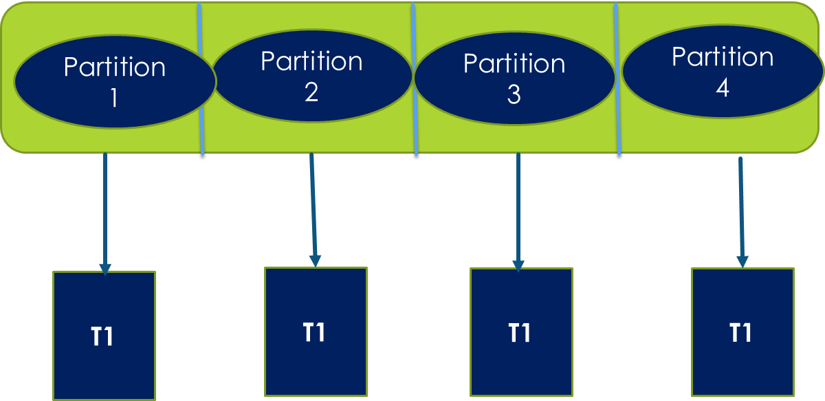
Data Parallel
Most parallel work in these applications is focused on performing tasks on a data set.
a subset/partition of the dataset is given to each process.
each process performs the same tasks on the different subsets/partition of data.
Example: each task (T1) adds 3 to each data element.

Slide 10
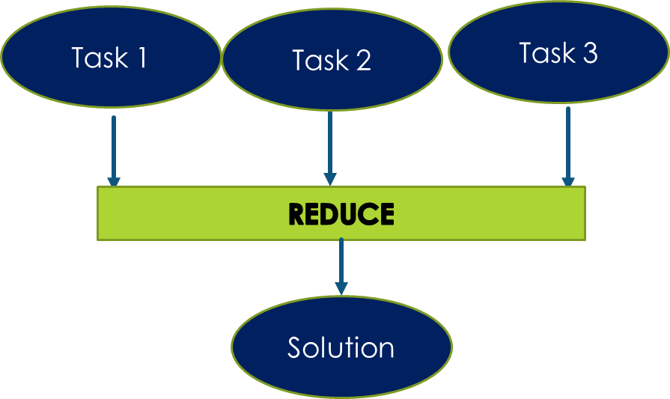
Task Parallel
a subset of the tasks is allocated to each process
each process performs a different subset of tasks on the same data.
at the end of the tasks, all of processes have to share the results of the tasks executed, (global reduction).

Slide 11
Pipelining
A stream of data is passed through a succession of processes, each of which perform some task on it.
A pipeline is composed of several computations called stages.
Computation stages performed on data are ordered but independent.
Computation stages run independently for each item.
Each output of computation becomes input to the following computation.

Slide 12
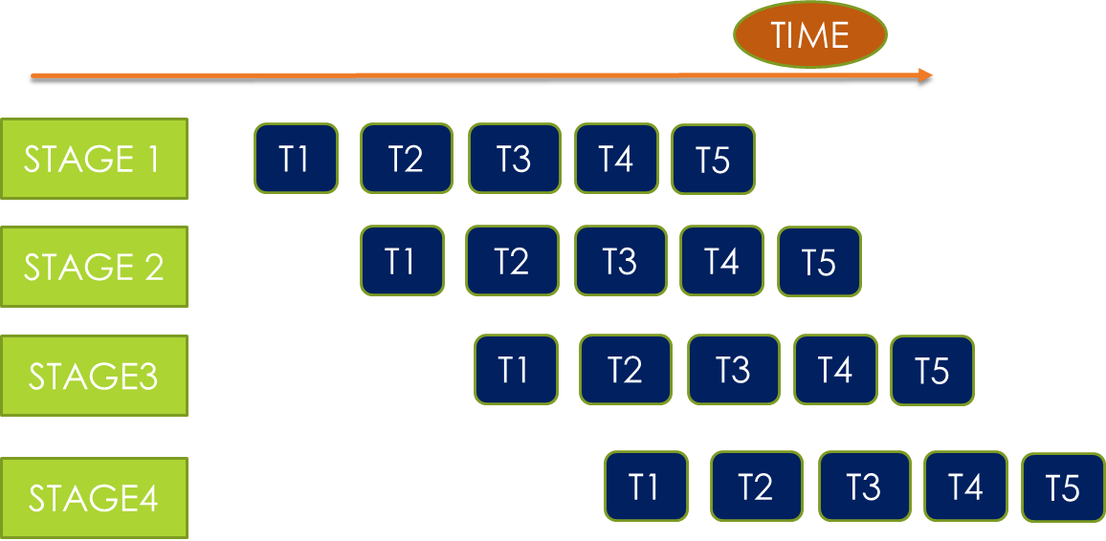
Pipelining
Enables modular design
Conceptually simple
Serial computation still a bottleneck

Slide 13
Divide and Conquer
Concurrency is obtained by:
Splitting the problem into subproblems
Concurrently solving the subproblems
Merging the solved subproblems solutions into a solution for the whole problem

Slide 14
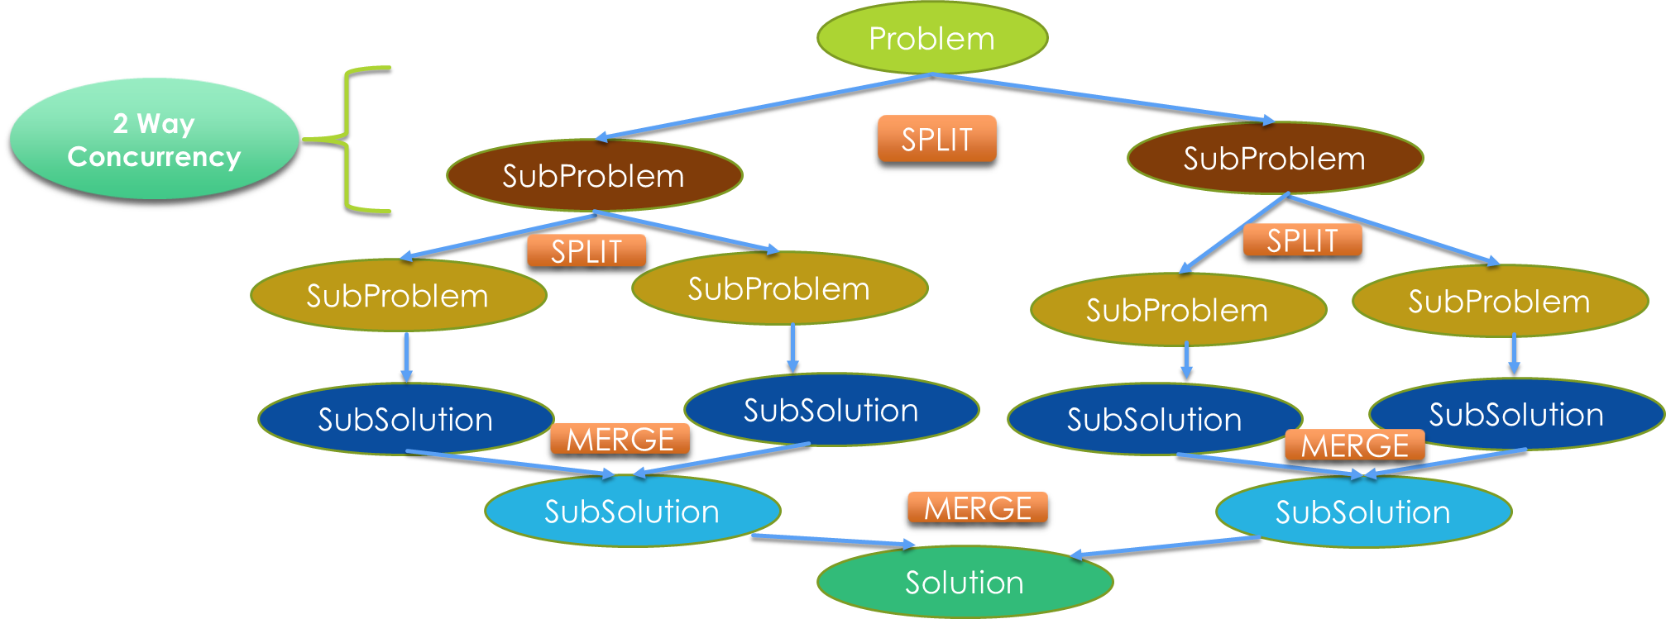
Divide and Conquer

Slide 15
Thank You!

