Slide 1
Blue Waters Petascale Semester Curriculum v1.0 Unit 2: Parallel Computing Concepts Lesson 6: Parallel Algorithms 2 Developed by Beau Christ for the Shodor Education Foundation, Inc.

Slide 2
Except where otherwise noted, this work by The Shodor Education Foundation, Inc. is licensed under CC BY-SA 4.0. To view a copy of this license, visit https://creativecommons.org/licenses/by-sa/4.0 Browse and search the full curriculum at http://shodor.org/petascale/materials/semester-curriculum We welcome your improvements! You can submit your proposed changes to this material and the rest of the curriculum in our GitHub repository at https://github.com/shodor-education/petascale-semester-curriculum We want to hear from you! Please let us know your experiences using this material by sending email to petascale@shodor.org

Slide 3
Parallel Algorithms 2

Slide 4
Outline
Example #1: Matrix Multiplication
Example #2: Trapezoidal Rule
Example #3: Odd-Even Transposition Sort

Slide 5
Example #1: Matrix Multiplication
Many scientific simulations involve modeling using matrices, such as population studies and spread of disease.
A very common operation on matrices is multiplying two of them together.
For example:
-4 1
9 -3
15 7
2 3
6 1
36 -3

Slide 6
Example #1: Matrix Multiplication
The general process:
You can only multiply two matrices if the number of columns in the first matrix is the same as the number of rows in the second matrix.
The resulting matrix will have the same number of rows as the first matrix and the same number of columns as the second matrix.
To compute the value at location (x,y) in the result matrix, use row x of the first matrix and column y of the second, multiplying the corresponding positions and summing them all together.

Slide 7
Example #1: Matrix Multiplication
These values must match!
If you want to multiply a 4 by 8 matrix with an 8 by 6 matrix...
The result will be a 4 by 6 matrix

Slide 8
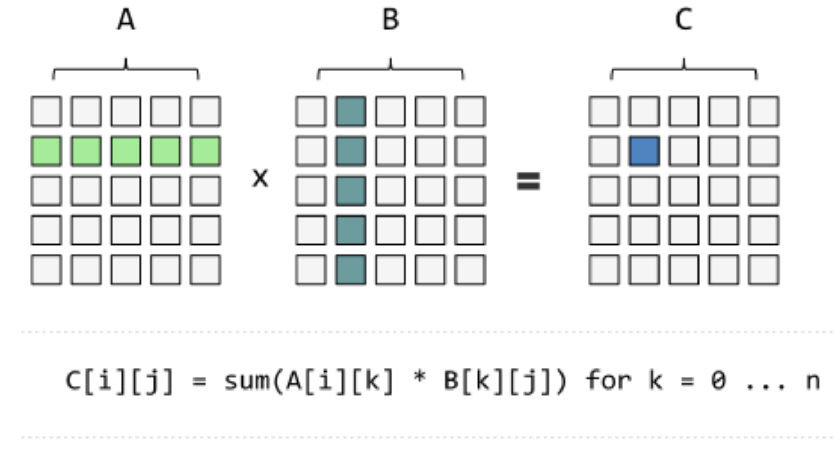
Example #1: Matrix Multiplication
Image from: https://insidehpc.com/2016/01/heterogeneous-streams/

Slide 9
Example #1: Matrix Multiplication
The sequential solution for computing result matrix C from A x B:
for each row r in matrix A: for each column c in matrix B: total = 0 for each corresponding position i between row r and column c: total = total + A[r, i] * B[i, c] C[r, c] = total
Could this be parallelized, and if so, how might you do it? If it helps, imagine you are multiplying two matrices that are each 10,000 x 10,000 elements. That’s a lot of numbers!

Slide 10
Example #1: Matrix Multiplication
The parallel solution: have each process take a portion of the rows!
P1 could process these rows
P2 could process these rows
Image from: https://insidehpc.com/2016/01/heterogeneous-streams/

Slide 11
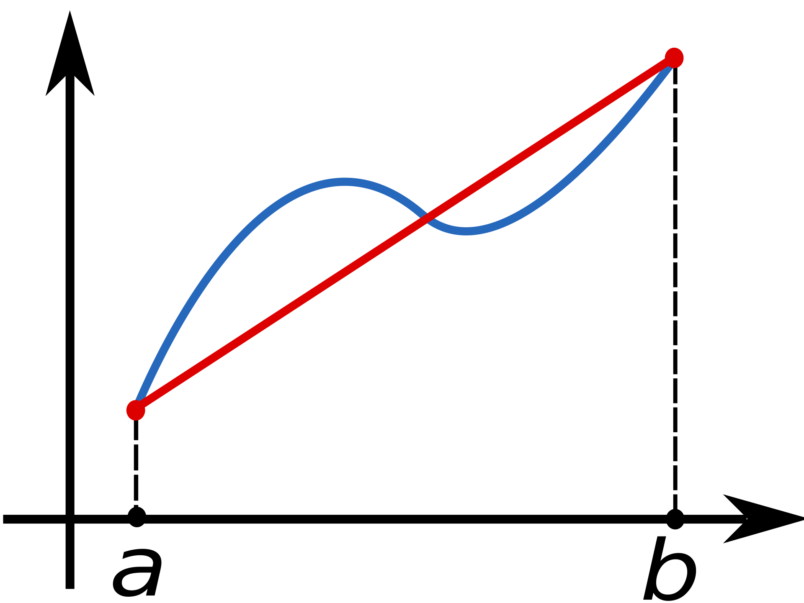
Example #2: Trapezoidal Rule
The trapezoidal rule is a numerical technique for approximating the area underneath a curve.
Trapezoids are used as the shape because they fit fairly well, and it is extremely easy to compute the area of a trapezoid..

Slide 12
Example #2: Trapezoidal Rule
Remember, this is only an approximation!
This isn’t included in the result, but it should be.
This is included in the result, but it shouldn’t be.

Slide 13
Example #2: Trapezoidal Rule
The trapezoidal rule works really well as you keep dividing the interval in which you are interested into more and more trapezoids.
The smaller they are, the closer they fit the curve, and thus the more accurate the approximation!

Slide 14
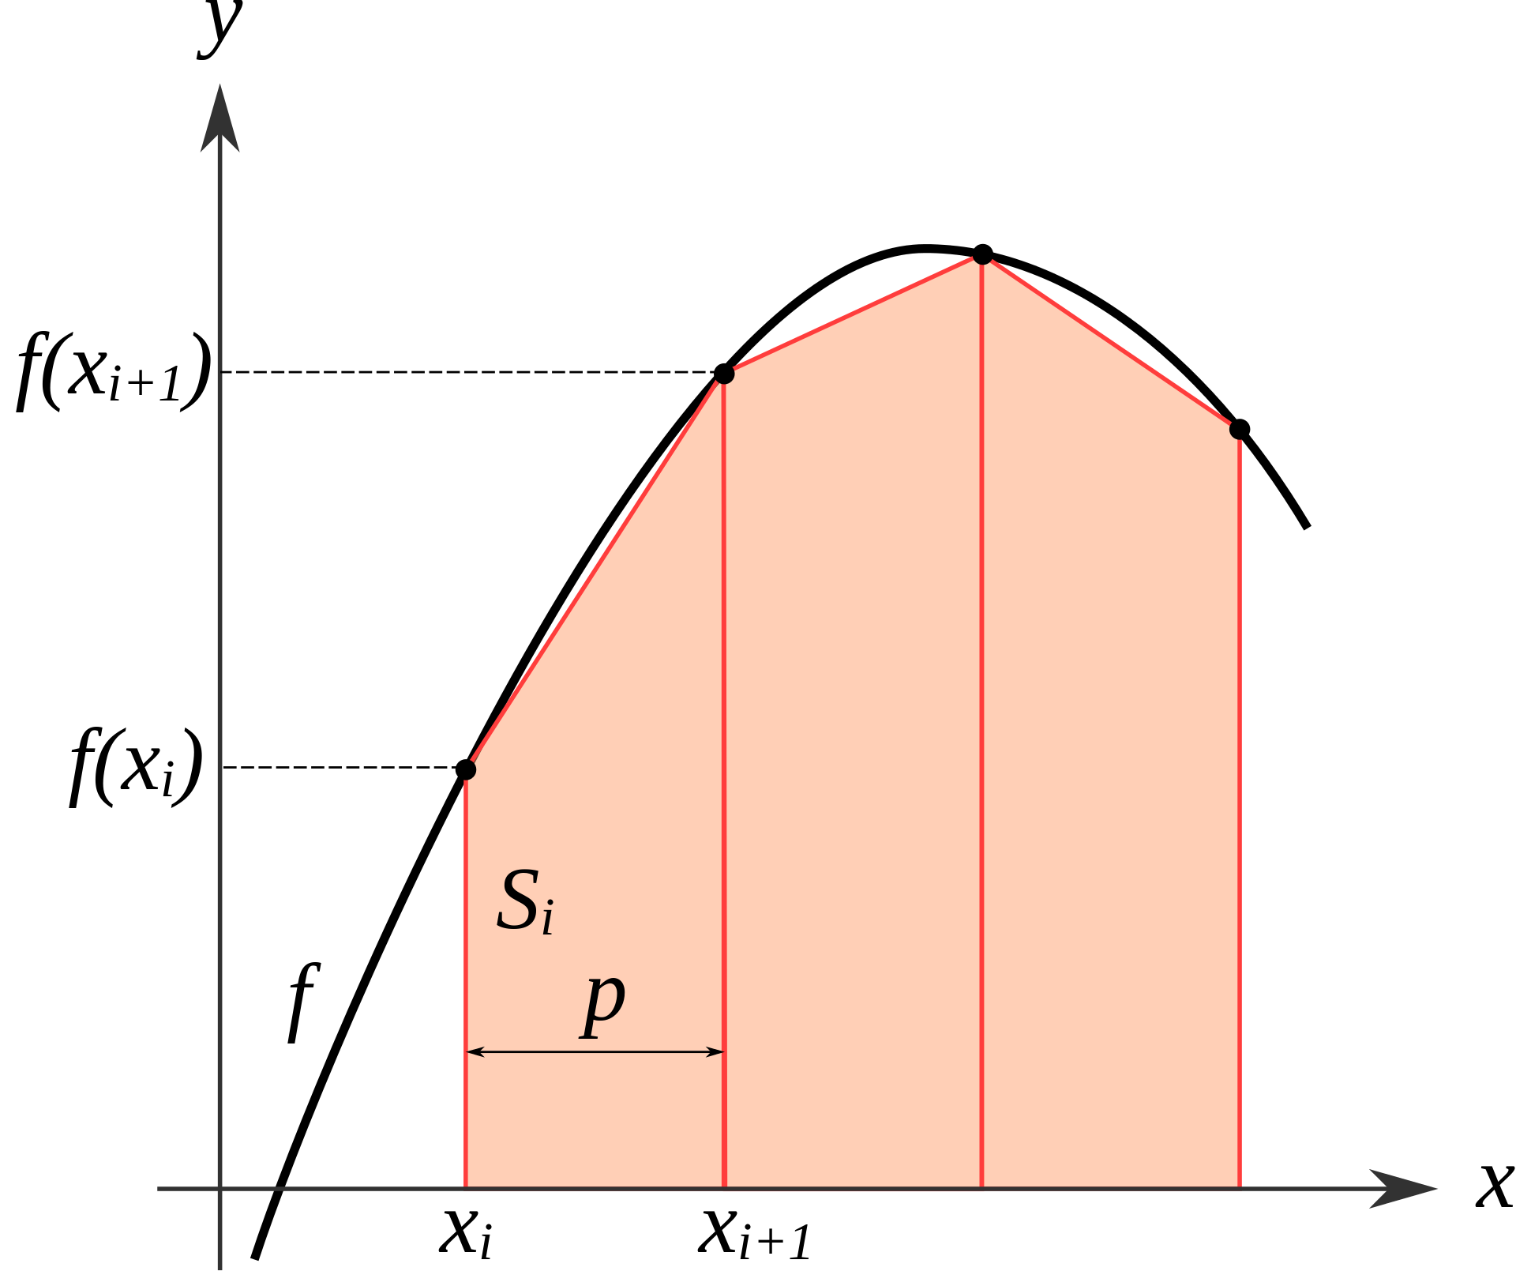
Example #2: Trapezoidal Rule
As the shapes are still all trapezoids, it simply turns into a straightforward probably using basic algebra to compute each individual area, and then sum them all up.

Slide 15
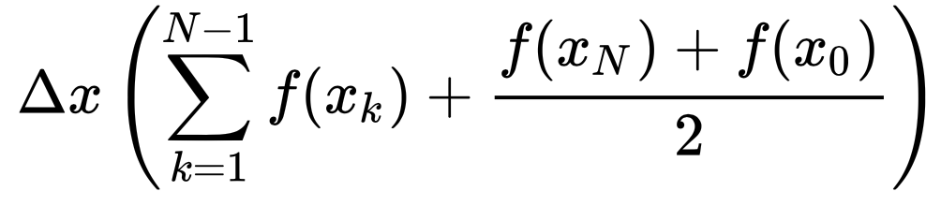
Example #2: Trapezoidal Rule
The sequential solution:
If you choose to use N trapezoids (the more you use, the better the solution), where each one has a width of △x, then the math can be simplified to the following equation:

Slide 16
Example #2: Trapezoidal Rule
These pieces are one time computations (constant time)
The sequential solution:
This piece will involve more computation time as the number of trapezoids increases (can be implemented in code with a loop)

Slide 17
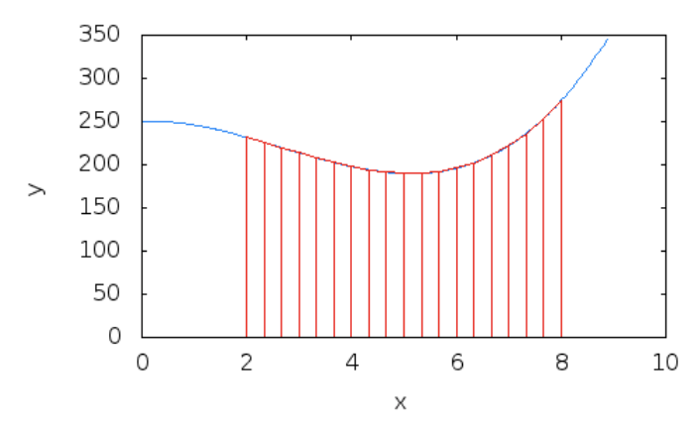
Example #2: Trapezoidal Rule
The parallel solution:
Each process can take a portion of the trapezoids (or in terms of the equation we have seen, each process could process their own piece of the summation/loop)
Combine the partial sums at the end
P1
P2

Slide 18
Example #3: Odd-Even Transposition Sort
Sorting is also a common task in many applications, and so we ask a similar question here: If there are a lot of items to sort, can we utilize parallel algorithms to speed up the process?
We will first look at a simple sequential sorting algorithm, Bubble Sort.

Slide 19
Example #3: Odd-Even Transposition Sort
Bubble Sort works by comparing each pair of neighbors, left to right, and swapping them if they are out of order. The name comes from the idea that for each complete pass over all the numbers, the next largest value “bubbles” its way to the top (or technically the right side of the list of values)
You can guarantee they will be sorted if you do N passes over the numbers, where N is the total number of items to be sorted.

Slide 20
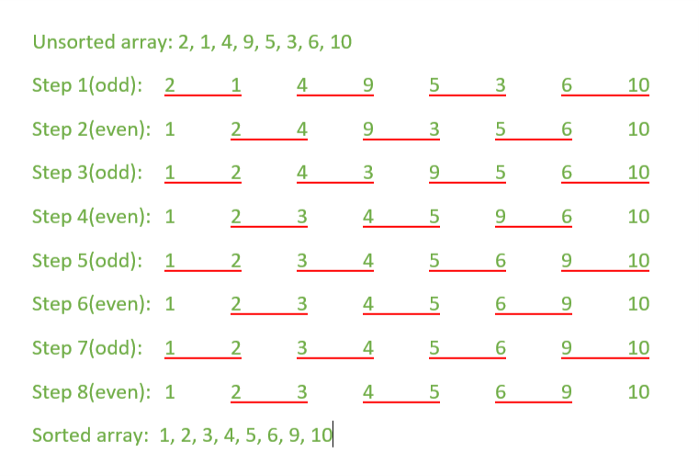
Example #3: Odd-Even Transposition Sort
Odd-Even Transposition Sort is an extension of Bubble Sort, where each phase/pass only compares odd positions with the value to the right of each, or even positions with the value to the right of each, alternating between odd and even each pass.
Image from: https://www.geeksforgeeks.org/odd-even-transposition-sort-brick-sort-using-pthreads/

Slide 21
Example #3: Odd-Even Transposition Sort
Visualizing Bubble Sort
Visualizing Odd-Even Transposition Sort

Slide 22
Example #3: Odd-Even Transposition Sort
Bubble Sort cannot be parallelized in a straightforward manner, because issues arise if a process is comparing two values next to another process comparing values
For example, if P1 is swapping positions 3 and 4 while P2 is swapping positions 4 and 5, incorrect results could occur.
Odd Even Transposition Sort solves this by assigning portions of the comparisons during each odd/even phase to each contributing process, and it is guaranteed that there is no overlapping locations being compared while in the same phase.

Slide 23
Conclusion
You have seen three examples where parallelization can be achieved to increase performance
In general, when coming up with a parallel algorithm, you want to avoid situations where two processes could be using a memory location at the same time
You will learn that there are ways using code to prevent two processes from using the same memory location simultaneously

