Slide 1
Blue Waters Petascale Semester Curriculum v1.0 Unit 3: Using a Cluster Lesson 5: Running Code on a Cluster 1 Developed by Juan R. Perilla for the Shodor Education Foundation, Inc.

Slide 2
Except where otherwise noted, this work by The Shodor Education Foundation, Inc. is licensed under CC BY-SA 4.0. To view a copy of this license, visit https://creativecommons.org/licenses/by-sa/4.0 Browse and search the full curriculum at http://shodor.org/petascale/materials/semester-curriculum We welcome your improvements! You can submit your proposed changes to this material and the rest of the curriculum in our GitHub repository at https://github.com/shodor-education/petascale-semester-curriculum We want to hear from you! Please let us know your experiences using this material by sending email to petascale@shodor.org

Slide 3

Running parallel applications ON a CLUSTER

Slide 4

Learning objectives
Running jobs on the compute nodes of a cluster:
Running multicore jobs in a cluster
Running multimode jobs in a cluster
Running GPU accelerated jobs in a cluster

Slide 5


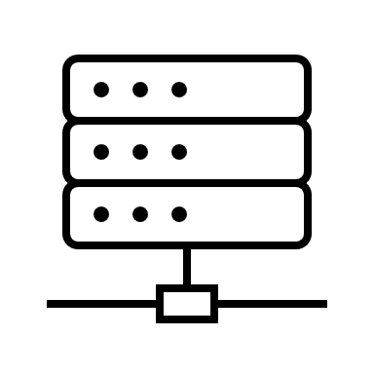
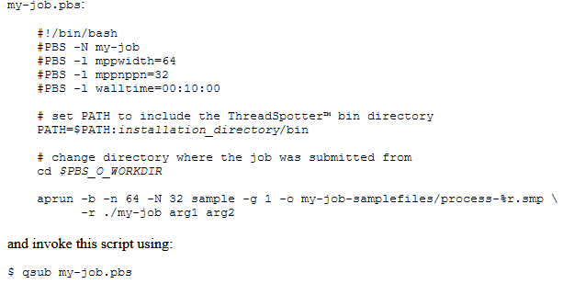
CLUSTER ARCHITECTURE
A supercomputer is a shared resource that is used by several users concurrently. To optimize access to the resource the minimal unit of execution of a program is defined as a job. Jobs are scheduled to run in a group of nodes for a given amount of time as requested by the user. The queue manager, so-called scheduler, ensures that jobs are queued using some fair use policy (e.g., TORQUE).
Your jobs should run on the compute nodes of the cluster.
The action of sending a job to the queueing systems is called job submission. Therefore, in contrast to running programs on a local computer, programs in a supercomputer are first queued and subsequentely managed by a workload manager (e.g., Moab, Slurm).
Login nodes
Compute nodes
To submit the job you must write a submission script.

Slide 6
File systems
File system | Best Storage Practices | Best Activities
$HOME | cron jobs small scripts environment settings | compiling, editing
$WORK | software installations original datasets that can't be reproduced job scripts and templates | staging datasets
$SCRATCH | temporary datasets I/O files job files | all job I/O activity
Typically in a cluster there are several filesystems with different purposes.

Slide 7
CASE STUDY ON Frontera: Running jobs
Resources
Processor 1
Cores
…
Processor n
Frontera uses the Slurm Workload Manager as its job scheduler.
Resources are requested through the job scheduler:
Single node:
Serial
Threaded jobs (OpenMP)
Multi node (MPI):
Multicore (OpenMP or SMP)
Cores
Node 1
Job scheduler

Slide 8
Running multi node jobs
Resources
Processor 1
Processor 1
Allocation of resources consist in requesting a given number of nodes and the number of processes per node.
Cores
Cores
…
…
…
Processor n
Processor n
According to the request of resources, the total number of MPI ranks are distributed along the nodes and cores.
Cores
Cores
Node 1
Node 2
Job scheduler
Commands to control cpu-affinity include:
--cpus-per-task
--cpu-bind
Assign the number of CPUs per process and arrange CPU-binding according to Non-Uniform Memory Access (NUMA) design

Slide 9
USING CLUSTER-SPECIFIC LAUNCHERS
Launcher managers
Once resources are allocated, the jobs are launched by the generic job manager supported on the processors.
For parallel jobs (using MPI):
Launch a single job parallelizing the steps involved in the workflow
Launch a job multiple times over the resources allocated.
srun
ibrun
srun enables setting interactive sessions for resource allocation and job submission
MPI jobs
--distribution ; Controls the placements of ranks across sockets within the nodes requested
--cpu_bind ; Distributes ranks across physical CPUs or logical cores (hyperthreading).
--map_cpu ; List of CPUIDs mapped to the total number of ranks on every node.
TACC-specific MPI launcher.
ibrun allocates the total number of ranks according to the resource allocation set with Slurm.
Additional flags include:
-n ; Total number of ranks
-N ; Total number of nodes
export IBRUN_TASKS_PER_NODE= number of ranks per node
In the absence of flags, the numactl command enables the control of process and memory affinity
-N ; socket affinity
-C ; core affinity

Slide 10
USING CLUSTER-SPECIFIC LAUNCHERS
Resources
Processor 1
Core n
Running one job per hw thread
For a single node, processes are bound to each of the cores allocated by the resource manager. Hence, for each processor, one job is allocated per physical core.
Running one job per logical thread
Hyperthreading enables the distribution of multiple processes across the logical cores on a processor. For instance, one process can be bound to each of the threads on each core. The result is the distribution of more than one job per physical core.
hw Thread
hw Thread
Cores
…
…
Processor n
Cores
Node 1

Slide 11
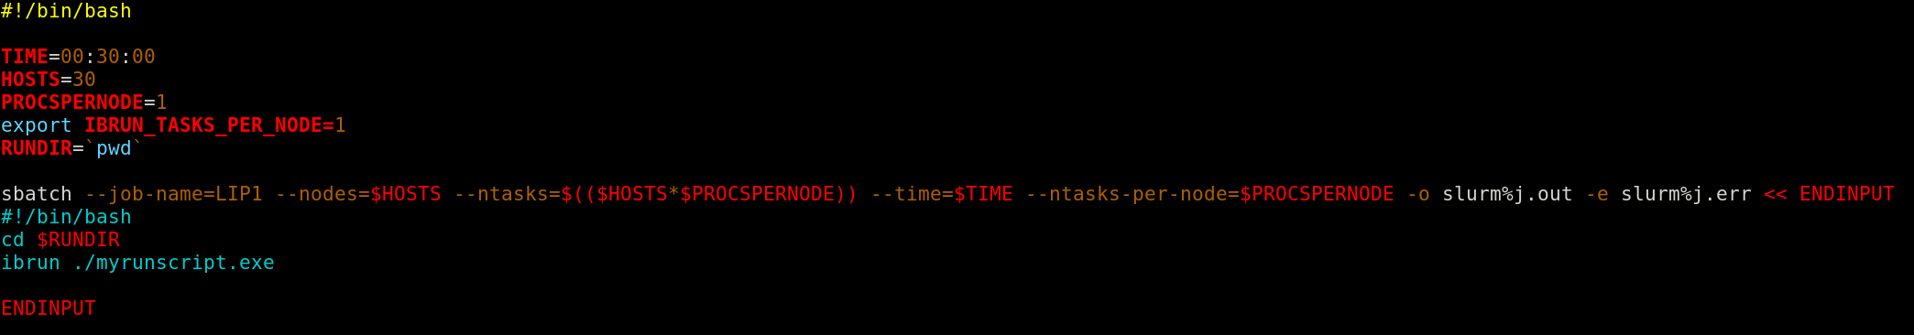
Example
The following script corresponds to a submission example to allocate 30 MPI-ranks on 30 nodes, placing 1 node per rank. Upon resource allocation, the execution script is run with the MPI-launcher ibrun.
Allocation of more than one rank per node is enabled by increasing the number of processes/tasks per node.

Slide 12

references
Using aprun: https://bluewaters.ncsa.illinois.edu/using-aprun
Queueing policies: https://bluewaters.ncsa.illinois.edu/queues-and-scheduling-policies
Accessing compute nodes: https://bluewaters.ncsa.illinois.edu/accessing

