Slide 1
Blue Waters Petascale Semester Curriculum v1.0 Unit 3: Using a Cluster Lesson 7: Scaling on a Cluster 1 Developed by Linh B. Ngo for the Shodor Education Foundation, Inc.

Slide 2
Except where otherwise noted, this work by The Shodor Education Foundation, Inc. is licensed under CC BY-SA 4.0. To view a copy of this license, visit https://creativecommons.org/licenses/by-sa/4.0 Browse and search the full curriculum at http://shodor.org/petascale/materials/semester-curriculum We welcome your improvements! You can submit your proposed changes to this material and the rest of the curriculum in our GitHub repository at https://github.com/shodor-education/petascale-semester-curriculum We want to hear from you! Please let us know your experiences using this material by sending email to petascale@shodor.org

Slide 3
Overall Concept
There are two typical issues in solving a problem:
Existing resources are not enough to handle the current problem.
Existing resources are just enough to handle the current problem, but the problem needs to be solved at larger scales.
Adding computers to handle the first issue is called strong scaling.
Adding computers and increasing the size of the problem to address the second issue is called weak scaling.

Slide 4
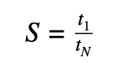
Speedup
How fast the program becomes when more computing resources are added.
Improvement in performance = Reduction in run time

Slide 5
Scaling Limitation
There is a limit to how much resources can be added to improve performance.
Scalings are limited by proportion of serial (non-parallelizable) code/task within a program/workflow.
Strong scaling: Amdahl's Law
Weak scaling: Gustafson’s Law

Slide 6
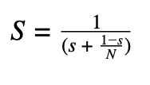
Strong scaling: Amdahl’s Law
Let’s call s the proportion of code that cannot be parallelized. Hence 1-s represents the remainder proportion of code that can be parallelized. The speedup in strong scaling (S) can then be calculated as:

Slide 7

Weak scaling: Gustafson’s Law
In weak scaling we scale up the problem as well as resources, we need to consider scaled speedup (SS).
Let’s call s the proportion of code that cannot be parallelized. Hence 1-s represents the remainder proportion of code that can be parallelized. The scaled speedup in strong scaling can then be calculated as:

Slide 8
Scaling in a cluster (1)
Running multiple instances of a program in parallel
Scheduler support: Job Array
Module support: gnu-parallel
No code modification is needed.

Slide 9
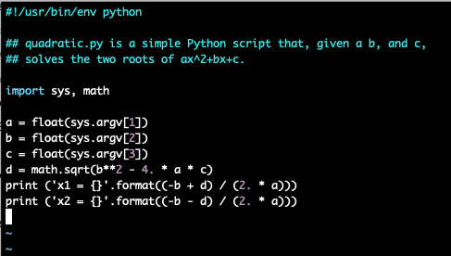
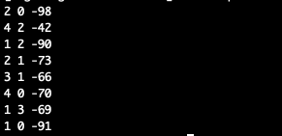
Quadratic Calculation
Input files for 8 quadratic functions

Slide 10
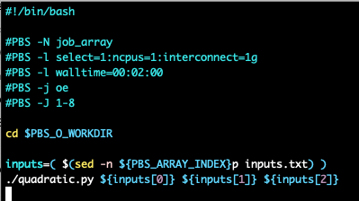

Job Array
Output in one job
List of jobs’ output files from the job array submission

Slide 11
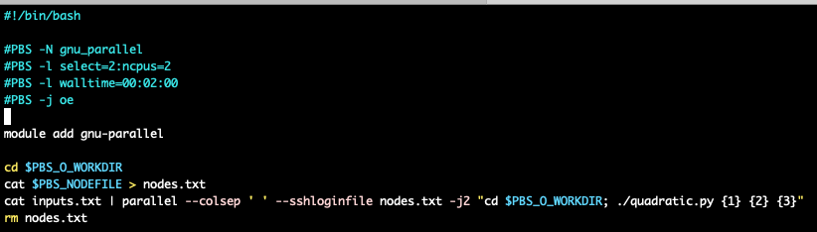
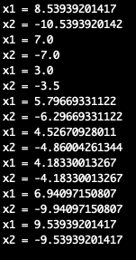
GNU-Parallel
Output from 8 quadratic functions within one job.

