Slide 1
Blue Waters Petascale Semester Curriculum v1.0 Unit 3: Using a Cluster Lesson 9: Scaling on a Cluster 3 Developed by Michael N. Groves for the Shodor Education Foundation, Inc.

Slide 2
Except where otherwise noted, this work by The Shodor Education Foundation, Inc. is licensed under CC BY-SA 4.0. To view a copy of this license, visit https://creativecommons.org/licenses/by-sa/4.0 Browse and search the full curriculum at http://shodor.org/petascale/materials/semester-curriculum We welcome your improvements! You can submit your proposed changes to this material and the rest of the curriculum in our GitHub repository at https://github.com/shodor-education/petascale-semester-curriculum We want to hear from you! Please let us know your experiences using this material by sending email to petascale@shodor.org

Slide 3
Learning Objectives
Students will:
Learn how to check the status of a job on a cluster
Understand what is the checkpointing of a job
Discuss how the allocation of different number resources affect computation time using data that they collect from the execution of a provided piece of code

Slide 4
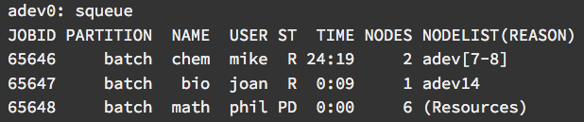
squeue: Checking the Status of a Job
squeue - Displays all jobs currently in the queue
By default it will report (in priority order) the jobs that are
Currently running
Pending to run

Slide 5
squeue: What the Output Means
ST: Job state where “R” means running and “PD” means pending
TIME: How long the job has been running in days-hours:minutes:seconds
NODELIST(REASON): Where the job is running or the reason it is still pending

Slide 6
squeue: Customizing the Output
Some common squeue flags include:
-l: Reports more of the available information
-u USER: Will only load jobs submitted by user USER
--start: Reports the expected start times of pending jobs
See the manual for all available options

Slide 7
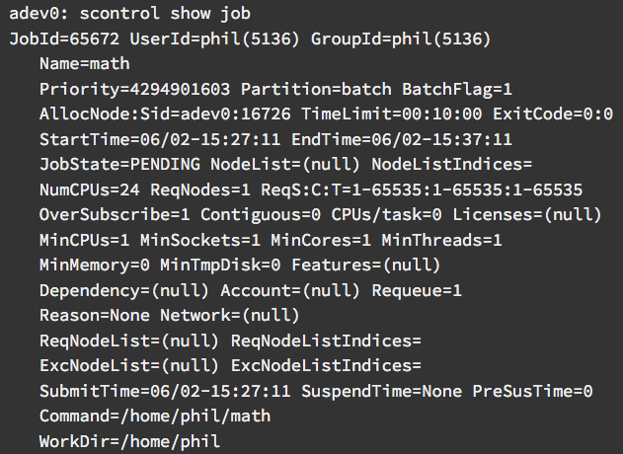
scontrol show job JOBNUMBER
For even more details about jobs you can use
scontrol show job JOBNUMBER
Where JOBNUMBER is optional

Slide 8
Checkpointing and Cancelling Jobs
Checkpointing
It is good practice for long calculations to save their state periodically so that if/when the job is terminated the calculation can be restarted a the last save point
Cancelling Jobs
If a job no longer needs to run, it can be cancelled by typing
scancel JOBNUMBER

Slide 9
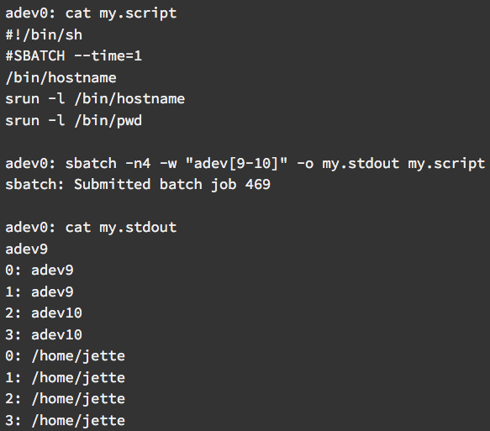
SLURM Output File
SLURM Outputs information to an output file that the user can specify
In the example on the left the output file is named “my.stdout”
In it is the screen printout of the two commands in my.script

Slide 10
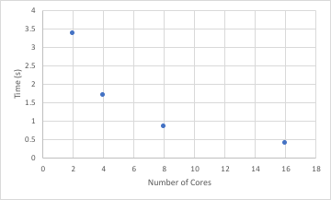
Testing Effect of Resource Allocation
When parallelizing processes, there tends to be a limit on the speed-up when more processors are added.
We will explore this effect by numerically calculating π

Slide 11
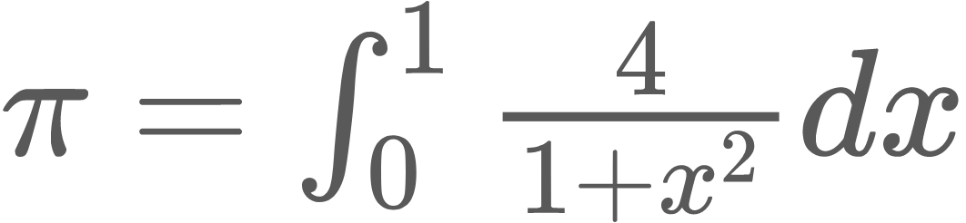
Testing Effect of Resource Allocation: Calculating π
π can be calculated exactly using the following relationship:
π = 4 arctan(1)
This expression above can be determined using polynomials by evaluating the following integral between 0 and 1.

Slide 12
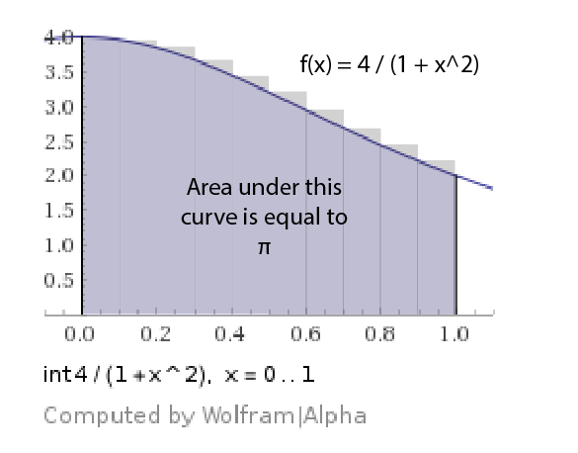

Breaking the problem down
This polynomial based integral can be numerically solved by adding up the area of rectangles of height f(x_{i}) and width ∆x:
This can be distributed between cores since they are independent operations.

Slide 13
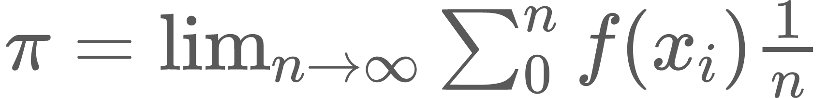
Activity Setup
In reality, to get an accurate representation of π, ∆x must be very small.
In the activity, you will plot how long this numerical integration takes when n is very large as a function of number of cores to illustrate how parallelization has speed-up limits.

Slide 14
Summary
To check the status on a job type ‘squeue’
It is good practice for long calculations to save their state periodically so that if/when the job is terminated the calculation can be restarted a the last save point
There is a limit to the speed-up that parallelization of code can achieve

Slide 15
Lesson 3.13
Following the Progression of a Job (Torque/Maui)

Slide 16
Learning Objectives
Students will:
Learn how to check the status of a job on a cluster
Understand what is the checkpointing of a job
Discuss how the allocation of different number resources affect computation time using data that they collect from the execution of a provided piece of code

Slide 17
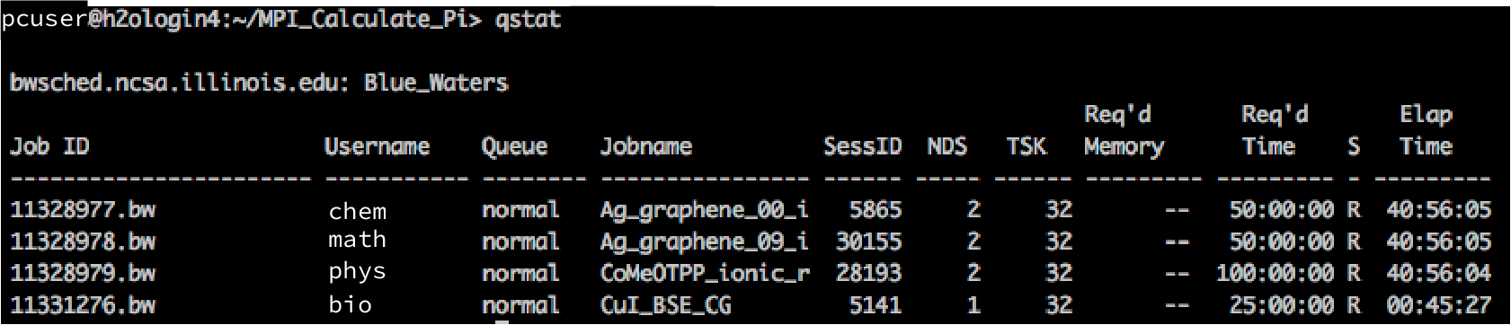
qstat: Checking the Status of a Job
qstat - Displays all jobs currently in the queue
By default it will report (in priority order) the jobs that are
Currently running
Pending to run

Slide 18
qstat: What the Output Means
Job ID: System assigned identifier for the job
Queue: Resources/Priority assigned to the job
Jobname: Text identifier the user assigned to the job
S: Job state where “R” means running and “Q” means queued
Elap Time: How long the job has been running in hours:minutes:seconds

Slide 19
qstat: Customizing the Output
Some common squeue flags include:
-q: Reports on the available queues
-u USER: Will only load jobs submitted by user USER
-f JOB ID: Reports detailed information on the job assigned JOB ID
See the manual for all available options

Slide 20
qstat -f JOBID
For even more details about jobs you can use
qstat -f JOBID
Where JOBID is the JOB ID
the scheduler assigned to a job

Slide 21
Checkpointing and Cancelling Jobs
Checkpointing
It is good practice for long calculations to save their state periodically so that if/when the job is terminated the calculation can be restarted a the last save point
Cancelling Jobs
If a job no longer needs to run, it can be cancelled by typing
qdel JOBID

Slide 22
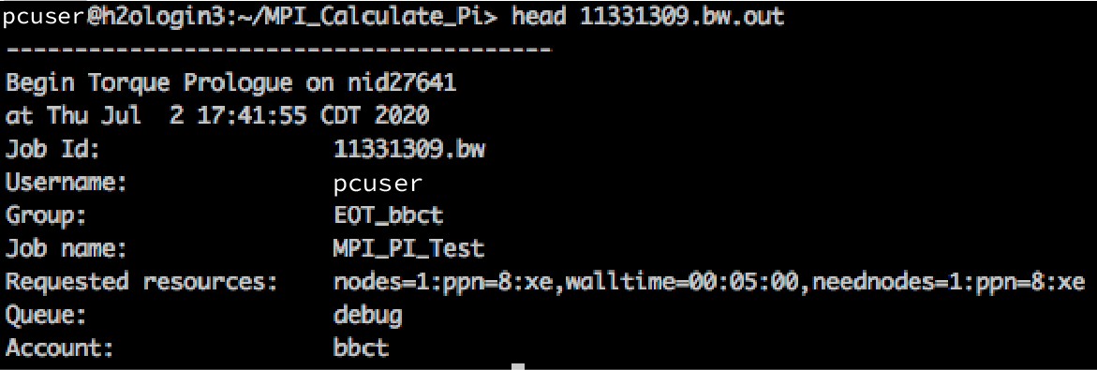
Torque/Maui Output and Error Files
The scheduler outputs information to an output file that the user can specify
In the example to the right, the output file used the form JOBID.out.
Error messages are also outputted to user defined error files

Slide 23
Testing Effect of Resource Allocation
When parallelizing processes, there tends to be a limit on the speed-up when more processors are added.
We will explore this effect by numerically calculating π

Slide 24
Testing Effect of Resource Allocation: Calculating π
π can be calculated exactly using the following relationship:
π = 4 arctan(1)
This expression above can be determined using polynomials by evaluating the following integral between 0 and 1.

Slide 25
Breaking the problem down
This polynomial based integral can be numerically solved by adding up the area of rectangles of height f(x_{i}) and width ∆x:
This can be distributed between cores since they are independent operations.

Slide 26
Activity Setup
In reality, to get an accurate representation of π, ∆x must be very small.
In the activity, you will plot how long this numerical integration takes when n is very large as a function of number of cores to illustrate how parallelization has speed-up limits.

Slide 27
Summary
To check the status on a job type ‘qstat’
It is good practice for long calculations to save their state periodically so that if/when the job is terminated the calculation can be restarted a the last save point
There is a limit to the speed-up that parallelization of code can achieve

