Slide 1
Blue Waters Petascale Semester Curriculum v1.0 Unit 4: OpenMP Lesson 1: Race Conditions Developed by David P. Bunde for the Shodor Education Foundation, Inc.

Slide 2
Except where otherwise noted, this work by The Shodor Education Foundation, Inc. is licensed under CC BY-SA 4.0. To view a copy of this license, visit https://creativecommons.org/licenses/by-sa/4.0 Browse and search the full curriculum at http://shodor.org/petascale/materials/semester-curriculum We welcome your improvements! You can submit your proposed changes to this material and the rest of the curriculum in our GitHub repository at https://github.com/shodor-education/petascale-semester-curriculum We want to hear from you! Please let us know your experiences using this material by sending email to petascale@shodor.org

Slide 3
Definition and Example: Race condition
Different tasks in the program have operations that can interfere with each other depending on the order in which they are performed
First example: Commercial kitchen with many chefs
All need to use a single cutting board, which they clean after use
Works fine if each chef finishes before the next starts, but contaminates food if two try to use it together
Solution: Buy more cutting boards
Cutting board represents shared variable that shouldn’t be shared

Slide 4
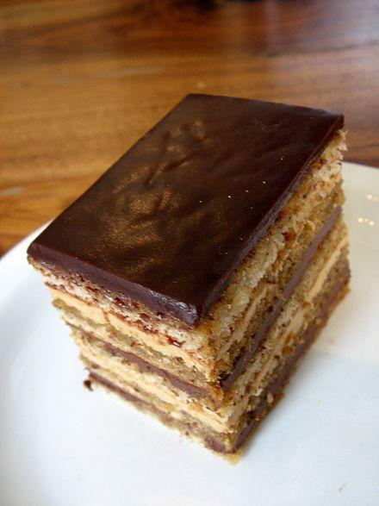
Second example: Chefs who need to interact
Chefs making many-layered opera cake
Layers can be made separately, but can’t all try to deposit on serving plate at once
Called a reduction: many contributions combined into one final product
Image: Arnold Gatilao, via Wikipedia
Notes:
Image by Arnold Gatilao, 2007, from https://en.wikipedia.org/wiki/Opera_cake and shared with a CC 2.0 license

Slide 5

Race conditions in code: Mandelbrot set
Fractal image composed by black and white pixels
For our purposes, just assume we have a function mandelbrot that takes real-valued coordinates and returns whether that pixel is in the set (i.e. is black)

Slide 6
Race conditions in code: Mandelbrot set
for (int j = 0; j < numRows; j++) {
for (int i = 0; i < numCols; i++) {
x = ((double)i / numCols -0.5) * 2;
y = ((double)j / numRows -0.5) * 2;
pixels[i][j] = mandelbrot(x,y);
}
}

Slide 7
Race conditions in code: Mandelbrot set
Creates multiple threads, which split iterations of the j loop
#pragma omp parallel for
for (int j = 0; j < numRows; j++) {
for (int i = 0; i < numCols; i++) {
x = ((double)i / numCols -0.5) * 2;
y = ((double)j / numRows -0.5) * 2;
pixels[i][j] = mandelbrot(x,y);
}
}

Slide 8

Parallel output
#pragma omp parallel for
for (int j = 0; j < numRows; j++) {
for (int i = 0; i < numCols; i++) {
x = ((double)i / numCols -0.5) * 2;
y = ((double)j / numRows -0.5) * 2;
pixels[i][j] = mandelbrot(x,y);
}
}
Notes:
Point out the extra black pixels in the background (haze in image) and the white pixels in the interior of the image. Then point out the race on x and y

Slide 9
Solving the race
Need to give each thread its own copies of x and y
Two approaches:
Add qualifier to pragma
#pragma omp parallel for private(x,y)
Declare variables inside the loop
for (int i = 0; i < numCols; i++) {
double x = ((double)i / numCols -0.5) * 2;
double y = ((double)j / numRows -0.5) * 2;
...
Notes:
Transition: Point out that these work because the race is caused by unnecessary sharing

Slide 10
Race involving a reduction
#pragma omp parallel for private(x,y)
for (int j = 0; j < numRows; j++) {
for (int i = 0; i < numCols; i++) {
x = ((double)i / numCols -0.5) * 2;
y = ((double)j / numRows -0.5) * 2;
int pixel = mandelbrot(x,y);
pixels[i][j] = pixel;
if(pixel == 0)
numBlack++;
}
}
Notes:
Counting the number of black pixels
Note the race on the line that increments numBlack (possibly by running the serial code and then the OpenMP version)
Point out that this is like the opera cake example: a single variable gets the result of all the work

Slide 11
How the race can happen
C code Actual operations
numBlack++ Load into register
Increment register
Store from register
Notes:
Talk about how the single C instruction turns into multiple instructions for the computer.
Transition: What happens if two threads do this nearly simultaneously?

Slide 12
How the race can happen
C code First task Second task
numBlack++ Load into register
Increment register Load into register
Store from register Increment register
Store from register
Notes:
Now have 2 tasks running at same time (time is y axis)
Key point is that the two loads will both load the same value. Then each task will increment its local copy. The result that is eventually stored only has the effect of one of the increments

Slide 13
Fixing the race
Variable into which results are combined
#pragma omp parallel for private(x,y) reduction(+:numBlack)
for (int j = 0; j < numRows; j++) {
for (int i = 0; i < numCols; i++) {
x = ((double)i / numCols -0.5) * 2;
y = ((double)j / numRows -0.5) * 2;
int pixel = mandelbrot(x,y);
pixels[i][j] = pixel;
if(pixel == 0)
numBlack++;
}
}
Operation used to combine them
Notes:
Counting the number of black pixels
Note the race on the line that increments numBlack (possibly by running the serial code and then the OpenMP version)
Point out that this is like the opera cake example

