Slide 1
Blue Waters Petascale Semester Curriculum v1.0 Unit 4: OpenMP Lesson 11: N-Body Mechanics in OpenMP Developed by Justin Oelgoetz for the Shodor Education Foundation, Inc.

Slide 2
Except where otherwise noted, this work by The Shodor Education Foundation, Inc. is licensed under CC BY-SA 4.0. To view a copy of this license, visit https://creativecommons.org/licenses/by-sa/4.0 Browse and search the full curriculum at http://shodor.org/petascale/materials/semester-curriculum We welcome your improvements! You can submit your proposed changes to this material and the rest of the curriculum in our GitHub repository at https://github.com/shodor-education/petascale-semester-curriculum We want to hear from you! Please let us know your experiences using this material by sending email to petascale@shodor.org

Slide 3
A simple N-Body Problem Parallelized with OpenMP

Slide 4
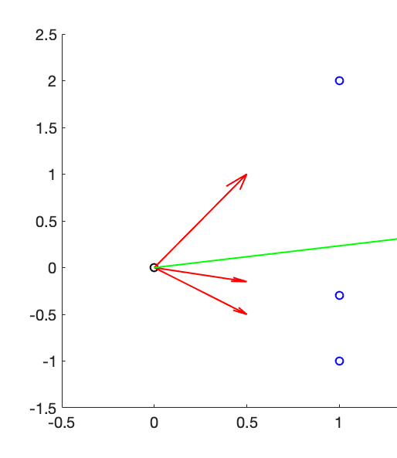

What is the N-body problem
In the N-body problem, some number of bodies (N) interact with each other.
Each Body feels the force of the interaction from every other body
Thus the total force on a body is given by $F_{j}=\sum_{i≠j}{F_{i,j}}$
If there are N bodies, (N²-N)/2 forces must normally be calculated (red)
These are summed resulting in a single net force (green)

Slide 5

Newtonian Mechanics
We start from Newton’s laws, namely F=ma (where F is the force, m the mass, and a the acceleration
As acceleration is the second derivative of position with respect to time we arrive at the differential equation linking displacement to force:
$$\frac{∂^{2}\vec{r_{i}(t)}}{∂t^{2}}=\frac{\vec{F_{i}(t)}}{m_{i}}$$
Now we need to develop an expression for force

Slide 6

Newtonian Gravity
Different forces have different mathematical expressions
For example, force fields with repulsive and attractive terms that often look like $±\frac{1}{{\left|\vec{r}\right|}^{n}}$ or $±e^{−{α\left|\vec{r}\right|}^{n}}$ are commonly used in molecular mechanics problems
For this problem we will be using Newtonian Gravity: $\vec{F_{i,j}}=\frac{Gm_{i}m_{j}}{{\left|\vec{r_{i,j}}\right|}^{3}}\vec{r_{i,j}}$ where $\vec{F_{i,j}}$ is the force exerted on object i by object j, G is a universal constant, $m_{i}$ the mass of object i, and $\vec{r_{i,j}}$ is the displacement vector from object I to object j.
In order to find the total force (needed for the differential equation) we need to sum over all the bodies thus the total force on object i can be written as:
$$\vec{F_{i,j}}=\sum_{j≠i}{\frac{Gm_{i}m_{j}}{{\left|\vec{r_{i,j}}\right|}^{3}}\vec{r_{i,j}}}$$

Slide 7

Deriving Verlet’s Method (1/2)
The displacement of the i^{th} particle can be expanded forward in time as a Taylor series (to 3rd order) as $\vec{r_{i}\left(t_{0}+∆t\right)}=\vec{r_{i}\left(t_{0}\right)}+\left[{\left(\frac{∂\vec{r_{i}\left(t\right)}}{∂t}\right)}_{t=t_{0}}∙∆t \right]+\left[{\frac{1}{2}\left(\frac{∂^{2}\vec{r_{i}\left(t\right)}}{∂t^{2}}\right)}_{t=t_{0}}∙∆t^{2}\right]+{\frac{1}{6}\left(\frac{∂^{3}\vec{r_{i}\left(t\right)}}{∂t^{3}}\right)}_{t=t_{0}}∙∆t^{3}$ Where f is the force, a the acceleration, r the displacement (all vectors), and t is the time and m the mass of the particle
We can also expand the displacement backward in time:
$$\vec{r_{i}\left(t_{0}−∆t\right)}=\vec{r_{i}\left(t_{0}\right)}−\left[{\left(\frac{∂\vec{r_{i}\left(t\right)}}{∂t}\right)}_{t=t_{0}}∙∆t \right]+\left[{\frac{1}{2}\left(\frac{∂^{2}\vec{r_{i}\left(t\right)}}{∂t^{2}}\right)}_{t=t_{0}}∙∆t^{2}\right]−{\frac{1}{6}\left(\frac{∂^{3}\vec{r_{i}\left(t\right)}}{∂t^{3}}\right)}_{t=t_{0}}∙∆t^{3}$$

Slide 8

Deriving Verlet’s Method (2/2)
If we add the previous two equations together and solve for $\vec{r_{i}\left(t_{0}+∆t\right)}$, we notice that the terms with odd powers of $∆t$ cancel and we arrive at: $\vec{r_{i}\left(t_{0}+∆t\right)}=2∙\vec{r_{i}\left(t_{0}\right)}−\vec{r_{i}\left(t_{0}−∆t\right)}+2\left[{\frac{1}{2}\left(\frac{∂^{2}\vec{r_{i}\left(t\right)}}{∂t^{2}}\right)}_{t=t_{0}}∙∆t^{2}\right]$
Thus the next position depends on the previous two positions and the second derivative at the previous position.
Recall though that the second derivative is just the acceleration, thus we can simplify this to:
$$\vec{r_{i}\left(t_{0}+∆t\right)}=2∙\vec{r_{i}\left(t_{0}\right)}−\vec{r_{i}\left(t_{0}−∆t\right)}+2\sum_{j≠i}{\frac{Gm_{j}}{{\left|\vec{r_{i,j}}\right|}^{3}}\vec{r_{i,j}}}$$

Slide 9

Writing the vectors using components
Recall that:
$\vec{r_{i}\left(t\right)}=x(t)\hat{i}+y(t)\hat{j}+z(t)\hat{k}$ (here $\hat{i}$, $\hat{j}$, and $\hat{k}$ are the unit vectors in Cartesian space) and
$\vec{r_{i,j}\left(t\right)}=(x_{j}(t)−x_{i}(t))\hat{i}+(y_{j}(t)−y_{i}(t))\hat{j}+(z_{j}(t)−z_{i}(t))\hat{k}$
Thus we can break the equation we derived for Verlet’s method into three equations coupled through the $\vec{r_{i,j}}$ terms:
$$x_{i}\left(t_{0}+∆t\right) =2∙x_{i}\left(t_{0}\right)−x_{i}\left(t_{0}−∆t\right)+2\sum_{j≠i}{\frac{Gm_{j}}{{\left|\vec{r_{i,j}}\right|}^{3}}(x_{j}\left(t_{0}\right)−x_{i}\left(t_{0}\right))}$$
$$y_{i}\left(t_{0}+∆t\right) =2∙y_{i}\left(t_{0}\right)−y_{i}\left(t_{0}−∆t\right)+2\sum_{j≠i}{\frac{Gm_{j}}{{\left|\vec{r_{i,j}}\right|}^{3}}(y_{j}\left(t_{0}\right)−y_{i}\left(t_{0}\right))}$$
$$z_{i}\left(t_{0}+∆t\right) =2∙z_{i}\left(t_{0}\right)−z_{i}\left(t_{0}−∆t\right)+2\sum_{j≠i}{\frac{Gm_{j}}{{\left|\vec{r_{i,j}}\right|}^{3}}(z_{j}\left(t_{0}\right)−z_{i}\left(t_{0}\right))}$$

Slide 10

There is a problem however
$$x_{i}\left(t_{0}+∆t\right) =2∙x_{i}\left(t_{0}\right)−x_{i}\left(t_{0}−∆t\right)+2\sum_{j≠i}{\frac{Gm_{j}}{{\left|\vec{r_{i,j}}\right|}^{3}}(x_{j}−x_{i})}$$
This formula requires we know 2 positions! In general we only know the initial conditions (or 1 position)!
We can overcome this if we know an initial velocity, the first derivative, $v_{i}(t_{0}){=\left(\frac{∂\vec{r_{i}\left(t\right)}}{∂t}\right)}_{t=t_{0}}$if we use this and we assume the third derivative (the jerk) is 0 we can use our Taylor series to get a second position, for example:
$$x_{i}\left(t_{0}+∆t\right) =x_{i}\left(t_{0}\right)+v_{i}(t_{0})∙∆t+\frac{1}{2}\left[\sum_{j≠i}{\frac{Gm_{j}}{{\left|\vec{r_{i,j}}\right|}^{3}}(x_{j}\left(t_{0}\right)−x_{i}\left(t_{0}\right))}\right]{∆t}^{2}$$

Slide 11
The Algorithm
Load initial conditions
(Calculate Accelerations) Loop i over the body index form 1 to Nbodies
Loop j over the body index from 1 to Nbodies
Calculate force between object i and j
Add force into the sum of the force on object i
(Calculate Next Position - Taylor) Loop over the body index from 1 to Nbodies
Calculate a second set of x, y, & z coordinates Δt in the future (the next time step) using the previous Taylor series expansion
Loop from time step 2 until the final time index (Ntimes)
(Calculate Accelerations) Loop i over the body index form 1 to Nbodies
Loop j over the body index from 1 to Nbodies
Calculate force between object i and j
Add force into the sum of the force on object i
(Calculate Next Position - Verlet) Loop over the body index from 1 to Nbodies
Calculate the next set of x, y, & z coordinates using Verlet’s method

Slide 12
If you were to pick one thing to parallelize, with OpenMP, what would it be?

Slide 13
If you were to pick one thing to parallelize, with OpenMP, what would it be?
Answer: Calculating the Accelerations (two nested loops – it scales as N²)!

Slide 14
Acceleration Code: Where does the #pragma go?
void acceleration(double x[], double y[], double z[], int itime, int Nbodies, double mass, double ax[], double ay[], double az[]) {
double F;
double dx, dy, dz, r;
int ibody2;
double G=6.67430e-11;
for(int ibody1=0;ibody1<Nbodies;ibody1++) {
dx=x[index(itime,ibody1,Nbodies)];
dy=y[index(itime,ibody1,Nbodies)];
dz=z[index(itime,ibody1,Nbodies)];
r=sqrt(dx*dx+dy*dy+dz*dz)+1.0e7;
// 1.0e7 is to soften the potential, prevent "explosions"
F=(G*10*mass*Nbodies/(r*r*r));
ax[ibody1]=-F*dx;
ay[ibody1]=-F*dy;
az[ibody1]=-F*dz;
for (ibody2=0;ibody2<ibody1-1;ibody2++) {
dx=x[index(itime,ibody1,Nbodies)]-
x[index(itime,ibody2,Nbodies)];
dy=y[index(itime,ibody1,Nbodies)]-
y[index(itime,ibody2,Nbodies)];
dz=z[index(itime,ibody1,Nbodies)]-z[index(itime,ibody2,Nbodies)];
r=sqrt(dx*dx+dy*dy+dz*dz)+1.0e7;
// 1.0e7 is to soften the potential, prevent "explosions"
F=(G*mass/(r*r*r));
ax[ibody1]-=F*dx;
ay[ibody1]-=F*dy;
az[ibody1]-=F*dz;}
// We don't do ibody1=ibody2
for (ibody2=ibody1+1;ibody2<Nbodies;ibody2++) {
dx=x[index(itime,ibody1,Nbodies)]-
x[index(itime,ibody2,Nbodies)];
dy=y[index(itime,ibody1,Nbodies)]-
y[index(itime,ibody2,Nbodies)];
dz=z[index(itime,ibody1,Nbodies)]-
z[index(itime,ibody2,Nbodies)];
r=sqrt(dx*dx+dy*dy+dz*dz)+1.0e7;
// 1.0e7 is to soften the potential, prevent "explosions"
F=(G*mass/(r*r*r));
ax[ibody1]-=F*dx;
ay[ibody1]-=F*dy;
az[ibody1]-=F*dz;}}}

Slide 15
Acceleration Code: Where does the #pragma go?
void acceleration(double x[], double y[], double z[], int itime, int Nbodies, double mass, double ax[], double ay[], double az[]) {
double F;
double dx, dy, dz, r;
int ibody2;
double G=6.67430e-11;
#pragma omp parallel for simd private(ibody2,dx,dy,dz,r,F)
for(int ibody1=0;ibody1<Nbodies;ibody1++) {
dx=x[index(itime,ibody1,Nbodies)];
dy=y[index(itime,ibody1,Nbodies)];
dz=z[index(itime,ibody1,Nbodies)];
r=sqrt(dx*dx+dy*dy+dz*dz)+1.0e7;
// 1.0e7 is to soften the potential, prevent "explosions"
F=(G*10*mass*Nbodies/(r*r*r));
ax[ibody1]=-F*dx;
ay[ibody1]=-F*dy;
az[ibody1]=-F*dz;
for (ibody2=0;ibody2<ibody1-1;ibody2++) {
dx=x[index(itime,ibody1,Nbodies)]-
x[index(itime,ibody2,Nbodies)];
dy=y[index(itime,ibody1,Nbodies)]-
y[index(itime,ibody2,Nbodies)];
dz=z[index(itime,ibody1,Nbodies)]-
z[index(itime,ibody2,Nbodies)];
r=sqrt(dx*dx+dy*dy+dz*dz)+1.0e7;
// 1.0e7 is to soften the potential, prevent "explosions"
F=(G*mass/(r*r*r));
ax[ibody1]-=F*dx;
ay[ibody1]-=F*dy;
az[ibody1]-=F*dz;}
// We don't do ibody1=ibody2
for (ibody2=ibody1+1;ibody2<Nbodies;ibody2++) {
dx=x[index(itime,ibody1,Nbodies)]-
x[index(itime,ibody2,Nbodies)];
dy=y[index(itime,ibody1,Nbodies)]-
y[index(itime,ibody2,Nbodies)];
dz=z[index(itime,ibody1,Nbodies)]-
z[index(itime,ibody2,Nbodies)];
r=sqrt(dx*dx+dy*dy+dz*dz)+1.0e7;
// 1.0e7 is to soften the potential, prevent "explosions"
F=(G*mass/(r*r*r));
ax[ibody1]-=F*dx;
ay[ibody1]-=F*dy;
az[ibody1]-=F*dz;}}}

Slide 16
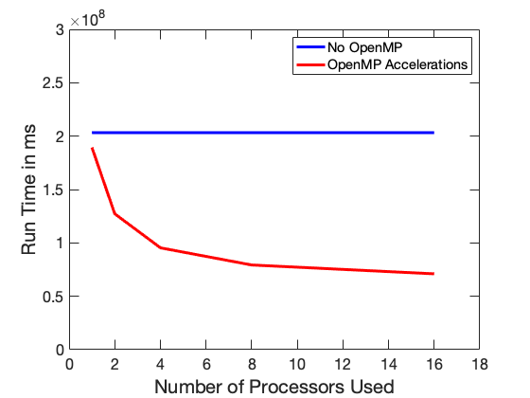
Runtime as a function of the number of processors
We can plot the run time of the code (with the SINGLE pragma versus the number of processors used on BlueWaters
As you can see the run time decreases nicely with the number of processors

Slide 17
Can We do Better?

Slide 18
Position Calculations: Where do the #pragmas go?
acceleration(x,y,z,itime,Nbodies,mass,ax,ay,az);
vx=0;
vy=0;
itimep1=itime+1;
for (int ibody1=0; ibody1<Nbodies; ibody1++) {
// vx and vy for cirucular rotation
vx=-omega*y[index(itime,ibody1,Nbodies)];
vy=omega*x[index(itime,ibody1,Nbodies)];
x[index(itimep1,ibody1,Nbodies)]=x[index(itime,ibody1,Nbodies)]+
vx*dt+0.5*ax[ibody1]*dt*dt;
y[index(itimep1,ibody1,Nbodies)]=y[index(itime,ibody1,Nbodies)]+
vy*dt+0.5*ay[ibody1]*dt*dt;
z[index(itimep1,ibody1,Nbodies)]=z[index(itime,ibody1,Nbodies)]+
0.5*az[ibody1]*dt*dt;} // vz=0
// Now the meat! Verlet integration
// x(i)=2*x(i-1)-x(i-2)+a(i-1)*dt*dt
for(itime=1;itime<Ntime-1;itime++){
acceleration(x,y,z,itime,Nbodies,mass,ax,ay,az);
itimep1=itime+1;
itimem1=itime-1;
for(int ibody1=0;ibody1<Nbodies;ibody1++){
x[index(itimep1,ibody1,Nbodies)]=
2*x[index(itime,ibody1,Nbodies)]-
x[index(itimem1,ibody1,Nbodies)]+ax[ibody1]*dt*dt;
y[index(itimep1,ibody1,Nbodies)]=
2*y[index(itime,ibody1,Nbodies)]-
y[index(itimem1,ibody1,Nbodies)]+ay[ibody1]*dt*dt;
z[index(itimep1,ibody1,Nbodies)]=
2*z[index(itime,ibody1,Nbodies)]-
z[index(itimem1,ibody1,Nbodies)]+az[ibody1]*dt*dt;}}

Slide 19
Position Calculations: Where do the #pragmas go?
acceleration(x,y,z,itime,Nbodies,mass,ax,ay,az);
vx=0;
vy=0;
itimep1=itime+1;
#pragma omp parallel for simd private(vx,vy)
for (int ibody1=0; ibody1<Nbodies; ibody1++) {
// vx and vy for cirucular rotation
vx=-omega*y[index(itime,ibody1,Nbodies)];
vy=omega*x[index(itime,ibody1,Nbodies)];
x[index(itimep1,ibody1,Nbodies)]=x[index(itime,ibody1,Nbodies)]+
vx*dt+0.5*ax[ibody1]*dt*dt;
y[index(itimep1,ibody1,Nbodies)]=y[index(itime,ibody1,Nbodies)]+
vy*dt+0.5*ay[ibody1]*dt*dt;
z[index(itimep1,ibody1,Nbodies)]=z[index(itime,ibody1,Nbodies)]+
0.5*az[ibody1]*dt*dt;} // vz=0
// Now the meat! Verlet integration
// x(i)=2*x(i-1)-x(i-2)+a(i-1)*dt*dt
#pragma omp parallel for simd
for(itime=1;itime<Ntime-1;itime++){
acceleration(x,y,z,itime,Nbodies,mass,ax,ay,az);
itimep1=itime+1;
itimem1=itime-1;
for(int ibody1=0;ibody1<Nbodies;ibody1++){
x[index(itimep1,ibody1,Nbodies)]=
2*x[index(itime,ibody1,Nbodies)]-
x[index(itimem1,ibody1,Nbodies)]+ax[ibody1]*dt*dt;
y[index(itimep1,ibody1,Nbodies)]=
2*y[index(itime,ibody1,Nbodies)]-
y[index(itimem1,ibody1,Nbodies)]+ay[ibody1]*dt*dt;
z[index(itimep1,ibody1,Nbodies)]=
2*z[index(itime,ibody1,Nbodies)]-
z[index(itimem1,ibody1,Nbodies)]+az[ibody1]*dt*dt;}}

Slide 20
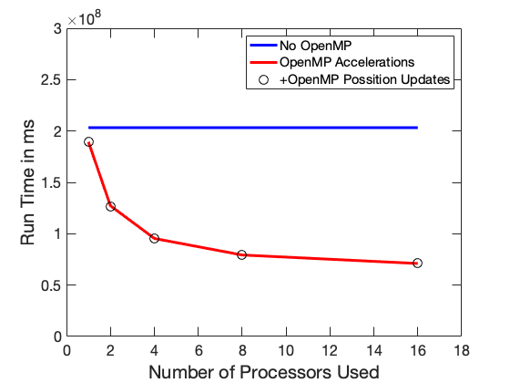
Runtime as a function of the number of processors
As before we can plot the run time of the code (both of the SINGLE pragma in the acceleration routine and with the two additional pragmas in the location calculation loops) versus the number of processors used on BlueWaters
As we can see the run time decreases nicely with the number of processors
But parallelizing the location calculation loops results in essentially no speedup! 10000 bodies is simply too small to see the effect.

Slide 21
Is there anything left to Parallelize?

Slide 22
Initialization Code: Where does the #pragma go?
The example code uses a Monte Carlo approach to build initial conditions where the mass density decays as ρ(r)=e^{-ar}, where r is the density and a is a characteristic scale length
for (int ibody1=0; ibody1<Nbodies; ibody1++) {
prob1=0.0;
prob2=1.0;
while (prob2>=prob1) {
tempx=rand();
// Recall rand returns an integer between 0 and RAND_MAX
tempx=((tempx/RAND_MAX)-0.5)*2*LBox;
// Now tempx holds a number between -LBox and + LBox
tempy=rand();
tempy=((tempy/RAND_MAX)-0.5)*2*LBox;
tempz=rand();
tempz=((tempz/RAND_MAX)-0.5)*2*LBox;
// The above code will make our masses scattered
//evenly throughout the box.
// We really want the mass to be more concentrated
// at the center, so we are going to accept
// or reject with a probability of
// exp(-scalelength*r^2/LBox)
// This code + the while loop accomplishes this
tempr=sqrt(tempx*tempx+tempy*tempy+tempz*tempz);
prob1=exp(-scalelength*tempr/LBox);
prob2=rand();
prob2=(prob2/RAND_MAX); }
x[index(itime,ibody1,Nbodies)]=tempx;
y[index(itime,ibody1,Nbodies)]=tempy;
z[index(itime,ibody1,Nbodies)]=tempz;}

Slide 23
It is a trick Question – rand is not thread safe!
We do need to add a “#pragma omp parallel for” but just adding a parallel for will not result in working code!
The behavior of rand() is not defined for multiple threads
Need to instead use rand_r() and a different seed for each thread (we don’t want the threads putting objects at the same coordinates as each other)
Warning: rand()/rand_r() were used for simplicity here, and because we don’t need good pseudo-random numbers.
In general rand()/rand_r() are not good enough for scientific codes – but that is beyond the scope of this lesson

Slide 24
Initialization Code: The Parallelized version
Note the “#pragma omp parallel” beginning is separated from the “#pragma omp for”
This is because each thread must generate its own seed, which this code bases in part on its thread number
All the calls to rand() have been replaced by calls to rand_r(&seed), the seed must be passed with each call to rand_r()
#pragma omp parallel private(tempx,tempy,tempz,tempr,prob1,prob2)
{
unsigned int seed=t1.tv_usec+omp_get_thread_num();
#pragma omp for
for (int ibody1=0; ibody1<Nbodies; ibody1++) {
prob1=0.0;
prob2=1.0;
while (prob2>=prob1) {
tempx=rand_r(&seed);
// Recall rand returns an integer between 0 and RAND_MAX
tempx=((tempx/RAND_MAX)-0.5)*2*LBox;
// Now tempx holds a number between -LBox and + LBox
tempy=rand_r(&seed);
tempy=((tempy/RAND_MAX)-0.5)*2*LBox;
tempz=rand_r(&seed);
tempz=((tempz/RAND_MAX)-0.5)*2*LBox;
// The above code will make our masses scattered evenly
// throughout the box.
// We really want the mass to be more concentrated at the
// center, so we are going to accept
// or reject with a probability of exp(-scalelength*r^2/LBox)
// This code + the while loop accomplishes this
tempr=sqrt(tempx*tempx+tempy*tempy+tempz*tempz);
prob1=exp(-scalelength*tempr/LBox);
prob2=rand_r(&seed);
prob2=(prob2/RAND_MAX); }
x[index(itime,ibody1,Nbodies)]=tempx;
y[index(itime,ibody1,Nbodies)]=tempy;
z[index(itime,ibody1,Nbodies)]=tempz;}
} // this closes the #pragma omp parallel

Slide 25
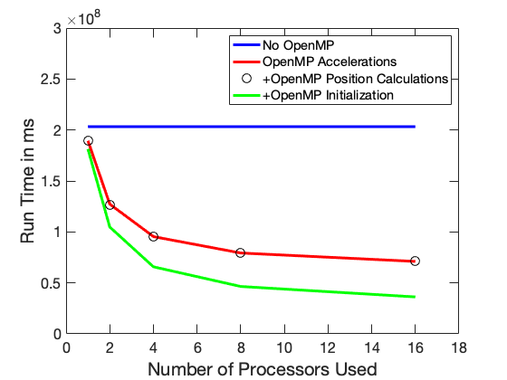
Runtime as a function of the number of processors
As before we can plot the run time of the code (both of the SINGLE pragma in the acceleration routine and with the two additional pragmas in the location calculation loops) versus the number of processors used on BlueWaters
As we can see the run time decreases nicely with the number of processors
But parallelizing the location calculation loops results in essentially no speedup! 10000 bodies is simply too small to see the effect.

Slide 26
Can we do more?
Yes, but we’d need to move away from the way we are storing positions and calculating accelerations.
One of the options is the Barnes-Hut algorithm which stores the positions in an octree which allows one to easily treat collections of distant objects as a single object with their combined mass at their center of mass.
Another is solving for the gravitational potential (using for instance a spectral method) at each time step and calculating the forces based on that potential.
Both approaches are beyond the scope of this lesson
If you’d like to know more, check out the GalaxSee HPC modules at
http://shodor.org/petascale/materials/UPModules/NBody/
http://shodor.org/petascale/materials/UPModules/NBodyScaling/

Slide 27
Additional Suggested Exercises
Investigate scaling is the number of bodies is increased (from say 10000 to 100000 or even 1000000). Does Parallelizing the position calculations begin to make a difference?
Investigate the effect of scheduling (static, dynamic, etc) of the various loops on runtime.
For a particular schedule type, investigate the effect of chunk size on run time.

